Slide 1
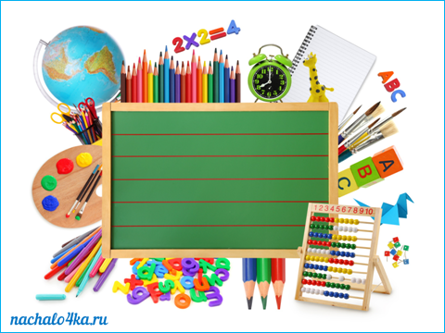
Matematika
2-sinf

Slide 2
Mavzu: 3-bob Mustahkamlash

Slide 3
Mustaqil topshiriqni tekshirish:
Tomoni va uchi
4 tadan bo‘lgan shakllar chizing.

Slide 4
Tomoni va uchi 4 tadan bo‘lgan shakllar chizing.

Slide 5
Mustahkamlash uchun test
1. Ifodaning qiymatini toping:
57+23-9
A) 71
B) 80
D) 81

Slide 6
Mustahkamlash uchun test
2. Ifodaning qiymatini toping:
87-23+7
A) 64
B) 71
D) 80

Slide 7
Mustahkamlash uchun test
3. Yig‘indini toping:
57+34+9
A) 100
B) 90
D) 91

Slide 8
Mustahkamlash uchun test
4. Ayirmani toping:
87-34-8
A) 53
B) 45
D) 61

Slide 9
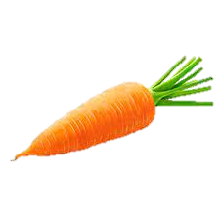
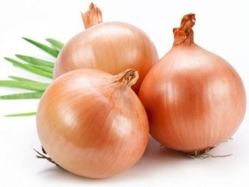
Mustahkamlash uchun test
5. Necha kilogramm sabzavot qoldi?
Bor edi Ishlatildi Qoldi?
63 kg
? kg
7 kg
2 kg
A) 53 kg
B) 54 kg
D) 72 kg

Slide 10
Mustahkamlash uchun test
6. Qaysi shakl ortiqcha?
A
B
D

Slide 11
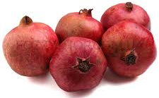
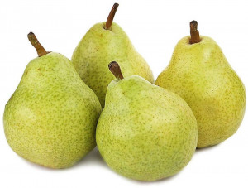
Mustahkamlash uchun test
7. Jami mevalar necha kilogramm?
A) 52 kg
B) 59 kg
D) 97 kg
45 kg
7 kg ko‘p
? kg

Slide 12
Mustahkamlash uchun test
8. Qaysi misolda tekshirish to‘g‘ri yozilgan?
A
B
D
45-24=21
45-21=23
21+24=45
45-24=21
24+21=45
21+24=45
45-24=22
45-24=22
24+22=45

Slide 13
Mustahkamlash uchun test
9. Rasmda nechta uchburchak bor?
A) 10 ta
B) 4 ta
D) 7 ta

Slide 14
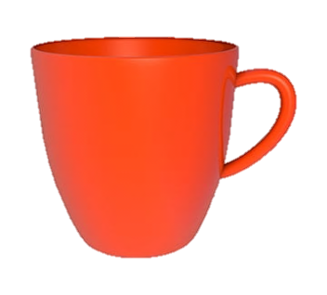
Mustahkamlash uchun test
10. Qaysi rasmda simmetriya o‘qi to‘g‘ri o‘tkazilgan?
A
B
D
-----------
------------
-----------

Slide 15
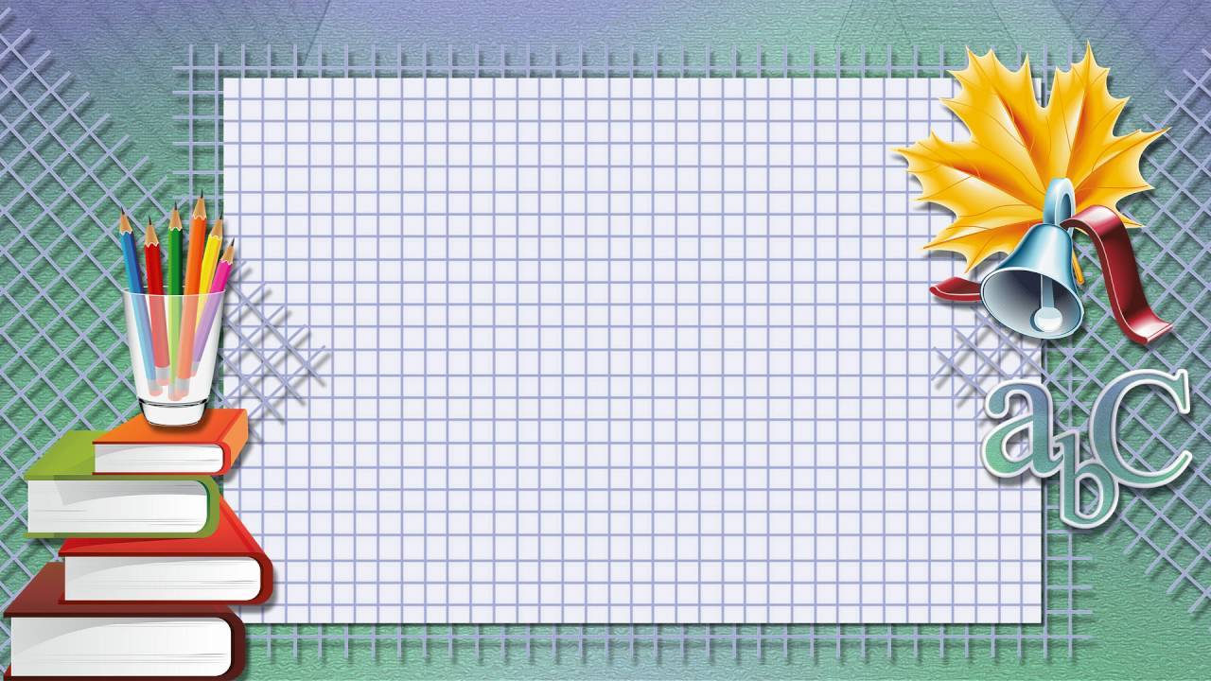
Mustaqil topshiriq:
Qo‘shishga doir 3 ta
misol yozing va natijani tekshiring.

Slide 16
E’tiboringiz uchun rahmat!

