Slide 1
Matematika
2-sinf

Slide 2
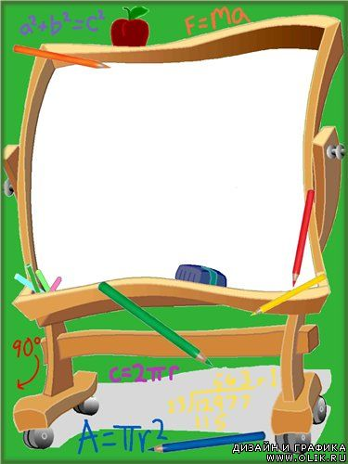
Mavzu:
Ko‘paytirishga doir masalalar (takrorlash)
Hashar
Beshik
Dengiz
Sochiq

Slide 3
Mustaqil topshiriqni tekshirish:
(86-bet. 6-misol)
Hashar
Beshik
Dengiz
Sochiq

Slide 4
6.
Hisoblaymiz.
Natijalar nima uchun teng? (86-bet)
5 x 4
6 x 7
5 x 8
9 x 3
4 x 5
x
x
x

Slide 5
6.
Hisoblaymiz.
Natijalar nima uchun teng? (86-bet)
5 · 4 = 20
6 · 7 = 42
4 · 5 = 20
7 · 6 = 42
5 · 8 = 40
9 · 3 = 27
8 · 5 = 40
3 · 9 = 27

Slide 6
1.
Namuna asosida hisoblaymiz. (87-bet)
7+7+4+7=
3·7+4=
21+4=
25
24
8+8+8+8-8=
4·8-8=
32-8=
6+6+6+6=
24
4·6=

Slide 7
2.
Natijalarni taqqoslaymiz. (87-bet)
11
18
13
<
2 + 9 3 · 6 - 5
9
16
9
=
1 + 8 2 · 8 - 7
11
15
11
=
3 + 8 3 · 5 - 4

Slide 8
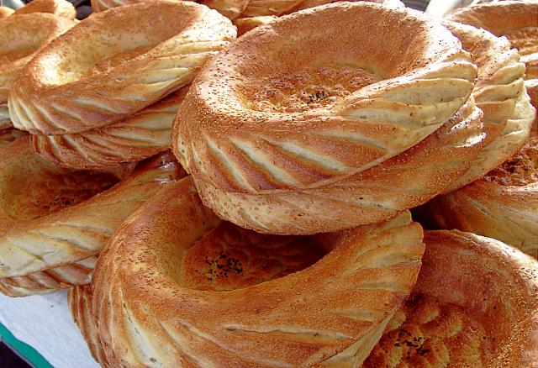
3-masala. (87-bet)
1 kg undan 4 dona patir non yopilsa,
7 kg undan necha dona patir non yopiladi?

Slide 9
3-masala. (87-bet)
1 kg undan - 4 dona
7 kg undan - ? dona
Yechish: 7 · 4 = 28 (dona)
Javob: 7 kg undan 28 dona
patir non yopiladi.

Slide 10
4.
Namunadagidek bajaramiz va taqqoslaymiz. (87-bet)
7 · 3 3 · 7
=
7 · 3 = 7 + 7 + 7 =
21
21
3 · 7 = 3 + 3 + 3 + 3 + 3 + 3 + 3 =

Slide 11
4.
Namunadagidek bajaramiz va taqqoslaymiz. (87-bet)
=
5 · 4 4 · 5
5 · 4 = 5 + 5 + 5 + 5 =
20
4 · 5 = 4 + 4 + 4 + 4 + 4 =
20

Slide 12
4.
Namunadagidek bajaramiz va taqqoslaymiz. (87-bet)
8 · 4 4 · 8
=
8 · 4 = 8 + 8 + 8 + 8 =
32
4 · 8 = 4 + 4 + 4 + 4 + 4 + 4 + 4 + 4 =
32

Slide 13
Mustaqil topshiriq:
87-bet. 5-topshiriq
Hashar
Beshik
Dengiz
Sochiq

Slide 14
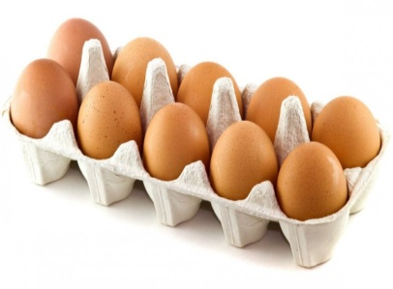
5.
Qutilar soni nechta?
Jami tuxumlar soni-chi?
x =

Slide 15
E’tiboringiz uchun rahmat!

