Slide 1
Matematika
2-sinf

Slide 2
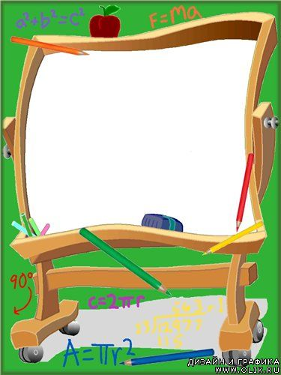
Mavzu: Tarkibiy qismlar
orasidagi bog‘lanishlar
(12-dars. 132-bet)
:
Hashar
Beshik
Dengiz
Sochiq

Slide 3
Mustaqil topshiriqni tekshirish:
131-bet. 5-misol
Hashar
Beshik
Dengiz
Sochiq

Slide 4
5.
Hisoblaymiz. Bo‘sh kataklarni to‘ldiramiz.
(131-bet)
8 · 8 = 64
7 · 9 = 63
9 · 2 = 18
2 · = 18
8 · = 64
9 · = 63
9
8
7
64 : 8 =
8
63
: 9 = 7
18 : = 9
2
64 : = 8
18 : 9 =
2
8
63 : 7 =
9

Slide 5
Qanday xulosaga keldingiz? (132-bet)
bo‘luvchi
bo‘linuvchi
54 : 6 = 9
bo‘linma
bo‘linma
9 · 6 = 54
bo‘linuvchi
bo‘linuvchi
54 : 9 = 6
bo‘luvchi
bo‘linma

Slide 6
2.
Hisoblaymiz. (132-bet)
5 · 3 = 15
7 · 7 = 49
4 · 4 = 16
3 · 5 =
15
7
· 7 = 49
4
· 4 = 16
16 : = 4
15 : = 5
49
: 7 = 7
4
3
15 : 5 =
3
49 : = 7
16
: 4 = 4
7

Slide 7
3.
Mulohaza yuritamiz. Bo‘linmalar qanday hosil bo‘ldi? (132-bet)
16 : 4 = ?
16 - 4 = 12
12 - 4 = 8
8 - 4 = 4
16
4
12
4
8
4
4
4
4 - 4 = 0
16 : 4 = 4
12
8
4
0

Slide 8
4.
5 sonini necha marta ayirdik? Bo‘linma nimaga teng? (133-bet)
20 – 5 – 5 – 5 – 5 = 0
20 : 4 = 5
20 : ? = ?

Slide 9
Hashar
Beshik
Dengiz
Sochiq
Mustaqil topshiriq:
133-bet. 5-misol

Slide 10
5.
Namuna asosida hisoblaymiz. (133-bet)
18 : 6 = 3
20 : 5=
42 : 6 =
6 · 3 = 18
5 · = 20
· 6 = 42
18 : 3 = 6
20 : = 5
42 : = 6

Slide 11
5.
Namuna asosida hisoblaymiz. (133-bet)
24 : 8 =
72 : 9=
90 : 9 =
8 · = 24
9 · = 72
· 9 = 90
24 : = 8
72 : = 9
90 : = 9

Slide 12
E’tiboringiz uchun rahmat!

