Slide 1
Matematika
2-sinf

Slide 2
Mavzu:
Takrorlash

Slide 3
Mustaqil topshiriqni tekshiramiz:
174-bet. 6-misol

Slide 4
6-misol
Amallarni bajaramiz.
15:3=5
(15+35):5=10
36:4=9
(68-28):4=10
79-(15+48)=16
55+(35-17)=73

Slide 5
1-topshiriq
Shakllar qanday bo‘laklarga bo‘lingan?
yarim
yarim
chorak
chorak
chorak
uchdan bir

Slide 6
2-misol
Ifodalarning qiymatini topamiz.
15
18
6 · 3 + 18
(11 + 4) : 3
= 36
= 5
0
36
2 + (12 · 0)
17 + (6 · 6)
= 53
= 2
7
14 : (19 - 12)
= 2
10
5 · (12 - 2)
= 50

Slide 7
3-misol
Hisoblaymiz. (175-bet)
20
54
7 + 13 + 6 · 9
= 74
24
56
= 80
66 - 42 + 7 · 8

Slide 8
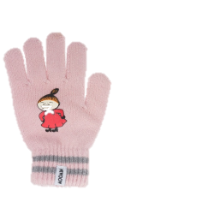
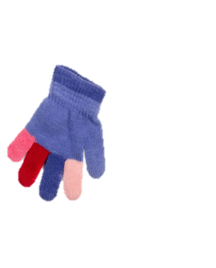
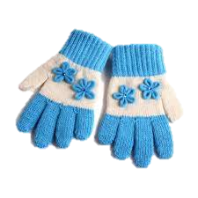
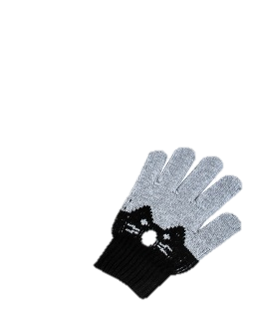
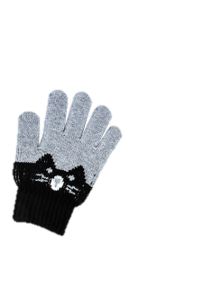
4-topshiriq
Qo‘lqoplardagi jami barmoqlar nechta?
5
5
10
10 · 10 =
100

Slide 9
Mustaqil topshiriq:
175-bet. 5-misol

Slide 10
Hisoblaymiz. (175-bet)
5.
44
35
37
15
46
18
-
-
+
34
25
29
31
39
24
+
+
-

Slide 11
E’tiboringiz
uchun rahmat!

