Slide 1
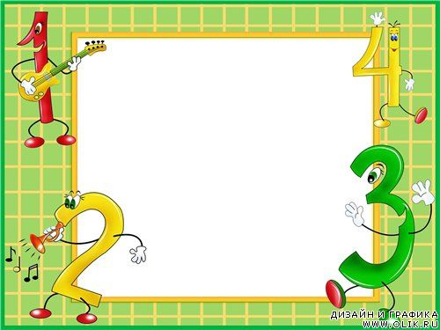
Matematika
2-sinf

Slide 2
Mavzu:
Takrorlash

Slide 3
176-bet.
6-misol

Slide 4
10
Hisoblaymiz. (176-bet)
52
44
32
29
60
19
45
33
72
18
29
51
-
-
-
+
+
+
8
61
41
78
54
80

Slide 5
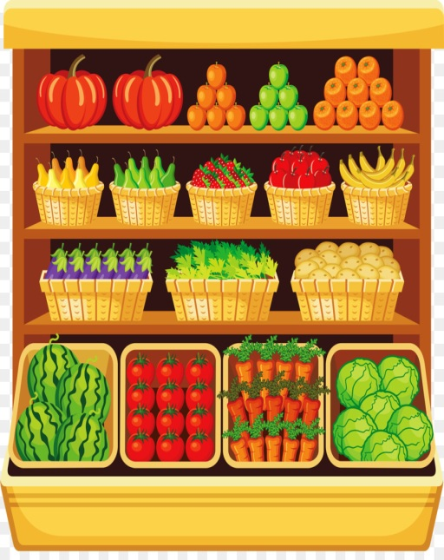
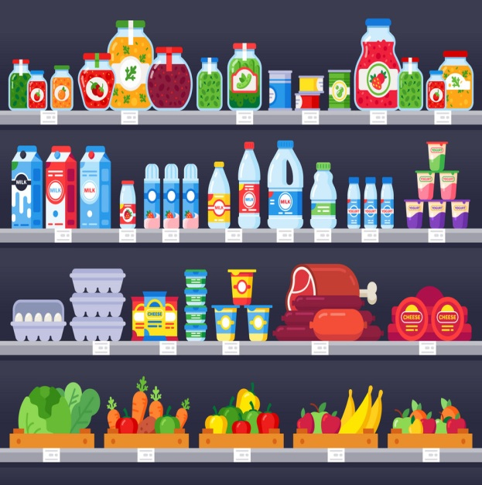
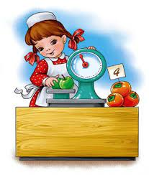
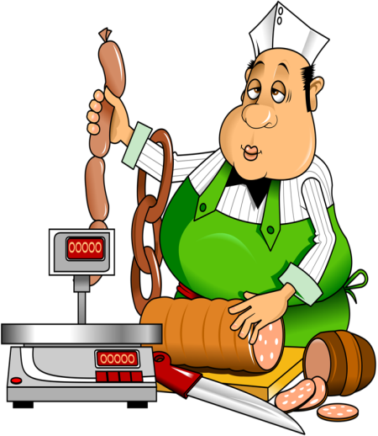
11
Rasm asosida savollarga javob beramiz.

Slide 6
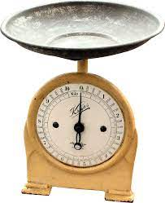
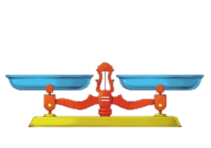
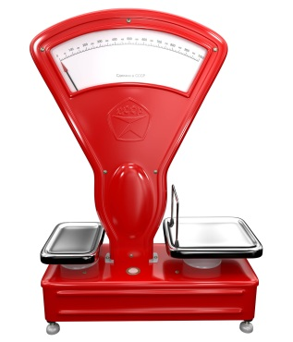
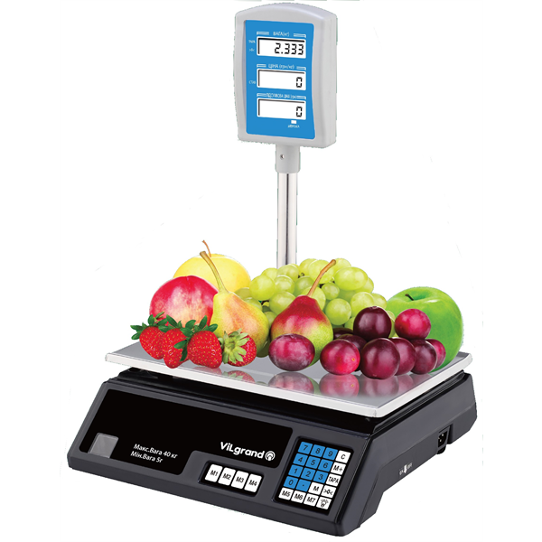
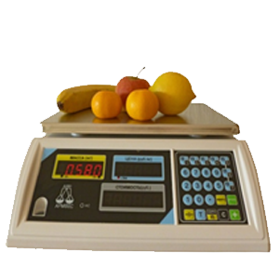
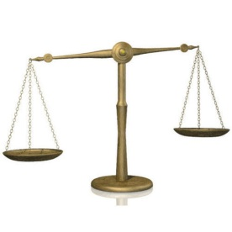
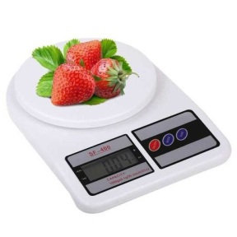
11
Tarozi turlari:

Slide 7
12
Kim tez hisoblaydi? (177-bet)
38
14
25
11
44
21
24
14
23

Slide 8
13
Zuhraning jami sharlari nechta edi?
Qo‘limdagidan
ikki barobar
ko‘pi uchdi?
5 · 2 = 10
Zuhra, nechta
sharing uchib
ketdi?
10 + 5 = 15

Slide 9
14
Kim tez hisoblaydi? (177-bet)
90 - 54 - 35
18 + 29 + 24
36
-
19
47
+
53
17
100

Slide 10
15
Yig‘indi va ayirmalarga doir ifoda tuzamiz va qiymatini topamiz. (178-bet)
+
20 + 15 = 35

Slide 11
15
Yig‘indi va ayirmalarga doir ifoda tuzamiz va qiymatini topamiz. (178-bet)
-
28 - 12 = 16

Slide 12
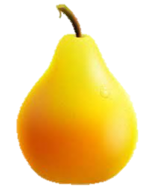
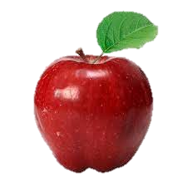
16
To‘g‘ri javobni topamiz. (178-bet)
13 + 11 =
A) 68
20 + 12 =
B) 72
+ = ?
D) 56
24 + 32 = 56

Slide 13
Mustaqil topshiriq:
17-misol. (178-bet)

Slide 14
17
Hisoblaymiz. (178-bet)
21
40
96
50
13
80
-
+
+
21
40
+

Slide 15
Salomat
bo‘ling!

