Slide 1
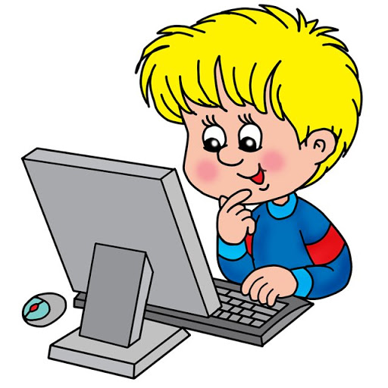
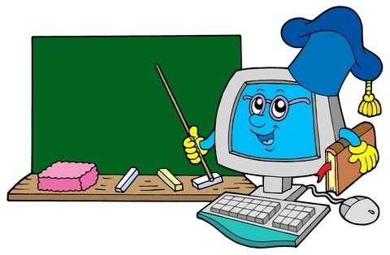
INFORMATIKA VA AXBOROT TEXNOLOGIYALARI
6-sinf
MAVZU: AMALIY MASHG‘ULOT

Slide 2
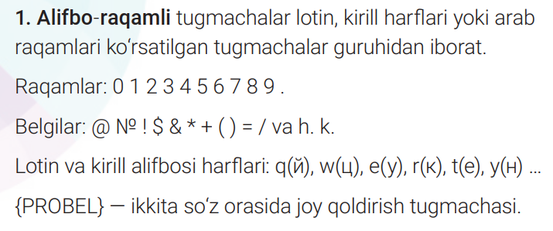
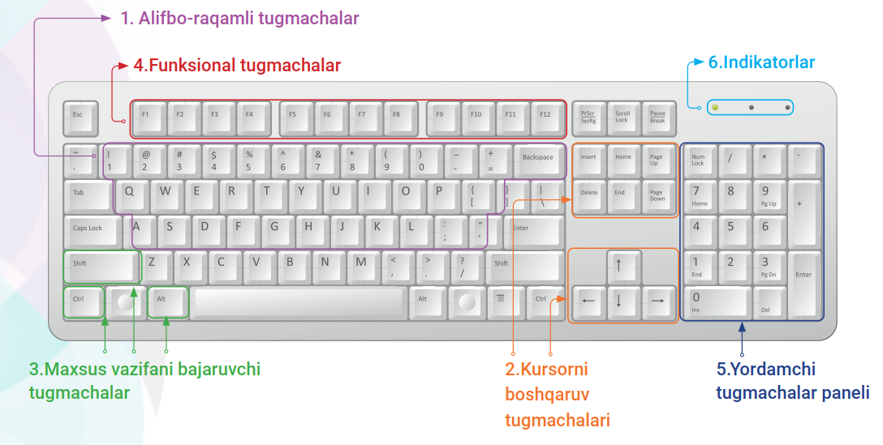
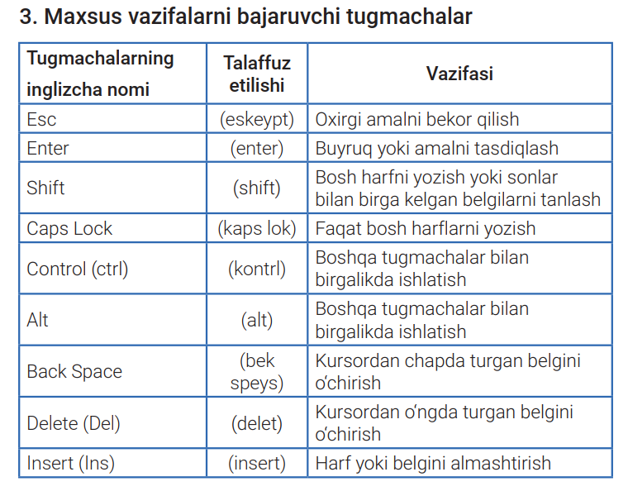
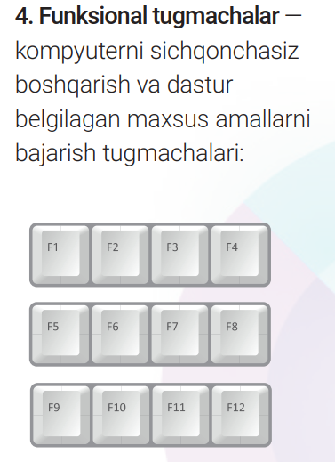
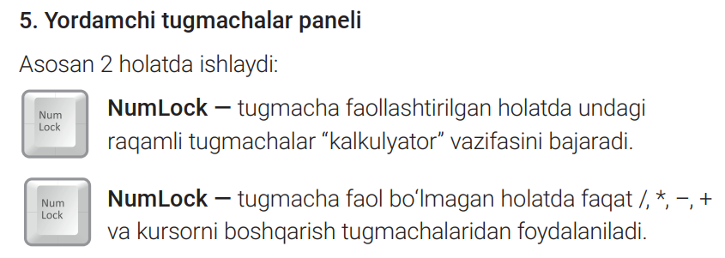
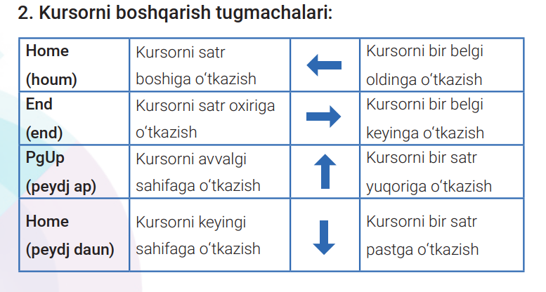
MUSTAHKAMLASH

Slide 3
MUSTAHKAMLASH
Tugmacha | Vazifasi | Tugmacha | Vazifasi
↑ | Bitta satr yuqoriga | Ctrl + ← | Bitta so‘z chapga
↓ | Bitta satr pastga | Ctrl + $→$ | Bitta so‘z o‘ngga
← | Bitta belgi chapga | Ctrl+ Page Up | Sahifa boshiga
→ | Bitta belgi o‘ngga | Ctrl+ Page Down | Sahifa oxiriga
Home | Satr boshiga | Page Up | Bitta ekran yuqoriga (10–12 satr)
End | Satr oxiriga | Page Down | Bitta ekran pastga (10–12 satr)
Ctrl + ↑ | Oldingi abzas boshiga o‘tish | Ctrl+Home | Hujjat boshiga
Ctrl + ↓ | Keyingi abzas boshiga o‘tish | Ctrl+End | Hujjat oxiriga

Slide 4
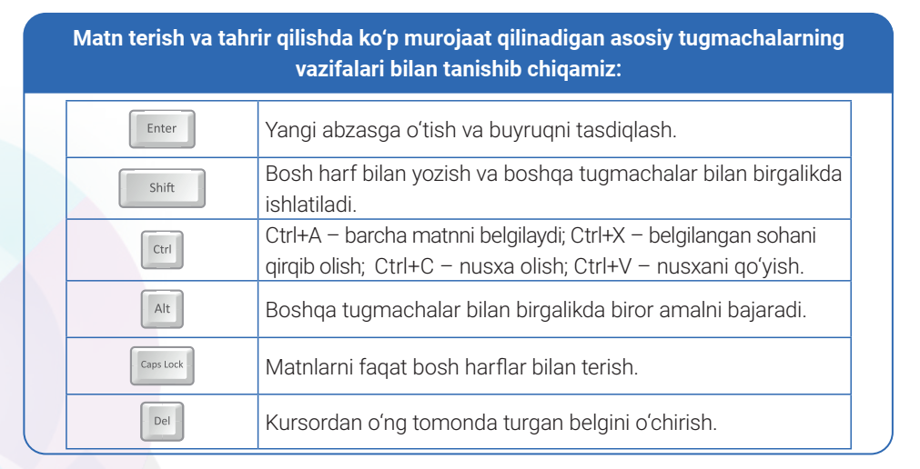
MUSTAHKAMLASH

Slide 5
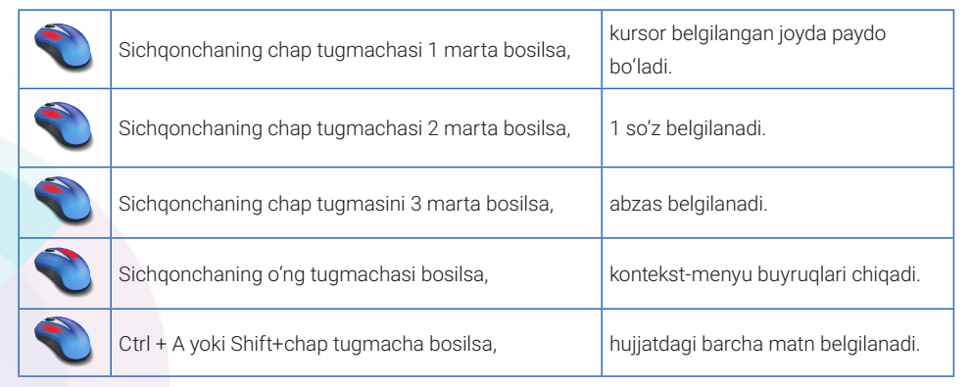
MUSTAHKAMLASH
Matn, abzas va satrlarni tezkor belgilash usullari

Slide 6
MUSTAHKAMLASH

Slide 7
MUSTAHKAMLASH

Slide 8
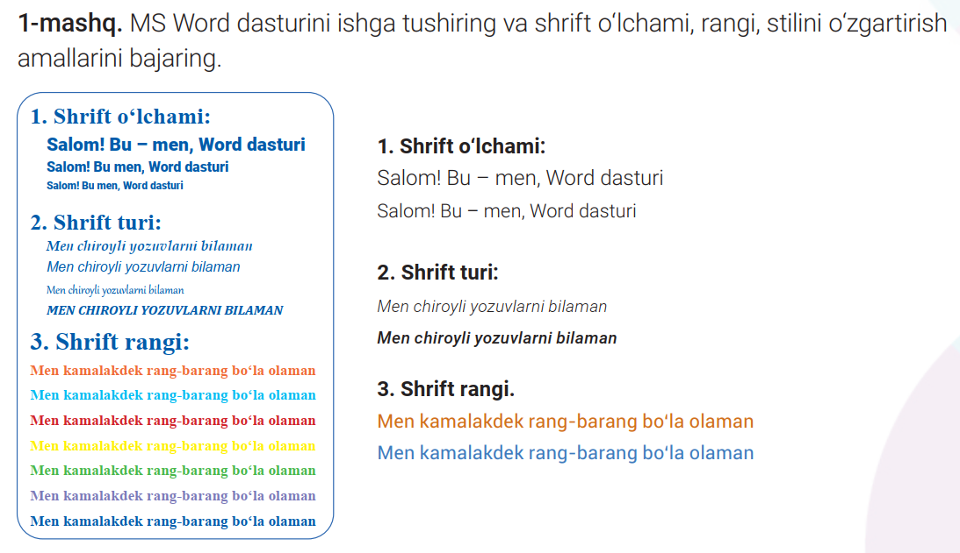
AMALIY MASHG‘ULOT

Slide 9
WordART KOLLEKSIYASI

Slide 10
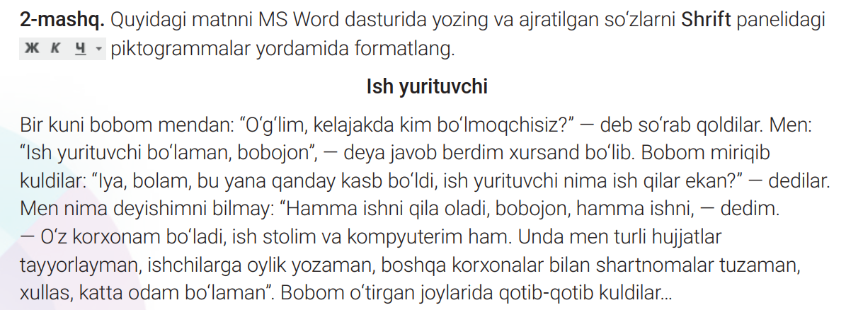
AMALIY MASHG‘ULOT

Slide 11
AMALIY MASHG’ULOT

Slide 12
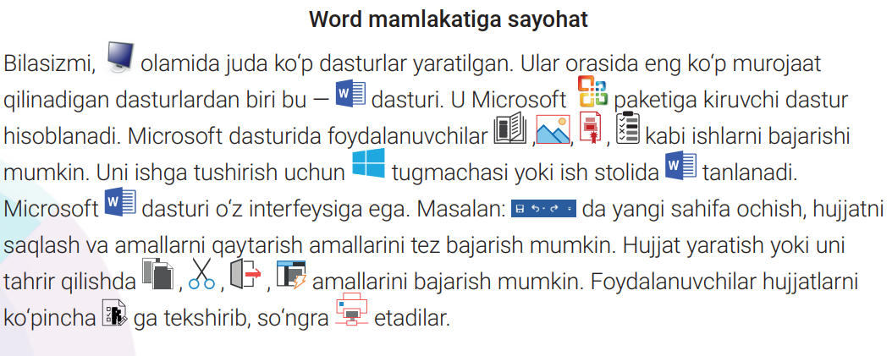
MUSTAQIL BAJARISH UCHUN TOPSHIRIQ:
Rasmlarga mos so‘zlarni qo‘ying va hikoyani so‘zlab bering!

