Slide 1
MATEMATIKA
5- sinf
MAVZU: NATURAL SONLARNI KO‘PAYTIRISH VA UNING XOSSALARIGA DOIR MASALALAR

Slide 2
OG‘ZAKI HISOBLAYMIZ
11
: 10
·?
5
50
55
: 4
· 3
200
165
- 40
· 5
125
40
25
: 5
+15

Slide 3
NATURAL SONLARNI KO‘PAYTIRISH
a sonini b soniga ko‘paytirish deganda, har biri a ga teng bo‘lgan
b ta qo‘shiluvchilar yig‘indisini topish tushuniladi
a · b = a + a + a +…..+ a
b ta

Slide 4
NATURAL SONLARNI KO‘PAYTIRISH
Ko‘paytuvchi
Ko‘paytuvchi
12 · 8 = 96
Ko‘paytma
Ko‘paytma

Slide 5
KO‘PAYTMA SHAKLIDA YOZING
236 + 236 + 236 + 236 =
236 · 4
у + у + у + у + у + у + у =
у · 7
= 7y
(х+5) + (х+5) + (х+5) =
=(х+5) · 3
= 3(х+5)

Slide 6
4 · 6
=
6 · 4
Doirachalar sonini qanday sanash mumkin?

Slide 7
KO‘PAYTIRISHNING O‘RIN ALMASHTIRISH QONUNI
a·b = b·a

Slide 8
(6 · 4) · 2
=
=
6 · (4 · 2)
=
(6 · 2) · 4
=
Doirachalar sonini qanday sanash mumkin?

Slide 9
KO‘PAYTIRISHNING GURUHLASH QONUNI
a·b·c = a · (b · c)=
= (a · c) · b

Slide 10
MISOLLAR
Qulay usulda hisoblang
1) 125 · 376 · 8
2) 4 · 238 · 25
3) 20 · 641 · 50
Yechish:
1) 125 · 376 · 8 = 376 · (125 ·8)=
= 376 ·1000 = 376000

Slide 11
YECHISH
2) 4 · 238 · 25 = (4 ·25) ·238 =
= 100 · 238 = 23800
3) 20 · 641 · 50 = 641 ·(20 · 50)=
= 641 · 1000 = 641000

Slide 12
KO‘PAYTIRISHNING TAQSIMOT QONUNI
a·b + a·c = a·(b+c)
a·(b+c) = a·b + a·c
a·b - a·c = a·(b-c)
a·(b-c) = a·b - a·c

Slide 13
MISOLLAR
2. Ifodaning qiymatini toping
1) 785 · 136 – 585 · 136
2) 426 ·278 + 574 ·278
3) 87 · 925 + 925 ·64 - 51 ·925
4) 38 · 124 + 41 ·124 + 93 ·21 + 31 ·21

Slide 14
YECHISH
1) 785 · 136 – 585 · 136 =
=136·(785–585)=136·200= 27200
426 ·278 + 574 ·278 =
278·(426+574)=278·1000=278000

Slide 15
YECHISH
3)87 · 925 + 925 · 64 – 51 · 925=
= 925 · (87 + 64 - 51) =
= 925 ·100 = 92500

Slide 16
YECHISH
4) 38·124 + 41·124 + 93·21 + 31·21=
=124·(38+41)+21·(93+31)=
=124·79 + 21· 124 = 124·(79 + 21) =
= 124·100=12400

Slide 17
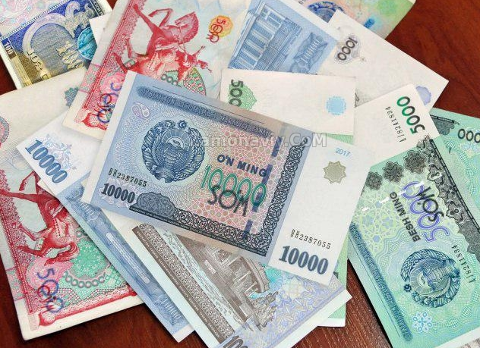
MASALA
Kamolada 4 ta 5000 so‘mlik, Sanamda esa 10 ta 500 so‘mlik pullar bor. Ularning pullari har biri 8000 so‘mdan bo‘lgan uchta sovg‘a olish uchun yetadimi?

Slide 18
YECHISH
4 ta 5000,
10 ta 500
8000 so‘mdan 3 ta sovg‘a
4 ∙ 5000 =
20 000 (so‘m)
10 ∙ 500 =
5 000 (so‘m)
20 000 + 5000 =
25 000 (so‘m)
3 ∙ 8000 =
24 000 (so‘m)
25 000 > 24 000
Javob: Sovg‘a uchun yetarli

Slide 19
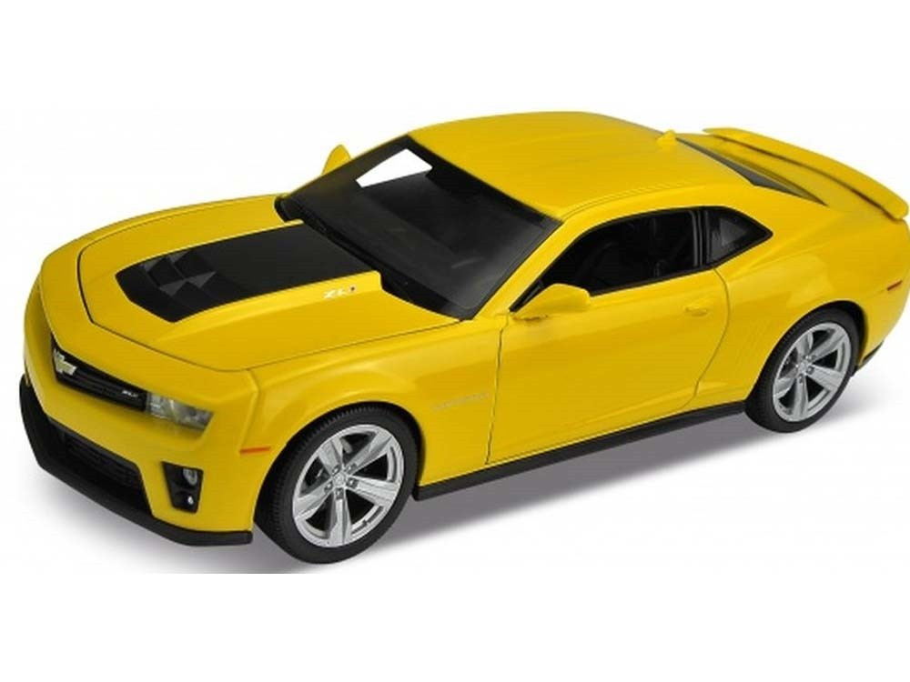
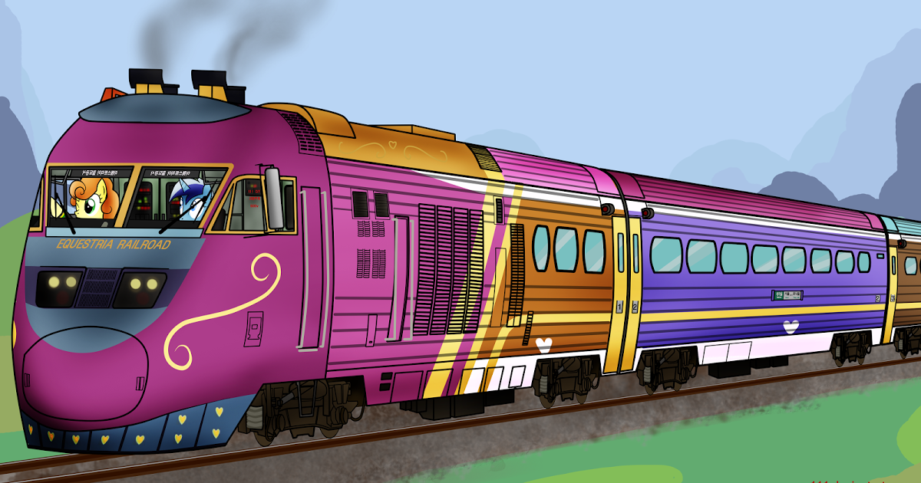
MASALA
Poyezd 80 km/soat tezlik bilan 3 soat, avtomobil esa 130 km/soat tezlik bilan 2 soat yurdi. Ularning qaysi biri ko‘proq masofani bosib o‘tgan?

Slide 20
MUSTAQIL BAJARISH UCHUN TOPSHIRIQLAR
Darslikdagi 691-, 692-, 694-, 698- masalalarni yechish (137- bet)

