Slide 1

MATEMATIKA
5- sinf
MAVZU: SONLI VA HARFLI IFODALAR, TENGLAMALARGA DOIR MASALALAR

Slide 2
SONLI IFODALAR
Sonlar, arifmetik amallar va qavslardan tuzilgan ifodalar sonli ifodalar deyiladi.
35 : (82 – 75) + 11 · 9

Slide 3
SONLI IFODANING QIYMATI
Sonli ifodada amallarni belgilangan tartibda bajarishdan hosil bo‘lgan natija sonli ifodaning qiymati deyiladi.
35 : (82 – 75) + 11 · 9 = 104

Slide 4
HARFLI IFODALAR
Sonlar, arifmetik amallar, qavslar bilan bir qatorda harflar ham ishtirok etgan bo‘lsa, uni harfli yoki harfiy ifoda deb ataladi.
7a + 5b – 27: c

Slide 5
HARFLI IFODANING QIYMATI
Harfli ifodadagi harflar o‘rniga harfning qiymatlari qo‘yib hisoblanganda chiqqan natija harfli ifodaning qiymati deyiladi.
7a + 5b – 27: c

Slide 6
MISOL
Harfli ifodaning qiymatini toping
(15a + 37) – (137 - 12b), bunda, a= 7, b = 6
Yechish:
(15a + 37) – (137- 12b) =
= (15·7 + 37) – (137 – 12 · 6) =
=(105+37) – (137 – 72) = 142 – 65 = 77
Javob: 77

Slide 7
MISOL
Harfli ifodaning qiymatini toping
(18m - 63) + (132 - 9n), bunda, m = 5, n = 4
Yechish:
(18m - 63) + (132- 9n) =
= (18·5 - 63) + (132 – 9 · 4) =
=(90 - 63) + (132 – 36) = 27 +96 = 123
Javob: 123

Slide 8
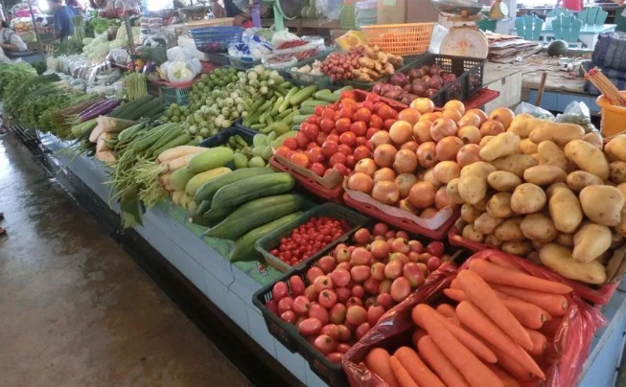
MASALA
Bozorda kartoshka 3200 so‘m, piyoz 1800 so‘m, sabzi 1500 so‘m bo‘lsa, G‘ofur a kg kartoshka, b kg piyoz, c kg sabzi olishi uchun necha so‘m sarflaydi? a = 8, b= 3, c = 4 bo‘lganda hisoblang.

Slide 9
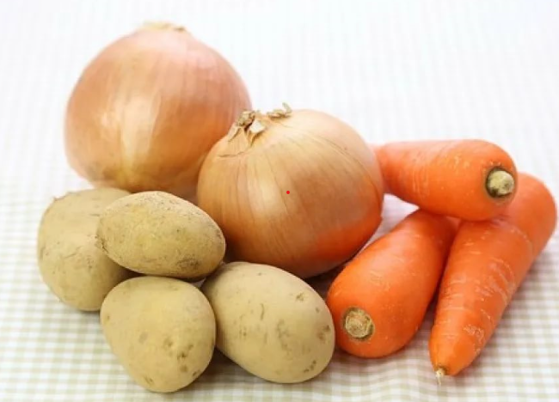
YECHISH
a kg – 3200 so‘mdan
b kg – 1800 so‘mdan
c kg – 1500 so‘mdan
a = 8, b= 3, c = 4
3200a +1800b +1500c =
3200·8 + 1800·3 + 1500·4 =
= 25600 + 5400 + 6000 = 37000
Javob: 37000 so‘m

Slide 10
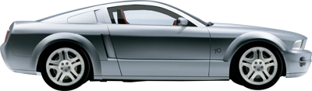
MASALA
Avtomobil birinchi kuni d km, ikkinchi kuni undan 7 km ko‘p masofani bosib o‘tdi. Agar avtomobil umumiy 984 km masofani bosib o‘tgan bo‘lsa, uchinchi kuni qancha masofani bosib o‘tgan? d = 325; 292 da hisoblang.
1-kun
2-kun
3-kun
d
d +7
?
984 km

Slide 11
YECHISH
I kuni – d km
II kuni – d+7 km
III kuni - ? km
d = 325; 292
984 km
984 –(d + d + 7) = 984 –(2d +7)=
= (984 – 7) – 2d = 977 – 2d
1) 977 – 2 ·325 = 977 – 650 = 327 (km)
2) 977 – 2 ·292 = 977 – 584 = 393 (km)
Javob: 327 km; 393 km

Slide 12
TENGLAMA
Noma’lum son qatnashgan tenglik tenglama deyiladi.
x + 83 = 325 - 68
107 - y = 91
3a + 58 = 246

Slide 13
TENGLAMA
Noma’lumning tenglikni to‘g‘ri tenglikka aylantiruvchi qiymati tenglamaning ildizi deyiladi.
37 - y = 23
y = 14
37 - 14 = 23

Slide 14
NOMA’LUM QO‘SHILUVCHINI TOPISH
Tenglamani yeching: x + 25 = 42
Yechish:
x + 25 = 42
x = 42 – 25
x = 17

Slide 15
NOMA’LUM QO‘SHILUVCHINI TOPISH
Tenglamani yeching: 38 + y = 63
Yechish:
38 + y = 63
y = 63 – 38
y = 25

Slide 16
NOMA’LUM AYIRILUVCHINI TOPISH
Tenglamani yeching: 72 - x = 29
Yechish:
72 – x = 29
x = 72 – 29
x = 43

Slide 17
NOMA’LUM KAMAYUVCHINI TOPISH
Tenglamani yeching: x - 57 = 84
Yechish:
x - 57 = 84
x = 84 + 57
x = 141

Slide 18
TENGLAMA
Tenglamani yeching: 263 - ( x+124)=98
Yechish:
263 - (x+124) = 98
(x +124) = 263 - 98
x + 124 = 165
x = 165- 124
x = 41

Slide 19
MASALA
To‘g‘ri to‘rtburchakning perimetri 68 cm, eni bo‘yidan 4cm qisqa. Uning bo‘yini toping.
x - 4
Yechish:
P = 68 cm
x
bo‘yi – x,
eni – x - 4
a + b = 68 : 2 = 34
x + x – 4 = 34
2x – 4 = 34
2x = 34 + 4
2x = 38, x = 19

Slide 20

MUSTAQIL BAJARISH UCHUN TOPSHIRIQLAR:
Darslikdagi 687-, 688-, 689-, 693- masalalarni yechish.
(137- bet)

