Slide 1
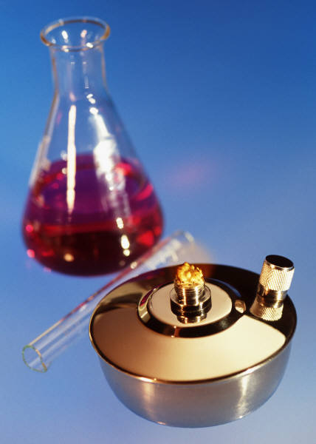
KIMYO
11-sinf

Slide 2
Mustaqil ishlash uchun topshiriqlar
1. 20,8 gr Al(OH)₃ ning g/ekv lar
sonini toping?
2. 6,67 gr Fe₂(SO₄)₃ ning g/ekv lar
sonini toping?

Slide 3
1-masalaning yechimi
E_{(asos)}=$\frac{M(asos)}{n(OH)}$ n_{ekv}=$\frac{m}{E}$
E_{(asos)}=$\frac{M(\text{Al}\text{(}\text{OH}\text{)3})}{n(3)}$=$\frac{78}{3}$=26
n _{ekv}=$\frac{m}{E}$= $\frac{20,8}{26}$=0,8 g/ekv

Slide 4
KIMYO
Mavzu:
Normal konsentratsiya mavzusida masalalar yechish

Slide 5
2-masalaning yechimi
l
E_{(tuz)}=$\frac{M(tuz)}{n∗V}$ n_{ekv}=$\frac{m}{E}$
E_{(tuz)}=$\frac{M(\text{Fe}\text{2}\text{(}\text{SO}\text{4}\text{)}\text{3} )}{2∗3}$=$\frac{400}{6}$=66,67
n _{ekv}=$\frac{m}{E}$= $\frac{6,67}{66,67}$= 0,1 g/ekv

Slide 6
1-masala
1 litr eritma tarkibida 2g/ekv NH₄Cl
bo‘lsa, shu eritmaning normal
konsentratsiyasini aniqlang?

Slide 7
Masalaning yechimi
Berilgan:
$\text{n}\text{ekv}\text{=}$ 2g/ekv
V=1litr
$\text{C}\text{N}\text{=}$?

Slide 8
1-masalaning yechimi
$$\text{C}\text{N}\text{=}\frac{n}{V}\text{ekv}$$
$$\text{C}\text{N}\text{=}\frac{n}{V}\text{ekv} \text{=}\frac{2}{1} \text{=}\text{2 }\text{N}$$

Slide 9
2-masala
200 gr suvga 98 gr H₂SO₄ qo‘shilishidan hosil bo‘lgan eritmaning (p=1,192 g/ml) normal konsentratsiyasini aniqlang?

Slide 10
Masalaning yechimi
Berilgan:
m(H₂O)=200 gr
m(H₂SO₄)=98 gr
p(eritma)=1,192
C_{N}=?

Slide 11
Masalaning yechimi
E_{(kislota)}=$\frac{M(kislota)}{n(H)}$
E_{(kislota)}=$\frac{M(kislota)}{n(H)}$ = $\frac{M\left(\text{H}\text{2}\text{SO}\text{4}\right)}{n(H)}$ = $\frac{98}{2}$=49

Slide 12
Masalaning yechimi
n_{ekv}=$\frac{m}{E}$
n_{ekv}=$\frac{m}{E}$=$\frac{98}{49}$=2 g/ekv $\text{H}\text{2}\text{SO}\text{4}$

Slide 13
Masalaning yechimi
M_{(eritma)}=200+98=298 gr
V_{eritma}=$\frac{m}{p}eritma=\frac{298}{1,192}=250ml=0,25l$

Slide 14
Masalaning yechimi
C_{N}=$\frac{n}{V}$^{ekv}
C_{N}=$\frac{n}{V}$^{ekv} =$\frac{2}{0,25}$ ^{=8 N}

Slide 15
3-masala
8,2 gr H₂SO₃ ning 0,25 N li eritmasining hajmini (l) aniqlang?

Slide 16
Masalaning yechimi
Berilgan:
m=8,2 gr
C_{N}=?
V=?

Slide 17
Masalaning yechimi
E_{(kislota)}=$\frac{M(kislota)}{n(H)}$
E_{(kislota)}=$\frac{M(kislota)}{n(H)}$ = $\frac{M\left(\text{H}\text{2}\text{SO}\text{3}\right)}{n(H)}$ = $\frac{82}{2}$=41

Slide 18
Masalaning yechimi
n_{ekv}=$\frac{m}{E}$
n_{ekv}=$\frac{m}{E}$=$\frac{8,2}{41}$=0,2 g/ekv $\text{H}\text{2}\text{SO}\text{3}$

Slide 19
Masalaning yechimi
C_{N}=$\frac{n}{V}$^{ekv}
V=$\frac{n}{\text{C}\text{N}}$^{ekv} = $\frac{0,2}{0,25}$=0,8l

Slide 20
4-masala
4M li Al₂(SO₄)₃ eritmasining normal konsentratsiyasini aniqlang?

Slide 21
Masalaning yechimi
C_{N}=C_{M}*Val(kat)*n(kat)
C_{N}=C_{M}*Val(kat)*n(kat)=4*3*2=24

Slide 22
5-masala
40 % li (p=1,2g/ml) Al(NO₃)₃
eritmasining normal konsentratsiyasini aniqlang?

Slide 23
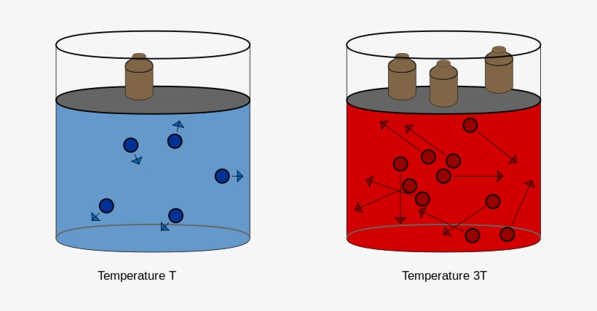
5-masala
Berilgan:
C%=40
p=1,2 g/ml
C_{N}=?

Slide 24
Masalaning yechimi
C_{N}=$\frac{C\%∗p∗10}{E}$
E_{(tuz)}=$\frac{M(tuz)}{n∗V}$=$\frac{\left(\text{Al}\text{(}\text{NO}\text{3}\text{)}\text{3} \right)}{1∗3}$=$\frac{213}{3}$=71
C_{N}=$\frac{C\%∗p∗10}{E}$=$\frac{40∗1,2∗10}{71}$=6,76 N

Slide 25
Mustaqil bajarish uchun topshiriqlar
1. 12,6 gr HNO₃ ning 0,5 N li eritmasining hajmini aniqlang
2. 6 N li H₂SO₃ eritmasining molyar konsentratsiyasini aniqlang?

