Slide 1
Algebra
10-sinf
Mavzu:
Eng sodda trigonometrik tenglamalar (2-qism)

Slide 2
Mustaqil bajarish uchun berilgan mashqlarni tekshirish
130-mashq. Hisoblang: $1)arcsin0; 2) arcsin\frac{\sqrt{3}}{2}$.
130-mashq. Hisoblang: $1)arcsin0; 2) arcsin\frac{\sqrt{3}}{2}$.
Yechish.
1) $arcsin0=x$
$$x=arcsina$$
$$xε\left[−\frac{π}{2};\frac{π}{2}\right]$$
$$x=0$$
$$2) arcsin\frac{\sqrt{3}}{2}=x$$
$$x=\frac{π}{3}$$

Slide 3
Mustaqil bajarish uchun berilgan mashqlarni tekshirish
131-mashq. Hisoblang: $1) arcsin\left(−\frac{\sqrt{2}}{2}\right); 2) arcsin\left(−\frac{1}{2}\right)$.
Yechish.
1) $arcsin\left(−\frac{\sqrt{2}}{2}\right)=x$
$$xε\left[−\frac{π}{2};\frac{π}{2}\right]$$
$$x=arcsina$$
$$x=−\frac{π}{4}$$
$$2) arcsin\left(−\frac{1}{2}\right)=x$$
$$x=−\frac{π}{6}$$

Slide 4
Eng sodda trigonometrik tenglamalar
Yechish.

Slide 5
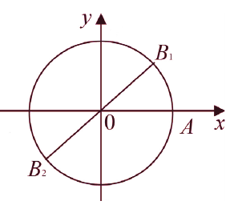
Eng sodda trigonometrik tenglamalar
$tgx=\frac{sinx}{cosx}$ bo‘lgani uchun $tgx$ birlik doiradagi $B (x; y)$nuqta ordinatasining abssissasiga nisbatiga teng,
ya’ni bu nuqta $\frac{y}{x}=a$ to‘g‘ri chiziq bilan birlik doiraning kesishish nuqtasidir.

Slide 6
Eng sodda trigonometrik tenglamalar

Slide 7
Eng sodda trigonometrik tenglamalar
$$sinx=sina, cosx=cosb, tgx=tgc ko‘rinishdagi tenglamalar$$

Slide 8
Misollar yechish
132-mashq. Hisoblang: 1)$arccos0;$ 2) $\arccos\left(−\frac{\sqrt{3}}{2}\right)$
$1)−1≤0≤1, \frac{π}{2}∈\left[0:π\right]$ va$\cos{\frac{π}{2}=0}$ bo‘lgani uchun
$$\arccos{0=}\frac{π}{2}$$
2)$\arccos\left(−\frac{\sqrt{3}}{2}\right)=x$
$$x=π−\frac{π}{6}=\frac{5π}{6}$$
134-mashq. $\text{Hisoblang}\text{:} 1)\operatorname{arctg}{1}$; $2) arctg\left(−\frac{1}{\sqrt{3}}\right)$
$$2) arctg\left(−\frac{1}{\sqrt{3}}\right)=x$$
$$1)\operatorname{arctg}{1}=x$$
$$x=arctga$$
$$x=\frac{π}{4}$$
$$xε\left[−\frac{π}{2};\frac{π}{2}\right]$$
$$x=−\frac{π}{6}$$

Slide 9
Misollar yechish
140-mashq. $\text{Hisoblang}\text{:} 1) 3\operatorname{arctg}\left(\sqrt{3}\right)+3arccos\left(\frac{1}{2}\right)$
1) $3\operatorname{arctg}\left(\sqrt{3}\right)+3arccos\left(\frac{1}{2}\right)=3∙\frac{π}{3}+3∙\frac{π}{3}=2π$
141-mashq. Hisoblang: $\text{1)} 2\operatorname{arctg}{1+3\arcsin\left(−\frac{1}{2}\right)}$
1)$2\operatorname{arctg}{1+3\arcsin\left(−\frac{1}{2}\right)=2∙\frac{π}{4}−3∙\frac{π}{6}=\frac{π}{2}−\frac{π}{2}=0}$
142-mashq. Ifoda ma’noga egami? $1) \arccos\left(\sqrt{8}−3\right)$
$$( π−\arccos\left(\sqrt{8}−3\right))∈\left(0;\frac{π}{2}\right)$$
$$−1≤\sqrt{8}−3≤1$$
$$ha$$
$$≈−0,17$$

Slide 10
Misollar yechish
144-mashq. Tenglamani yeching: $1) sinx=−\frac{1}{2}$
$$1) sinx=−\frac{1}{2}$$
$$x={(−1)}^{k}arcsin\frac{1}{2}+πk, k∈Z$$
$$x={(−1)}^{k} \frac{π}{6}+πk, k∈Z$$
146-mashq. Tenglamani yeching: $1) cosx=−\frac{\sqrt{2}}{2}$
$$1) cosx=−\frac{\sqrt{2}}{2}$$
$$x=±\left(π−arccos\frac{\sqrt{2}}{2}\right)+2πn, n∈Z$$
$$x=±\frac{3π}{4}+2πn, n∈Z$$

Slide 11
Misollar yechish
148-mashq. Tenglamani yeching: $3) tg9x=−1$
$$3) tg9x=−1$$
$$\text{9}x=−arctg1+πk, k∈Z$$
$$9x=−\frac{π}{4}+πk, k∈Z$$
$$x=−\frac{π}{36}+\frac{πk}{9}, k∈Z$$
151-mashq. Tenglamani yeching: 3)$2 sinx+\sqrt{2}=0$
$$x={(−1)}^{k} arcsin\frac{\sqrt{2}}{2}+πk, k∈Z$$
$3) 2 sinx=−\sqrt{2}$
$sinx=−\frac{\sqrt{2}}{2}$
$$x={(−1)}^{k} \frac{π}{4}+πk, k∈Z$$

Slide 12
Misollar yechish
157-mashq. Tenglamani yeching: 1)$2\sin^{2}x−sinx−1=0$
$$sinx=a$$
$$a_{1}=−\frac{1}{2}; { a}_{2}=1$$
$${2a}^{2}−a−1=0$$
$$sinx=−\frac{1}{2} sinx=1$$
$x={(−1)}^{k−1} \frac{π}{6}+πk, k∈Z$ ;
$x=\frac{π}{2}+2πk , k∈Z$

Slide 13
Misollar yechish
160-mashq. Tenglamani yeching: 1)$cosx=cos2x$
$$−2\sin{\frac{x−2x}{2}}\sin{\frac{x+2x}{2}}=0$$
$$cosx−cos2x=0$$
$$2sin{\frac{x}{2}}=0; \sin{\frac{3x}{2}}=0$$
$$\frac{x}{2}=πk, kεZ \frac{3x}{2}= πk, kεZ$$
$x=2πk, kεZ x=\frac{2πk}{3}, kεZ$

Slide 14
Mustaqil bajarish uchun topshiriqlar
Darslik II qismining 43-sahifasidagi
148-150-159-mashqning 2)- tartibdagi misollarini yechish

Slide 15
Algebra
10-sinf
Mavzu:
Eng sodda trigonometrik tengsizliklar

Slide 16
Mustaqil bajarish uchun berilgan mashqlarni tekshirish
148-mashq. Tenglamani yeching: $2) tgx=1$
$$x=arctg1+πk, k∈Z$$
$$x=\frac{π}{4}+πk, k∈Z$$
$$2) tgx=1$$
150-mashq. Tenglamani yeching: 2)$2cosx−\sqrt{3}=0$
$$x=± arccos\frac{\sqrt{3}}{2}+2πk, k∈Z$$
$2) 2cosx=\sqrt{3}$
$cosx=\frac{\sqrt{3}}{2}$
$$x=±\frac{π}{6}+2πk, k∈Z$$

Slide 17
Mustaqil bajarish uchun berilgan mashqlarni tekshirish
159-mashq. Tenglamani yeching: 1)${tg}^{2}x−3tgx−4=0$
$$tgx=a$$
$$x≠ \frac{π}{2}+πk, k∈Z$$
$$a^{2}−3a−4=0$$
$$a_{1}=−1; { a}_{2}=4$$
$tgx=−1$ $tgx=4$
$x= arctg(−1)+πk, k∈Z$ ;
$x=arctg4+πk , k∈Z$
$x= \frac{3π}{4}+πk, k∈Z$ ;

Slide 18
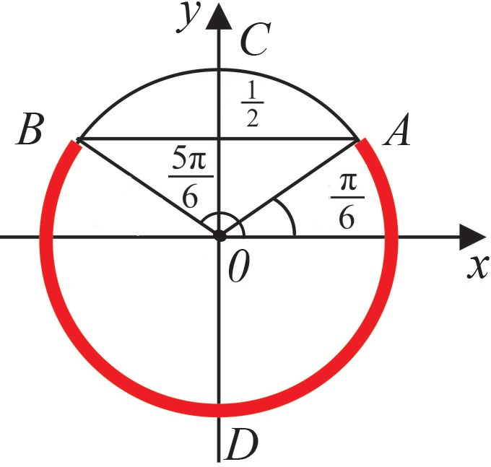
Eng sodda trigonometrik tengsizliklar
$а1 <\sin{x}< b1, а2 <\cos{x}< b2, а3 < tgx < b3$ko‘rinishdagi tengsizliklar eng sodda trigonometrik tengsizliklar deyiladi. Bu yerda a₁, b₁, a₂, b₂, a₃, b₃ − berilgan haqiqiy sonlar. Bunday tengsizliklarni yechishda birlik doiradan va funksiya grafigidan foydalanish qulay.
1- misol. $sinx≤ 0,5$tengsizlikni $[0, 2π]$kesmada yeching.
Javob:

Slide 19
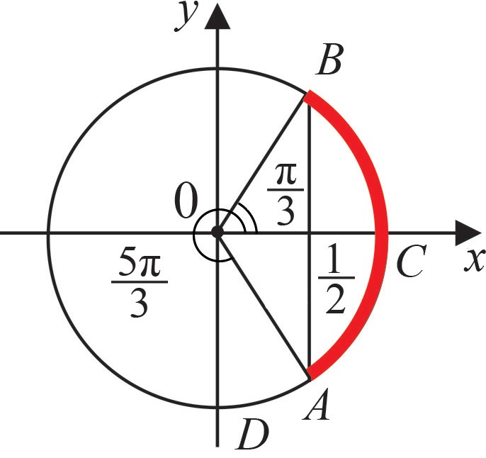
Eng sodda trigonometrik tengsizliklar
2-misol. $cosx>0,5$tengsizlikni $[0, 2π]$kesmada yeching.
Javob:

Slide 20
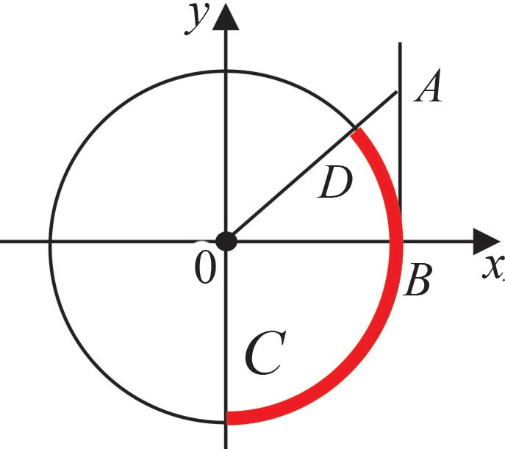
Eng sodda trigonometrik tengsizliklar
3-misol. $tgx≤1$tengsizlikni $\left[−\frac{π}{2};\frac{π}{2}\right]$ kesmada yeching.
Javob: $\left(−\frac{π}{2}; \left.\frac{π}{4}\right] \right.$

Slide 21
Eng sodda trigonometrik tengsizliklar
4-misol. Tengsizlikni yeching: $sinx<\frac{\sqrt{2}}{2}$.
$$\left[0;\frac{π}{4}\right)∪\left[\frac{3π}{4};2π\right)$$
Funksiyaning davriyligidan
Javob: $\left[2π;\frac{π}{4}+2πn\right)∪\left[\frac{3π}{4}+2πn;2π(n+1)\right)$

Slide 22
Eng sodda trigonometrik tengsizliklar
5-misol. $−2cosx≥1$tengsizlikni yeching.
$$cosx≤−\frac{1}{2}$$
$$\frac{2π}{3}$$
$$\frac{4π}{3}$$
Javob: $\left[\frac{2π}{3}+2πn;\frac{4π}{3}+2πn\right]$

Slide 23
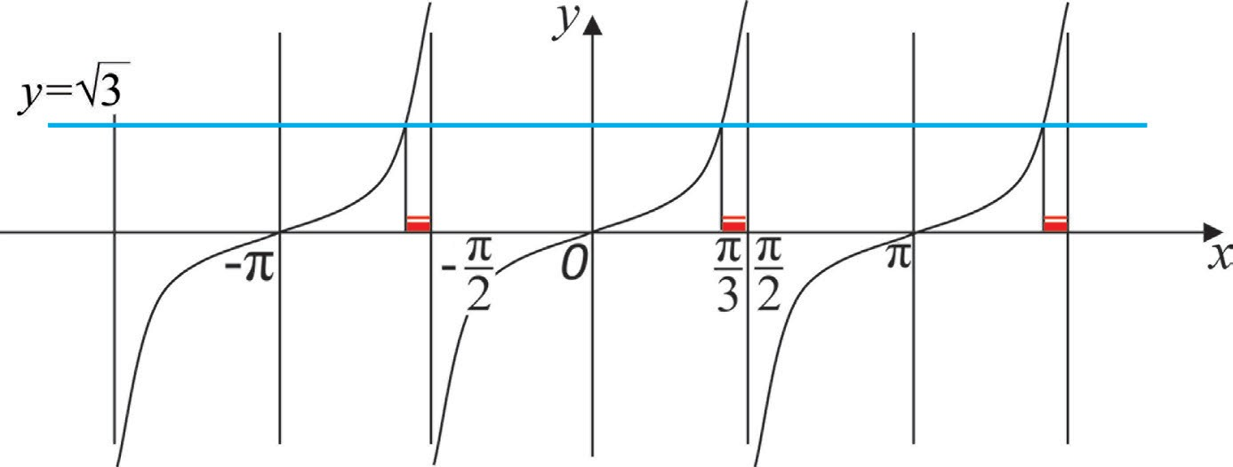
Eng sodda trigonometrik tengsizliklar
6-misol. $tgx>\sqrt{3}$tengsizlikni yeching.
$$tgx>\sqrt{3}$$
Javob: $\left[\frac{π}{3}+πn;\frac{π}{2}+πn\right)$

Slide 24
Mustaqil bajarish uchun topshiriqlar
Darslik II qismining 46-sahifasidagi
162-mashqning 1), 3)- tartibdagi misollarini yechish

