Slide 1
MATEMATIKA
6-sinf
MAVZU: KASRLARNI QO‘SHISH VA AYIRISHGA DOIR MASALALAR YECHISH

Slide 2

OG‘ZAKI BAJARAMIZ

Slide 3

OG‘ZAKI BAJARAMIZ

Slide 4
MISOLLAR
1. Amallarni bajaring
5
1
1)
12
6
4
7
2)
9
18

Slide 5
YECHISH
1
2
5
1
5
+
2
7
1)
12
6
12
12
2
1
4
-
7
7
8
1
2)
9
18
18
18

Slide 6
MISOLLAR
Amallarni bajaring
9
3
+
1)
1
2
14
8
2
8
2)
6
2
15
9

Slide 7
YECHISH
4
7
9
3
+
21
57
36
1
1)
+
2
3
3
1
4
14
8
56
56
56
3
5
2
8
-
-
6
40
51
40
11
2)
6
2
4
3
3
15
9
45
45
45

Slide 8

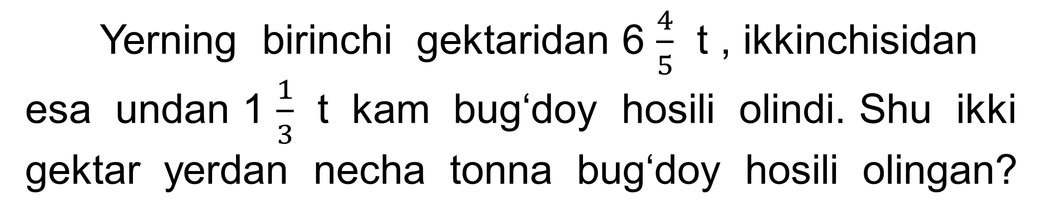
MASALA
Yerning birinchi gektaridan 6 $\frac{4}{5}$ t , ikkinchisidan esa undan 1 $\frac{1}{3}$ t kam bug‘doy hosili olindi. Shu ikki gektar yerdan necha tonna bug‘doy hosili olingan?

Slide 9
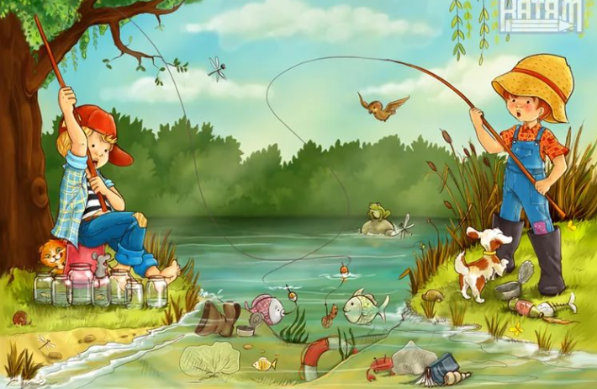

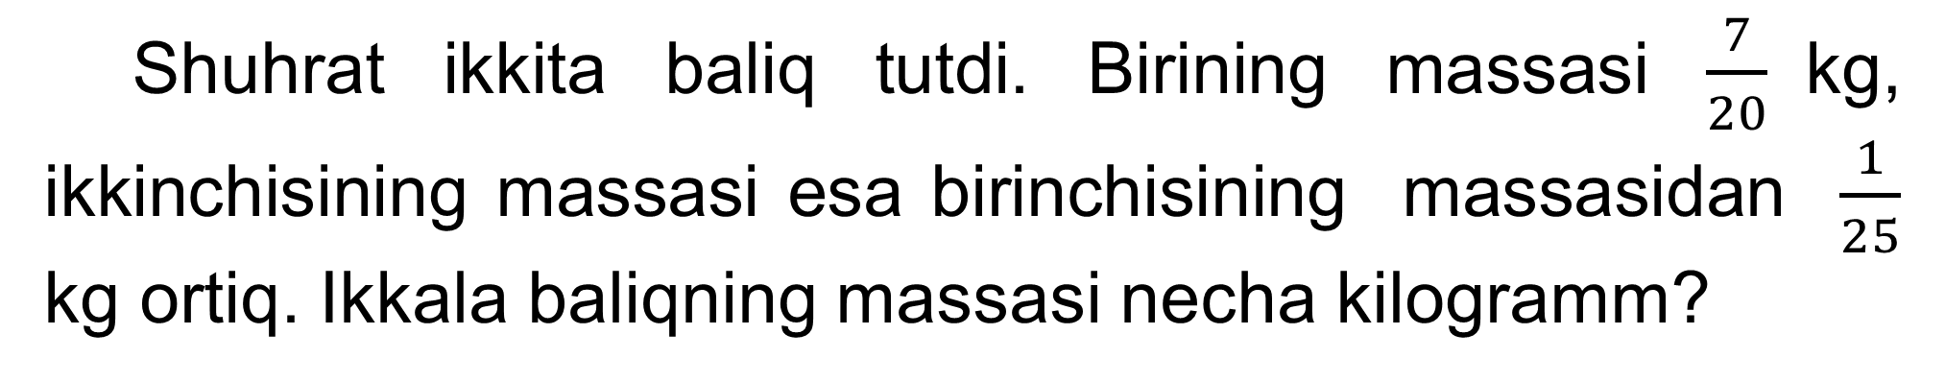
MASALA
Shuhrat ikkita baliq tutdi. Birining massasi $\frac{7}{20}$kg, ikkinchisining massasi esa birinchisining massasidan $\frac{1}{25}$ kg ortiq. Ikkala baliqning massasi necha kilogramm?

Slide 10

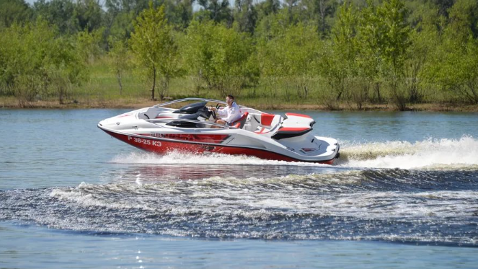
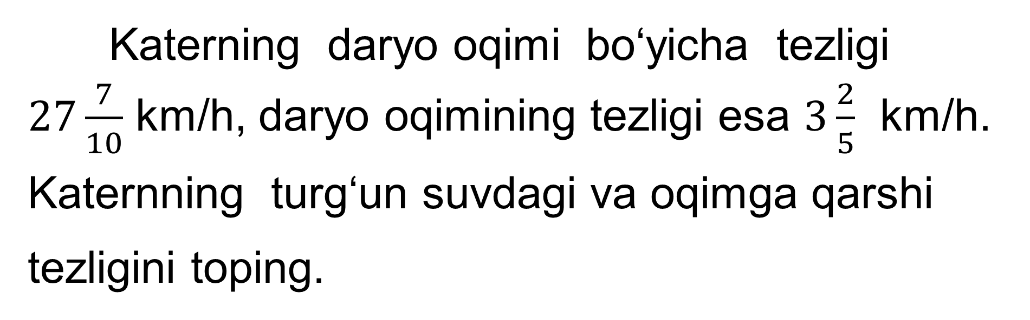
MASALA
Katerning daryo oqimi bo‘yicha tezligi $27\frac{7}{10}$ km/h, daryo oqimining tezligi esa $3\frac{2}{5}$ km/h. Katernning turg‘un suvdagi va oqimga qarshi tezligini toping.

Slide 11

MUSTAQIL BAJARISH UCHUN TOPSHIRIQLAR:
Darslikdagi 1184-, 1185-, 1186- masalalarni yechish
(228-sahifa).

