Slide 1
MATEMATIKA
5- sinf
MAVZU: ARALASH SONLAR

Slide 2
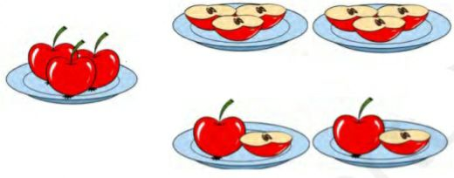
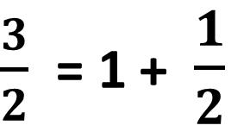
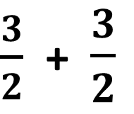
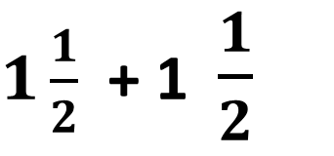
1$\frac{1}{2}$ aralash sonning ifodasi bo‘lib, 1- uning butun qismi, $\frac{1}{2}$ esa kasr qismi deb yuritiladi. Butun va kasr qismlari ajratib yozilgan sonlar aralash sonlar deb ataladi.
Aralash sonlar
3 ta olmani ikkita bolaga teng bo‘lib bering.
$\frac{3}{2}$ + $\frac{3}{2}$
$\frac{3}{2}$ = 1 + $\frac{1}{2}$
3 ta olma=
$1\frac{1}{2}$ + 1 $\frac{1}{2}$

Slide 3
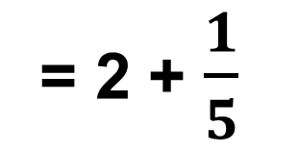
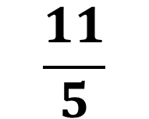
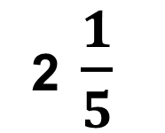
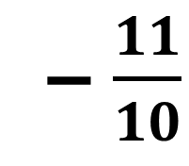
Noto‘g‘ri kasrni aralash son ko‘rinishida ifodalash algoritmi: 1) kasrning maxrajiga bo‘linadi; 2) hosil bo‘lgan to‘liqsiz bo‘linma aralash sonning butun qismi bo‘ladi. 3) qoldiq aralash sonning kasr qismi surati, bo‘luvchi esa maxraji bo‘ladi.
Noto‘g‘ri kasrni aralash son ko‘rinishida ifodalash algoritmi
bo‘luvchi
maxraj
– $\frac{11}{10}$
5
2 $\frac{1}{5}$
2
to‘liqsiz bo‘linma
butun qism
1
qoldiq
surat
$$\frac{11}{5}$$
= 2 + $\frac{1}{5}$

Slide 4
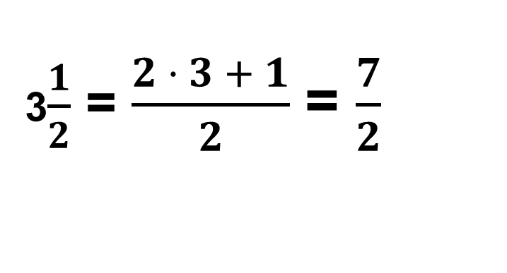
Aralash sonni noto‘g‘ri kasr ko‘rinishida ifodalash
3$\frac{1}{2}$ = $\frac{1}{2}$ + $\frac{1}{2}$ + $\frac{1}{2}$ + $\frac{1}{2}$ + $\frac{1}{2}$ + $\frac{1}{2}$ + $\frac{1}{2}$ = $\frac{7}{2}$ yoki
3$\frac{1}{2}$ = $\frac{2 · 3 + 1}{2}$ = $\frac{7}{2}$

Slide 5
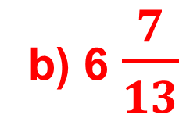
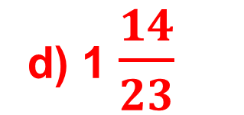
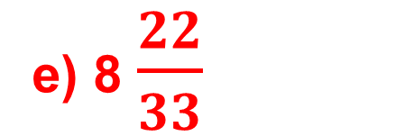
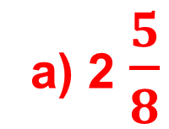
a) Ikki butun sakkizdan besh; b) olti butun o‘n uchdan yetti; d) bir butun yigirma uchdan o‘n to‘rt; e) sakkiz butun o‘ttiz uchdan yigirma ikki.
138 - masala
Raqamlar bilan yozing.
a) 2 $\frac{5}{8}$
d) 1 $\frac{14}{23}$
b) 6 $\frac{7}{13}$
e) 8 $\frac{22}{33}$

Slide 6
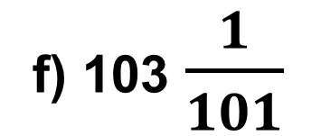
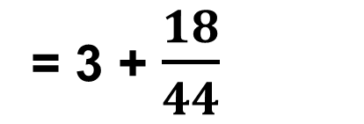
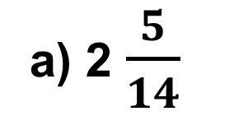
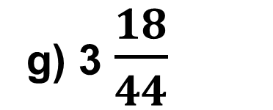
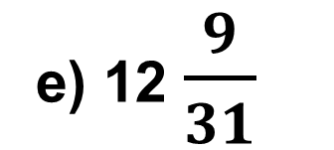
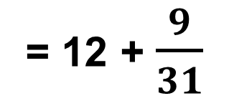
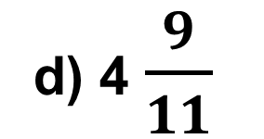
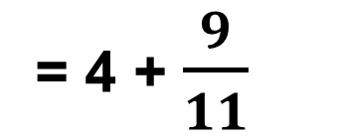
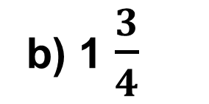
= 2 + $\frac{5}{14}$
139 – misol
e) 12 $\frac{9}{31}$
= 12 + $\frac{9}{31}$
a) 2 $\frac{5}{14}$
f) 103 $\frac{1}{101}$
= 103 + $\frac{1}{101}$
b) 1 $\frac{3}{4}$
= 1 + $\frac{3}{4}$
g) 3 $\frac{18}{44}$
= 3 + $\frac{18}{44}$
d) 4 $\frac{9}{11}$
= 4 + $\frac{9}{11}$

Slide 7
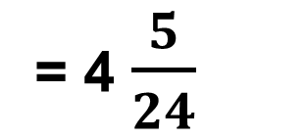
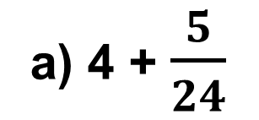
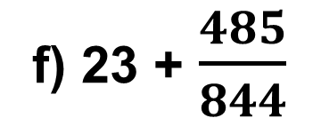
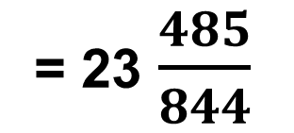
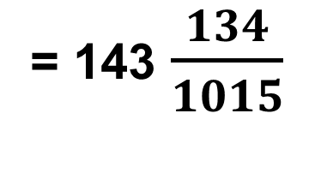
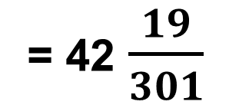
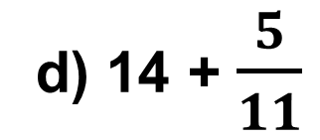
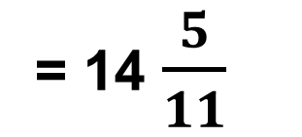
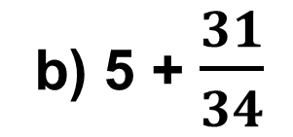
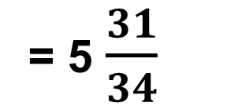
= 143 $\frac{134}{1015}$
141-masala
Yig‘indini aralash son ko‘rinishida ifodalang.
a) 4 + $\frac{5}{24}$
= 4 $\frac{5}{24}$
e) 42 + $\frac{19}{301}$
= 42 $\frac{19}{301}$
b) 5 + $\frac{31}{34}$
= 5 $\frac{31}{34}$
f) 23 + $\frac{485}{844}$
= 23 $\frac{485}{844}$
g) 143 + $\frac{134}{1015}$
d) 14 + $\frac{5}{11}$
= 14 $\frac{5}{11}$

Slide 8
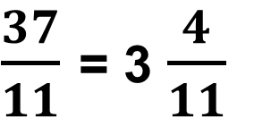
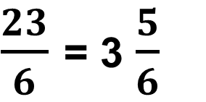
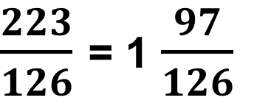
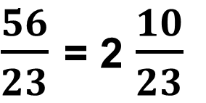
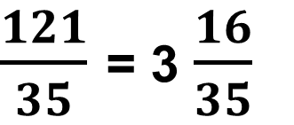
a) 23 : 6 =
142 - misol
Bo‘linmani aralash son ko‘rinishida ifodalang:
$\frac{56}{23}$ = 2 $\frac{10}{23}$
$\frac{23}{6}$ = 3 $\frac{5}{6}$
e) 56 : 23 =
$\frac{121}{35}$ = 3 $\frac{16}{35}$
d) 121 : 35 =
$\frac{37}{11}$ = 3 $\frac{4}{11}$
$\frac{223}{126}$ = 1 $\frac{97}{126}$
f) 37 : 11 =
b) 223 : 126 =

Slide 9
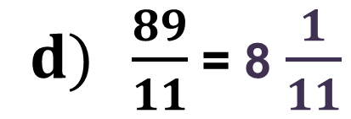
143 - misol
Noto‘g‘ri kasrni aralash songa aylantiring:
$d) \frac{89}{11}$= 8 $\frac{1}{11}$
$f) \frac{180}{44}$= 4 $\frac{4}{44}$
$a) \frac{77}{14}$= 5 $\frac{7}{14}$
$b) \frac{37}{24}$= 1 $\frac{13}{24}$
$g) \frac{1001}{101}$= 9$\frac{92}{101}$
$e) \frac{94}{31}$= 3 $\frac{1}{31}$

Slide 10
Mustaqil bajarish uchun topshiriqlar:
Darslikning 42-betidagi 144 -,145 - misollarni yechish.

