Slide 1
MATEMATIKA
5- sinf
MAVZU: MASALALAR YECHISH

Slide 2
Mustahkamlash
1) Aralash sonlar deb qanday sonlarga aytiladi va misol keltirib izohlang.
2) Noto‘g‘ri kasrni aralash son ko‘rinishida qanday ifodalanadi?
3) Aralash sonni noto‘g‘ri kasr ko‘rinishida ifodalash algoritmi.

Slide 3
= $\frac{1 ·7+5}{7}$ = $\frac{12}{7}$
146 - misol
Sonni noto‘g‘ri kasr ko‘rinishida ifodalang:
a) 1 $\frac{5}{7}$
g) 112 $\frac{451}{1001}$
= $\frac{112 · 1001+451}{1001}$ = $\frac{112112+451}{1001}$=
$$\frac{112 563}{1001}$$
f) 12 $\frac{218}{494}$
$$\frac{6146}{494}$$
= $\frac{12 · 494 + 218}{494}$ = $\frac{5928 +218}{494}$=

Slide 4
b) $\frac{11}{12}$ + $\frac{4}{12}$ = $\frac{15}{12}$ = 1$\frac{3}{12}$
147-misol
Qo‘shishni bajaring va natijasini aralash son ko‘rinishida ifodalang:
a) $\frac{3}{7}$ + $\frac{6}{7}$ = $\frac{9}{7}$ = 1$\frac{2}{7}$
e) $\frac{23}{29}$ + $\frac{14}{29}$ = $\frac{37}{29}$ = 1$\frac{8}{29}$
d) $\frac{11}{13}$ + $\frac{9}{13}$ = $\frac{20}{13}$ = 1$\frac{7}{13}$
f) $\frac{13}{17}$ + $\frac{11}{17}$ + $\frac{8}{17}$ = $\frac{32}{17}$ = 1$\frac{15}{17}$

Slide 5
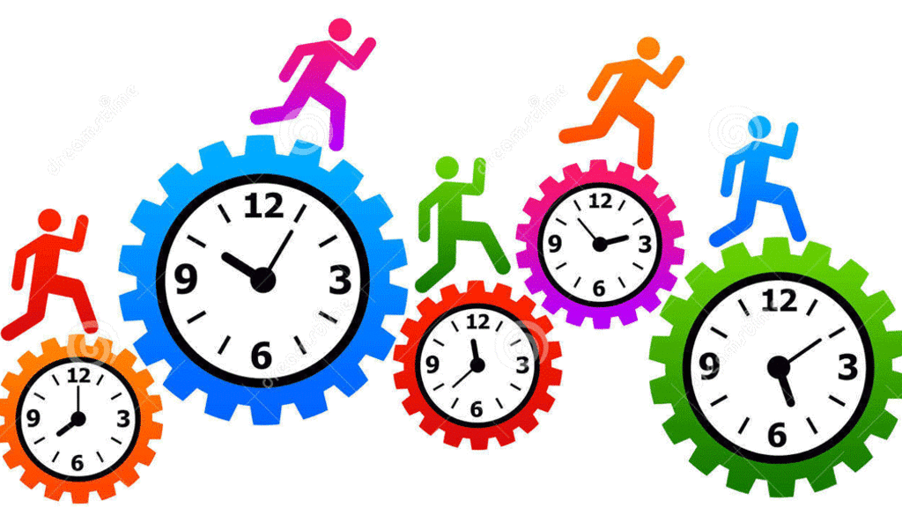
a) 2 soat 34 minut
148 - masala
Soatlarda ifodalang
= 2 $\frac{34}{60}$soat
= 4 $\frac{43}{60}$soat
b) 4 soat 43 minut
= 6 $\frac{14}{60}$soat
d) 6 soat 14 minut

Slide 6
1 kunda = 12 : 7 = $\frac{12}{7}$ = 1 $\frac{5}{7}$
149 - masala
Oila bir haftada 12 kg kartoshka iste’mol qildi. Oila bir kunda o‘rtacha necha kilogramm kartoshka iste’mol qilganini toping. Javobni aralash son ko‘rinishida ifodalang.
1 hafta = 7 kun

Slide 7
151 - masala
Rasmdan foydalanib, noto‘g‘ri kasrni aralash son ko‘rinishida yozing.
$a) \frac{7}{2}$= 3 $\frac{1}{2}$
$b) \frac{11}{3}$=3$\frac{2}{3}$
$d) \frac{21}{4}$= 5 $\frac{1}{4}$
$e) \frac{19}{8}$= 2 $\frac{3}{8}$

Slide 8
1 km = 100 000 cm
152 - masala
Olim: “Bo‘yim $\frac{9}{6000}$ km, vaznim esa $\frac{2}{50}$ tonna”, - deb aytdi. U
adashmayaptimi?
9 km = 900 000 cm
$\frac{9}{6000}$ km = $\frac{900 000}{6000}$ cm (900 000 : 6000) = 150 cm
1 t = 1000 kg
2 t = 2000 kg
$\frac{2}{50}$ t = $\frac{2000 }{50}$ kg (2000 : 50) = 40 kg

Slide 9
2 $\frac{3}{5}$ = $\frac{2 ·5 + 3}{5}$ = $\frac{13}{5}$
153-masala
Rasmdan foydalanib, 2 $\frac{3}{5}$ aralash sonni noto‘g‘ri kasrga aylantiring:
O
X
1
2
2 $\frac{3}{5}$
3
0

Slide 10
Mustaqil bajarish uchun topshiriqlar:
Darslikning 43-betidagi
154 - , 155 - , 156 - misollarni yechish.

