Slide 1
MATEMATIKA
5- sinf
MAVZU: ARALASH SONLARNI QO‘SHISH

Slide 2
2 $\frac{2}{5}$ va 1$\frac{1}{5}$ sonlarni yig‘indisini toping.
Aralash sonlarni qo‘shish
+
=
3 + $\frac{3}{5}$
2 $\frac{2}{5}$ + 1$\frac{1}{5}$ =
2 + $\frac{2}{5}$ + 1 + $\frac{1}{5}$ =
2 + 1 + $\frac{2}{5}$ + $\frac{1}{5}$ =
=
3 $\frac{3}{5}$
+
2
$$\frac{2}{5}$$
1
$$\frac{1}{5}$$
3
$$\frac{3}{5}$$
Bu qisqacha quyidagi ko‘rinishda
+
=
+

Slide 3
Noto‘g‘ri kasr ko‘rinishida
Qo‘shishda kasr qismlar yig‘indisi noto‘g‘ri kasr ko‘rinishida bo‘lishi mumkin. Bunday hollarda noto‘g‘ri kasrning butun qismi ajratiladi va butun qismlar yig‘indisiga qo‘shiladi.
2 + 1$\frac{1}{4}$
1$\frac{3}{4}$ + 1$\frac{2}{4}$ =
2 $\frac{5}{4}$ = 2 + $\frac{5}{4}$ =
2 + 1+ $\frac{1}{4}$
3 $\frac{1}{4}$
=
=
+
=

Slide 4
159 - misol
Hisoblang va yig‘indini qanday topganingizni tushuntiring.
a) 2 $\frac{1}{3}$ + 1 =
2 + $\frac{1}{3}$ + $1$
=
3 $\frac{1}{3}$
d) 1+ 2 $\frac{2}{5}$=
1 + $2$ + $\frac{2}{5}$
3 $\frac{2}{5}$
=
b) 3 $\frac{2}{3}$ + 2 =
3 + $\frac{2}{3}$ + $2$
5 $\frac{2}{3}$
e) 3 $\frac{1}{5}$ + $\frac{2}{5}$ =
3 + $\frac{1}{5}$ + $\frac{2}{5}$
=
3 $\frac{3}{5}$
=

Slide 5
160 - misol
Yig‘indini toping.
a) 1 $\frac{1}{12}$ + 2 $\frac{1}{12}$ =
1 + $\frac{1}{12}$ + 2 + $\frac{1}{12}$ =
1 + 2 + $\frac{1}{12}$ + $\frac{1}{12}$ =
3 $\frac{2}{12}$
( )
( )
b) 3 $\frac{5}{9}$ + 1$\frac{1}{9}$ =
3 + $\frac{5}{9}$ + 1 + $\frac{1}{9}$ =
3 + 1 + $\frac{5}{9}$ + $\frac{1}{9}$ =
4 $\frac{6}{9}$
( )
( )
d) 4 $\frac{2}{9}$ + 1 $\frac{1}{9}$ =
4 + $\frac{2}{9}$ + 1 + $\frac{1}{9}$ =
4 + 1 + $\frac{2}{9}$ + $\frac{1}{9}$ =
5 $\frac{3}{9}$
( )
( )

Slide 6
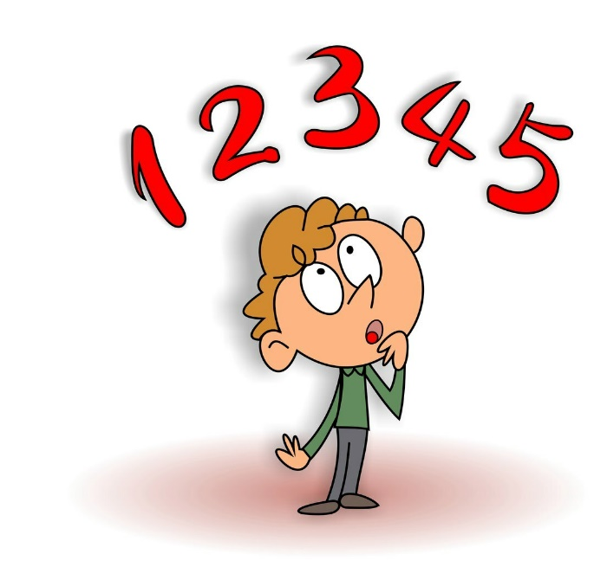
a) $\frac{3}{8}$ + $\frac{7}{8}$ =
161 - misol
Yig‘indini toping va natijani aralash son ko‘rinishida tasvirlang:
b) $\frac{6}{11}$ + $\frac{8}{11}$ =
$\frac{14}{11}$ =
1$\frac{3}{11}$
$\frac{10}{8}$ =
1$\frac{2}{8}$
d) $\frac{2}{3}$ + $\frac{2}{3}$ =
$\frac{4}{3}$ =
1$\frac{1}{3}$
e) $\frac{11}{12}$ + $\frac{7}{12}$ =
$\frac{18}{12}$ =
1$\frac{6}{12}$

Slide 7
5 + ($\frac{1}{13}$ + $\frac{4}{13}$ + $\frac{3}{13}$) =
163-masala
Yig‘indini toping.
a) $\frac{1}{5}$ + $\frac{2}{5}$ + 7 =
7 + ($\frac{1}{5}$ + $\frac{2}{5}$) =
7 $\frac{3}{5}$
b) $\frac{1}{8}$ + 2 + $\frac{3}{8}$ =
2 + ($\frac{1}{8}$ + $\frac{3}{8}$) =
2 $\frac{4}{8}$
a) 10 + $\frac{1}{8}$ + $\frac{3}{8}$ =
10 + ($\frac{1}{8}$ + $\frac{3}{8}$) =
10 $\frac{4}{8}$
a) 5 $\frac{1}{13}$ + $\frac{4}{13}$ + $\frac{5}{13}$ =
5 $\frac{8}{13}$

Slide 8
Eni: 12 $\frac{5}{8}$ cm
1- masala
To‘g‘ri to‘rtburchakning eni 12 $\frac{5}{8}$ cm, bo‘yi esa undan 7 $\frac{3}{8}$ cm uzun.
To‘g‘ri to‘rtburchakning bo‘yini toping.
Yechish:
7 $\frac{3}{8}$ cm uzun
b = 12 $\frac{5}{8}$ + 7 $\frac{3}{8}$ =
19 $\frac{8}{8}$
=
19 + 1 = 20 cm
Bo‘yi: b =?

Slide 9
Daryo oqimi tezligi: 2 $\frac{5}{7}$ km/soat
2 - masala
Daryo oqimining tezligi 2 $\frac{5}{7}$ km/soat, qayiqning turg‘un suvdagi tezligi 15 $\frac{3}{7}$ km/soat. Qayiqning oqim bo‘ylab tezligini toping.
Qayiqning o‘z tezligi: 15 $\frac{3}{7}$ km/soat
Oqim bo‘ylab tezligi: ?
Yechish: 15 $\frac{3}{7}$ + 2 $\frac{5}{7}$ =
17 + $\frac{8}{7}$
= 17 + 1$\frac{1}{7}$ = 18 $\frac{1}{7}$

Slide 10
Mustaqil bajarish uchun topshiriqlar:
Darslikning 46-betdagi 164 - , 165 - , 167 - misollarni yechish.

