Slide 1
MATEMATIKA
5- sinf
MAVZU: MASALALAR YECHISH

Slide 2
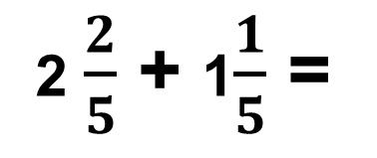
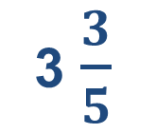
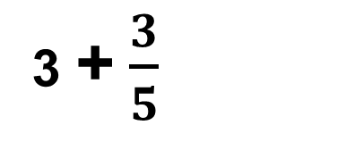
2 $\frac{2}{5}$ va 1$\frac{1}{5}$ sonlarni yig‘indisini toping.
Aralash sonlarni qo‘shish
+
=
3 + $\frac{3}{5}$
2 $\frac{2}{5}$ + 1$\frac{1}{5}$ =
2 + $\frac{2}{5}$ + 1 + $\frac{1}{5}$ =
2 + 1 + $\frac{2}{5}$ + $\frac{1}{5}$ =
=
3 $\frac{3}{5}$
+
2
$$\frac{2}{5}$$
1
$$\frac{1}{5}$$
3
$$\frac{3}{5}$$
Bu qisqacha quyidagi ko‘rinishda
+
=
+

Slide 3
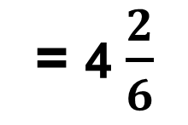
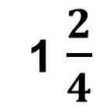
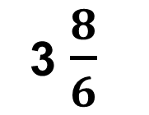
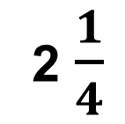

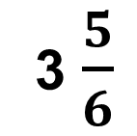
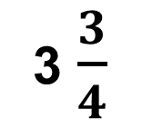
1- masala
Rasmlarni tegishli shakllar bilan to‘ldiring va ular yordamida amallarni bajaring.
+
=
2 $\frac{1}{4}$
+
1 $\frac{2}{4}$
=
3 $\frac{3}{4}$
+
3 $\frac{5}{6}$
+
$\frac{3}{6}$
3 $\frac{8}{6}$
= 4 $\frac{2}{6}$
=

Slide 4
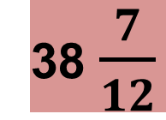
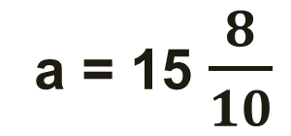
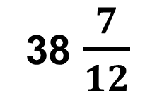

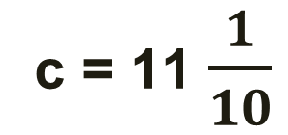
P = ?
2 - masala
Uchburchakning tomonlari 15 $\frac{8}{10 }$ dm, 12 $\frac{9}{10}$ dm va 11 $\frac{1}{10}$ dm. Uning perimetrini toping.
P = a + b + c
a = 15 $\frac{8}{10}$
b = 12 $\frac{9}{10}$
38 $\frac{7}{12}$
15 $\frac{5}{12}$ + 12 $\frac{1}{12}$ + 11 $\frac{1}{12}$=
38 $\frac{7}{12}$
c = 11 $\frac{1}{10}$
P =

Slide 5
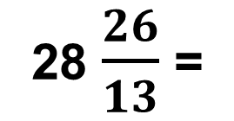
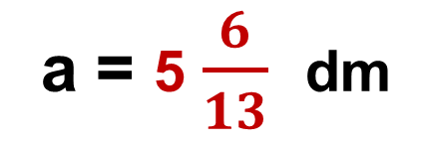
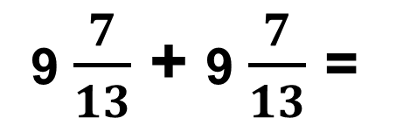
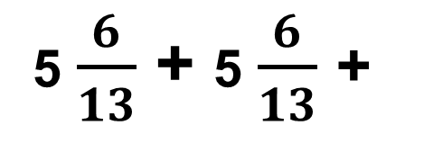
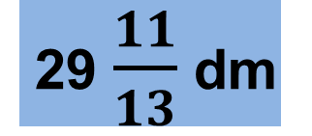
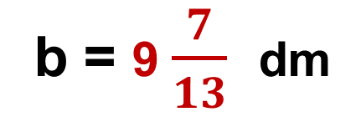
a = 5 $\frac{6}{13}$ dm
3 - masala
To‘g‘ri to‘rtburchakning eni 5 $\frac{6}{13}$ dm, bo‘yi esa 9 $\frac{7}{13}$ dm. To‘g‘ri to‘rtburchakning perimetrini toping.
P = a + a + b + b
= 2a + 2b
29 $\frac{11}{13}$ dm
P = ?
b = 9 $\frac{7}{13}$ dm
5 $\frac{6}{13}$ + 5 $\frac{6}{13}$ +
9 $\frac{7}{13}$ + 9 $\frac{7}{13}$ =
10 $\frac{12}{13}$ + 18 $\frac{14}{13}$ =
28 $\frac{26}{13}$ =
P =
30 dm

Slide 6
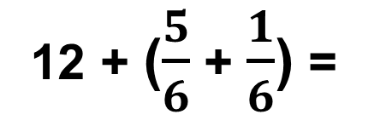
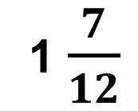
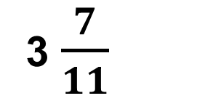
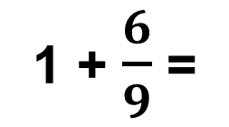
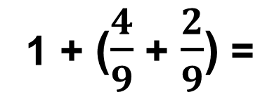
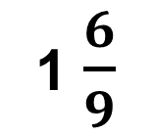
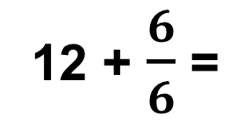
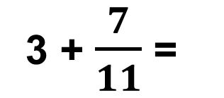
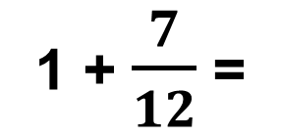
166 - masala
a) $\frac{4}{9}$ + $\frac{2}{9}$ + 1 =
1 + ($\frac{4}{9}$ + $\frac{2}{9}$) =
1 + $\frac{6}{9}$ =
1 $\frac{6}{9}$
b) $\frac{4}{11}$ + 3 + $\frac{3}{11}$ =
3 + ($\frac{4}{11}$ + $\frac{3}{11}$) =
3 + $\frac{7}{11}$ =
3 $\frac{7}{11}$
d) 1$\frac{5}{12}$ + $\frac{1}{12}$ + $\frac{1}{12}$=
1 + ($\frac{5}{12}$ + $\frac{1}{12}$ + $\frac{1}{12}$) =
1 + $\frac{7}{12}$ =
1 $\frac{7}{12}$
e) 12 + $\frac{5}{6}$ + $\frac{1}{6}$ =
12 + ($\frac{5}{6}$ + $\frac{1}{6}$) =
12 + $\frac{6}{6}$ =
12 + 1 =
13

Slide 7
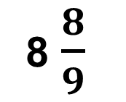
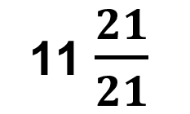
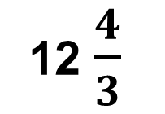
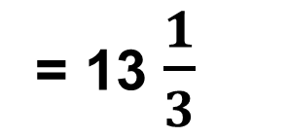
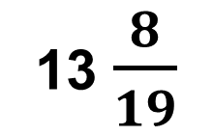
Aralash sonlarni qo‘shish
a) 5 $\frac{5}{9}$ + 2 $\frac{1}{9}$ + 1$\frac{2}{9}$ =
8 $\frac{8}{9}$
b) 7 $\frac{1}{3}$ + 4$\frac{1}{3}$ + 1$\frac{2}{3}$ =
12 $\frac{4}{3}$
= 13 $\frac{1}{3}$
d) 4 $\frac{5}{19}$ + 6 $\frac{1}{19}$ + 3 $\frac{2}{19}$ =
13 $\frac{8}{19}$
e) 8 $\frac{11}{21}$ + 2 $\frac{6}{21}$ + 1$\frac{4}{21}$ =
11 $\frac{21}{21}$
= 12

Slide 8
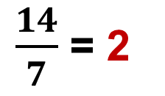
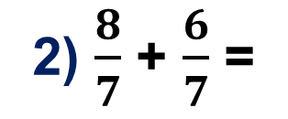
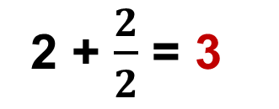
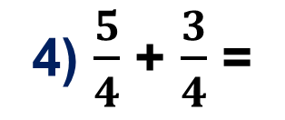
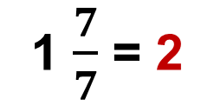
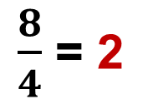
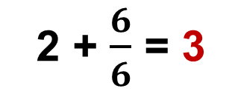
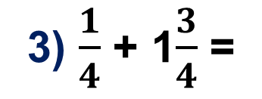
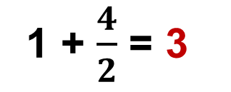
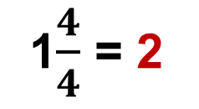
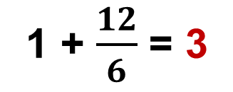
Sonli labirint
1) 1$\frac{4}{7}$ + $\frac{3}{7}$ =
1 $\frac{7}{7}$ = 2
1) $\frac{3}{2}$ + 1 $\frac{1}{2}$ =
1 + $\frac{4}{2}$ = 3
$$1\frac{4}{7}$$
$$\frac{8}{7}$$
$$\frac{3}{2}$$
$$1\frac{4}{6}$$
$$1\frac{3}{4}$$
$\frac{14}{7}$ = 2
$$\frac{1}{2}$$
2) $\frac{8}{7}$ + $\frac{6}{7}$ =
1 + $\frac{12}{6}$ = 3
2) 1 $\frac{4}{6}$ + $\frac{8}{6}$ =
$$\frac{6}{7}$$
2
$$\frac{3}{7}$$
$$1\frac{5}{6}$$
3
$$\frac{8}{6}$$
$$\frac{3}{4}$$
3) $\frac{1}{4}$ + 1$\frac{3}{4}$ =
1$\frac{4}{4}$ = 2
2 + $\frac{6}{6}$ = 3
$$1\frac{1}{2}$$
3) 1$\frac{1}{6}$ + 1$\frac{5}{6}$ =
$$\frac{5}{4}$$
$$\frac{1}{4}$$
$$2\frac{1}{2}$$
$$1\frac{1}{6}$$
4) $\frac{5}{4}$ + $\frac{3}{4}$ =
$\frac{8}{4}$ = 2
2 + $\frac{2}{2}$ = 3
4) 2 $\frac{1}{2}$ + $\frac{1}{2}$ =

Slide 9
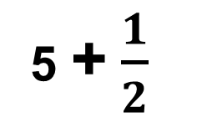
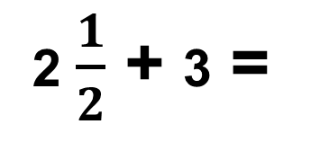
4 - masala
Rasmdan foydalanib, aralash sonlar ustida amallarni bajaring.
+
=
2 $\frac{1}{2}$ + 3 =
2 + $\frac{1}{2}$ + 3 =
2 + 3 + $\frac{1}{2}$ =
5 + $\frac{1}{2}$
5 $\frac{1}{2}$
=

Slide 10
Mustaqil bajarish uchun topshiriqlar:
Aralash sonlarni qo‘shishga doir 12 ta misollar tuzing.

