Slide 1
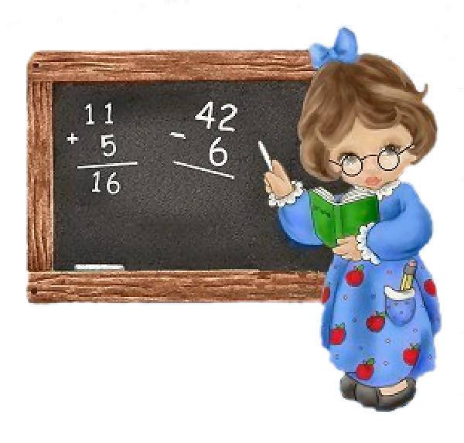
MATEMATIKA
5- sinf
MAVZU: ARALASH SONLARNI AYIRISH

Slide 2
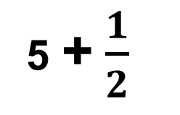
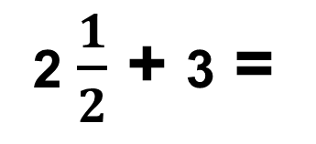
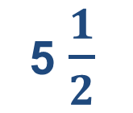
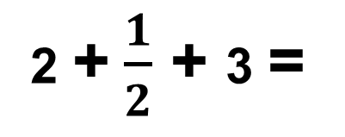
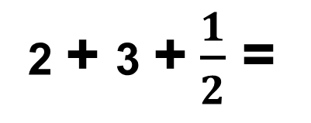
Masala
Rasmdan foydalanib, aralash sonlar ustida amallarni bajaring.
+
=
2 $\frac{1}{2}$ + 3 =
2 + $\frac{1}{2}$ + 3 =
2 + 3 + $\frac{1}{2}$ =
5 + $\frac{1}{2}$
5 $\frac{1}{2}$
=

Slide 3
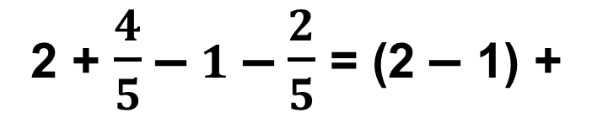
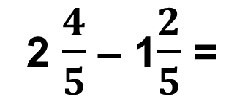


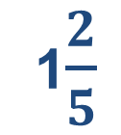

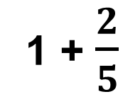
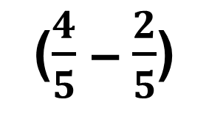
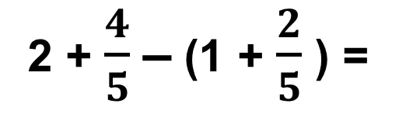
2 $\frac{4}{5}$ va 1$\frac{2}{5}$ sonlarni ayirmasini toping.
Aralash sonlarni ayirish
–
=
2 $\frac{4}{5}$ – 1$\frac{2}{5}$ =
2 + $\frac{4}{5}$ – (1 + $\frac{2}{5}$ ) =
2 + $\frac{4}{5}$ – $1$ – $\frac{2}{5}$ = (2 – 1) +
($\frac{4}{5}$ – $\frac{2}{5}$)
1 + $\frac{2}{5}$
1$\frac{2}{5}$
=
=
–
Bu qisqacha quyidagi ko‘rinishda
2
$$\frac{4}{5}$$
–
1
$$\frac{2}{5}$$
1
$$\frac{2}{5}$$
=
–

Slide 4
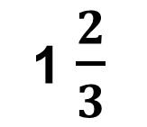
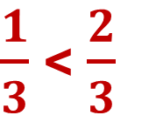
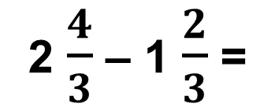
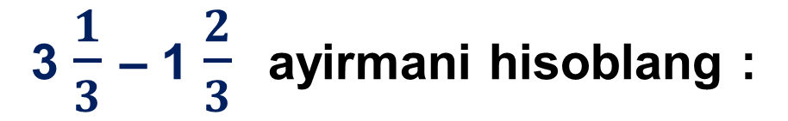
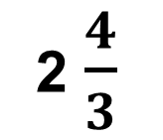
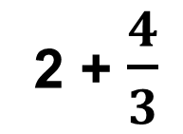
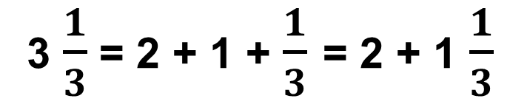
3 $\frac{1}{3}$ – 1 $\frac{2}{3}$ ayirmani hisoblang :
Aralash sonning kasr qismi kichik bo‘lganda
Ba’zida, aralash sonlarni ayirishda kamayuvchining kasr qismi, ayriluvchining kasr qismidan kichik bo‘lishi mumkin. Bunday hollarda 1 butun maydalanadi.
$\frac{1}{3}$ < $\frac{2}{3}$
3 $\frac{1}{3}$ = 2 + 1 + $\frac{1}{3}$ = 2 + 1 $\frac{1}{3}$
2 + $\frac{4}{3}$
2 $\frac{4}{3}$
=
=
2 $\frac{4}{3}$ – 1 $\frac{2}{3}$ =
1 $\frac{2}{3}$

Slide 5
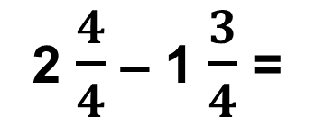
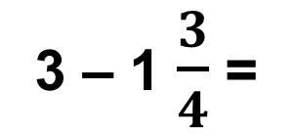
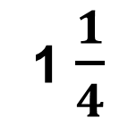
Butun sondan kasr sonni ayirish
Butun sondan kasr son ayrilayotganda ham xuddi shunday yo‘l tutiladi, ya’ni 1 butun “maydalanadi”. Buni quyidagi misollarda tushuntirish mumkin.
3 – 1 $\frac{3}{4}$ =
2 $\frac{4}{4}$ – 1 $\frac{3}{4}$ =
1 $\frac{1}{4}$
=

Slide 6
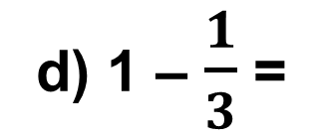
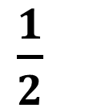

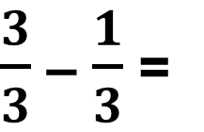

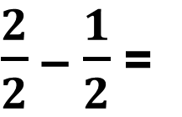
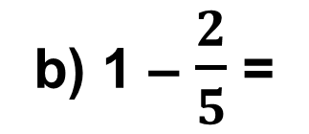
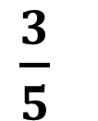
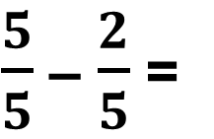
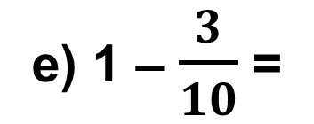
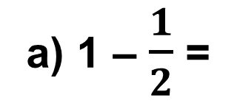
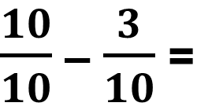
170 - misol
Butunni maydalash usuli bilan ayirmani hisoblang:
a) 1 – $\frac{1}{2}$ =
$\frac{2}{2}$ – $\frac{1}{2}$ =
$\frac{1}{2}$
d) 1 – $\frac{1}{3}$ =
$\frac{3}{3}$ – $\frac{1}{3}$ =
$\frac{2}{3}$
$\frac{7}{10}$
b) 1 – $\frac{2}{5}$ =
$\frac{5}{5}$ – $\frac{2}{5}$ =
$\frac{3}{5}$
e) 1 – $\frac{3}{10}$ =
$\frac{10}{10}$ – $\frac{3}{10}$ =

Slide 7
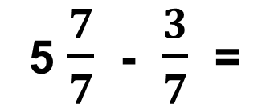
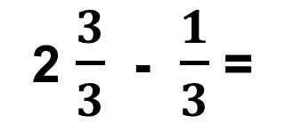
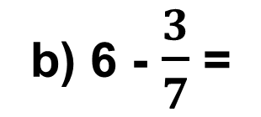
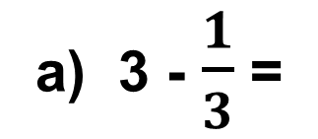
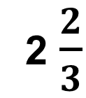
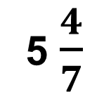
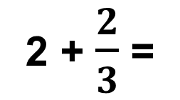
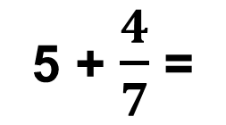
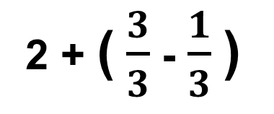
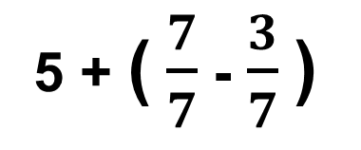
171 - misol
Ayirmani toping.
a) 3 - $\frac{1}{3}$ =
2 $\frac{3}{3}$ - $\frac{1}{3}$ =
2 + ( $\frac{3}{3}$ - $\frac{1}{3}$)
2 + $\frac{2}{3}$ =
2 $\frac{2}{3}$
=
b) 6 - $\frac{3}{7}$ =
5 $\frac{7}{7}$ - $\frac{3}{7}$ =
5 + ( $\frac{7}{7}$ - $\frac{3}{7}$)
5 + $\frac{4}{7}$ =
5 $\frac{4}{7}$
=

Slide 8

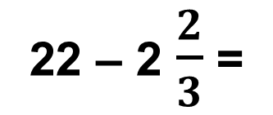
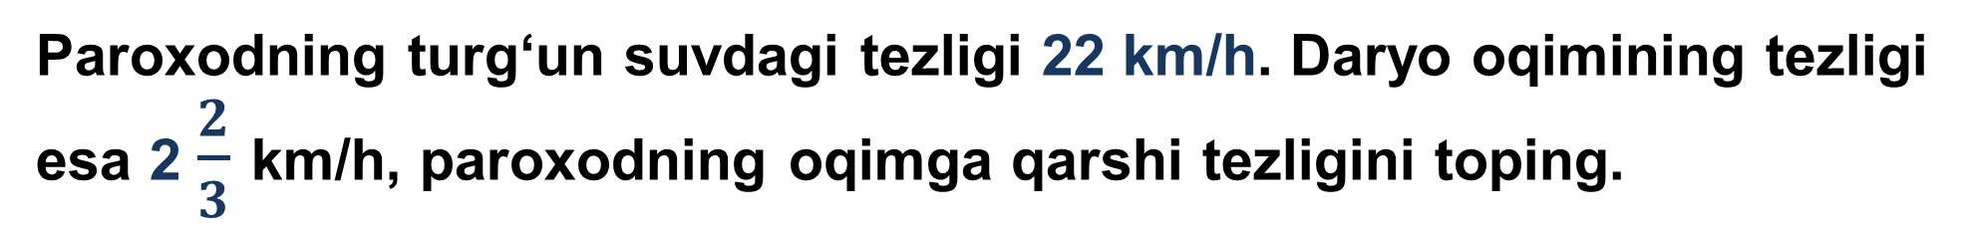
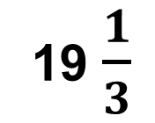
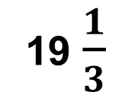
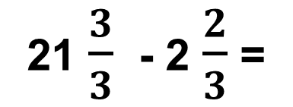
173 - masala
Paroxodning turg‘un suvdagi tezligi 22 km/h. Daryo oqimining tezligi esa 2 $\frac{2}{3}$ km/h, paroxodning oqimga qarshi tezligini toping.
22 – 2 $\frac{2}{3}$ =
21 $\frac{3}{3}$ - 2 $\frac{2}{3}$ =
19 $\frac{1}{3}$
19 $\frac{1}{3}$
Javob:

Slide 9
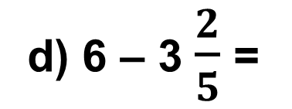
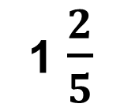
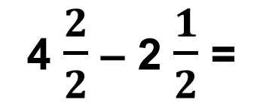









172 - misol
Ayirmani toping.
a) 5 – 2 $\frac{1}{2}$ =
4 $\frac{2}{2}$ – 2 $\frac{1}{2}$ =
2 $\frac{1}{2}$
d) 6 – 3 $\frac{2}{5}$ =
5 $\frac{5}{5}$ – 3 $\frac{2}{5}$ =
2 $\frac{3}{5}$
b) 6 – 1 $\frac{1}{2}$ =
5 $\frac{2}{2}$ – 1 $\frac{1}{2}$ =
4 $\frac{1}{2}$
e) 4 – 2 $\frac{3}{5}$ =
3 $\frac{5}{5}$ – 2 $\frac{3}{5}$ =
1 $\frac{2}{5}$

Slide 10

Mustaqil bajarish uchun topshiriqlar:
Darslikning 47 -betidagi
175 -, 176 -, 177 - misollarni bajarish.
TOPSHIRIQ

