Slide 1
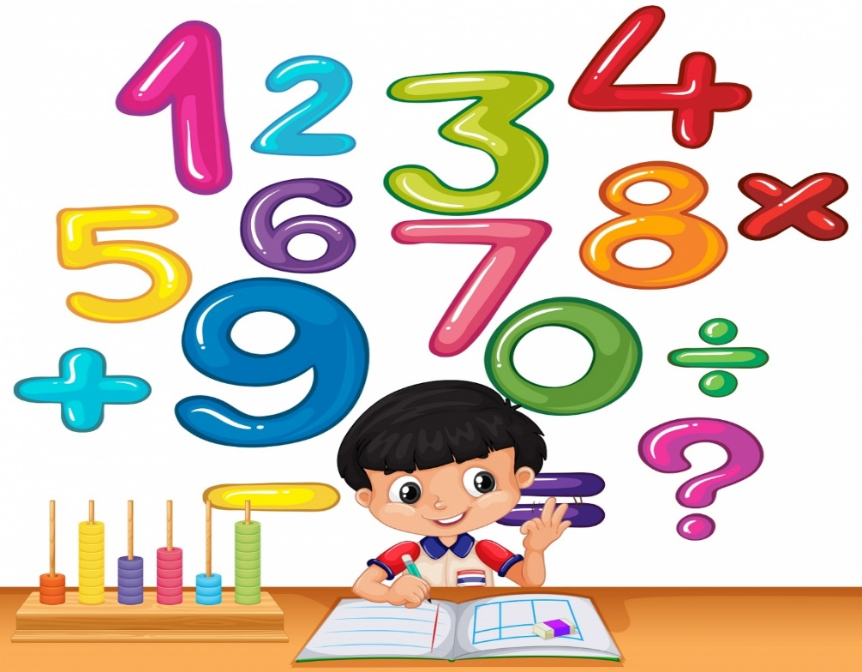
MATEMATIKA
5- sinf
MAVZU: MISOLLAR YECHISH

Slide 2
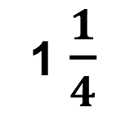
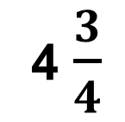
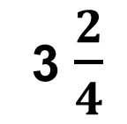
Ayirmani toping
–
=
4 $\frac{3}{4}$
3 $\frac{2}{4}$
1 $\frac{1}{4}$
–
=

Slide 3
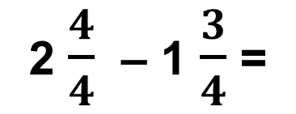
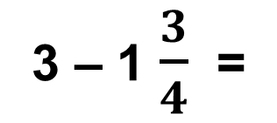
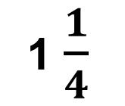
1- masala
Rasmlarni to‘ldiring va ular yordamida ayirmani toping.
–
=
3 – 1 $\frac{3}{4}$ =
2 $\frac{4}{4}$ – 1 $\frac{3}{4}$ =
1 $\frac{1}{4}$

Slide 4
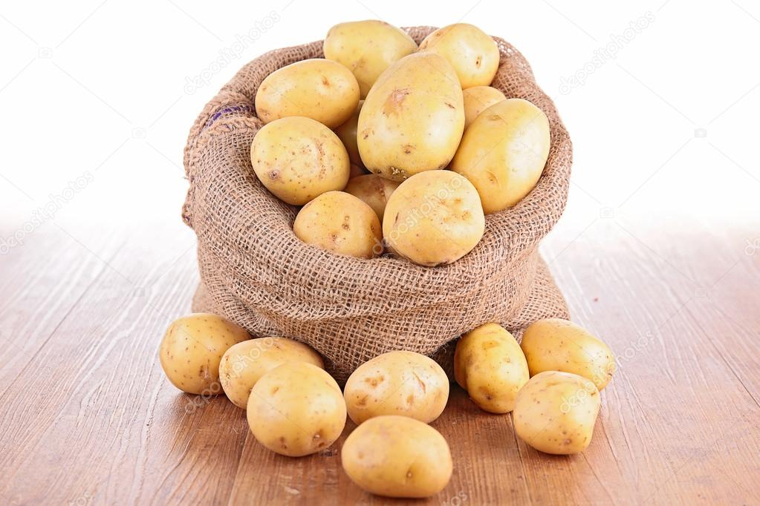
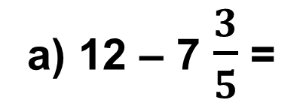
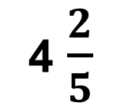
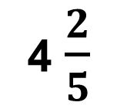
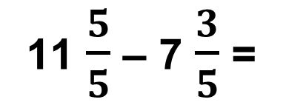
2 - masala
Do‘kondagi 12 tonna kartoshkaning 7 $\frac{3}{5}$ tonnasi sotildi. Do‘konda qancha kartoshka qoldi?
a) 12 – 7 $\frac{3}{5}$ =
11 $\frac{5}{5}$ – 7 $\frac{3}{5}$ =
4 $\frac{2}{5}$
4 $\frac{2}{5}$
Javob :

Slide 5
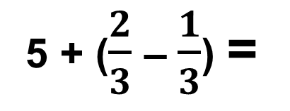
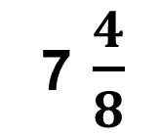
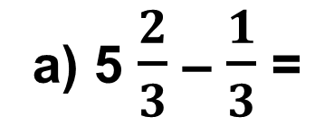
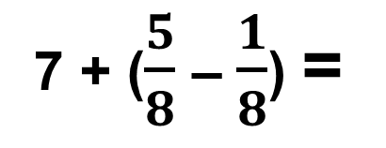
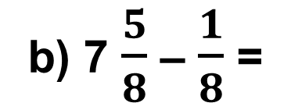
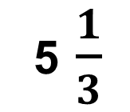
179 - misol
Ayirmani toping.
a) 5$\frac{2}{3}$ – $\frac{1}{3}$ =
5 + ($\frac{2}{3}$ – $\frac{1}{3}$) =
5 $\frac{1}{3}$
b) 7$\frac{5}{8}$ – $\frac{1}{8}$ =
7 + ($\frac{5}{8}$ – $\frac{1}{8}$) =
7 $\frac{4}{8}$

Slide 6
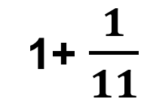
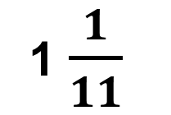
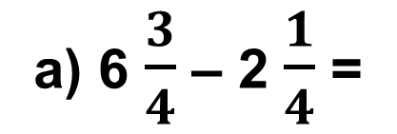
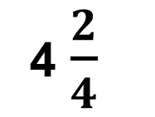
180 - misol
Ayirmani toping.
a) 6$\frac{3}{4}$ – 2 $\frac{1}{4}$ =
(6 – 2) + ($\frac{3}{4}$ – $\frac{1}{4}$) =
4 $\frac{2}{4}$
a) 9$\frac{2}{11}$ – 8 $\frac{1}{11}$ =
(9 – 8) + ($\frac{2}{11}$ – $\frac{1}{11}$) =
1+ $\frac{1}{11}$
=
1 $\frac{1}{11}$

Slide 7
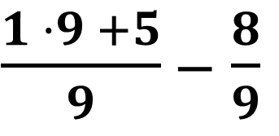
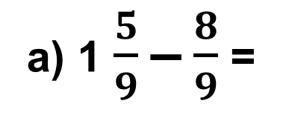
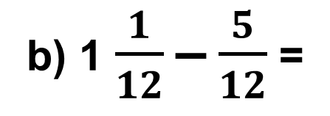
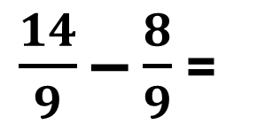

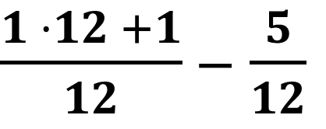
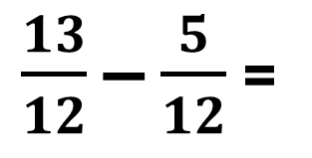
181 - misol
Ayirmani toping.
a) 1$\frac{5}{9}$ – $\frac{8}{9}$ =
$\frac{1 ·9 +5}{9}$ – $\frac{8}{9}$
$\frac{14}{9}$ – $\frac{8}{9}$ =
$$\frac{6}{9}$$
=
b) 1$\frac{1}{12}$ – $\frac{5}{12}$ =
$\frac{1 ·12 +1}{12}$ – $\frac{5}{12}$
$\frac{13}{12}$ – $\frac{5}{12}$ =
$$\frac{8}{12}$$
=

Slide 8
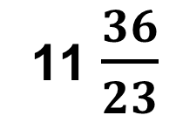
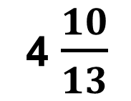
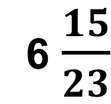
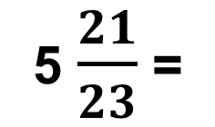
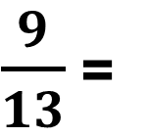
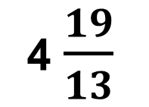
186 - misol
Ayirmani toping.
b) 12 $\frac{13}{23}$ 5 $\frac{21}{23}$ =
11$\frac{36}{23}$
5 $\frac{21}{23}$ =
6 $\frac{15}{23}$
–
–
a) 5$\frac{6}{13}$ – $\frac{9}{13}$ =
4 $\frac{19}{13}$
–
$\frac{9}{13}$ =
4 $\frac{10}{13}$
1) 11 + $\frac{23}{23}$ +$\frac{13}{23}$ = 11 $\frac{36}{23}$
1) 4 + $\frac{13}{13}$ +$\frac{6}{13}$ = 4 $\frac{19}{13}$

Slide 9
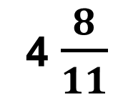
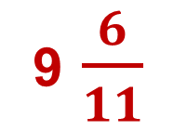
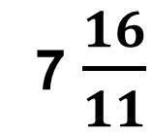
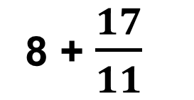
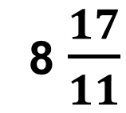
192 - misol
Ifodaning qiymatini toping.
b) 8$\frac{5}{11}$ – 3 $\frac{8}{11}$ + 4$\frac{9}{11}$ =
9 $\frac{6}{11}$
1) 7$\frac{11}{11}$ + $\frac{5}{11}$ =
7 $\frac{16}{11}$
2) 7$\frac{16}{11}$ – 3 $\frac{8}{11}$ =
4 $\frac{8}{11}$
3) 4$\frac{8}{11}$ + 4 $\frac{9}{11}$ =
8 $\frac{17}{11}$
8 + $\frac{17}{11}$
8 + 1 $\frac{ 6}{11}$ = 9 $\frac{6}{11}$
=
=

Slide 10
Mustaqil bajarish uchun topshiriqlar:
Darslikning 49 - betidagi 195 -,196 - misollarni bajarish.

