Slide 1
MATEMATIKA
5- sinf
MAVZU: MASALALAR YECHISH

Slide 2
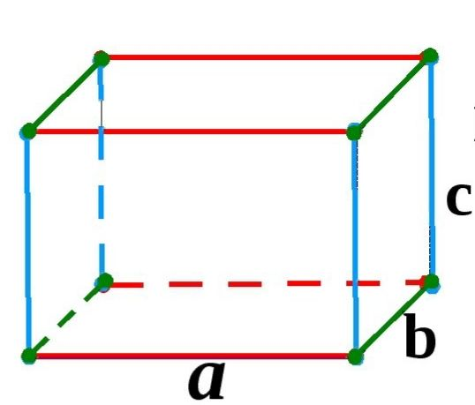
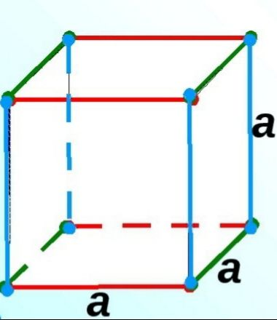
V = abc
Mustahkamlash
V = Sa · H
V = a³

Slide 3
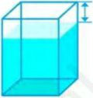
V = 30 · 40 · (50 – 10) = 30 · 40 · 40 = 48000 cm³ =
280 - masala
Rasmdagi akvariumning yuqori yog‘i sathidan 10 cm past qilib suv bilan to‘ldirilgan. Akvariumdagi suv hajmini toping.
40 cm
Berilgan :
Formula :
10 cm
a=30 cm
V = a · b · c
b=40 cm
50 cm
V = a · b · (c – 10)
c=50 cm
V=?
30 cm
48 dm³ = 48 l

Slide 4
V = 3 cm · 4 cm · 2 cm = 24 cm³
285 - masala
Rasm asosida to‘g‘ri burchakli parallelepipedning hajmini hisoblash jarayonini tushuntiring.
3 cm
2 cm
4 cm
Parallelepiped qirrasi 1 cm bo‘lgan 24 ta kubdan iborat.

Slide 5
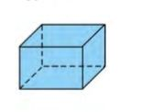
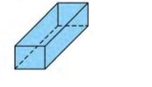
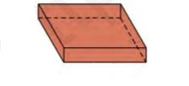
288 - masala
4 - rasmdagi to‘g‘ri burchakli parallelepipedlarning hajmini toping.
ad)
ae)
af)
4 cm
3 m
1 m
2 dm
30 dm
3 dm
5 cm
5 m
15 dm
2 dm = 20 cm
1 m = 10 dm
30 dm = 3 m
V = 5 ·20 · 4 = 400 cm³
V = 15 · 3 · 10 = 450 dm³
V = 5 · 3 · 3 = 45 m³

Slide 6
Yuqoridagi munosabatlardan foydalanib jadvalni to‘ldiring.
291 - masala
1 cm³ = 1 milli litr (ml)
1 cm³ = 1 milli litr (ml) = 1 g
1 dm³ = 1 litr (L)
1 dm³ = 1 litr (L) = 1 kg
Hajmi | Sig‘imi | Massasi
3 cm³ | 3 ml | ?
5 dm³ | ? | 5 kg
? | 2 ml | 2 g
? | 5 ml | ?
? | ? | 84 kg
400 cm³ | ? | ?
3 g
5 l
2 cm³
5 cm³
5 g
84 dm³
84 l
400 ml
400 g

Slide 7
a) 25 ml = 25 cm³
292 - masala
a) 25 ml suvning hajmi qancha? b) 8 kg suvning hajmi qancha?
d) Idishga 24 000 kg suv sig‘adi. Idishning sig‘imi qancha?
b) 8 kg = 8 dm³
d) 24000 kg = 24000 dm³

Slide 8
Berilgan :
293 - masala
Eni 15 cm, bo‘yi 2 dm va balandligi 18 cm bo‘lgan to‘g‘ri burchakli parallelepipedning qirralari simdan yasaldi. Buning uchun kamida qancha sim ishlatilgan?
Formula:
a=15 cm
L = 4 (a + b + c)
b=2 dm=20 cm
L = 4 (15 + 20 + 18) = 4 · 53 = 212 cm
c=18 cm
L = ?
Javob: Buning uchun kamida 212 cm sim ishlatilgan.

Slide 9
Mustaqil bajarish uchun topshiriqlar:
Darslikning 73 - betidagi
303 -, 304 - masalalarni bajarish.

