Slide 1

MATEMATIKA
5- sinf
MAVZU: MASALALAR YECHISH

Slide 2
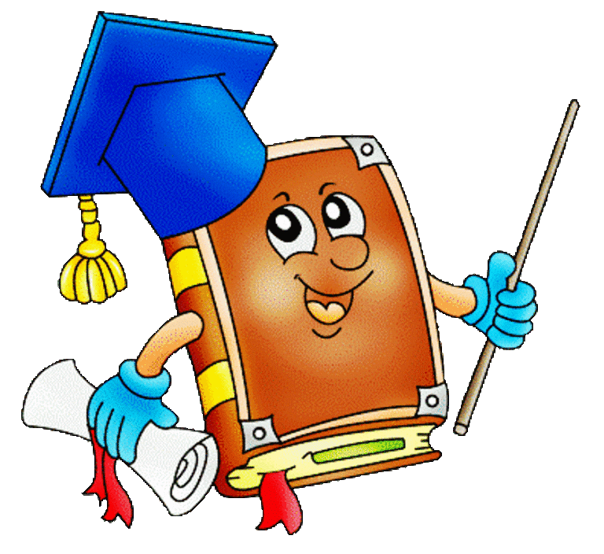
a) V = abc, V = 3 dm · 4 dm · 6 dm = 72 dm³
295 - masala
O‘lchamlari a) 3 dm, 4 dm va 6 dm; b) 12 cm, 2 dm va 3 dm; d) 6 m, 40 dm va 2 m bo‘lgan to‘g‘ri burchakli parallelepipedlarning hajmini toping.
b) V = abc, V = 12 cm · 20 cm · 30 cm = 7200 cm³
d) V = abc, V = 6 m · 4 m · 2 m = 48 m³

Slide 3
Berilgan:
296 - masala
O‘lchamlari 6 dm, 12 dm, va 17 dm bo‘lgan to‘g‘ri burchakli parallelepiped sirtining yuzini hisoblang.
Formula:
a=6 dm
S = 2(ab + bc + ac)
b=12 dm
S = 2(6 ·12 + 12 ·17 + 6 · 17) = 2 · 378 = 756 dm²
c=17 dm
S = ?
Javob: Sirtining yuzi 756 dm²

Slide 4
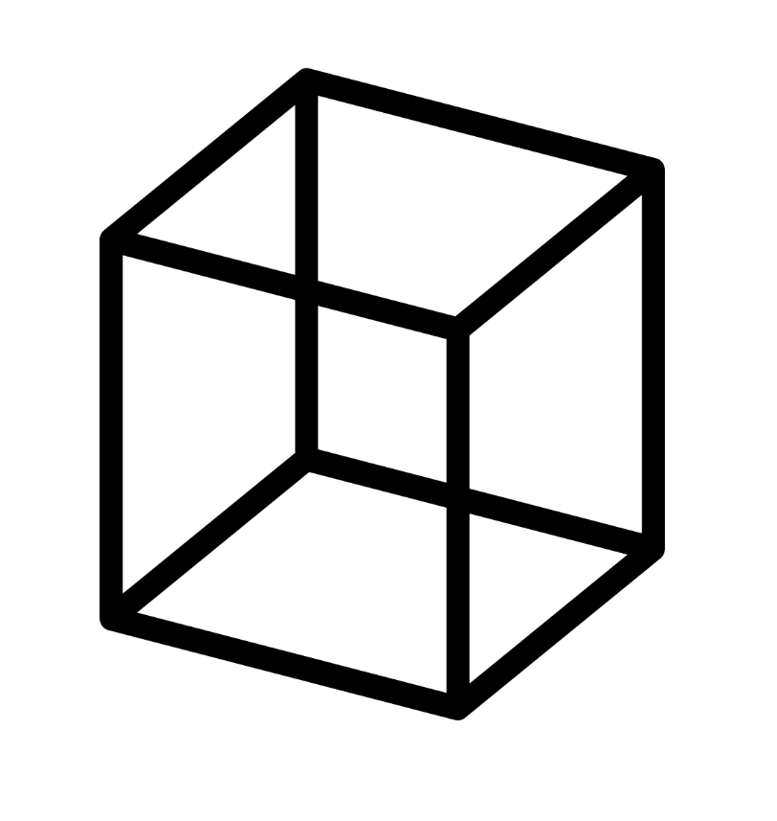
S = 6a²
297 - masala
Qirrasi 25 dm bo‘lgan kubni bo‘yash kerak. Buning uchun qanday kattalikdagi yuzani bo‘yash kerak bo‘ladi?
S = 6 · 25² = 6 · 625 = 3750 dm³
Javob: Buning uchun 3750 dm³ kattalikdagi
yuzani bo‘yash kerak bo‘ladi.

Slide 5
Berilgan :
299 - masala
Yog‘och taxtaning bo‘yi 8 m, eni 3 dm va qalinligi 30 cm. 1 dm³ taxtaning massasi 650 g ekani ma’lum bo‘lsa, taxtaning massasini toping.
Formula :
a=8 m = 80 dm
V = abc
b=3 dm
c=30 cm =3 dm
V = 80 · 3 · 3 = 720 dm³
V = ?
1 dm³
650 g
720 · 650 = 468 000 g = 468 kg

Slide 6
300 - masala
To‘g‘ri burchakli parallelepiped shaklidagi majlislar zalining bo‘yi 40 m, eni 25 m va hajmi 6000 m³. Uning balandligini toping.
Berilgan :
Formula :
a=40 m
V = a · b · c
b=25 m
c = V : (a · c)
V=6000 m³
c=?
c = 6000 m³ : (40 m · 25 m) = 6000 m³ : 1000 m² = 6 m
Javob: Balandligi 6 m.

Slide 7

A. 8 ta uchi, 10 ta qirrasi, 5 ta yog‘i.
Yutuqlaringizni tekshiring:
To‘g‘ri burchakli parallelepipedning nechta uchi, qirrasi va yog‘i bor?
B. 6 ta uchi, 8 ta qirrasi, 12 ta yog‘i.
D. 8 ta uchi, 12 ta qirrasi, 6 ta yog‘i.
E. 6 ta uchi, 12 ta qirrasi, 8 ta yog‘i.

Slide 8

A. V =abc, V = S · H, V=a³
Yutuqlaringizni tekshiring:
Qaysi javobda to‘g‘ri burchakli parallelepiped va kub hajm formulasi keltirilgan?
B. V =abc, V=a²
D. S =ab, V=a², V=abc
E. S =2(ab + bc +ac), V=a³

Slide 9
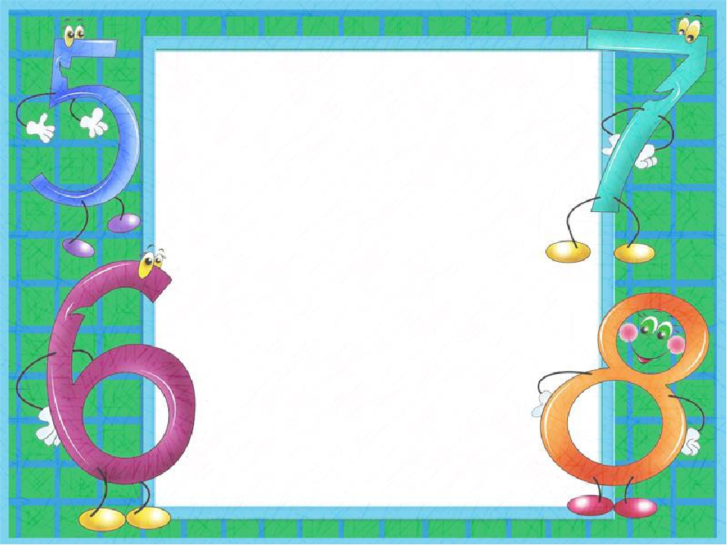
Mustaqil bajarish uchun topshiriqlar:
Darslikning 74 – betidagi
5 –, 6 –, 7–, 9 – masalalarni bajarish.

