Slide 1
MATEMATIKA
5- sinf
MAVZU: MASALALAR YECHISH

Slide 2
x• Oldin sonning butun qismi yoziladi;
O‘nli kasr
Maxraji 10, 100,1000 va hokazo sonlardan iborat bo‘lgan kasrlar o‘nli kasrlar deb ataladi.
Maxraji 10, 100, 1000 va hokazo bo‘lgan sonlarni o‘nli kasr ko‘rinishida quyidagicha yoziladi:
x• so‘ng kasr qismining surati yoziladi va ular bir –biridan vergul
bilan ajratiladi.
Kasr qismining maxraji 10, 100, 1000 va hokazo bo‘lgan har qanday sonni o‘nli kasr ko‘rinishida ifodalash mumkin.
Agar kasr to‘g‘ri kasr bo‘lsa, uning o‘nli yozuvida butun qism 0 deb olinadi.

Slide 3
4,7
309 - misol
Sonni o‘nli kasr ko‘rinishida yozing va o‘qing.
a) 4 $\frac{7}{10}$ =
e) $\frac{3}{10}$ =
0,3
b) 7 $\frac{318}{1000}$ =
f) 3 $\frac{9}{100}$ =
7,318
3,09
d) $\frac{67}{100}$ =
g) 14 $\frac{433}{10 000}$=
0,67
14,0433

Slide 4
310 - misol
Sonning butun va kasr qismlarini ajrating va o‘nli kasr ko‘rinishida yozing:
7 $\frac{318}{1000}$ =
e) $\frac{343}{10}$ =
34 $\frac{3}{10}$ =
b) $\frac{7318}{1000}$ =
7,318
34,3
f) $\frac{9907}{100}$ =
99 $\frac{7}{100}$ =
d) $\frac{6721}{100}$ =
67 $\frac{21}{100}$ =
99,07
67,21

Slide 5
a) 1 millimetr detsimetrning; b) 1 millimetr metrning; d) 1 santimetr kilometrning; e) 1 metr kilometrning qanday qismini tashkil qiladi?
316 - misol
Quyidagi sxema asosida savollarga javob bering:
1 km
1 m
1 dm
1 cm
1 mm
1000
10
10
10
a) $\frac{1}{100}$ qismi
d) $\frac{1}{100 000}$ qismi
b) $\frac{1}{1000}$ qismi
e) $\frac{1}{1000}$ qismi

Slide 6
a) 6,13 m =
317 - misol
Metr va santimetrlarda ifodalang:
6 m + $\frac{13}{100}$ m =
6 $\frac{13}{100}$ =
6 m 13 cm
16 m + $\frac{1}{100}$ m =
16 $\frac{1}{100}$ =
b) 16,01 m =
16 m 1 cm
7 m + $\frac{10}{100}$ m =
7 $\frac{10}{100}$ =
d) 7,10 m =
7 m 10 cm

Slide 7
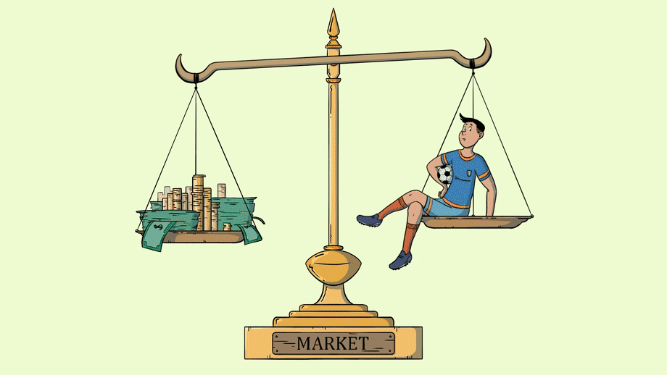
a) 2,783 t =
318 – misol (2)
Tonna va kilogrammlarda ifodalang:
2 t + $\frac{783}{1000}$ t =
2 $\frac{783}{1000}$ =
2 t 783 kg
25 t + $\frac{19}{1000}$ t =
25 $\frac{19}{1000}$ =
d) 25,019 t =
25 t 19 kg

Slide 8
318 - misol (3)
So‘mda ifodalang va o‘nli kasr ko‘rinishda yozing:
14 so‘m + $\frac{58}{100}$so‘m =
a) 14 so‘m 58 tiyin =
14,58 so‘m
4 so‘m + $\frac{3}{100}$so‘m =
d) 403 tiyin =
4,03 so‘m
14 so‘m + $\frac{38}{100}$so‘m =
e) 1438 tiyin =
14,38 so‘m

Slide 9
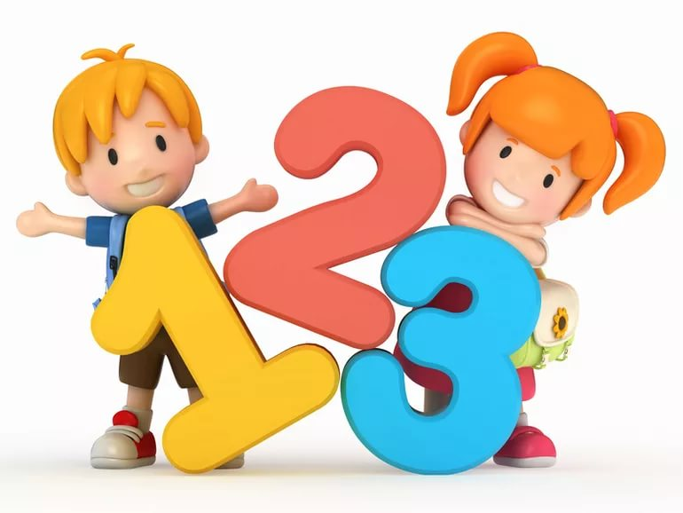
Mustaqil bajarish uchun topshiriqlar:
Darslikning 79 - betidagi
319 -, 320 - masalalarni bajarish.

