Slide 1

MATEMATIKA
5- sinf
MAVZU: SONLAR NURIDA ODDIY KASRLARNI TASVIRLASH

Slide 2

kasrning surati
Mustahkamlash
$\frac{a}{b}$ ko‘rinishdagi yozuvga oddiy kasrlar deb ataladi.
$$\frac{a}{b}$$
kasrning maxraji
Kasrning maxraji – butun nechta ulushga bo‘linganini;
Kasrning surati -bu ulushlardan nechtasi olinganini bildiradi.

Slide 3


Masala
Daftaringizga tomoni 8 ta katak uzunligiga teng bo‘lgan kvadrat chizing. Uni 4 ta teng bo‘lakka bo‘ling. Kvadratning to‘rtdan bir qismini qizil rangga, yarmini esa yashil rangga bo‘yang. Kvadratning qanday qismi bo‘yalmay qoldi?
Qismi bo‘yalmay qoldi.
$$\frac{1}{4}$$

Slide 4





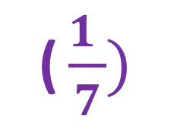





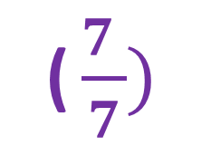
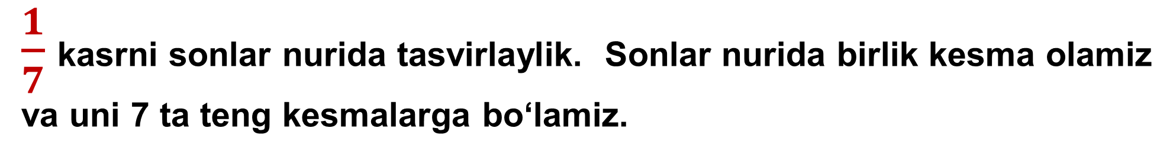









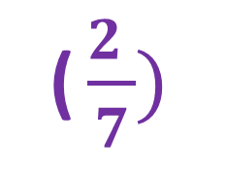



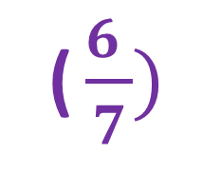




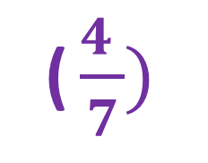

Kasrlarni sonlar nurida tasvirlash
$\frac{1}{7}$ kasrni sonlar nurida tasvirlaylik. Sonlar nurida birlik kesma olamiz va uni 7 ta teng kesmalarga bo‘lamiz.
( $\frac{1 }{7})$
( $\frac{5 }{7})$
( $\frac{7 }{7})$
$$A$$
$$K$$
$$E$$
$$\frac{1}{7}$$
$$\frac{2}{7}$$
$$\frac{3}{7}$$
$$\frac{4}{7}$$
$$\frac{5}{7}$$
$$\frac{6}{7}$$
$$\frac{7}{7}$$
$$0$$
( $\frac{2 }{7})$
( $\frac{6 }{7})$
$$B$$
$$F$$
X
( $\frac{3 }{7})$
$$o$$
$$A$$
$$E$$
$$C$$
$$\frac{1}{7}$$
$$\frac{1}{7}$$
$$\frac{1}{7}$$
$$\frac{1}{7}$$
$$\frac{1}{7}$$
$$\frac{1}{7}$$
$$\frac{1}{7}$$
( $\frac{4 }{7})$
$$D$$

Slide 5
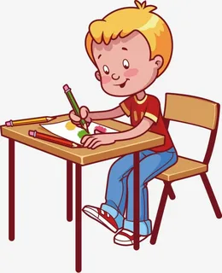

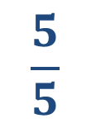
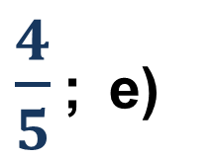


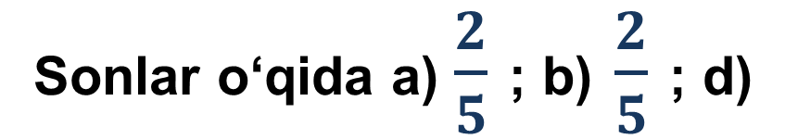

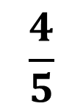



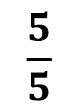
14-masala
Sonlar o‘qida a) $\frac{2}{5}$ ; b) $\frac{2}{5}$ ; d)
$\frac{4}{5}$ ; e)
$$\frac{5}{5}$$
kasrlarni tasvirlang.
$$\frac{1}{5}$$
$$\frac{1}{5}$$
$$\frac{1}{5}$$
$$\frac{1}{5}$$
$$\frac{1}{5}$$
$$o$$
$$\frac{2}{5}$$
$$\frac{4}{5}$$
$$\frac{5}{5}$$
X

Slide 6

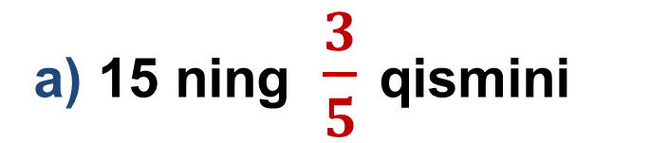
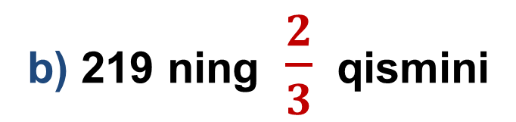
a) 15 ning $\frac{3}{5}$ qismini
15 -masala
Biror m sonining (miqdorning ) $\frac{a}{b}$ qismini topish uchun m sonini b ga bo‘lib, a ga ko‘paytirish kerak.
(15 : 5) ·3=3 · 3= 9
(219 : 3) · 2=73 · 2= 146
b) 219 ning $\frac{2}{3}$ qismini

Slide 7
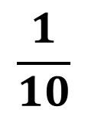
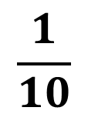

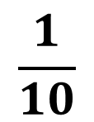

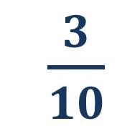
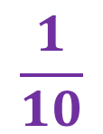
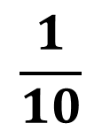

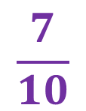
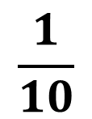
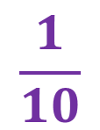
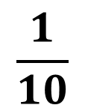
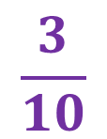
b)
17-masala
Daftarning 10 katagi uzunligini birlik kesma deb olib uzunligiga teng bo‘lgan kesmani chizing.
$$\frac{1}{10}$$
$$\frac{1}{10}$$
$$\frac{1}{10}$$
$\frac{3}{10}$
a)
$$\frac{3}{10}$$
$$\frac{1}{10}$$
$$\frac{1}{10}$$
$$\frac{1}{10}$$
$$\frac{1}{10}$$
$$\frac{1}{10}$$
$$\frac{1}{10}$$
$$\frac{1}{10}$$
$$\frac{7}{10}$$
b)
$$\frac{7}{10}$$

Slide 8




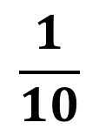


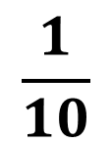

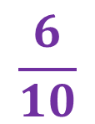
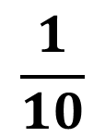

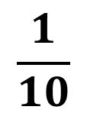
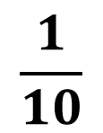
$$\frac{1}{5}$$
$$\frac{1}{5}$$
$$\frac{1}{5}$$
$$\frac{1}{5}$$
$$\frac{4}{5}$$
d)
$$\frac{4}{5}$$
$$\frac{1}{10}$$
$$\frac{1}{10}$$
$$\frac{1}{10}$$
$$\frac{1}{10}$$
$$\frac{1}{10}$$
$$\frac{1}{10}$$
$$\frac{6}{10}$$
e)
$$\frac{6}{10}$$

Slide 9














24-masala
Daftarning 6 katagi uzunligini birlik kesma deb olib, sonlar o‘qida
$$\frac{1}{6}$$
$$\frac{2}{6}$$
$$\frac{4}{6}$$
$$\frac{5}{6}$$
a)
b)
d)
e)
kasrlarni tasvirlang.
$$\frac{1}{6}$$
$$\frac{1}{6}$$
$$\frac{1}{6}$$
$$\frac{1}{6}$$
$$\frac{1}{6}$$
$$\frac{1}{6}$$
$$\frac{1}{6}$$
$$\frac{2}{6}$$
$$\frac{4}{6}$$
$$\frac{5}{6}$$

Slide 10

Mustaqil bajarish uchun topshiriqlar:
Darslikning 23-betdagi 34-,35-,36- masalalarni yechish.

