Slide 1
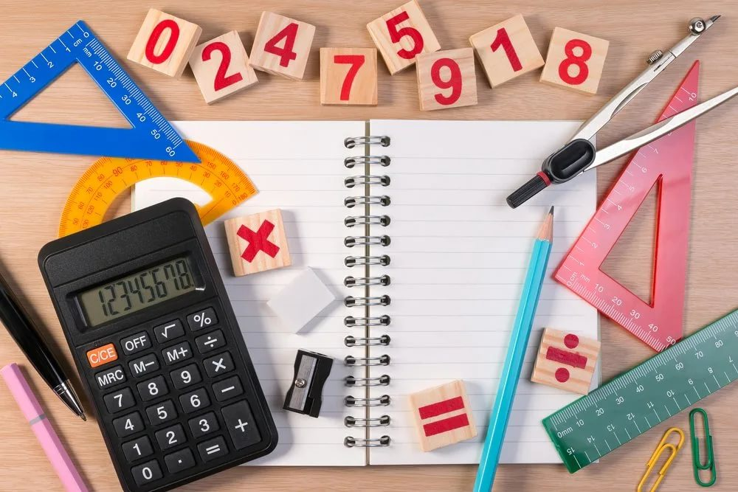
MATEMATIKA
5- sinf
MAVZU: BIR XIL MAXRAJLI KASRLARNI QO‘SHISH

Slide 2
To‘g‘ri kasrlar :
Mustahkamlash
Quyidagi kasrlardan qaysi biri to‘g‘ri , qaysi biri noto‘g‘ri kasr ekanligini aniqlang.
$\frac{3}{7};$
$\frac{24}{17};$
$\frac{5}{8};$
$\frac{19}{11};$
$\frac{7}{13};$
$\frac{29}{29};$
$\frac{27}{22};$
$\frac{237}{639};$
$\frac{3}{7};$
$\frac{5}{8};$
$$\frac{7}{13}$$
$\frac{237}{639};$
$$;$$
$$\frac{24}{17};$$
$$\frac{19}{11};$$
$$\frac{29}{29};$$
$\frac{27}{22};$
Noto‘g‘ri kasrlar :

Slide 3
Bir xil maxrajli kasrlarni qo‘shish
Bir xil maxrajli kasrlarni qo‘shishda, qo‘shiluvchilarning surati qo‘shilib, natija yig‘indining suratiga, maxraj esa o‘zgarishsiz qoldirilib, yig‘indining maxrajiga yoziladi.
$$\frac{a}{b}$$
$$\frac{c}{b}$$
$$+$$
$$\frac{a c}{b}$$
$$=$$
$$+$$
$$\frac{1}{5}$$
$$\frac{2}{5}$$
$$\frac{3}{5}$$
$$+$$
$$=$$

Slide 4
82-masala
Kasrlar ustida amallarni bajaring:
$$+$$
$$a) \frac{3}{5}$$
$$\frac{3 4}{5}$$
$$\frac{7}{5}$$
$$+$$
$$\frac{4}{5}$$
$$e) \frac{8}{11}$$
$$\frac{4}{11}$$
$$\frac{8 4}{11}$$
$$\frac{12}{11}$$
$$+$$
$$=$$
$$=$$
$$+$$
$$=$$
$$=$$
$$+$$
$$\frac{3 4}{12}$$
$$+$$
$$b) \frac{3}{12}$$
$$\frac{4}{12}$$
$$\frac{7}{12}$$
$$f) \frac{46}{125}$$
$$\frac{34}{125}$$
$$\frac{46 34}{125}$$
$$\frac{80}{125}$$
$$+$$
$$=$$
$$=$$
$$+$$
$$=$$
$$=$$
$$+$$
$$d) \frac{13}{25}$$
$$\frac{14}{25}$$
$$\frac{13 14}{25}$$
$$\frac{27}{25}$$
$$+$$
$$+$$
$$=$$
$$=$$
$$k) \frac{33}{5}$$
$$\frac{4}{5}$$
$$\frac{33 4}{5}$$
$$\frac{37}{5}$$
$$+$$
$$=$$
$$=$$

Slide 5
83-masala
Massasi $\frac{4}{15 }$ kg bo‘lgan pomidorga , $\frac{7}{15}$ bodring va $\frac{2}{15}$ piyoz qo‘shib salat tayyorlandi. Salatning massasini toping.
$$\frac{4}{15 }$$
Pomidor:
$$\frac{7}{15}$$
Bodring:
$$\frac{2}{15}$$
Piyoz:
$$\frac{4}{15}$$
$$\frac{7}{15}$$
$$\frac{2}{15}$$
$$\frac{13}{15}$$
$$+$$
$$+$$
$$=$$
Salatning massasi:

Slide 6
Tenglik o‘rinlimi?
$$a) \frac{3}{9}$$
$$\frac{5}{9}$$
$$\frac{10}{9}$$
$$k) \frac{9}{5}$$
$$\frac{4}{5}$$
$$\frac{13}{5}$$
$$+$$
$$=$$
$$+$$
$$=$$
$$b) \frac{8}{5}$$
$$\frac{4}{5}$$
$$\frac{12}{10}$$
$$l) \frac{5}{5}$$
$$\frac{4}{5}$$
$$\frac{9}{10}$$
$$+$$
$$=$$
$$+$$
$$=$$
$$\frac{5}{5}$$
$$h) \frac{2}{5}$$
$$\frac{3}{5}$$
d$) \frac{1}{5}$
$$\frac{4}{5}$$
$=$ 1
$$+$$
$$=$$
$$+$$

Slide 7
1 kg ning $\frac{1}{5}$ qismi yog‘ x kg ning $\frac{1}{5}$ qismi 20 kg yog‘ (x : 5) · 1= 20 x= 20 · 5 x=100 kg
95-masala
Agar 1 kg pistaning $\frac{1}{5}$ qismini yog‘ tashkil qilsa, 20 kg pista yog‘i olish uchun necha kilogramm pista kerak bo‘ladi?

Slide 8
Mustaqil bajarish uchun topshiriqlar:
Darslikning 33-betdagi 96-, 97-, 98- masalalarni yechish.

