Slide 1
MATEMATIKA
5- sinf
MAVZU: KO‘PBURCHAK PERIMETRI

Slide 2
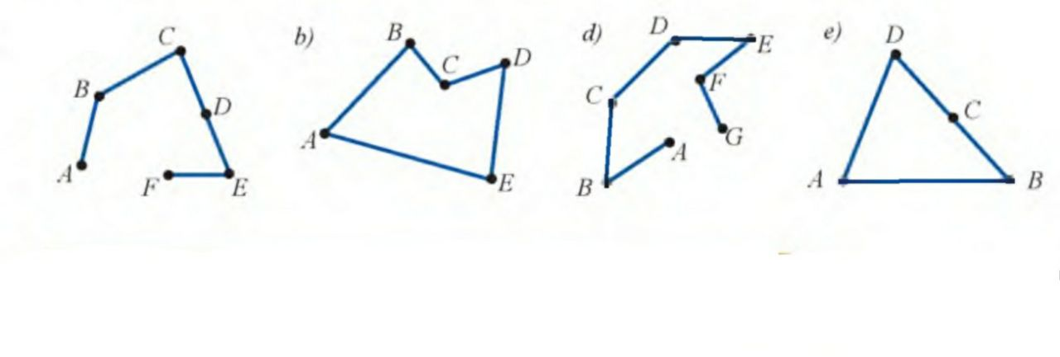
Mustahkamlash
1. Siniq chiziq va yopiq siniq chiziq deb nimaga aytiladi?
2. Berilgan rasmda siniq chiziq, yopiq siniq chiziq va ko‘pburchaklarni aniqlang.
3. Ko‘pburchak nima va unga nimalar misol bo‘la oladi?
a va d siniq chiziq
b va e yopiq siniq chiziq
b va e ko‘pburchak

Slide 3
Ko‘pburchak perimetri
2 cm
5 cm
3
2 cm
2
2 cm
1
6 cm
6 cm
4 cm
4 cm
2 cm
2 cm
5 cm
3 cm
2 cm
4 cm
7 cm
4
5
6
4 cm
4 cm
3 cm
3 cm
7 cm
7 cm
4 cm

Slide 4
2) P=5+2+2+5+2+2=18 cm P=5 ·2+2 ·4=18 cm
7 cm
1
4 cm
1) P=4+4+3=11 cm
P=4 ·2+3= 11 cm
6
4 cm
3 cm
3 cm
3 cm
7 cm
6) P=7+3+7+3=20 cm
P=7·2+3·2=20 cm
P=(7+3) · 2= 20 cm
5 cm
4 cm
2 cm
2
2 cm
4
4 cm
4 cm
2 cm
2 cm
7 cm
5 cm
4) P=4+4+4+7=19 cm
P=4·3+7=19 cm

Slide 5
593-masala
To‘g‘ri to‘rtburchakning tomonlari: a) 8 dm va 2 dm; b) 12 cm va 2 dm
bo‘lsa, uning perimetrini toping.
Berilgan:
a=8 dm
b=2 dm
P=?
Formula:
P=2a +2b
P=2 · (a+b)
8 dm
2 dm
2 dm
Yechish:
P=2· 8+ 2 ·2=20 dm
P=2· (8+2)=2 ·10=20 dm
8 dm
Javob: Perimetri 20 dm

Slide 6
599-masala
To‘g‘ri to‘rtburchakning tomonlari 18 dm va 22 dm. Perimetri to‘g‘ri to‘rtburchak perimetriga teng bo‘lgan kvadrat tomonini toping.
Berilgan: a=18 dm b=22 dm P=?
Formula: P=2a + 2b
P=2 ·(a+b)
22 dm
18 dm
18 dm
Yechish
:
P=2·18 + 2·22=36 + 44=80 dm P=2·(18+22)=2 · 40=80 dm
P=4a
80=4a
a=80 : 4 a=20 dm
22 dm

Slide 7
600-masala
To‘g‘ri to‘rtburchakning perimetrini hisoblash formulasi:
P=2a +2 b dan foydalanib jadvalni to‘ldiring.
a | 12 cm | 8 dm | 28 cm | 35 m | 24 m | 12 mm
P | 6 cm | 6 dm | 6 dm | ? | ? | ?
b | ? | ? | ? | 220 m | 100 m | 14 cm
75 m
26 m
58 mm
36 cm
28 dm
176 dm

Slide 8
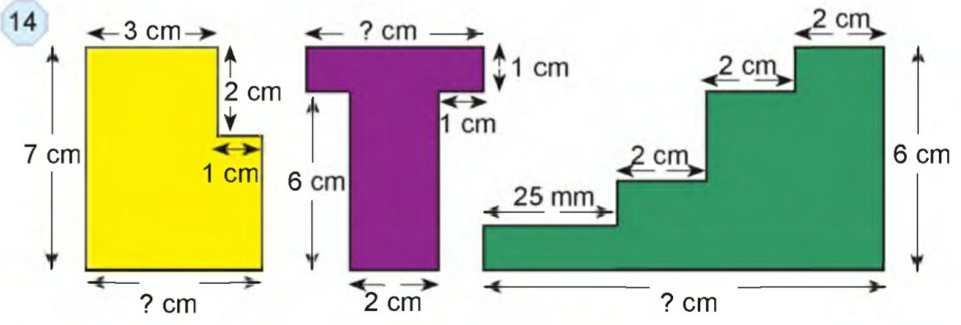
614-masala
14-rasmdagi shakllarning noma’lum uzunliklarini toping va perimetrini turli xil usullarda hisoblang.
1) x=3+1=4 cm, 7-2=5 cm
P=7+3+2+1+5+4=22 cm
2)x=1+2+1=4 cm
P=4+1+1+6+2+6+1+1=22 cm
3)x=25+20+20+20=85 mm
P=85+60+85+60=170+120=290 mm=29 cm

Slide 9
Darslikning 132- betdagi
604-, 605-, 606-, 607-masalalarni yechish.

