Slide 1
MATEMATIKA
5- sinf
MAVZU:
TO‘G‘RI VA NOTO‘G‘RI KASRLAR

Slide 2
yoki
Mustahkamlash
$\frac{11}{19}$
$$\frac{7}{19}$$
$$\frac{17}{38}$$
a)
$$\frac{23}{38}$$
$$>$$
yoki
d)
$$>$$
b)
$$\frac{23}{100}$$
$$\frac{67}{100}$$
$$\frac{4}{51}$$
$$\frac{23}{51}$$
e)
yoki
$$>$$
$$>$$
yoki

Slide 3
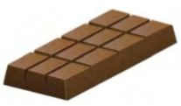
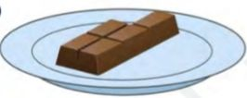
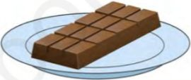
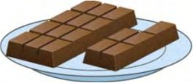
To‘g‘ri va no‘to‘g‘ri kasrlar
$\frac{5}{12}$
To‘g‘ri kasrlar
Noto‘g‘ri kasrlar
$\frac{12}{12}$
$\frac{17}{12}$

Slide 4
59- masala
Quyidagi kasrlardan qaysi biri to‘g‘ri, qaysi biri noto‘g‘ri kasr ekanligini aniqlang:
$\frac{1}{4};$
$\frac{5}{3};$
$\frac{3}{4};$
$\frac{17}{12};$
$\frac{4}{6};$
$\frac{8}{8};$
$\frac{23}{22};$
$\frac{209}{999};$
$\frac{1}{4};$
$\frac{3}{4};$
$\frac{4}{6};$
$\frac{209}{999};$
to‘g‘ri kasr :
$\frac{5}{3};$
$\frac{17}{12};$
$\frac{8}{8};$
$\frac{23}{22};$
noto‘g‘ri kasr :

Slide 5
Birdan katta :
60 -masala
Quyidagi kasrlardan qaysi biri : a) 1 dan katta ; b) 1 ga teng ; d) 1 dan kichik ?
$\frac{5}{9};$
$\frac{4}{3};$
$\frac{8}{13};$
$\frac{17}{9};$
$\frac{81}{79};$
$\frac{7}{7};$
$\frac{2}{9};$
$\frac{51}{90};$
$\frac{42}{42}$ ;
$\frac{1}{19}$ ;
$\frac{4}{3};$
$\frac{17}{9}$ ;
$\frac{81}{79}$ ;
$\frac{7}{7};$
$\frac{42}{42}$ ;
Birga teng :
$\frac{5}{9};$
$\frac{8}{13};$
$\frac{2}{9};$
$\frac{51}{90}$ ;
$\frac{1}{19}$ ;
Birdan kichik :

Slide 6
Birdan katta : Birga teng : Birdan kichik :
62- masala
Daftaringizga sonlar nurini chizing. Unda 8 katak uzunligiga teng bo‘lgan birlik kesmalar olib, koordinatalari
bo‘lgan nuqtalarni belgilang.
Bu kasrlarning qaysilari : a) 1 dan katta ; b) 1 ga teng ; d) 1 dan kichik?
$\frac{1}{8};$
$\frac{4}{8};$
$\frac{5}{8};$
$\frac{3}{8};$
$\frac{9}{8};$
$\frac{11}{8};$
$\frac{8}{8};$
$\frac{13}{8}$
$\frac{1}{8}$
$\frac{3}{8}$
$\frac{4}{8}$
$\frac{5}{8}$
$\frac{8}{8}$
$\frac{9}{8}$
$\frac{11}{8}$
$\frac{13}{8}$
$\frac{9}{8};$
$\frac{11}{8};$
$\frac{13}{8};$
0
1
$$\frac{8}{8}$$
$\frac{3}{8};$
$\frac{4}{8};$
$\frac{5}{8};$
$\frac{1}{8};$

Slide 7
b) $\frac{7}{4}$ qismi
63-masala
Rasmga qarab : a) EM kesma KD kesmaning ; b) KD kesma EM kesmaning qanday qismini tashkil qilishini toping.
E
M
K
D
a) $\frac{4}{7}$ qismi

Slide 8
$\frac{a}{13}$ to‘g‘ri kasr : a$<$ 13 (1 dan 12 gacha bo‘lgan sonlar)
64- masala
a ning qanday qiymatlarida a) $\frac{a}{13}$ to‘g‘ri kasr ; b) $\frac{15}{a}$ noto‘g‘ri kasr bo‘ladi?
$\frac{15}{a}$ noto‘g‘ri kasr : 0 $<$ a$<$ 13 (1 dan 12 gacha bo‘lgan sonlar)

Slide 9
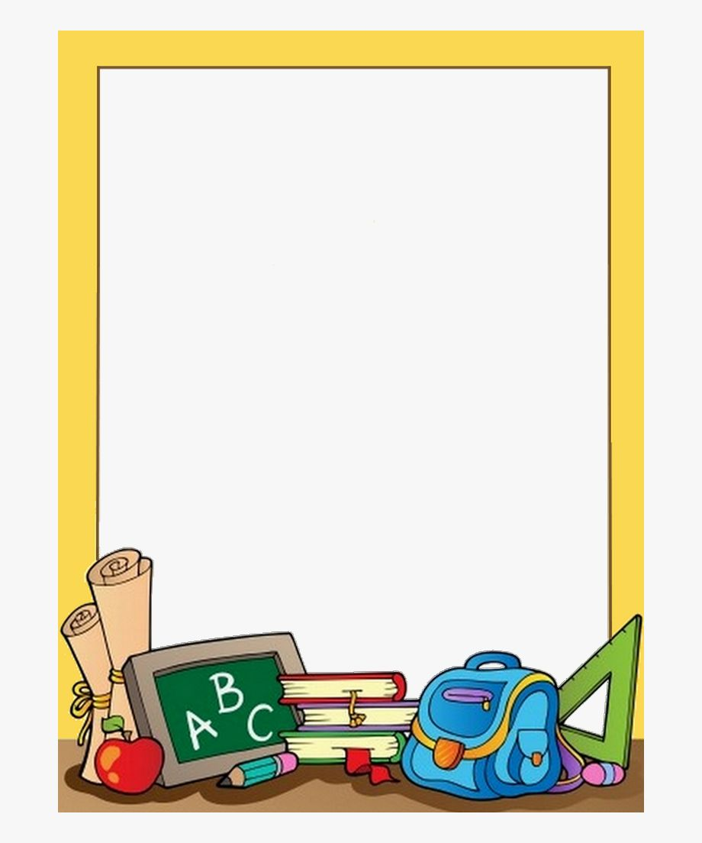
Mustaqil bajarish uchun topshiriqlar
Darslikning 29-betdagi
66-,67-,68-; 69-masalalarni yechish.

