Slide 1
MATEMATIKA
5- sinf
MAVZU: BIR XIL MAXRAJLI KASRLARNI AYIRISH

Slide 2

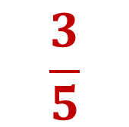
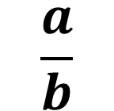

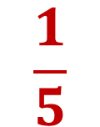
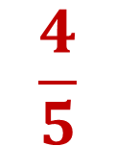
Bir xil maxrajli kasrlarni ayirish
Bir xil maxrajli kasrlarni ayirishda, kamayuvchining suratidan ayriluvchining surati ayirilib, natijani ayirmaning suratiga, maxraji esa o‘zgarish qoldirilib, ayirmaning maxrajiga yoziladi.
$$\frac{a}{b}$$
$$\frac{c}{b}$$
$$–$$
$$–$$
$$\frac{a c}{b}$$
$$=$$
$$\frac{4}{5}$$
$$\frac{1}{5}$$
$$\frac{3}{5}$$
$$–$$
$$=$$

Slide 3
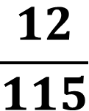
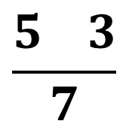
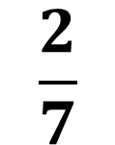
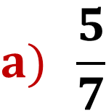
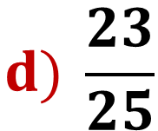
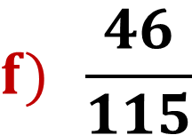
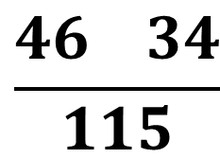
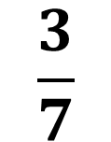
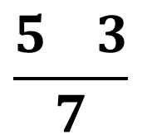
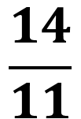
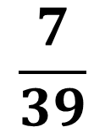
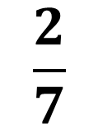


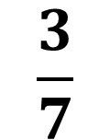
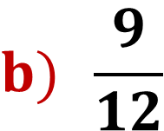
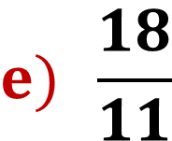
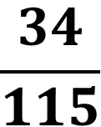
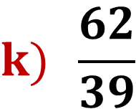
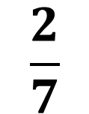
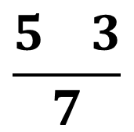
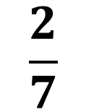
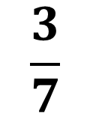
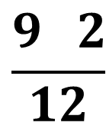
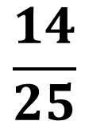

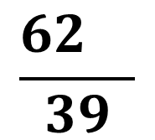
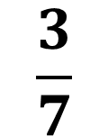
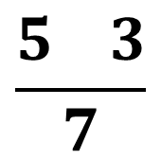
MISOLLAR
Kasrlar ustida amallarni bajaring:
$$–$$
$$–$$
$$–$$
$$–$$
$$–$$
$$\frac{5 3}{7}$$
$$\frac{5 3}{7}$$
$$\frac{5 3}{7}$$
$$a) \frac{5}{7}$$
$$\frac{5 3}{7}$$
$$\frac{2}{7}$$
$$\frac{2}{7}$$
$$\frac{2}{7}$$
$$\frac{3}{7}$$
$$\frac{2}{7}$$
$$\frac{3}{7}$$
$$\frac{18 4}{11}$$
$$\frac{3}{7}$$
$$–$$
$$\frac{3}{7}$$
$$=$$
$$e) \frac{18}{11}$$
$$\frac{4}{11}$$
$$\frac{14}{11}$$
$$–$$
$$=$$
$$–$$
$$=$$
$$–$$
$$=$$
$$=$$
$$–$$
$$=$$
$$=$$
$$=$$
$$=$$
$$=$$
$$–$$
$$–$$
$$b) \frac{9}{12}$$
$$\frac{2}{12}$$
$$\frac{9 2}{12}$$
$$\frac{7}{12}$$
$$f) \frac{46}{115}$$
$$\frac{34}{115}$$
$$\frac{46 34}{115}$$
$$\frac{12}{115}$$
$$–$$
$$=$$
$$=$$
$$–$$
$$=$$
$$=$$
$$–$$
$$d) \frac{23}{25}$$
$$\frac{14}{25}$$
$$\frac{23 14}{25}$$
$$\frac{9}{25}$$
$–$7
$$–$$
$$=$$
$$=$$
$$k) \frac{62}{39}$$
$$\frac{7}{39}$$
$$\frac{62 }{39}$$
$$\frac{55}{39}$$
$$–$$
$$=$$
$$=$$

Slide 4
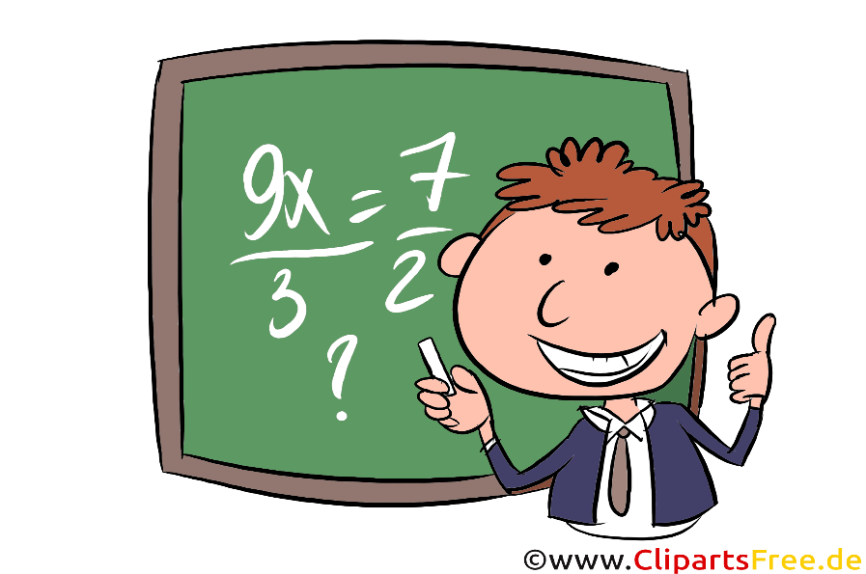


a + b - c
92-masala
a= $\frac{23}{75}$ ; b= $\frac{34}{75}$ ; c= $\frac{41}{75}$ bo‘lsa a+b-c ifodaning qiymatini toping.
$$\frac{23}{75}$$
$$\frac{34}{75}$$
$$\frac{41}{75}$$
$+$
$$\frac{23 41}{75}$$
34
$$–$$
$$–$$
$$\frac{16}{75}$$
$$+$$
$$=$$
$$=$$

Slide 5
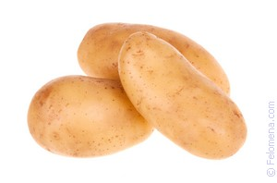
(200 : 10) · 6 =20 · 6 = 120
100-masala
200 gektar ekin maydonining $\frac{6}{10}$ qismiga kartoshka va $\frac{3}{10}$ piyoz ekildi. Nechta gektar ekin maydoni bo‘sh qoldi?
Kartoshka :
Piyoz :
(200 : 10) · 3 =20 · 3 = 60
Bo‘sh qolgan joy:
200 – (120 + 60) = 200 – 180 = 20 gektar

Slide 6
a) x – $\frac{3}{34}$ = $\frac{5}{34}$ x = $\frac{5}{34}$ + $\frac{3}{34}$ x = $\frac{8}{34}$
103-misol
a) $\frac{14}{87}$ + p = $\frac{80}{87}$ p = $\frac{80}{87}$ – $\frac{14}{87}$ p = $\frac{66}{87}$
Tekshirish : $\frac{8}{34}$ – $\frac{3}{34}$ = $\frac{5}{34}$
Tekshirish : $\frac{14}{87}$ + $\frac{66}{87}$ = $\frac{80}{87}$

Slide 7
104-misol
a) $\frac{17}{35}$ – x = $\frac{8}{35}$ + $\frac{3}{35}$
$\frac{17}{35}$ – x = $\frac{11}{35}$
x = $\frac{17}{35}$ – $\frac{11}{35}$
x = $\frac{6}{35}$
b) y – $\frac{17}{21}$ = $\frac{19}{21}$ – $\frac{16}{21}$
y – $\frac{17}{21}$ = $\frac{3}{21}$
x = $\frac{17}{21}$ + $\frac{3}{21}$
x = $\frac{20}{21}$

Slide 8
Mustaqil bajarish uchun topshiriqlar
Darslikning 34-betdagi
105-,106-,107- misollarni yechish.

