Slide 1
MATEMATIKA
5- sinf
MAVZU: BO‘LISH VA KASRLAR

Slide 2
MUSTAHKAMLASH
$$–$$
$$–$$
$$e) \frac{234}{2161}$$
$$\frac{227}{2161}$$
$$\frac{234 227}{2161}$$
$$\frac{7}{2161}$$
$$a) \frac{4}{19}$$
$$\frac{3}{19}$$
$$\frac{4 3}{19}$$
$$\frac{1}{19}$$
$$–$$
$$=$$
$$=$$
$$–$$
$$=$$
$$=$$
$$–$$
$$f) \frac{113}{117}$$
$$\frac{75}{117}$$
$$\frac{113 75}{117}$$
$$\frac{38}{117}$$
$$–$$
$$b) \frac{36}{50}$$
$$\frac{23}{50}$$
$$\frac{36 23}{50}$$
$$\frac{13}{50}$$
$$–$$
$$=$$
$$=$$
$$–$$
$$=$$
$$=$$

Slide 3
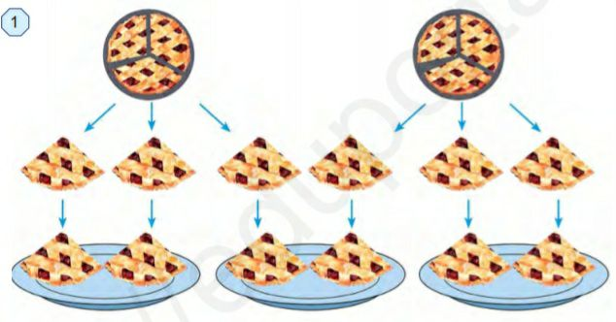
MASALA
6 ta ulush
$$\frac{1}{3}$$
$$\frac{1}{3}$$
$$\frac{2}{3}$$
+
$$=$$

Slide 4
Agar bo‘lish qoldiqsiz bajarilsa, bo‘linma natural sondan iborat bo‘ladi. Agar bo‘lish qoldiqli bajarilsa, bo‘linma kasr sondan iborat bo‘ladi.
KASRLAR
Demak, 2 : 3= $\frac{2}{3}$ deb yozish mumkin. Shuning uchun kasr chizig‘ini bo‘lish belgisi deb tushuniladi.
Har qanday natural sonlarni bo‘lish natijasini kasrlar yordamida ifodalash mumkin.
Masalan: 32 : 4 = $\frac{32}{4}$ = 8, 5 : 1 = $\frac{5}{1}$ = 5 , 4 : 7 = $\frac{4}{7}$ , 13 : 5 = $\frac{13}{5}$

Slide 5
Bir xil maxrajli kasrlarni qo‘shish qoidasi ifodalangan.
BO‘LISH
Har qanday natural sonlarni bo‘lish natijasini kasrlar yordamida ifodalash mumkin.
$$\frac{a}{c}$$
$$\frac{b}{c}$$
$$\frac{a+\text{b} }{c}$$
$$+$$
$$=$$
a : c + b : c = (a + b) : c yoki
(a + b) : c = a : c + b : c
Yig‘indini songa bo‘lishda har bir qo‘shiluvchilarni alohida –alohida bu songa bo‘lib, so‘ng hosil bo‘lgan bo‘linmalarni qo‘shish kifoya.

Slide 6
109 - misol
= $\frac{3}{7}$
= $\frac{9}{1}$
a) 3 : 7
e) 9 : 1
= $\frac{2}{10}$
= $\frac{25}{5}$
b) 2 : 10
f) 25 : 5
= $\frac{14}{23}$
= $\frac{87}{19}$
d) 14 : 23
g) 87 : 19

Slide 7
21 : 3 = 7
111-misol
a) $\frac{21}{3}$
d) $\frac{35}{7}$
35 : 7 = 5
b) $\frac{24}{6}$
e) $\frac{2525}{25}$
24 : 6 = 4
2525 : 25 = 101

Slide 8
1 hafta = 7 kun 1 kunda 18 : 7 = $\frac{18}{7}$ dona
Masalalar
113-masala: Bir haftada oila 18 ta non iste’mol qildi. Bir kunda oila iste’mol qilgan nonni kasr ko‘rinishida ifodalang.
115-masala: Halima 35 minutda 2 km yurdi. U 1 minutda yurgan yo‘lni kasr ko‘rinishida ifodalang.
35 minutda
1 minutda
2 km
2 : 35 = $\frac{2}{35}$ km

Slide 9
a) (34 + 51) : 17 = 34 : 17 + 51 : 17 = 2 + 3 = 5
121-misol
Yig‘indini songa bo‘lish qoidasiga ko‘ra ifodaning qiymatini toping.
b) (3434 + 68) : 34 = 3434 : 34 + 68 : 34 = 101 + 2 = 103
d) 156 : 26 + 364 : 26 = (364 +156) : 26 = 520 : 26 =20
g) 1107 : 123 + 1353 : 123 = (1107 + 1353 ) : 123 = 2460 : 123 =20
e) (133 + 228) : 19 = 361 : 19 = 19
f) (952 + 3528) : 56 = 4480 : 56 = 80

Slide 10
Mustaqil bajarish uchun topshiriqlar:
Darslikning 37-betidagi
117-,118-,119- misollarni yechish.

