Slide 1
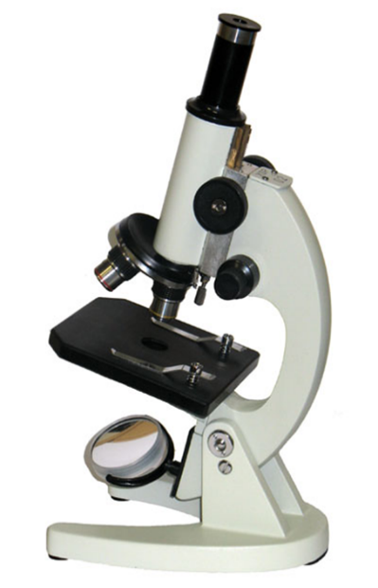
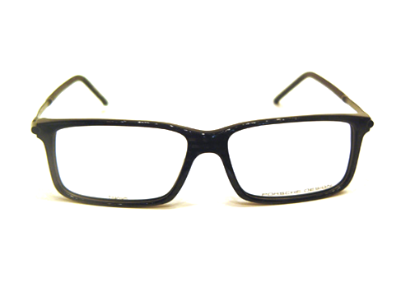
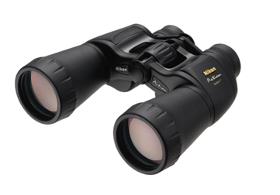
F I Z I K A
6- sinf
MAVZU: MASALALAR YECHISH

Slide 2
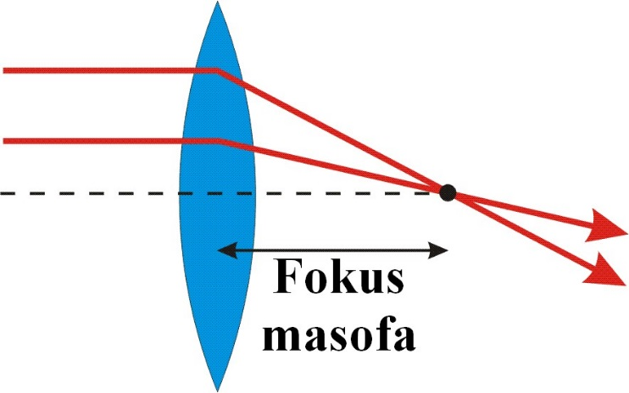
1-TOPSHIRIQ
Optik kuchi 5 dptr bo‘lgan linzaning fokus masofasini toping.

Slide 3
1-TOPSHIRIQ
Formula:
Berilgan:
D = 5 dptr
Topish kerak:
F = ?
Yechish:
F = $\frac{1}{D}$
F = $\frac{1}{5 dptr}=0,2 m$
Javob: F = 0,2 m = 20 cm

Slide 4
2-TOPSHIRIQ
Yorug‘likning shishadagi tezligi 200 000 km/s ga teng. Shishaning absolyut sindirish ko‘rsatkichini aniqlang.

Slide 5
2-TOPSHIRIQ
Berilgan:
$θ$ = 200 000 km/s
C = 300 000 km/s
Topish kerak:
n = ?
Formula:
n = $\frac{C}{θ}$
Yechish:
n = $\frac{C}{θ}$ = $\frac{\text{300 000 }\text{km}\text{/}\text{s} }{\text{200 000 }\text{km}\text{/}\text{s}}$ = 1,5
Javob: n = 1,5

Slide 6
3-TOPSHIRIQ
Buyum botiq ko‘zgudan 15 cm masofada turibdi. Ko‘zguning fokus masofasi 10 cm.
Ko‘zgudan tasvirgacha bo‘lgan masofani toping.

Slide 7
3-TOPSHIRIQ
Berilgan:
d = 15 cm = 0,15 m
F = 10 cm = 0,1 m
Topish kerak:
f $=$?
Formula:
$\frac{1}{F}=$ $\frac{1}{f}+$ $\frac{1}{d}$
Bu yerdan f ni topamiz.
$\frac{1}{f}=$ $\frac{1}{F}−$ $\frac{1}{d}$
Yechish:
$\frac{1}{f}=$ $\frac{1}{F}−$ $\frac{1}{d}=\frac{1}{0,1 m}− \frac{1}{0,15 m}=\frac{0,05}{0,015}$ m
f = $\frac{0,015 }{0,05}$ = 0,3 m = 30 cm
Javob: f = 30 cm

Slide 8
4-TOPSHIRIQ
Yassi ko‘zguga tushayotgan nur bilan undan qaytgan nur orasidagi burchak ${70}^{0}$ bo‘lsa, qaytgan nur bilan ko‘zgu tekisligi orasidagi burchakni toping.
${70}^{0}$
?

Slide 9
4-TOPSHIRIQ
Formulasi:
$α+β=$ ${70}^{0}$
$$α=β$$
$γ=$ ${90}^{0}$ - $α(β$)
${70}^{0}$
?
Yechish:
$α+β=$ ${70}^{0}$
$α=β$ $2α=$ ${70}^{0}$
$α$ = $\frac{{70}^{0}}{2}=$ ${35}^{0}$
$γ=$ ${90}^{0}$ - ${35}^{0}={55}^{0}$
Berilgan:
$α+β= {70}^{0}$
Topish kerak:
$$γ= ?$$
Javob: $γ={55}^{0}$

Slide 10
5-TOPSHIRIQ
Agar nur yassi ko‘zgudan $β$ burchak ostida qaytsa, tushish burchagi nimaga teng bo‘ladi?
?
$β$

Slide 11
5-TOPSHIRIQ
$$α$$
$$β$$
$$α=β$$

Slide 12
Mustaqil bajarish uchun topshiriqlar:
Optik kuchi 2,5 dptr bo‘lgan linzaning fokus masofasini toping.
Yorug‘likning suvdagi tezligi 225 000 km/s ga teng. Suvning absolyut sindirish ko‘rsatkichini aniqlang.

Slide 13
Mustaqil bajarish uchun topshiriqlar:
3. Buyum botiq ko‘gudan 25 cm masofada turipti. Ko‘zguning fokus masofasi 15 cm. Ko‘zgudan tasvirgacha bo‘lgan masofani toping.
4. Yassi ko‘zguga tushayotgan nur bilan undan qaytgan nur orasidagi burchak ${90}^{0}$ bo‘lsa, qaytgan nur bilan ko‘zgu tekisligi orasidagi burchakni toping.

