Slide 1
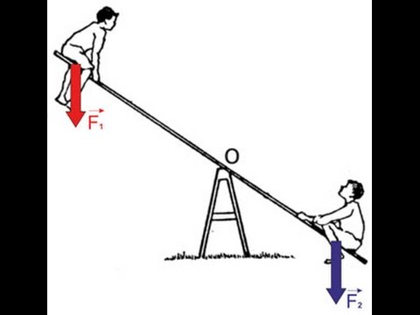
F I Z I K A
6- sinf
LABORATORIYA ISHI.
MAVZU: RICHAGNING MUVOZANATDA BO‘LISH SHARTINI O‘RGANISH

Slide 2
KERAKLI ASBOBLAR:
Laboratoriya richag-chizg‘ichi, yuklar to‘plami, shtativ.

Slide 3
TAKRORLASH
Qo‘zg‘almas tayanch atrofida aylana oladigan qattiq jismga richag deb ataladi.
$\frac{F_{1}}{F_{2}}$ = $\frac{{\text{𝓁}}_{2}}{{\text{𝓁}}_{1}}$
$F_{1}$ ${\text{𝓁}}_{1}$=$F_{2}$ ${\text{𝓁}}_{2}$
$M_{1}$=${ M}_{2}$

Slide 4
Laboratoriya mashg‘ulotini bajarish tartibi:
$F_{1}$ ${\text{𝓁}}_{1}$=$F_{2}$ ${\text{𝓁}}_{2}$
6 N$∙$ 0,1 m = 2 N $∙$ 0,3 m
$M_{1}$=${ M}_{1}$
0,6 N $∙$m = $\text{0,6 }\text{N}∙\text{m}$

Slide 5
Natijalarni jadvalga yozish
T/r | $$F_{1}$$ | $${\text{𝓁}}_{1}$$ | $$F_{2}$$ | $${\text{𝓁}}_{2}$$ | $$M_{1}$$ | $$M_{2}$$
1
2
3

Slide 6
Natijalarni jadvalga yozish
T/r | $$F_{1}$$ N | $${\text{𝓁}}_{1}$$ cm | $$F_{2}$$ N | $${\text{𝓁}}_{2}$$ cm | $$M_{1}$$ N m | $$M_{2}$$ N m
1 | 2 | 10 | 4 | 5 | 20 | 20
2 | 1 | 15 | 3 | 5 | 15 | 15
3 | 2 | 20 | 5 | 8 | 40 | 40

Slide 7
MASALALAR YECHISH
1. Rasmda ko‘rsatilgan richag muvozanatda turishi uchun ikkinchi yelkaga qanday massali yuk osish kerak?
10 kg
10 kg
? kg

Slide 8
MASALALAR YECHISH
2. Massasi 6 kg li bir jinsli xoda muvozanatda turishi uchun F kuch qanday bo‘lishi kerak?
F

Slide 9
MASALALAR YECHISH
3. Bir uchi devorga mahkamlangan, og‘irligi P= 50 N bo‘lgan sterjenning ikkinchi uchiga
F= 50 N kuch rasmdagidek ta’sir etmoqda. Sterjen gorizontal holatda muvozanatda turishi uchun O nuqtaga og‘irligi necha Nyuton bo‘lgan yuk osish kerak?
F
P = 50 N
0
N=?

Slide 10
Mustaqil bajarish uchun topshiriqlar:
Laboratoriya mashg‘ulotidan olingan natijalar asosida xulosa yozing.
Uchlariga 5,5 kg va 1 kg yuklar osilgan $\text{𝓁}$uzunlikdagi sterjen uchlaridan $\text{𝓁}$/ 5 masofada qo‘yilgan tayanch ustida muvozanatda turibdi. Sterjenning massasi qanday?

