Slide 1
F I Z I K A
7- sinf
MAVZU: BOBNI TAKRORLASHGA DOIR TOPSHIRIQLAR
( NAZORAT ISHI)

Slide 2
1-TOPSHIRIQ
Tezligi 30 m/s bo‘lgan velosiped va avtomashinaning impulslarini toping.
Velosipedning massasi 100 kg (haydovchisi bilan birgalikda), avtomashinaning massasi esa 2400 kg ga teng.

Slide 3
1-TOPSHIRIQ
Berilgan: Formula:
$θ=30\frac{m}{s}$
$m_{v }$= 100 kg
$m_{a }$= 2400 kg
Topish kerak:
$P_{v }$= ? $P_{a }$= ?
P = m $∙θ$
$P_{v }$ = $m_{v }∙$ $θ$
$P_{a}$ = $m_{a }∙ θ$
Yechish:
$P_{v }$ = 100 kg $∙ 30\frac{m}{s}$ = 3000 kg $∙$ m/s
$P_{a}$ = 2400 kg $∙ 30\frac{m}{s}$ = 72 000 kg $∙$ m/s
Javob:
$P_{v }$ = 3000 kg $∙$ m/s
$P_{a}$ = 72 000 kg $∙$ m/s

Slide 4
2-TOPSHIRIQ
Osmaga osilgan jismga bog‘langan ip pastga qarab 4 s davomida 10 N kuch bilan tortib turildi. Jismga ta’sir etgan kuch impulsini toping.

Slide 5
2-TOPSHIRIQ
Berilgan:
t= 4 s
F = 10 N
Topish kerak:
I = ?
Formulasi:
I = F $∙t$
F
Yechish:
I = 10 N $∙4 s$ = 40 N$∙s$
Javob:
I = 40 N$∙s$

Slide 6
3-TOPSHIRIQ
Sohilda tinch turgan qayiqdan massasi 60 kg bo‘lgan odam 5 m/s tezlik bilan sakraganda, qayiq 0,2 m/s tezlik olgan bo‘lsa, qayiqning massasini aniqlang.

Slide 7
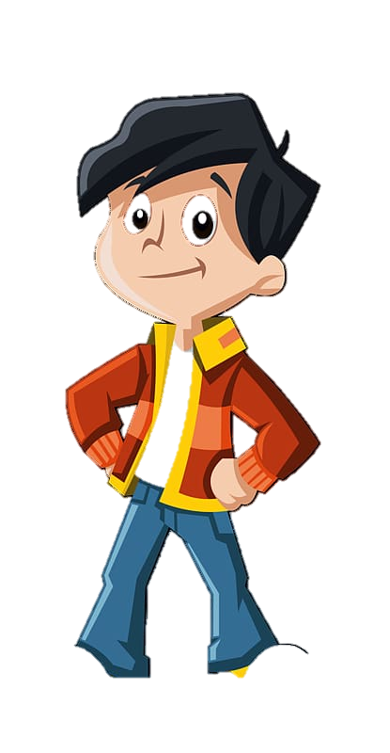
3-TOPSHIRIQ
$\vec{v_{b}}$= 5 m/s
$m_{b}$ = 60 kg
$$\vec{v_{q}}=0$$
$m_{q}$= ?
$$θ_{b}^{I }=0$$
$θ_{q}^{I }$= 0,2 m/s

Slide 8
3-TOPSHIRIQ
Berilgan:
$m_{b}$ = 60 kg
$θ_{b}$ = 5 m/s
$θ_{q}^{I }$= 0,2 m/s
Topish kerak:
${ m}_{q}$ = ?
Formula:
$m_{b}$ $θ_{b}$ + ${ m}_{q}$ $θ_{q}$= $m_{b}$ $θ_{b}^{I }$ + ${ m}_{q}$ $θ_{q}^{I }$
$θ_{q}$= 0 $θ_{b}^{I}$ = 0
$m_{b}$ $θ_{b}$ = ${ m}_{q}$ $θ_{q}^{I }$
${ m}_{q}$ = $\frac{m_{b} θ_{b}}{θ_{q}^{I }}$
Yechish:
${ m}_{q}$ = $\frac{60 kg∙5 m/s}{0,2 m/s}=\frac{300 kg}{0,2 }$= 1500 kg
Javob:
${ m}_{q}$ = 1500 kg = 1,5 t

Slide 9
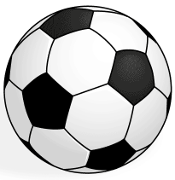
4-TOPSHIRIQ
Massasi 0,4 kg bo‘lgan to‘pga 0,01 s davomida zarb berilganda u 20 m/s tezlik oldi. To‘p qanday kuch bilan tepilgan?
$$θ$$
$F$=?

Slide 10
4-TOPSHIRIQ
Berilgan: Formula:
$θ=20\frac{m}{s}$
$m_{ }$= 0,4 kg
t = 0,01 s
Topish kerak:
F = ?
P = m $∙θ$
(1)
I = F t
(2)
(2) $=$ (1) natijada:
F t = m $∙θ$
F = $\frac{mθ}{t}$
(3)
F = $\frac{\text{0,4 }\text{kg} ∙ \text{20 }\text{m}\text{/}\text{s}}{\text{0,01 }\text{s}}$ = $\frac{\text{8 }kg m/s}{\text{0,01 }\text{s}}$ = 800 N
Yechish:
Javob:
F = 800 N

Slide 11
5-TOPSHIRIQ
6 m/s tezlik bilan harakatlanayotgan 30 kg massali aravachaga 6 kg yuk qo‘yildi. Bunda aravacha tezligi qanchaga kamaydi?

Slide 12
5-TOPSHIRIQ
$$m_{2}^{ }$$
$$θ_{2}^{ }$$
$$θ_{1}^{ }$$
$$m_{1}^{ }$$
$$m_{1}^{ }$$

Slide 13
5-TOPSHIRIQ
Berilgan: Formula:
$θ_{1}=20\frac{m}{s}$
$m_{1}$ = 30 kg
${ m}_{2}$ = 6 kg
Topish kerak:
${ θ}_{2}$=?
$m_{1}$ $θ_{1}$= M${ θ}_{2}$
(1)
M = $m_{1}$ + $m_{2}$
(2)
$m_{1}$ $θ_{1}$= ${(m}_{1}$ + $m_{2}$ ${) θ}_{2}$
${ θ}_{2}$= $\frac{m_{1} θ_{1}}{m_{1} \text{+} m_{2}}$
(3)
${ θ}_{2}$= $\frac{20 \frac{m}{s} ∙ 30 kg}{\text{30 }\text{kg} \text{+} 6 kg}$ = $\frac{600 m/s}{36}$ = 17 m/s
Yechish:
Javob:
${ θ}_{2}$=17 m/s

Slide 14
Mustaqil bajarish uchun topshiriqlar:
Tezligi 40 m/s bo‘lgan velosipedning impulsini toping. Velosipedning massasi 100 kg (haydovchisi bilan birgalikda) ga teng.
Osmaga osilgan jismga bog‘langan ip pastga qarab 20 s davomida 80 N kuch bilan tortib turildi. Jismga ta’sir etgan kuch impulsini toping.

Slide 15
Mustaqil bajarish uchun topshiriqlar:
3. Sohilda tinch turgan qayiqdan massasi 40 kg bo‘lgan odam 8 m/s tezlik bilan sakraganda, qayiq 0,4 m/s tezlik olgan bo‘lsa, qayiqning massasini aniqlang.
4. Massasi 0,5 kg bo‘lgan to‘pga 0,01 s davomida zarb berilganda u 15 m/s tezlik oldi. To‘p qanday kuch bilan tepilgan?

Slide 16
Mustaqil bajarish uchun topshiriqlar:
5. Nima uchun muz ustida sirpanib ketganimizda orqaga yiqilamiz?
O‘tmishda yurtimizda “Qo‘qon arava” nomi bilan mashhur aravalardan foydalanilgan. Nima uchun ularning g‘ildiraklari otning bo‘yidan ham baland qilib yasalgan?

