Slide 1
F I Z I K A
7- sinf
MAVZU: MEXANIK ENERGIYANING SAQLANISH QONUNI

Slide 2
SAQLANISH QONUNI
Massasi m = 1 kg li jism h = 45 m balandlikdan tashlanganda uning potensial va kinetik energiyalari qanday o‘zgarishini kuzatamiz.

Slide 3
SAQLANISH QONUNI
m
$E_{p 1}$= m g h
$E_{k 1}$= $\frac{m{θ_{2}}^{2}}{2}$
$$h_{1}$$
$E_{p 1}$= m g $h_{1}$
$E_{k 1}$= $\frac{m{θ_{1}}^{2}}{2}$

Slide 4
1- holat
SAQLANISH QONUNI
$$θ_{1}$$
m
${ h}_{1}$= 45 m
${ θ}_{1}$=0 m/s
${ E}_{p 1}$= ?
${ E}_{k 1}$= ?
1
$$h_{1}$$
$E_{p 1}$= m g $h_{1}$= 1$∙10∙45$ J = 450 J
$E_{k 1}$= $\frac{m{θ_{1}}^{2}}{2}=$ $\frac{{1∙0}^{2}}{2}$ J = 0 J

Slide 5
2- holat
SAQLANISH QONUNI
m
t = 1 s da ${ h}_{2}$ = ?
$$h_{2}$$
H = $\frac{{gt}^{2}}{2}$ = 5 m
2
$h_{2}$ = 45 m – 5 m = 40 m
$$θ_{2}$$
$$h_{1}$$
$E_{p 2}$= m g $h_{2}$=1$∙10∙40$ J = 400 J
$E_{k 2}$= $\frac{m{θ_{2}}^{2}}{2}=$ $\frac{{1∙10}^{2}}{2}$ J= 50 J

Slide 6
2- holat
SAQLANISH QONUNI
m
$$h_{2}$$
2
$E_{p 2}$= 400 J
$$θ_{2}$$
$E_{k 2}$ = 50 J
$$h_{1}$$

Slide 7
SAQLANISH QONUNI
$h_{1}=45$m balandlikdan tashlangan jism 2 s davomida 20 m masofani bosib o‘tadi.
Bunda,
$$h_{3}=25 m$$
$θ_{3}$= 20 m/s
$E_{p 3}$= m g $h_{3}$=1$∙10∙25$ J = 250 J
$E_{k 3}$= $\frac{m{θ_{3}}^{2}}{2}=$ $\frac{{1∙20}^{2}}{2}$ J = 200 J

Slide 8
3- holat
SAQLANISH QONUNI
m
$$h_{1}$$
$$h_{2}$$
$E_{p 3}$= 250 J
3
$E_{k 3}$=200 J
$$h_{3}$$
$$θ_{3}$$

Slide 9
SAQLANISH QONUNI
$h_{1}=45$m balandlikdan tashlangan jism 3 s da yerga yetib keladi, ya’ni jismning yerdan balandligi $h_{4}$=0 ga teng bo‘ladi.
$$h_{4}\text{ = 0}$$
$θ_{4}$= 30 m/s
$E_{p 4}$= m g $h_{4}$=1$∙10∙0$ J = 0 J
$E_{k 4}$= $\frac{m{θ_{4}}^{2}}{2}=$ $\frac{{1∙30}^{2}}{2}$ J= 450 J

Slide 10
4- holat
SAQLANISH QONUNI
m
$$h_{1}$$
$$h_{2}$$
$$h_{3}$$
$E_{p 4}$= 0 J
$$θ_{4}$$
$E_{k 4}$=450 J
4
$$h_{0}$$

Slide 11
SAQLANISH QONUNI
m
$E_{p 2}$= 450 J
1
$E_{k 2}$ = 50 J
$$h_{1}$$
$E_{p 2}$= 400 J
2
$E_{k 2}$ = 50 J
$$θ_{2}$$
$$h_{2}$$
$E_{p 3}$= 250 J
3
$E_{k 3}$=200 J
$$h_{3}$$
$E_{p 4}$= 0 J
$E_{k 4}$=450 J
4
$$h_{0}$$

Slide 12
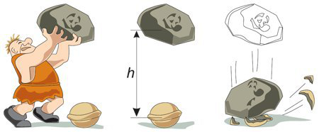
SAQLANISH QONUNI
Balandlikdan erkin tushayotgan jismning yerga urilish paytidagi potensial energiyasi nolga, kinetik energiyasi esa maksimal qiymatga teng bo‘ladi.

Slide 13
Yopiq sistemaning to‘liq mexanik energiyasi sistema qismlarining har qanday harakatida o‘zgarmay qoladi.
SAQLANISH QONUNI
${ E}_{k 1}+ E_{p 1}$ = $E_{k 2}+ E_{p 2}$
Bu tenglik mexanik energiyaning saqlanish qonunini ifodalaydi.

Slide 14
SAQLANISH QONUNI
1- holatda: ${ E}_{k 1}+ E_{p 1}$= 0 + 450 J = 450 J
2- holatda: ${ E}_{k 2}+ E_{p 2}$= 50 J + 400 J = 450 J
3- holatda: ${ E}_{k 3}+ E_{p 3}$= 200 J + 250 J = 450 J
4- holatda: ${ E}_{k 4}+ E_{p 4}$= 450 J + 0 J = 450 J

Slide 15
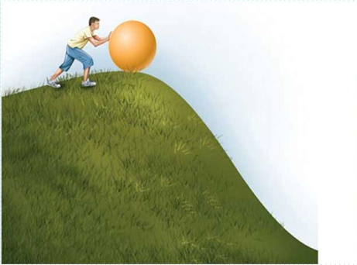
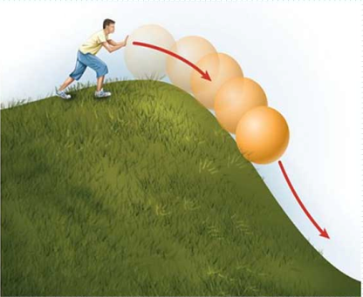
SAQLANISH QONUNI

Slide 16
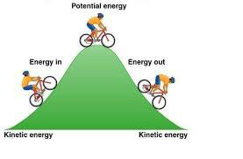
SAQLANISH QONUNI

Slide 17
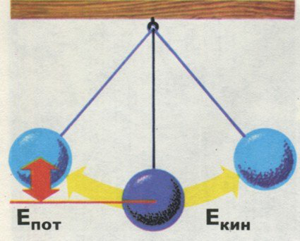
SAQLANISH QONUNI
Potensial
energiya
Potensial
energiya
kinetik
energiya

Slide 18
MASALALAR YECHISH
1. 10 m/s tezlikda uchayotgan
10 kg massali burgutning to‘liq mexanik energiyasini toping.
h = 40 m

Slide 19
MASALALAR YECHISH
2. Massasi 100 g bo‘lgan jism tik yuqoriga 30 m/s tezlik bilan otildi. 2 s dan keyin uning kinetik va potensial energiyalari qancha bo‘ladi? Eng yuqori balandlikda jism qanday potensial energiyaga ega bo‘ladi?

Slide 20
Mustaqil bajarish uchun topshiriqlar:
1. Mavzu oxiridagi berilgan savollarga javob yozing.
2. 29-mashqning qolgan masalalarini yeching.
3. Berilgan rasmli masalani yeching.

Slide 21
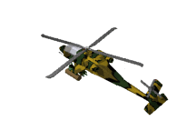
Mustaqil bajarish uchun topshiriqlar:
300 m
250 m
3. Ma’lum balandlikda uchayotgan 10 kg massali burgutning va 5 t massali vertolyotning potensial energiyalarini toping va taqqoslang.

