Slide 1
F I Z I K A
7- sinf
MAVZU: JISMNI KO‘TARISHDA VA SHU MASOFAGA GORIZONTAL KO‘CHIRISHDA BAJARILGAN ISHNI HISOBLASH

Slide 2
TAKRORLASH
Kinetik energiya formulasini ko‘rsating.
$$E_{k}=\frac{{m θ}^{2}}{2}$$
$E_{p}$= mgh
$$F_{d}=μ\frac{P}{R}$$
$F_{el}$=-k$∆$

Slide 3
TAKRORLASH
Mexanik ish formulasini ko‘rsating.
P = $ρ$gh
P $=m θ$
$$F_{s}=μm\text{g}$$
A = F$s$

Slide 4
TAKRORLASH
Noto‘g‘ri formulani ko‘rsating.
A $=\frac{{m θ}^{2}}{R}$
P = $ρ$gh
$$F_{s}=μm\text{g}$$
A = F$s$

Slide 5
BUGUNGI DARSDA
MAVZU: JISMNI KO‘TARISHDA VA SHU MASOFAGA GORIZONTAL KO‘CHIRISHDA BAJARILGAN ISHNI HISOBLASH

Slide 6
ISHNI BAJARISHDAN MAQSAD:
Jism vertikal va gorizontal yo‘l bo‘ylab ko‘chirilganda bajarilgan ishni mustaqil ravishda hisoblash.

Slide 7
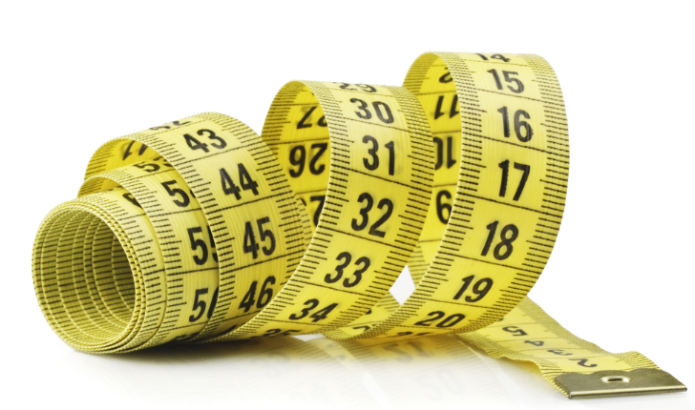
KERAKLI JIHOZLAR:

Slide 8
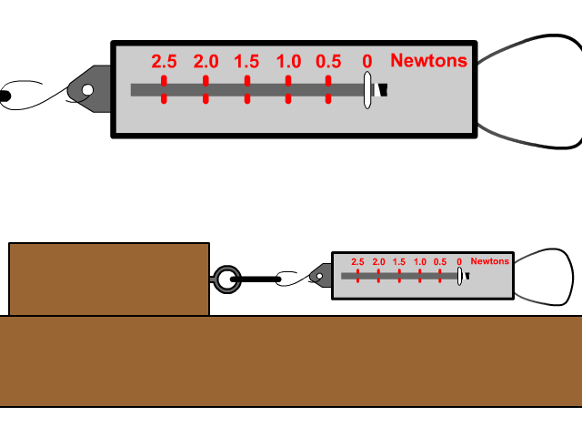
ISHNI BAJARISHDAN MAQSAD:
Jism vertikal va gorizontal yo‘l bo‘ylab ko‘chirilganda bajarilgan ishni mustaqil ravishda hisoblash.

Slide 9
Natijalarni jadvalga yozish
T/r | m, kg | $F_{og′}$, N | S , m | $$A_{h}\text{, }\text{J}$$ | $$A_{tek}\text{, }\text{J}$$
1
2
3
h, m
$F_{ish}$, N
$A_{h}$= $F_{og′}$h
$A_{tek}$= $F_{ish} S$

Slide 10
Natijalarni jadvalga yozish
T/r | m, kg | $F_{og′}$, N | S , m | $$A_{h}\text{, }\text{J}$$ | $$A_{tek}\text{, }\text{J}$$
1 | 0,05 | 0,5 | 0,3
2 | 0,15 | 1,5 | 0,3
3 | 0,25 | 2,5 | 0,3
h, m
$F_{ish}$, N
0,3
0,3
0,3

Slide 11
Natijalarni jadvalga yozish
T/r | m, kg | $F_{og′}$, N | S , m | $$A_{h}\text{, }\text{J}$$ | $$A_{tek}\text{, }\text{J}$$
1 | 0,05 | 0,5 | 0,3 | 1,5
2 | 0,15 | 1,5 | 0,3 | 4,5
3 | 0,25 | 2,5 | 0,3 | 7,5
h, m
$F_{ish}$, N
0,3
0,3
0,3
0,7
0,3
1,2

Slide 12
Natijalarni jadvalga yozish
T/r | m, kg | $F_{og′}$, N | S , m | $$A_{h}\text{, }\text{J}$$ | $$A_{tek}\text{, }\text{J}$$
1 | 0,05 | 0,5 | 0,3 | 1,5 | 0,9
2 | 0,15 | 1,5 | 0,3 | 4,5
3 | 0,25 | 2,5 | 0,3 | 7,5
h, m
$F_{ish}$, N
0,3
0,3
0,3
0,7
2,1
0,3
1,2
9

Slide 13
MUSTAQIL BAJARISH UCHUN TOPSHIRIQLAR:
Mavzu oxiridagi savollarga javob yozing.
Laboratoriya mashg‘ulotidan olingan natijalar asosida xulosa yozing.

