Slide 1
F I Z I K A
7- sinf
MAVZU: TABIATDA ENERGIYANING SAQLANISHI.
FOYDALI ISH KOEFFITSIYENTI

Slide 2
ASOSIY TUSHUNCHALAR
1
Energiya
Potensial energiya
2
3
Kinetik energiya
4
Quvvat
5
Saqlanish qonuni
Foydali ish koeffitsiyenti
6

Slide 3
TABIATDA ENERGIYA
Energiyaning saqlanish qonuni faqat mexanik hodisalar doirasidagina emas, balki boshqa barcha fizik hodisalarda o‘rinli.

Slide 4
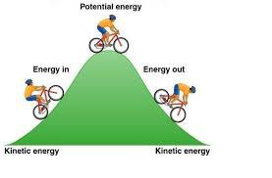
TABIATDA ENERGIYA
Bu hodisalarda energiya bir turdan boshqa turga aylanishi mumkin.
Bir vaqtning o‘zida jismda bir nechta energiya mavjud bo‘lishi mumkin.

Slide 5
Mexanik energiya
Kimyoviy energiya
Yorug‘lik energiyasi
Energiya turlari
Issiqlik energiyasi
Yadroviy energiya
Elektr energiya

Slide 6
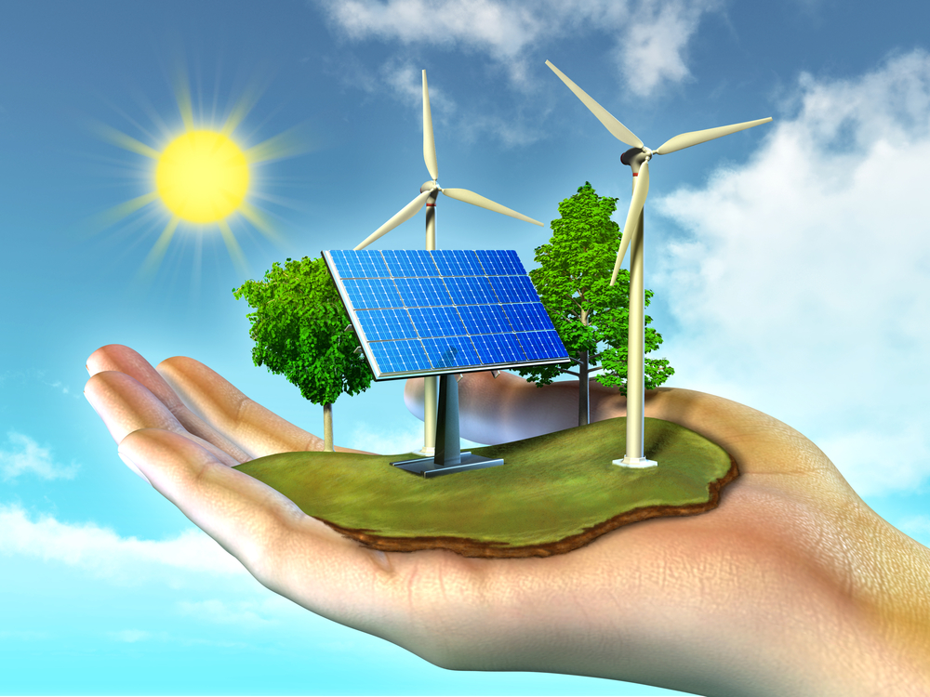
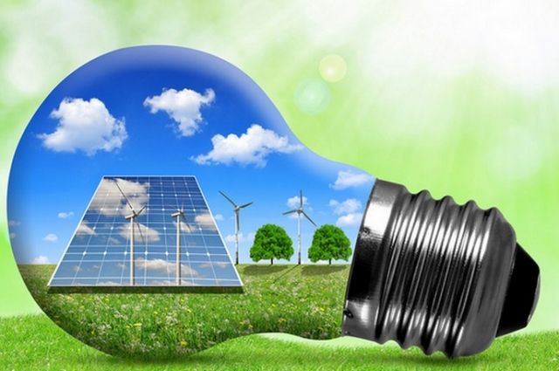

Slide 7
Eslab qoling!
Tabiatda energiya hech qachon bordan yo‘q va yo‘qdan bor bo‘lmaydi. U faqat bir turdan boshqa turga yoki bir jismdan boshqa jismga o‘tib, miqdor jihatdan o‘zgarishsiz qoladi.

Slide 8
Eslab qoling!
Har qanday mashina yoki dvigatelning foydali ishi to‘liq energiyadan kichik bo‘ladi.

Slide 9
FIK nima?
Foydali ishning sarflangan ishga nisbati bilan o‘lchanadigan kattalik foydali ish koeffitsiyenti deb ataladi va $η$ harfi bilan belgilanadi.
Qisqacha qilib FIK deb yoziladi.

Slide 10
FIK NING FORMULASI
$η$= $\frac{A_{f}}{A_{t}}$ $∙$100%
$A_{f}$ = $\frac{η{∙A}_{t}}{\text{100\%}}$
$A_{t}$= $\frac{A_{f}}{η}$ $∙$100%

Slide 11
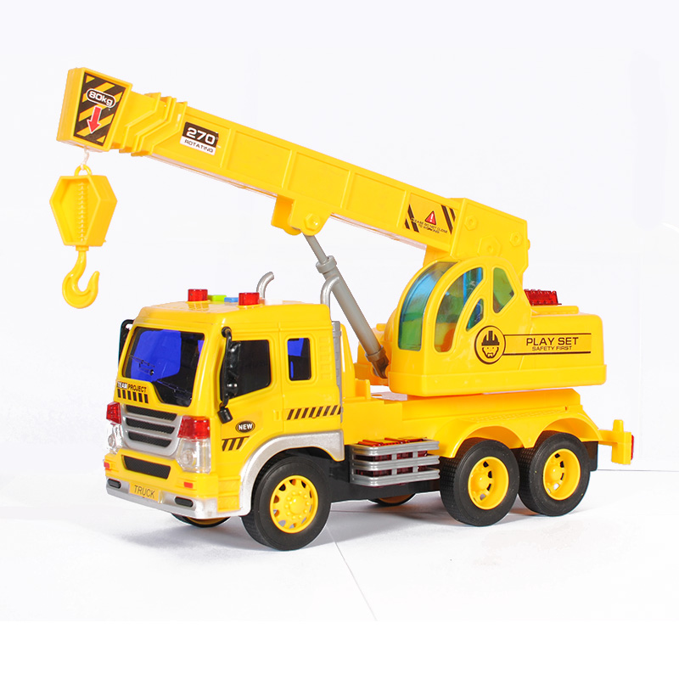
Masala yechish namunasi
Ko‘tarma kranga quvvati 10 kW bo‘lgan dvigatel o‘rnatilgan. Kran massasi 5000 kg bo‘lgan yukni 3 minut ichida 27 m balandlikka ko‘taradi. Kranning FIK ni toping.

Slide 12
MASALA YECHISH NAMUNASI
Formula:
Berilgan:
$N_{t }$= $10 kW=10 000 W$
m = 5000 kg
h = 27 m
t = 3 min= 180 s
g = 10 $\frac{m}{s^{2}}$
Topish kerak:
$η= ?$
$A_{t}$= $N_{t}$t
(1)
$A_{f}$= mgh
(2)
$η$= $\frac{A_{f}}{A_{t}}$ $∙$100%
(3)

Slide 13
Masala yechish namunasi
Formula:
Yechish:
$A_{t}$= $N_{t}$t
(1)
$A_{t}$= $(10 000 W∙$180) J= 1800 000J
$A_{f}$=mgh
(2)
$A_{f}$=(5000 $∙$10 $∙$27) J = 1350 kJ
$η$= $\frac{A_{f}}{A_{t}}$ $∙$100%
$η$= $\frac{\text{1350 }\text{000}\text{J}}{\text{1800 000}\text{J}}$ $∙$100% = 75 %
(3)
Javob:
$η$= 75 %

Slide 14
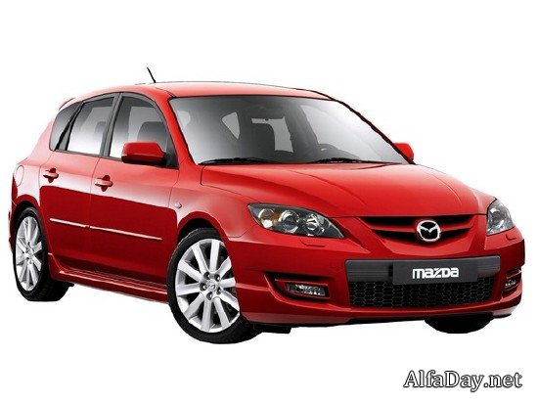
31- mashq
1. Avtomobilga quvvati 100 kW bo‘lgan dvigatel o‘rnatilgan. U 1 minutda 2,4 MJ foydali ish bajardi. Avtomobilning FIKni toping.

Slide 15
31-mashq (1)
Formula:
Berilgan :
$N_{ }$= $100 kW=10 0000 W$
$A_{f}$= 2,4 MJ
t = 1 min = 60 s
Topish kerak:
$η=?$
$η$= $\frac{A_{f}}{A_{t}}$ $∙$100%
(1)
$A_{t}$= $N_{t}$t
(2)
(2) $→\text{(1)}$
$η$= $\frac{A_{f}}{N_{t} \text{t}}$ $∙$100%
(3)
Yechish:
$η$= $\frac{2400000 J}{10 0000 W∙60 s}$ $∙100\%=40 \%$
Javob:
$η$= 40 %

Slide 16
31- mashq (2)
2. Samolyot to‘g‘ri chiziq bo‘ylab 900 km/h tezlik bilan tekis uchmoqda. Dvigatellarining quvvati 1,8 MW va FIK 70% ga teng bo‘lsa, tortish kuchi qanchaga teng bo‘ladi?

Slide 17
Masala chizmasi
$$θ=900 km/h$$
h

Slide 18
31-mashq (2)
Formula:
Berilgan:
$$θ=900 km/h$$
$N_{ }$= 1,8 M$W=180 0000 W$
$η$= 70 % = 0,7
Topish kerak:
$F_{t} = ?$
$η$= $\frac{A_{f}}{A_{t}}$ $∙$100%
(1)
$A_{t}$= $N_{t}$t
(2)
$A_{f}$= $F_{t}s$
(3)
(3) va(2) $→\text{(1)}$
$η$= $\frac{A_{f}}{N_{t} \text{t}}$ =$\frac{F_{t}∙s}{N_{t}∙\text{t}}=\frac{F_{t}∙θ}{N_{t}}∙$100%
$$F_{t}=\frac{η∙θ}{N_{t}∙100\%}$$

Slide 19
31-mashq (2)
Formula:
Yechish:
$η$= $\frac{A_{f}}{A_{t}}$ $∙$100%
(1)
$F_{t}=\frac{70\%∙1800000 W}{250 m/s∙100\%}$=
= $\frac{70∙1800 W}{25 m/s}$= 5040 N
$A_{t}$= $N_{t}$t
(2)
$A_{f}$= $F_{t}θ$
(3)
(3) va (2) $→\text{(1)}$
$$F_{t}=\frac{η∙N_{t}}{θ∙100\%}$$
(4)
Javob:
$F_{t}=$ 5040 N

Slide 20
KUCH BIRLIGINI KELTIRIB CHIQARAMIZ
$$F_{t}=\frac{η∙N_{t}}{θ∙100\%}$$
$\frac{\% ∙\frac{J}{s}}{\frac{m}{s}∙\%}$=
$\left[F\right]=\frac{\%∙W}{m/s∙\%}$=
= $\frac{\% ∙N ∙ \frac{m}{s}}{\frac{m}{s}∙ \%}$ =
N

Slide 21
Mustaqil bajarish uchun topshiriqlar:
Darslikdan mavzu oxiridagi savollarga javob yozing.
31-mashqdagi qolgan masalalarni yeching.

