Slide 1
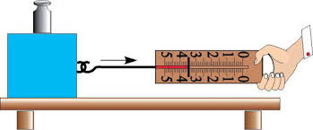
F I Z I K A
7- sinf
Laboratoriya ishi
MAVZU: SIRPANISH ISHQALANISH KOEFFITSIYENTINI ANIQLASH

Slide 2
Laboratoriya ishini bajarishdan maqsad:
Yog‘och chizg‘ich ustida sirpanayotgan taxtachaning ishqalanish koeffitsiyentini aniqlash yordamida sirpanish ishqalanishga oid bilimlarini mustahkamlash.

Slide 3
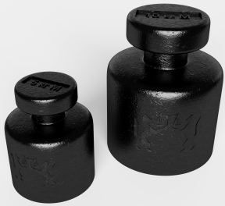
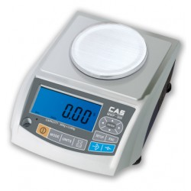
Laboratoriya ishini bajarish uchun kerak bo‘ladigan jihozlar:
Uzun yog‘och chizg‘ich, ilgakli taxtacha, dinamometr, tarozi, tarozi toshlari.

Slide 4
Laboratoriya ishini bajarish tartibi:
1. Taxtachaning massasini o‘lchab jadvalga yozamiz.
2. $P= m \text{g} \text{formuladan}$foydalanib, taxtachaning og‘irligini topamiz.

Slide 5
Laboratoriya ishini bajarish tartibi:
3. Taxtachaga dinamometr ilib, uni chizg‘ich bo‘ylab tekis sirpantiramiz va dinamometrning ko‘rsatishini sirpanish ishqalanish kuchiga teng deb olib, jadvalga yozamiz.
$$F_{i(s)}=$$
4.
$$μ_{s }=\frac{F_{i(s)}}{P}$$
$$μ_{s }=\frac{F_{i(s)}}{m\text{g}}$$

Slide 6
Laboratoriya ishini bajarish tartibi:
5. Taxtacha ustiga avval 100 g li, so‘ngra 200 g li tarozi toshlarini qo‘yib, tajribani takrorlaymiz.
100 g li tosh qo‘yganda
$$F_{i(s)}=$$
200 g li tosh qo‘yganda
$$F_{i(s)}=$$

Slide 7
Laboratoriya ishini bajarish tartibi:
6. Formuladan foydalanib, sirpanish ishqalanish koeffitsiyentining o‘rtacha qiymatini hisoblaymiz va natijani jadvalga yozamiz.
$$μ_{o^{′}rt }=\frac{μ_{1 }+μ_{2 }+μ_{3 }}{3}$$

Slide 8
Natijalarni jadvalga yozish
7. Absolyut va nisbiy xatolikni topamiz.
T/r | m, kg | P, N | $F_{i(s)}$, N | $$μ$$ | $$μ_{o^{′}rt }$$
1
2
3

Slide 9
Laboratoriya ishini bajarish tartibi:
T/r | m, kg | P, N | $F_{i(s)}$, N | $$μ$$ | $$μ_{o^{′}rt }$$
1
2
3

Slide 10
MASALALAR YECHISH
1. Sirpanish ishqalanish koeffitsiyenti 0,3 ga teng bo‘lsa, yetarli darajada quvvatli avtomobil qanday maksimal tezlanish bilan harakatlanishi mumkin?

Slide 11
MASALALAR YECHISH
2. Agar g‘ildiraklarining reslga sirpanish ishqalanish koeffitsiyenti 0,2 ga, poyezdning dumalanish ishqalanish koeffitsiyenti 0,006 ga teng bo‘lsa, 180 t lik elektrovoz qanday massali sostavni harakatga keltiradi?

Slide 12
Mustaqil bajarish uchun topshiriqlar:
Mavzu oxiridagi savollarga javob yozing.
23- mashqning qolgan masalalarini yeching.

