Slide 1
F I Z I K A
7- sinf
MAVZU: SIRPANISH ISHQALANISH. DUMALANISH ISHQALANISH

Slide 2
SIRPANISH ISHQALANISH
Sirpanish ishqalanish - bu bir jism yuzasi bo‘ylab boshqa jism sirpanib harakatlanganida vujudga keladigan ishqalanishdir.

Slide 3
SIRPANISH ISHQALANISH

Slide 4
SIRPANISH ISHQALANISH
P $=\text{m} \text{g}$
$$F_{i(s)}= \text{m} \text{g}$$
$$μ=\frac{F_{i(s)}}{m\text{g}}$$
$$F_{i(s)}= μ N$$

Slide 5
SIRPANISH ISHQALANISH

Slide 6
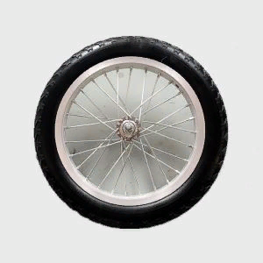
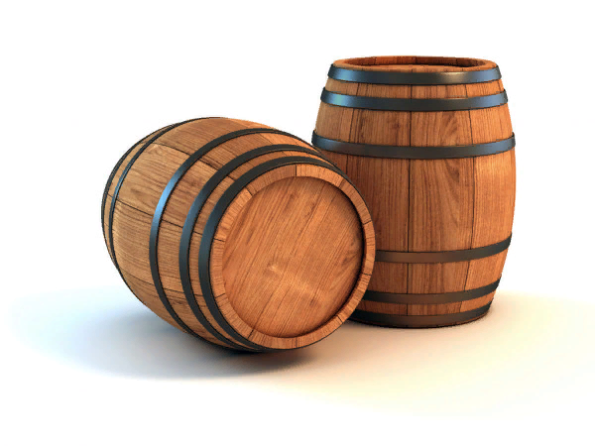
DUMALASH ISHQALANISH
Bir jism ikkinchi jism yuzasi bo‘ylab sirpanmasdan dumalasa, bunda hosil bo‘lgan ishqalanish dumalanish ishqalanish deyiladi.

Slide 7
DUMALASH ISHQALANISH

Slide 8
DUMALASH ISHQALANISH

Slide 9
DUMALASH ISHQALANISH
$$F_{i(d)}=μ_{d }\frac{P}{r}$$
$μ_{d }$- dumalanish ishqalanish koeffitsiyenti.
$μ_{d }$- ning qiymati po‘lat bilan po‘lat uchun o,2 mm ga,
avtomobil g‘ildiragi rezinasi bilan asfalt uchun 2 mm
ga teng.
$$μ=\frac{F_{i(s)}}{m\text{g}}$$

Slide 10
DUMALASH ISHQALANISH
$$μ_{d }=F_{i(d)}\frac{r}{P}$$
$$μ_{d }=F_{i(d)}\frac{r}{m\text{g}}$$
Demak, dumalayotgan jism radiusi qancha katta bo‘lsa, dumalanish ishqalanish koeffitsiyenti ham shuncha katta bo‘lar ekan.

Slide 11
MASALALAR YECHISH
Massasi 2 tonna bo‘lgan avtomobilning g‘ildiraklari bilan asfalt orasidagi dumalanish ishqalanish kuchini toping. G‘ildirak diametrini 1 m, rezina bilan asfalt orasidagi dumalanish ishqalanish koeffitsiyentini 2 mm, $\text{g}$ = 10 $\frac{m}{s^{2}}$ deb oling.

Slide 12
Mustaqil bajarish uchun topshiriqlar:
Mavzu oxiridagi savollarga javob yozing.
23- mashqning qolgan masalalarini yeching.

