Slide 1

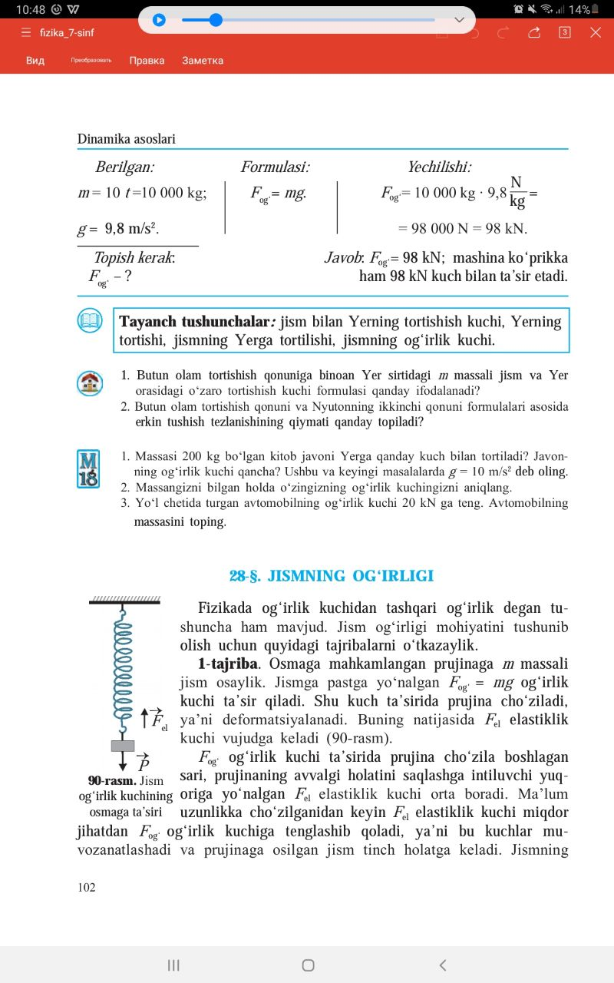
F I Z I K A
7- sinf
MAVZU: YUKLAMA VA VAZNSIZLIK

Slide 2
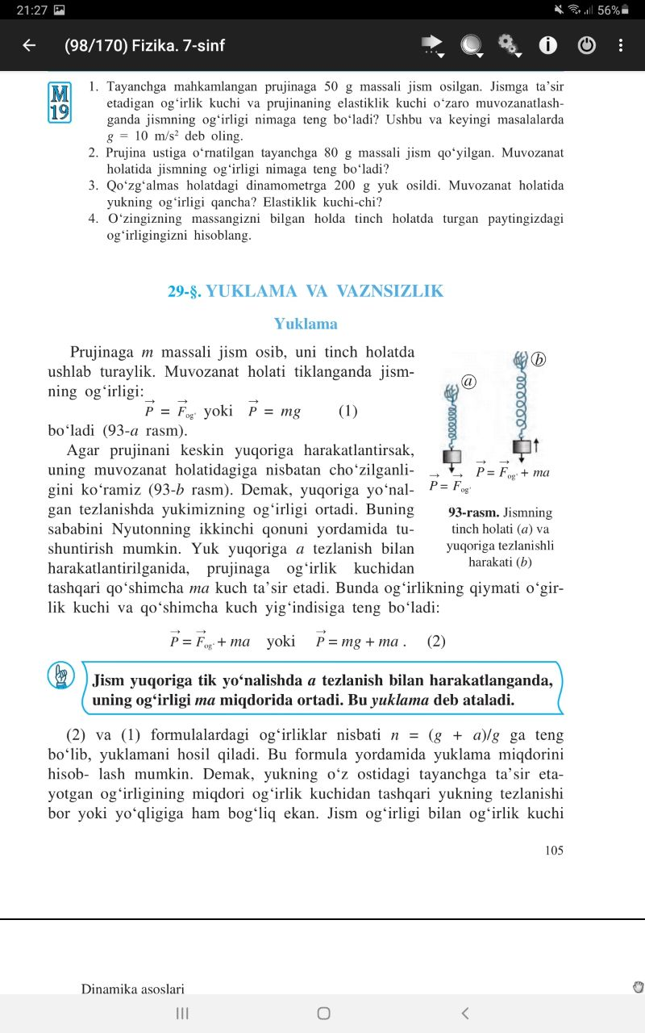
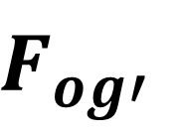
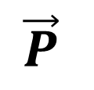
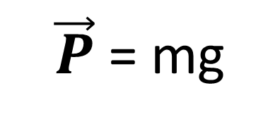
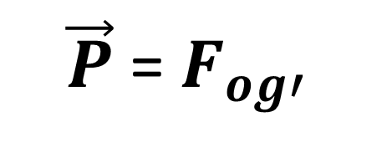
Y U K L A M A
a
Prujinaga m massasli jism osib uni tinch holatda ushlab turaylik.
$\vec{P}$= $F_{og′}$
$\vec{P}$= mg
$$F_{og′}$$
$$\vec{P}$$

Slide 3
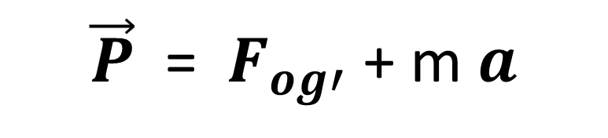
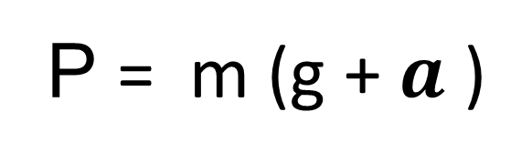
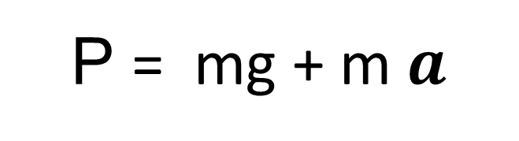
Y U K L A M A
a
b
Agar prujinani yuqoriga harakatlantirsak, uning muvozanat holatidagiga nisbatan cho‘zilganini ko‘ramiz.
$\vec{P}$ = $F_{og′}$+ m $a$
P = mg + m $a$
P = m (g + $a$ )

Slide 4
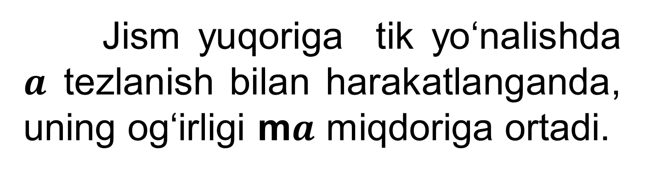
Y U K L A M A
Jism yuqoriga tik yo‘nalishda $a$tezlanish bilan harakatlanganda, uning og‘irligi m$a$ miqdoriga ortadi.
Bu ortishga esa yuklama deb ataladi.

Slide 5
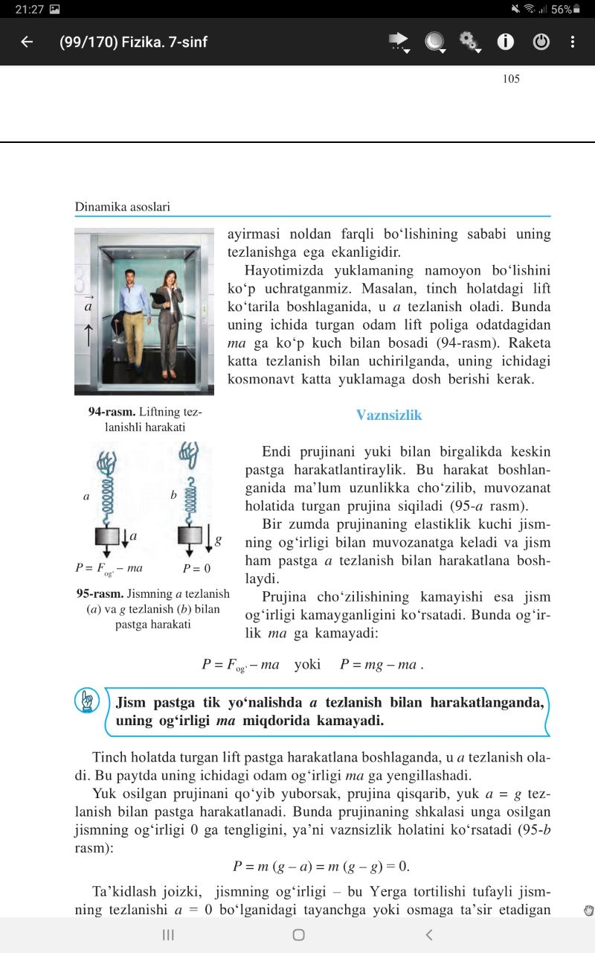
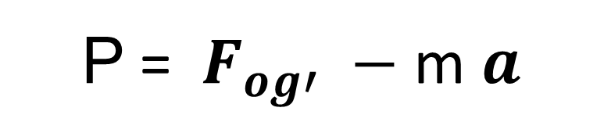
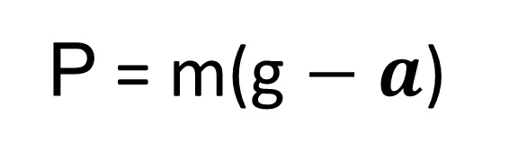
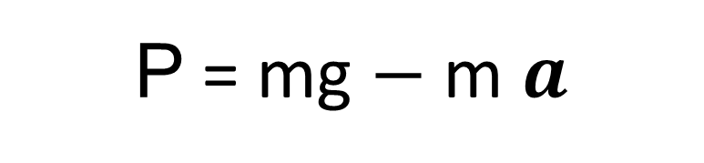
Y U K L A M A
P = mg $−$m $a$
P = m(g $−$ $a$)
P = $F_{og′} −$m $a$

Slide 6
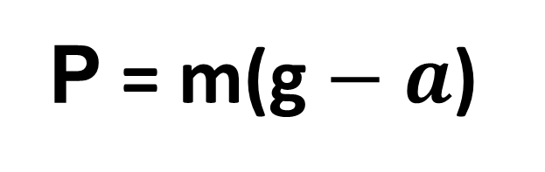

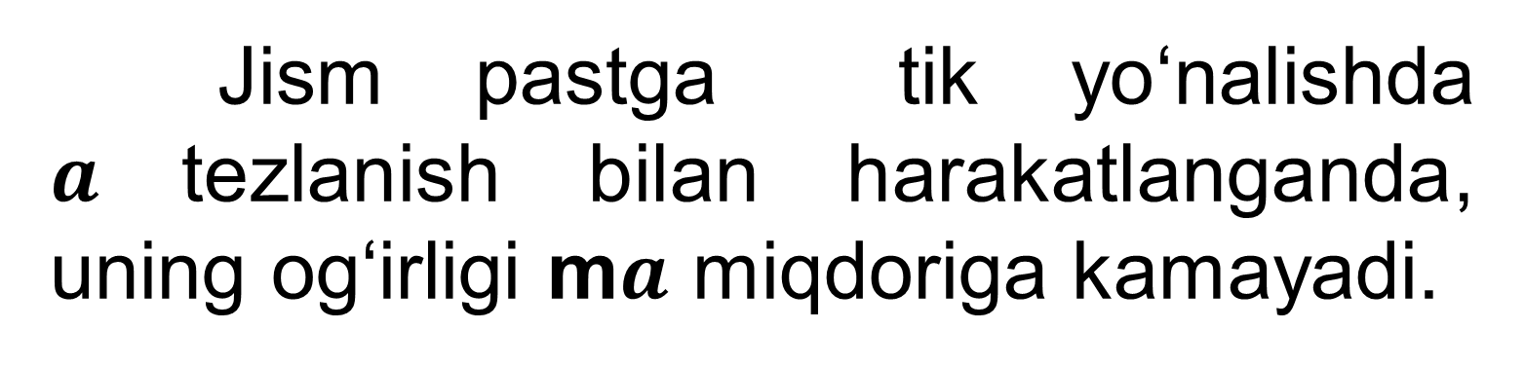
Y U K L A M A
Jism pastga tik yo‘nalishda $a$tezlanish bilan harakatlanganda, uning og‘irligi m$a$ miqdoriga kamayadi.
P = m(g $−$ $a$)
P = $F_{og′} −$m $a$

Slide 7

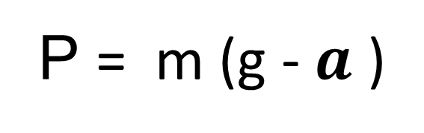
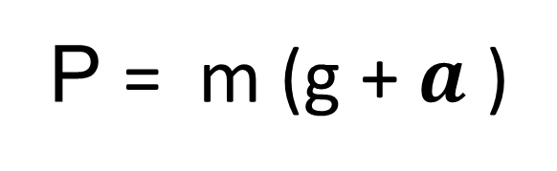

Y U K L A M A
$$\vec{a}$$
$$\vec{a}$$
P = m (g + $a$ )
P = m (g - $a$ )

Slide 8
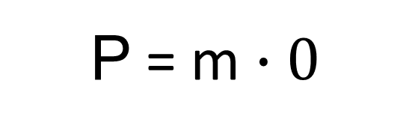

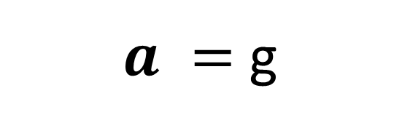
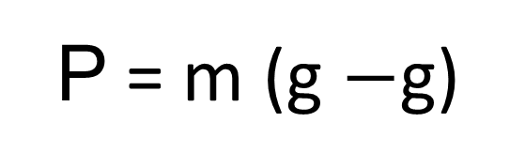
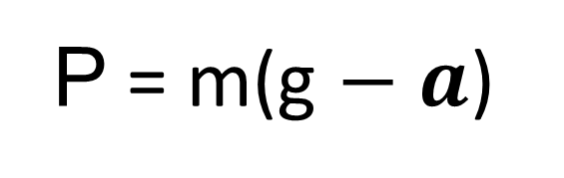

V A Z N S I Z L I K
P = mg $−$m $a$
P = m(g $−$ $a$)
$a =$ g
P = m (g $−$g)
P = m $∙0$
P = 0
P = $F_{og′} −$m $a$

Slide 9
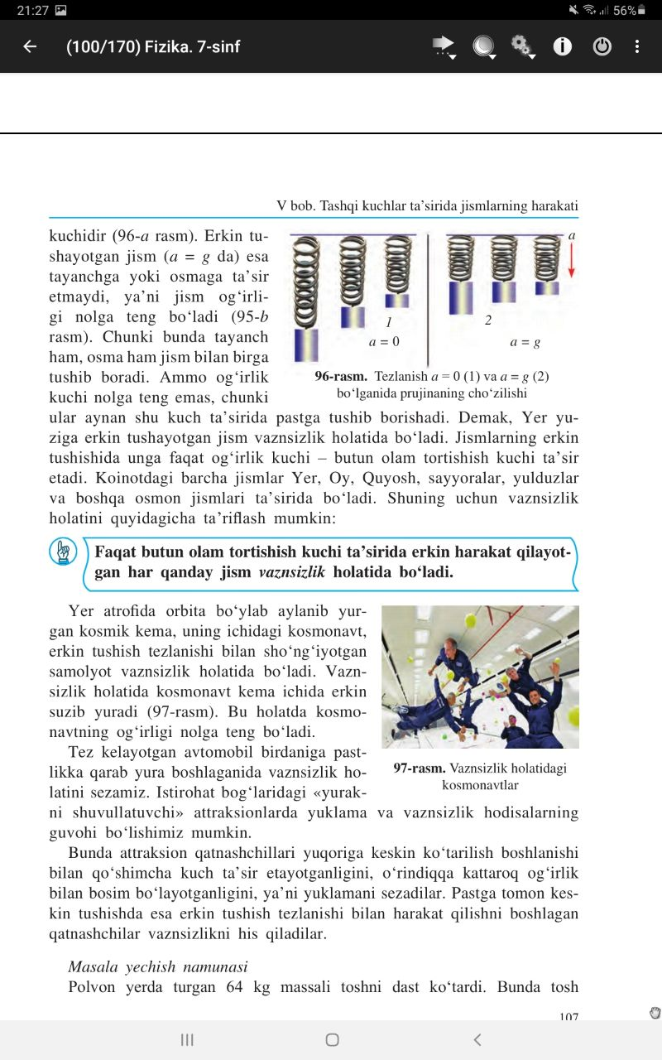
V A Z N S I Z L I K
Jismning tinch holatida tayanchga

Slide 10
V A Z N S I Z L I K
Faqat butun olam tortishish kuchi ta’sirida erkin harakat qilayotgan har qanday jism vaznsizlik holatida bo‘ladi.

Slide 11
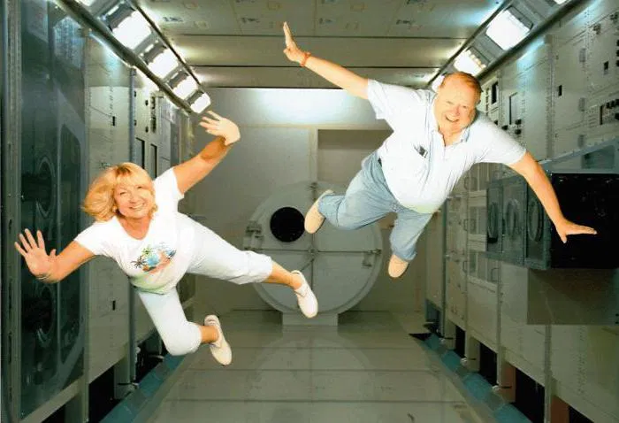
V A Z N S I Z L I K
Vazinsizlik holatidagi kosmonavtlar.

Slide 12
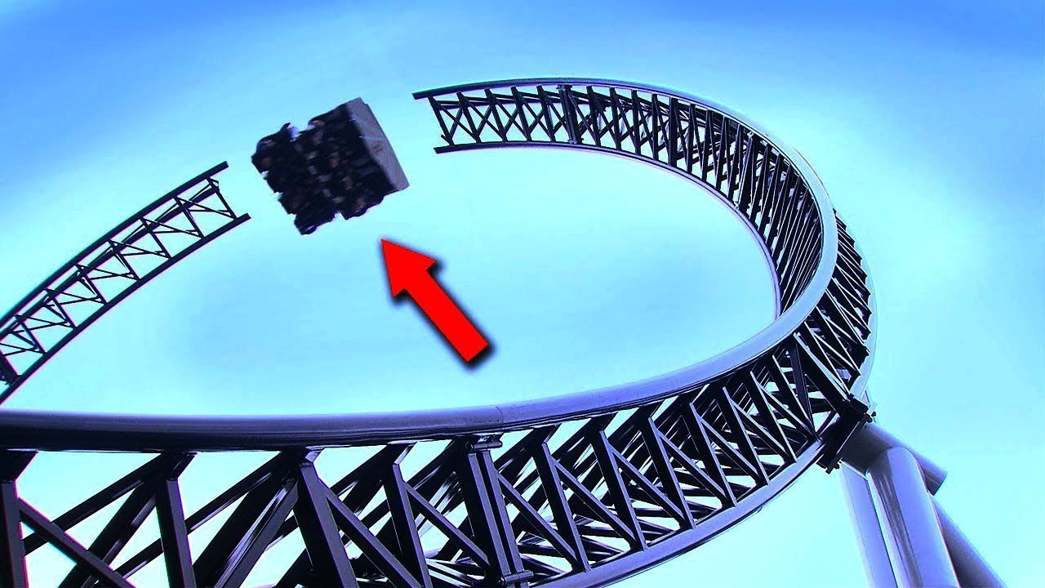
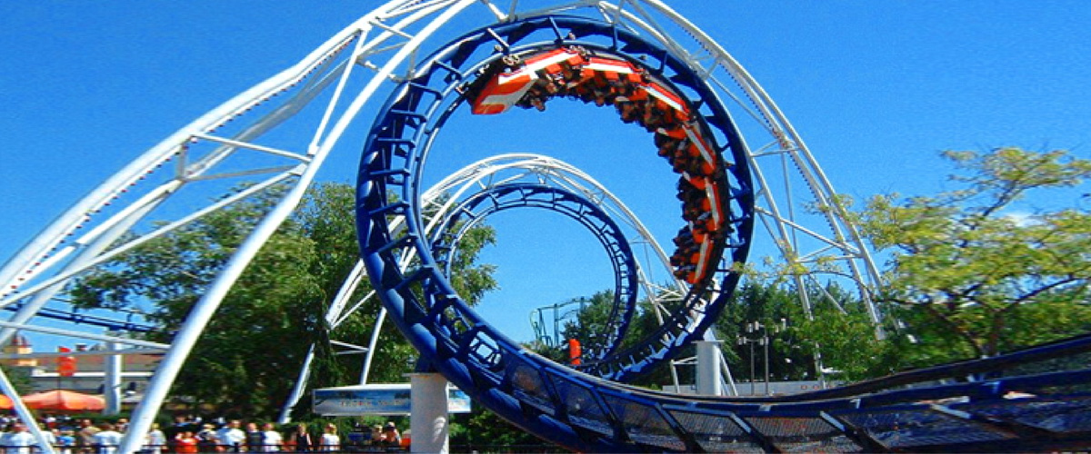
YUKLAMA VA VAZNSIZLIK

Slide 13
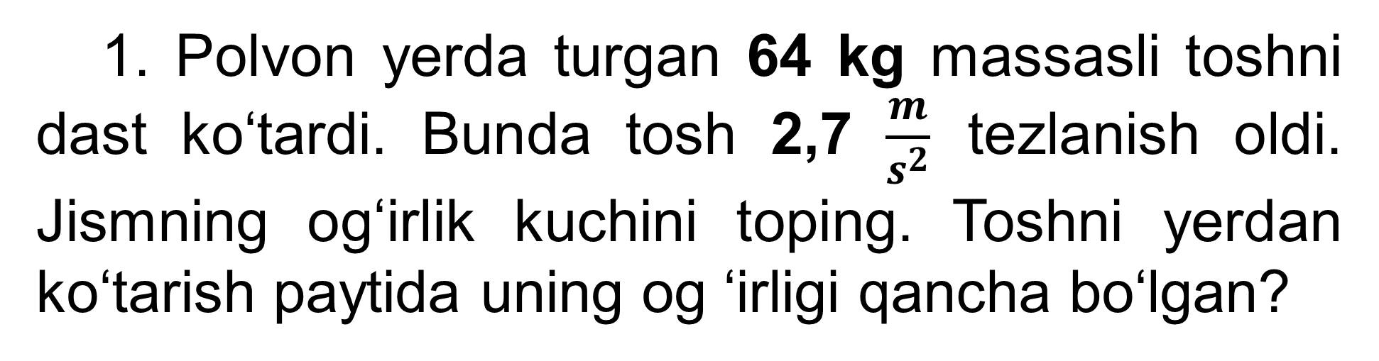
MASALALAR YECHISH
1. Polvon yerda turgan 64 kg massasli toshni dast ko‘tardi. Bunda tosh 2,7 $\frac{m}{s^{2}}$ tezlanish oldi. Jismning og‘irlik kuchini toping. Toshni yerdan ko‘tarish paytida uning og ‘irligi qancha bo‘lgan?

Slide 14
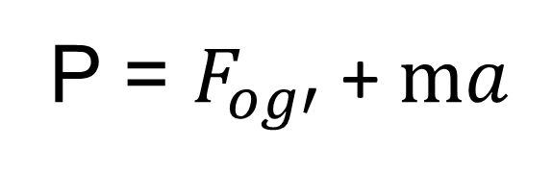
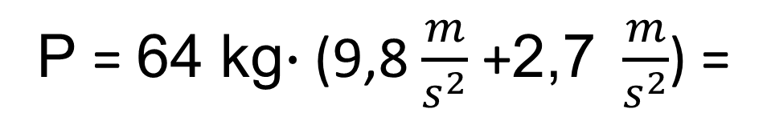
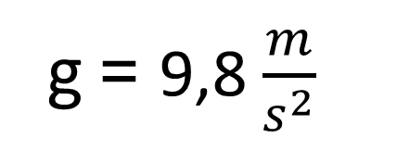
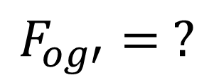
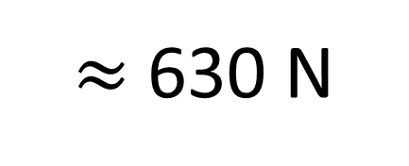
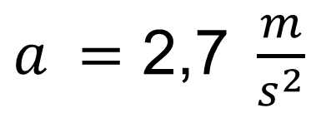
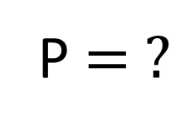
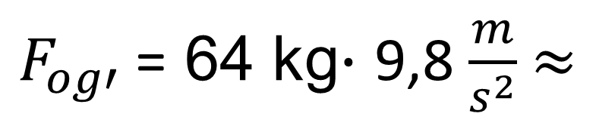
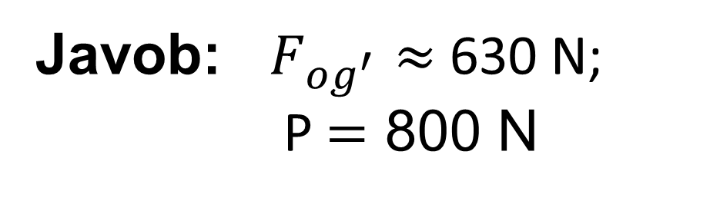
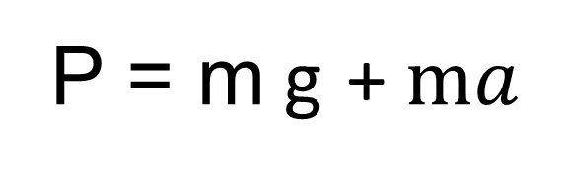
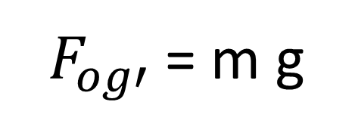
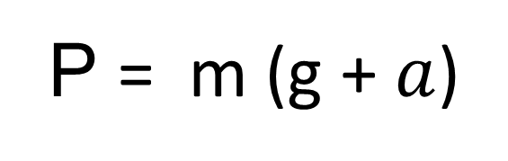
MASALALAR YECHISH
Berilgan:
Formulasi:
Yechilishi:
$F_{og′}$= m g
m = 64 kg
$F_{og′}$= 64 kg$∙$ 9,8 $\frac{m}{s^{2}}$ $≈$
$a$ $=\text{2,7 }\frac{m}{s^{2}}$
P = $F_{og′}$+ $ma$
$≈$630 N
g = 9,8 $\frac{m}{s^{2}}$
P = m g + $ma$
P = 64 kg$∙$ (9,8 $\frac{m}{s^{2}}$ +$\text{2,7 }\frac{m}{s^{2}}$) =
P = m (g + $a$)
$$F_{og′}= ?$$
= 800 N
P $= ?$
Javob: $F_{og^{′}}$ $≈$630 N;
P $=$ 800 N

Slide 15
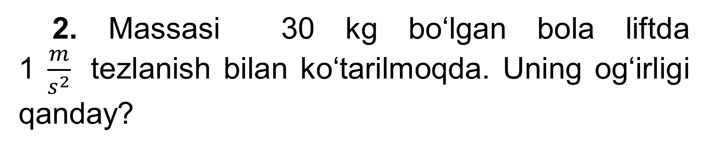
MASALALAR YECHISH
2. Massasi 30 kg bo‘lgan bola liftda 1 $\frac{m}{s^{2}}$tezlanish bilan ko‘tarilmoqda. Uning og‘irligi qanday?

Slide 16
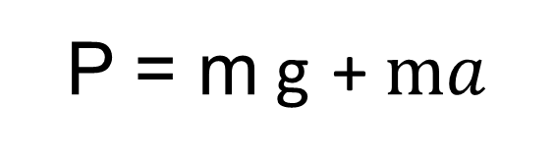
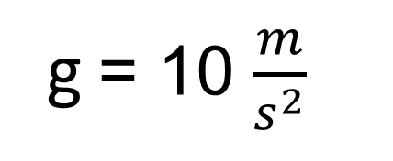
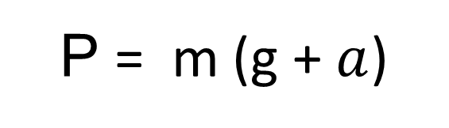
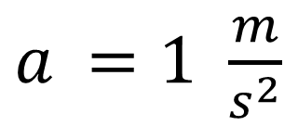
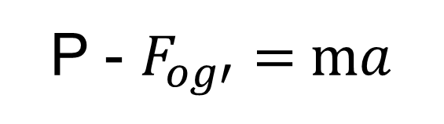
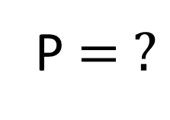
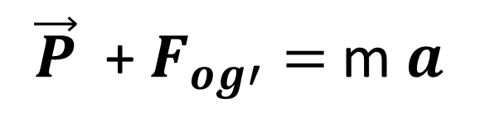

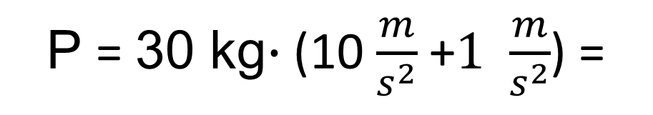
MASALALAR YECHISH
Berilgan:
Formulasi:
Yechilishi:
m = 30 kg
$\vec{P}$ + $F_{og′}=$m $a$
P = 30 kg$∙$ (10 $\frac{m}{s^{2}}$ +$\text{1} \frac{m}{s^{2}}$) =
$a$ $=\text{1} \frac{m}{s^{2}}$
P - $F_{og′}=$ $ma$
= 330 N
g = 10 $\frac{m}{s^{2}}$
P = m g + $ma$
P = m (g + $a$)
P $= ?$
Javob: P $=$ 330 N

Slide 17
MASALALAR YECHISH
3. Massasi 1 t bo‘lgan lift tetis tezlanuvchan harakat qilib, 10 s da 20 m masofaga tushdi. Lift kabinasini ko‘taruvchi arqonning taranglik kuchi qanday?

Slide 18









MASALALAR YECHISH
Berilgan:
Formulasi:
t = 10 s
$\vec{T}$ + $F_{og′}=$m $a$
S = 20 m
T = m (g - $a$)
m = 1000 kg
S = $\frac{{at}^{2}}{2}$
$a$ = $\frac{2S}{{ t}^{2}}$
g = 10 $\frac{m}{s^{2}}$
T = m (g - $\frac{2S}{{ t}^{2}}$)
T $= ?$
T = 1000 kg (10 $\frac{m}{s^{2}}$ - $\frac{2∙20 m}{{ (\text{10 }\text{s})}^{2}}$) =
9600 N
Javob: T $=$ 9600 N = 9,6 kN

Slide 19
Mustaqil bajarish uchun topshiriqlar:
Mavzu oxiridagi savollarga javob yozing.
20 - mashqning masalalarini yeching.

