Slide 1
F I Z I K A
7- sinf
MAVZU: AYLANMA HARAKATNI TAVSIFLAYDIGAN KATTALIKLAR ORASIDAGI MUNOSABATLAR

Slide 2
CHIZIQLI TEZLIK VA BURCHAK TEZLIK
$∆φ$= $\frac{∆\breve{s}}{R}$
$\text{υ}$ = $\frac{∆\breve{s}}{∆t}$
$∆\breve{s}$ = $∆φ$ R
$ω$ = $\frac{∆φ}{∆t}$
$\text{υ}$ = $\frac{∆φ \text{R}}{∆t}$
$\text{υ}$=$ω$ $\text{R}$

Slide 3
AYLANISH DAVRI
Jismning bir marta aylanishiga ketgan vaqt aylanish davri deb ataladi.
$T$ = $\frac{∆t}{N}$
$∆t$= 8 s
$N$= 20
O
$T$ = $\frac{\text{8 }\text{s}}{\text{20}}$ = 0,4 s
R

Slide 4
AYLANISH CHASTOTASI
Jismning vaqt birligidagi aylanishlar soni aylanish chastotasi deb ataladi.
$ν$ = $\frac{N}{∆t}$
$∆t$ = 8 s
$N$= 20
O
$ν$ = $\frac{\text{20}}{\text{8 }\text{s} }$ = 2,5 $\frac{1}{s}$
R

Slide 5
AYLANISH DAVRI VA CHASTOTASI
$T$ = $\frac{∆t}{N}$
$ν$ = $\frac{N}{∆t}$
$T$ = $\frac{1}{ν}$
$ν$ = $\frac{1}{T}$

Slide 6
KATTALIKLAR ORASIDAGI MUNOSABAT
$T$ = $\frac{2 πR}{\text{υ}}$
$\text{υ}$ = $\frac{2 πR}{T}$
$T$ = $\frac{2 π}{ω}$
$ω$ = $\frac{2 π}{T}$

Slide 7
KATTALIKLAR ORASIDAGI MUNOSABAT
$ν$= $\frac{\text{υ}}{2 πR}$
$\text{υ}$ = $2 πνR$
$ν$= $\frac{ω}{2 π}$
$ω$ = $2 π ν$

Slide 8
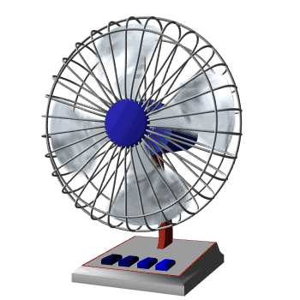
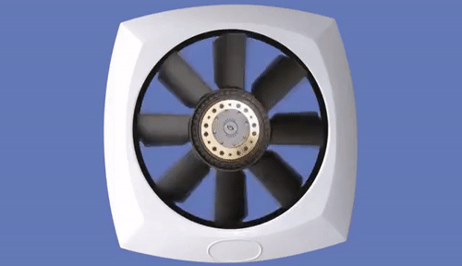
TEKIS AYLANMA HARAKAT

Slide 9
MASALALAR YECHISH
1. “Neksiya” avtomobili 90 km/h tezlik bilan tekis harakatlanmoqda. Agar avtomobil g‘ilgiragining radiusi 40 cm bo‘lsa, g‘ildirakning aylanish davri, aylanish chastotasi va burchak tezlikni toping.

Slide 10
Masalalar yechish
Berilgan:
Formulasi:
$\text{υ}$= 90 km/s
= 25 m/s
= $\frac{2∙3,14∙0,4 }{\text{υ}}$ = 0,1 s
$T$ = $\frac{2 πR}{\text{υ}}$
R = 40 cm
= 0,4 m
$T$= ?
$ν$ = $\frac{1}{T}$
= $\frac{1}{0,1 s}$ = 10 $\frac{1}{s}$
$$ν = ?$$
$ω$ $= ?$
$ω$ = $2 π ν$
$$=2∙3,14∙10=62,8 rad/s$$
Javob: T = 0,1 s, $ν$ = 10 $\frac{1}{s}$, $ω$ = $62,8 rad/s$

Slide 11
Mustaqil bajarish uchun topshiriqlar:
Avtomobilning tezligi 20 m/s, g‘ildiragining diametri 64 cm. Avtomobil g‘ildiragining burchak tezligini toping.
Jism 10 m/s tezlik bilan 2 m radiusli aylana bo‘ylab harakatlanmoqda. Uning aylanish chastotasini toping.

