Slide 1
ADABIYOT
7- sinf
MAVZU: ALISHER NAVOIY

Slide 2
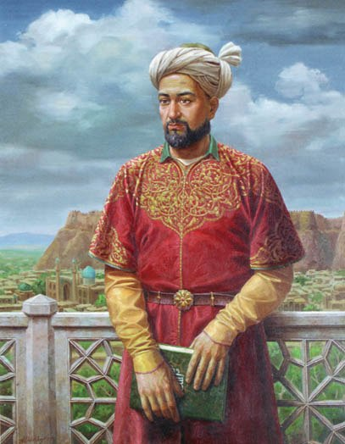
G‘AZAL MULKINING SULTONI
Turk nazmida chu men tor- tib alam,
Ayladim ul mamlakatni yak- qalam.
Olibmen taxti farmonimg‘a oson,
Cherik chekmay Xitodin to Xuroson

Slide 3
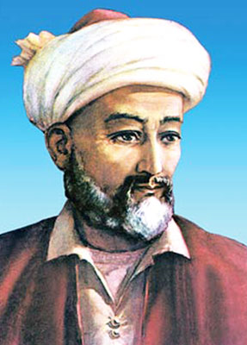
NIZOMIDDIN MIR ALISHER NAVOIY
G‘iyosiddin Muhammad
Shayx Muhammad Chang
HIROT
Muhammad Ali G‘aribiy
Mir Said Kobuliy
ATTOR
1447 - IROQ
(1441 -1501)

Slide 4
YILLAR VA YO‘LLAR
1451-Hirot
Sabzavor hokimi
1453
G‘iyosiddin vafoti
Sabzavor Mashhad
1457
Abulqosim Bobur vafoti
1464
noxushliklar
1960-2-yarmi “firdavsmonand” Samarqand
Fazlulloh Abulays

Slide 5
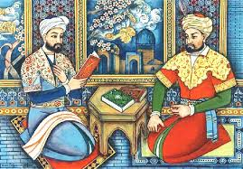
“AMIRI KABIR”, “AMIRI MUQARRAB”
“Ilgimdan kelganicha zulm tig‘in ushotib (sindirib), mazlum jarohatig‘a intiqom marhamini (qasos malhamini) qo‘ydum. Va ilgimdin kelmaganni ul Hazrat (Husayn Boyqaro) arzig‘a yetkurdim”
1469
MUHRDOR
VAZIR
HOKIM

Slide 6
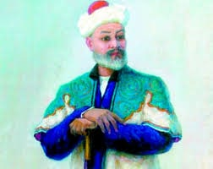
SHE’RIY DEVON
1465–1466-yillarda uning muxlislari she’rlarini to‘p-lab, “Devon” tuzdilar.
“Ilk devon”
1472–1476
“Badoye ul-bidoya”
1476–1483
“Navodir un-nihoya”

Slide 7
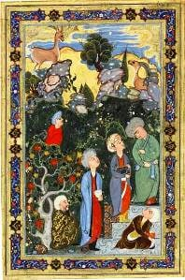
IJOD OLAMIDA
“Tarixi muluki Ajam”
“Mezon u-avzon”
“Tarixi anbiyo va hukamo”
“Majolis un-nafois”
“Sab’at-u abhur”
“Muhokamat ul-lug‘atayn”

Slide 8
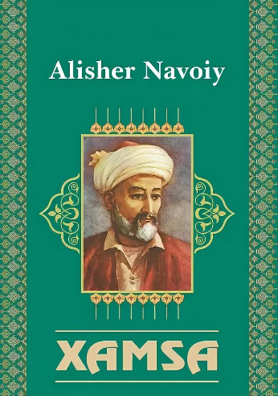
“XAMSA” (1483-1485)
“Hayrat ul-abror”
“Farhod va Shirin”
“Layli va Majnun”
“Sab’ayi sayyor”
“Saddi Iskandariy”

Slide 9
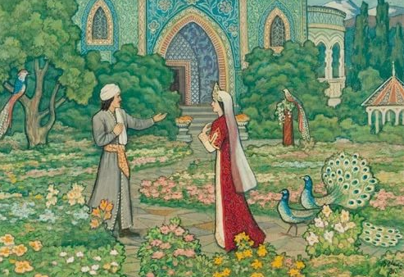
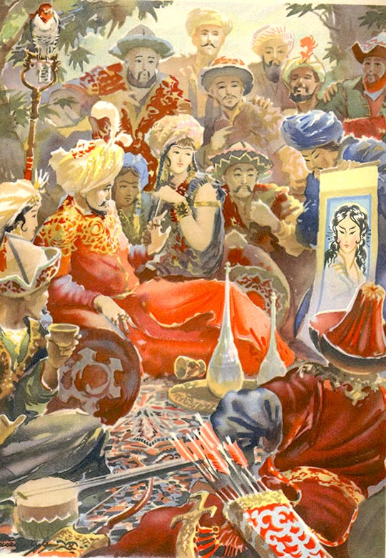
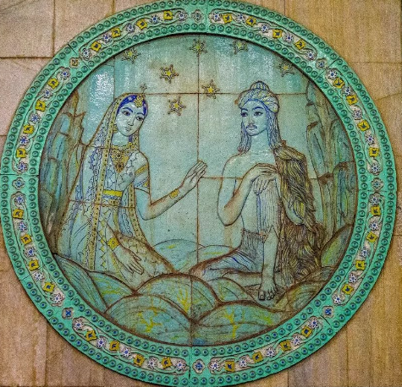
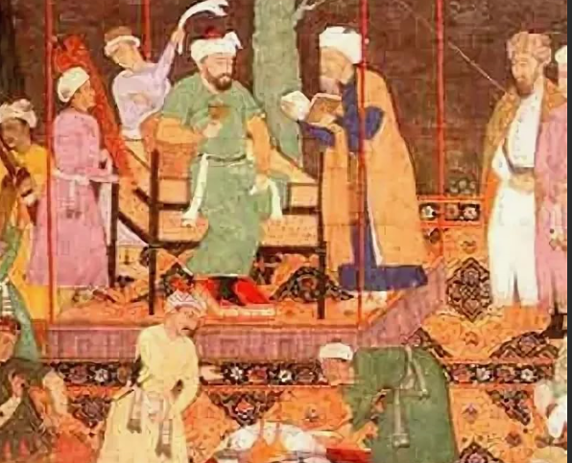
“XAMSA”

Slide 10
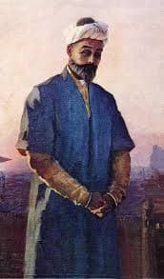
1489–1493 JUDOLIKLAR
Do‘stlari, ustozlaridan Sayyid Hasan Ardasher, Abdurahmon Jomiy, Pahlavon Muhammad ketma-ket vafot etdilar.
“Holoti Sayyid Hasan Ardasher”
“Holoti Pahlavon Muhammad”
“Xamsat ul-mutahayyirin

Slide 11
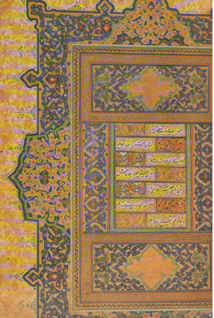
“XAZOYIN UL- MA’ONIY”
“G‘aroyib us-sig‘ar”
“Navodir ush-shabob”
“Badoye ul-vasat”
“Favoyid ul-kibar”

Slide 12
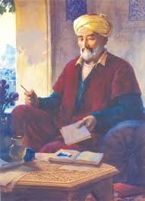
SAMARALI IJOD
“Nasoyim ul-muhabbat”
“Munshaot”
“Lison ut-tayr”
“Mahbub ul-qulub”
Gahe topdim falakdin notavonlig‘,
Gahe ko‘rdim zamondin komronlig‘,
Base issig‘, sovug‘ ko‘rdim zamonda,
Base achchig‘, chuchuk tottim jahonda.

Slide 13
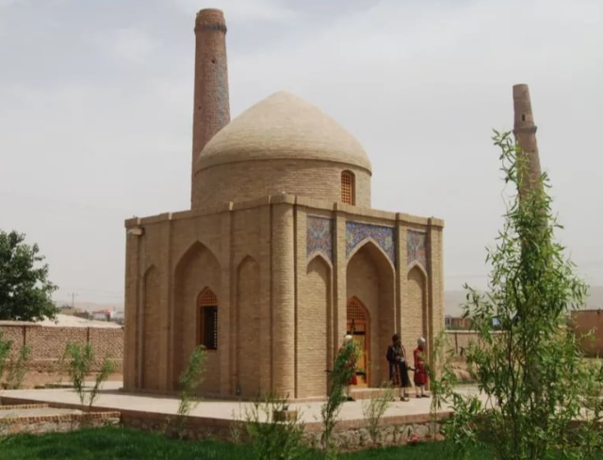
NAVOIY QABRI
Alisher Navoiy
1501-yilning 3-yanvar kuni Hirotda
vafot etdi
“SHAMS UL-MILLAT”

Slide 14
MUSTAQIL BAJARISH UCHUN TOPSHIRIQ
Alisher Navoiy asarlari ro‘yxatini daftaringizga tuzing.
Navoiydan 3 ruboiy va 2 tuyuq yod oling.
Darsligingizdagi “Sab’ai sayyor” dostonidan berilgan parchani o‘qing.

