Slide 1
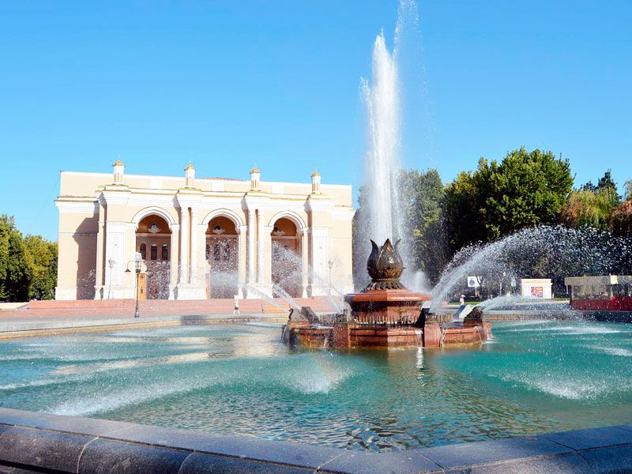
ENGLISH
Grade
8
THEME:
UNIT 10. All the World is a stage.
Lesson 5. At the theatre.
(page 82)

Slide 2
Checking the self-study work
U10, L4 p.119
1 Change the sentences from Reported Speech into Direct Speech.
1) He asked his son to bring him a glass of water.
1) Father (to his son): Bring me a glass of water.
2) The old woman ordered David to get out of her garden.
2) Old woman (to David): Get out of my garden!
3) The man told them to look around.
3) The man (to them): Look around.
4) Adrian asked Susan to listen to him.
4) Adrian (to Susan): Listen to me, please.

Slide 3
New words to learn
cast
curtain
performance
orchestra pit
stage
hall
cafeteria
stalls
cloak-room
to book
dress-circle
matinee
bunches of flowers
в ролях
штора
спектакль
оркестровая яма
сцена
зал
кафетерий
кресла партера
гардероб
забронировать
бельэтаж
дневной спектакль
букеты цветов

Slide 4
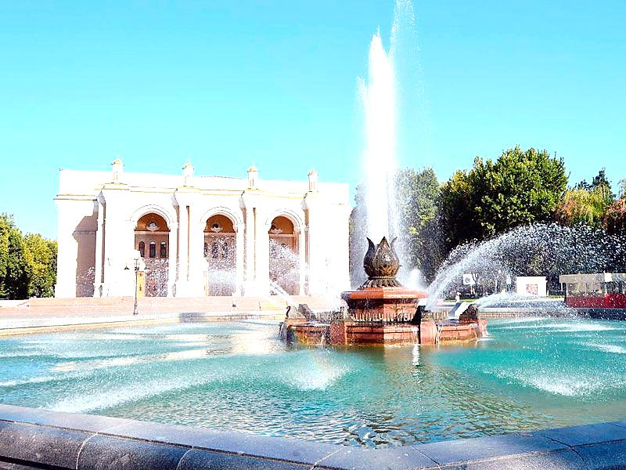
Activity 1 page 82
Complete the sentences with the words.
cast, curtain, performance, orchestra pit, stage, hall, cafeteria, the stalls, cloak-room, booked
I’ll never forget my first visit to the Navoiy Theatre when I was in Tashkent. My friend (1) ... two tickets for a matinee performance of the ballet “Snow-White and the Seven Dwarfs” by Khachaturian. We arrived at the theatre long before the (2) ... began.

Slide 5
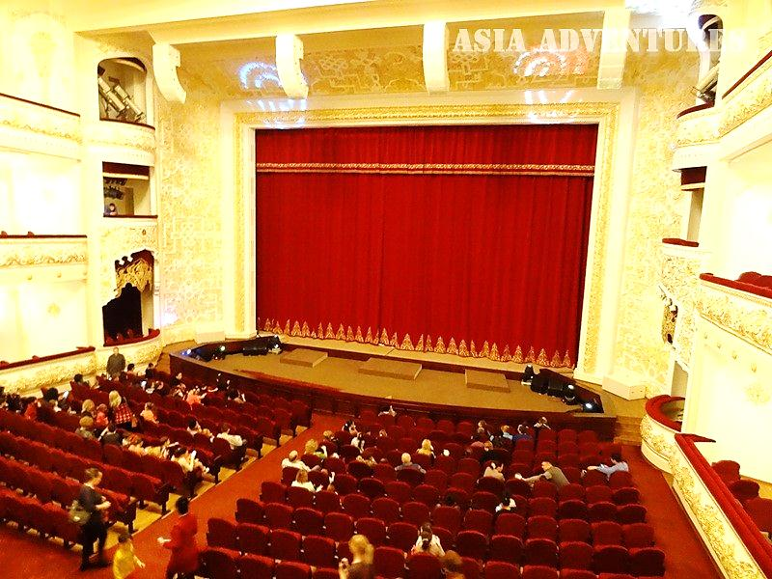
Activity 1 page 82
Complete the sentences with the words.
cast, curtain, performance, orchestra pit, stage, hall, cafeteria, the stalls, cloak-room, booked
We left our coats in the (3) ... and I got a programme to see what the (4) ... was. When we came into the (5) …, we saw many people looking for their seats. The musicians in the (6) ... were tuning their instruments. We found our seats, which were in (7) ..., and went to look at the theatre.

Slide 6
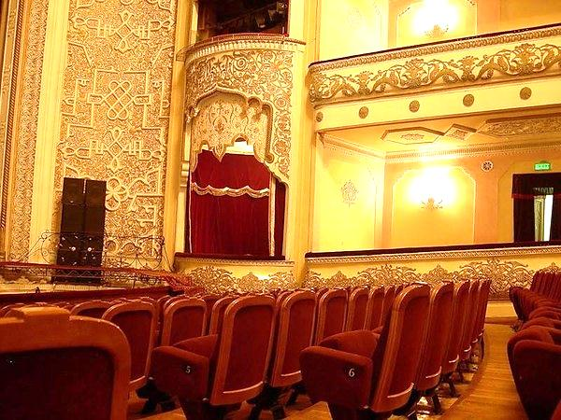
Activity 1 page 82
Complete the sentences with the words.
cast, curtain, performance, orchestra pit, stage, hall, cafeteria, the stalls, cloak-room, booked
My friend showed me the boxes, the dress-circle and balconies.
At twelve o’clock the performance started. The (8) ... went up. I was happy about what I saw on the (9) ... . I had never seen anything more
wonderful.

Slide 7
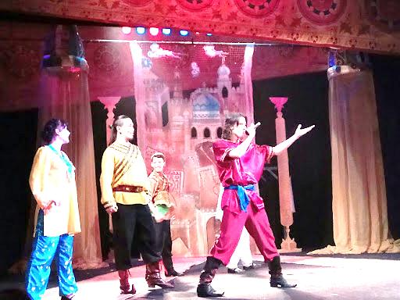
Activity 1 page 82
Complete the sentences with the words.
cast, curtain, performance, orchestra pit, stage, hall, cafeteria, the stalls, cloak-room, booked
The setting and the dancing were beautiful. The ballet seemed to me a fairytale. During the first interval we went to the (10) ... . At the end of the performance the dancers received large bunches of flowers. The performance was a great success.

Slide 8
2 Ask and answer.
Teacher look at this page. Pupil: look at page 75.
Theatre: The Youth Theatre of Uzbekistan
Place:
Opened in: One of the oldest theaters in Central Asia, the Youth Theater of Uzbekistan was opened in Tashkent on the 30th of April, 1928.
First performance:
Total number of seats: The total number of seats in the Youth Theater of Uzbekistan is 359.
Parts of the hall:
Number of performances: Now the Youth Theater of Uzbekistan has more than 40 performances.
Audience:
Popular with the audience: The Youth Theater of Uzbekistan has become one of the leading creative teams of the country, which is loved by the spectators in Uzbekistan and other countries.
Tashkent
“Uncle Tom’s Cabin” (the Moscow theatres).
There are seats in the stalls and some seats in the box. The theatre is not very big and there is no dress circle and balconies.
Young people and adults.

Slide 9
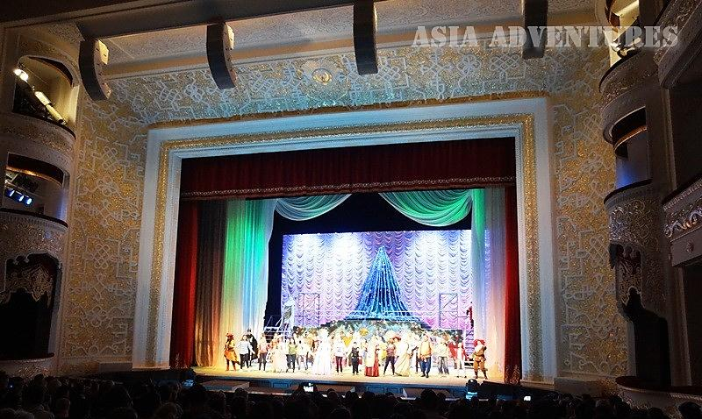
3a Listen and choose Lena or Botir.
Choose who...
1) … doesn’t like matinees?
2) … likes evening performances?
3) … hasn’t been to this theatre before?
4) ... has the seats in the box?
5) ... has the seats in the stalls?
6) ... hasn’t seen the play before?
Lena
Lena
Botir
Botir
Lena
both
All the world is a stage.

Slide 10
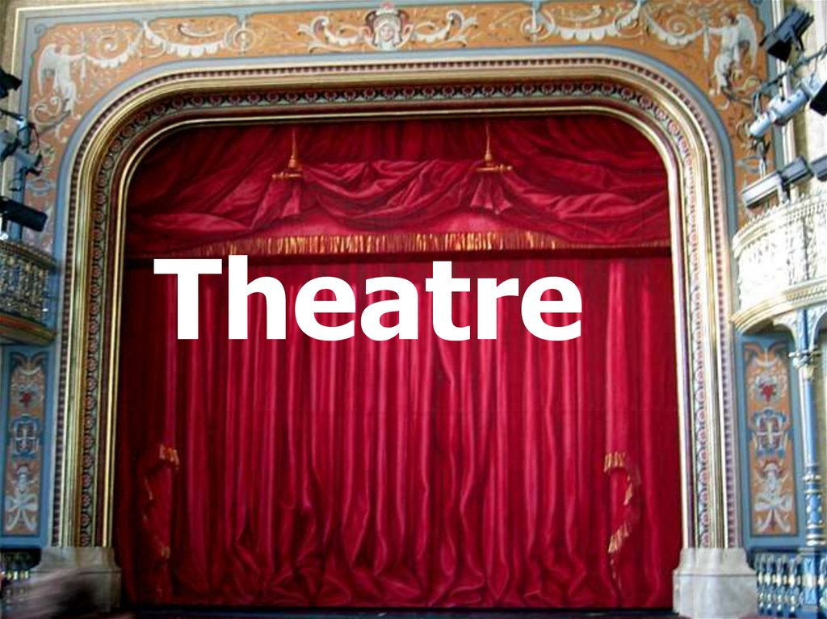
Listen to the second dialogue and say True or False.
F
1) The performance is on Saturday.
2) They are doing a new play.
3) They bought the tickets in the box office.
4) It was a matinee.
5) Their seats were in the dress circle.
6) They won’t need the opera glasses.
7) They are meeting outside the theatre.
T
F
F
T
F
T

Slide 11
4a Make up your dialogue.
Alice: What about going to the theatre on Sunday? They’re doing a
new play.
Bahrom: I’d love to. Do you think we’ll be able to get tickets? I know
that new plays are very popular with the public.
Alice: You’re quite right, but I’ve already booked seats by telephone.
Bahrom: Oh, it’s wonderful. Is it a matinee or an evening performance?
Alice: It’s an evening performance.
Bahrom: Where shall we sit? In the stalls?
Alice: No. Our seats are in the balcony. So, perhaps, we’ll need the
opera glasses.
Bahrom: Shall we meet outside the theatre at 7.15?
Alice: It suits me fine.
Bahrom: So, see you soon.

Slide 12
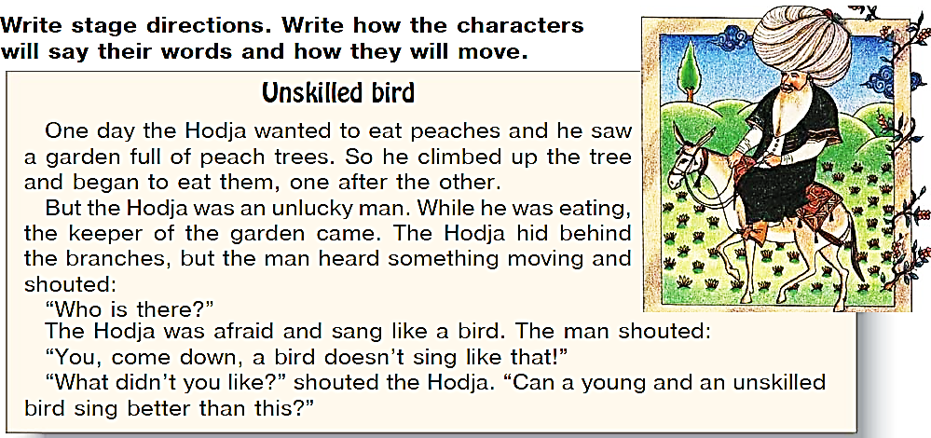
For self-study
1 Write a dialogue.
(U10, L5 p.120)
2 Design the stage set. Think about what can be put on the stage.
3 Write stage directions. Write how the characters will say their words and how they will move.

