Slide 1
ENGLISH
Grade
8
THEME:
UNIT 10. All the World is a stage.
Lesson 4. Great playwrights.
(page 81)

Slide 2
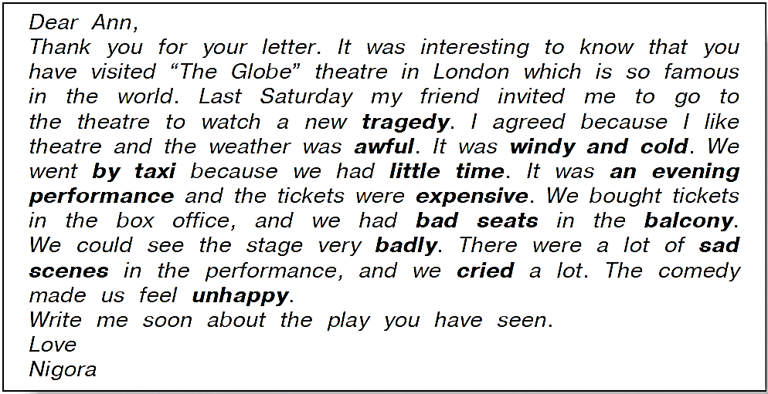
Checking the self-study work
(U10, L3 p.119)
,

Slide 3
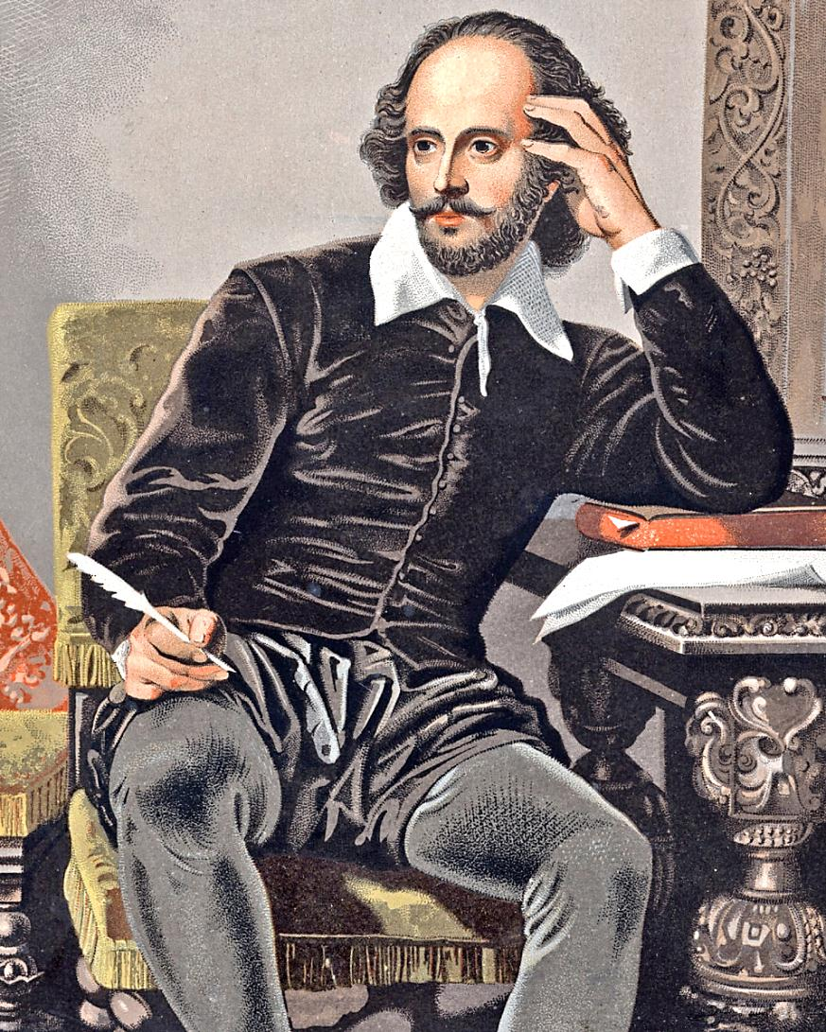
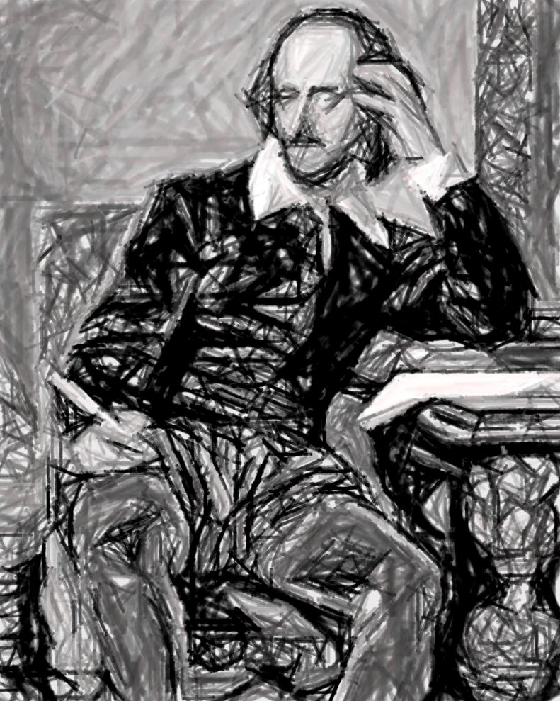
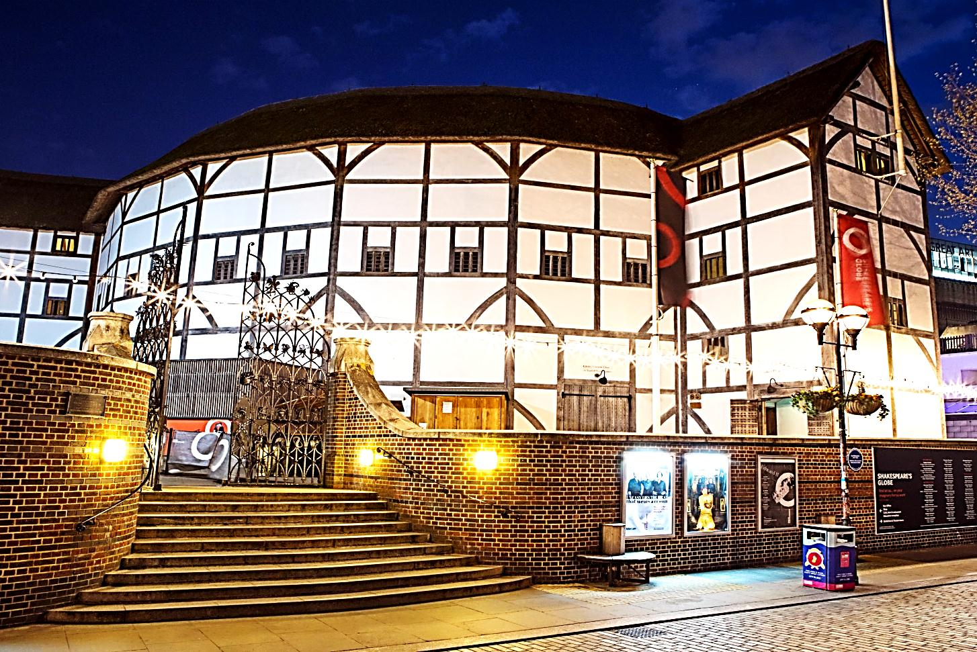
1a Answer the questions.
1) Who is the greatest English playwright?
2) What was the name of the theatre where he worked?
3) Who played all the roles in the theatre?

Slide 4
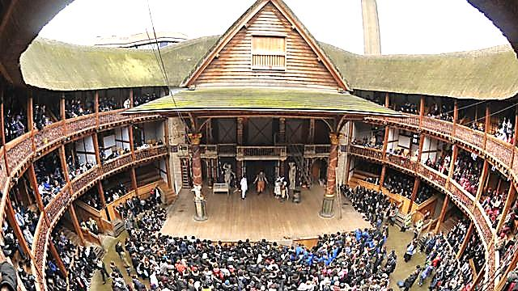
1b Read and check your answers.
Theatre in the 17th century
From ancient times some European countries had theatres where young men and boys played the roles of women. One example was “The Globe” , one of the most famous theatres of England.

Slide 5
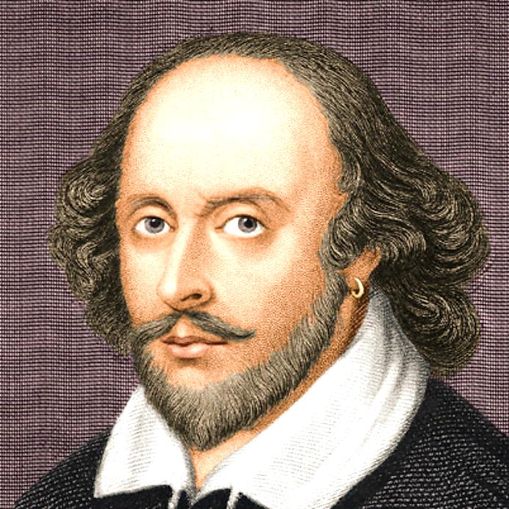
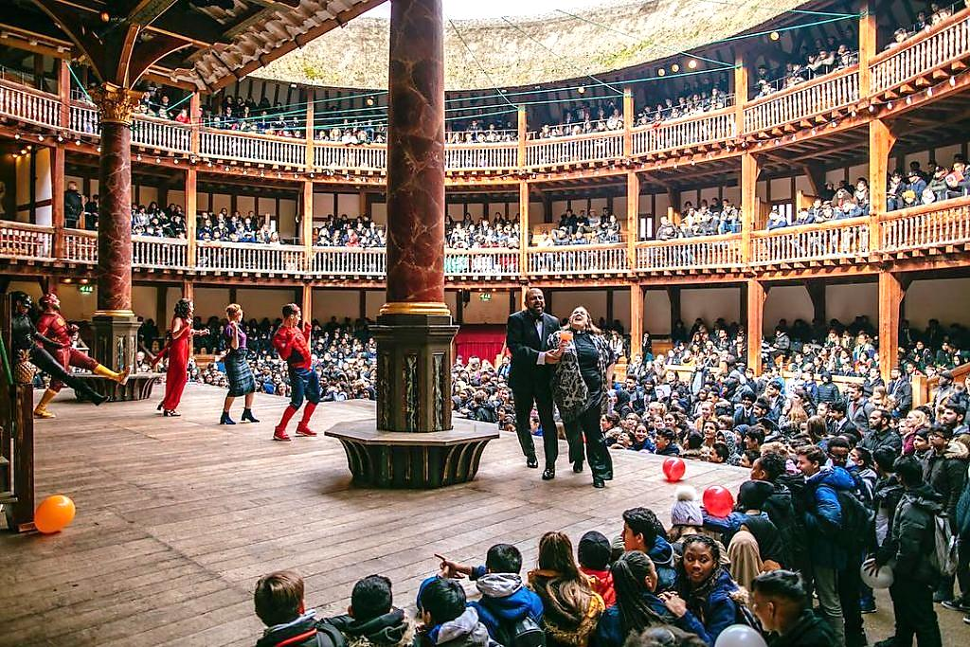
1b Read and check your answers.
The greatest English playwright Shakespeare (1594-1616) worked there first as an actor and then as the author of plays. Theatre lovers all over the world think his comedies, tragedies and histories are the best in the world.

Slide 6
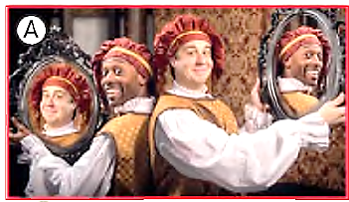
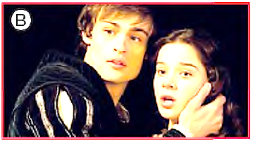
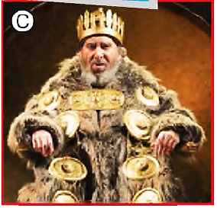
2a Match the pictures and the plays.
1) King Lear
2) Romeo and Juliet
3) The Comedy of Errors

Slide 7
2b Listen and match the texts with the plays.
The Comedy of Errors Romeo and Juliet King Lear

Slide 8
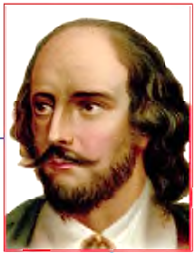
2c Answer the questions.
1) The author of the three plays is one man. Can you guess his name?
2) Which of the three plays is the funniest?
3) Which of the three plays deals with a serious moral issue?
4) Which of the three plays would you like to read or to see in the theatre? Why?

Slide 9
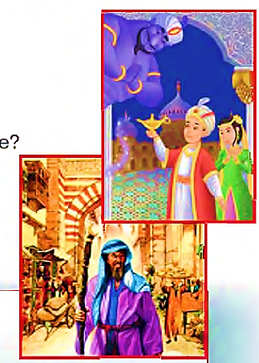
3 Read and write a short dialogue.
e.g. Abanazaar: Hi Aladdin. I’m your relative. I’m your father’s cousin’s wife’s brother.
Aladdin: Hi. Glad to meet you.
ALADDIN COMEDY SCRIPT
Author: Bradley Coffey
Genre: Comic version of traditional tale
The cruel wizard Abanazaar wanted to have power to rule the world. But the power could be only given to one person. It was Aladdin. When Abanazaar arrived in Peking, he looked for Aladdin and asked him to get a magic lamp from a secret cave. Abanazaar said that he was his long lost relative. He said that he would give Aladdin a lot of money. Aladdin needed money because he wanted to marry the Princess and so he agreed. But things got even better when Aladdin rubbed the lamp himself, and saw the Genie. Abanazaar was angry and he ordered Aladdin to give the lamp to him. Aladdin did not want to give it to him and Abanazaar tried to kill him ... .

Slide 10
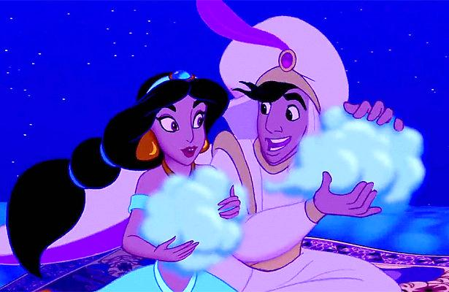
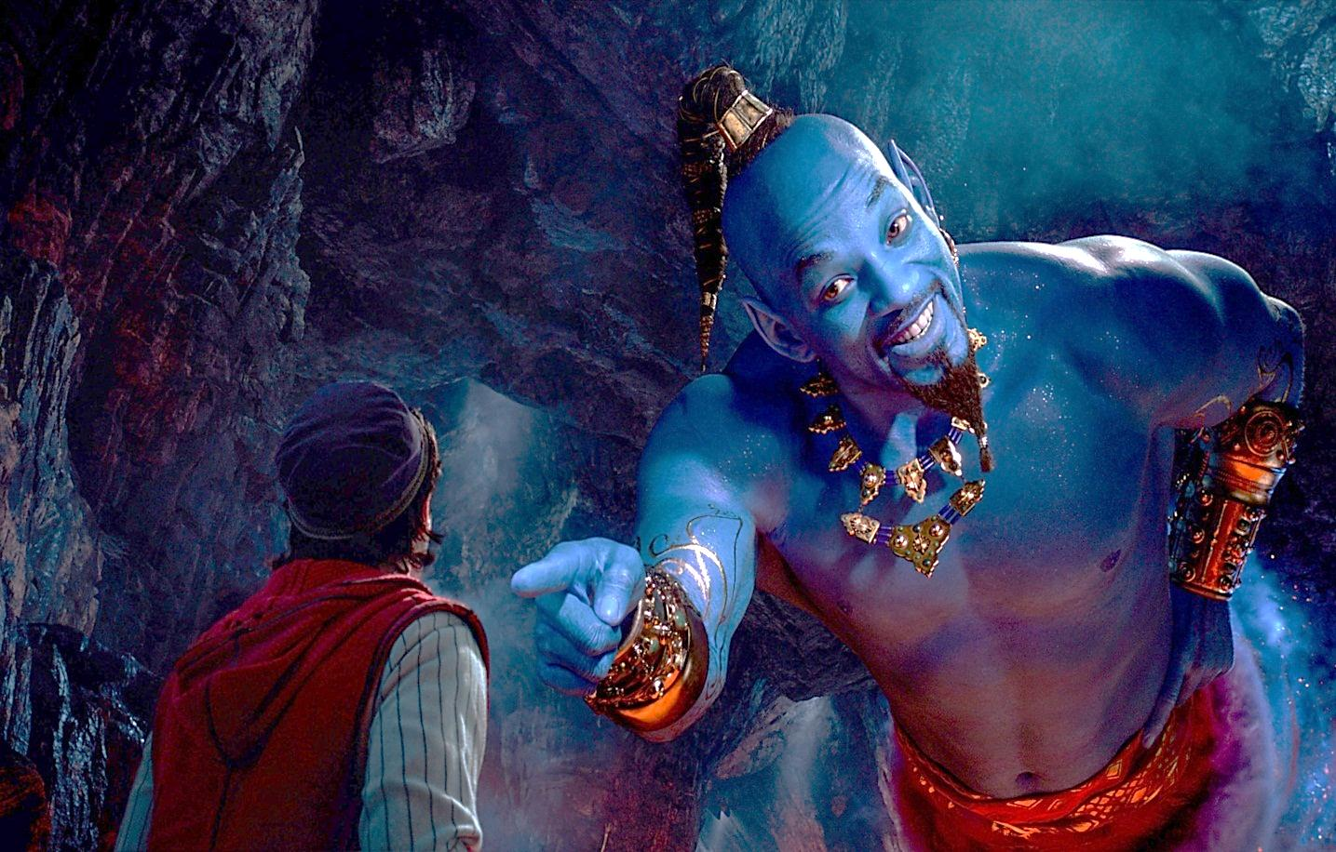
Watch the video and compare your dialogue.

Slide 11
For self-study
1 Change the sentences from the Reported Speech into the Direct Speech.
1) He asked his son to bring him a glass of water.
2) The old woman ordered David to get out of her garden.
3) The man told them to look around.
4) Adrian asked Susan to listen to him.
2 Look at the fact file and write about the actor.
(U10, L4 p.119)

