Slide 1
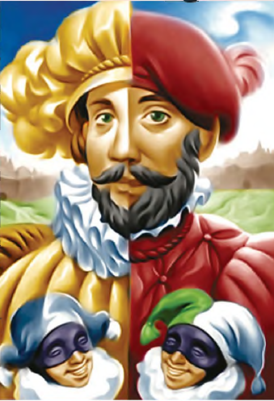
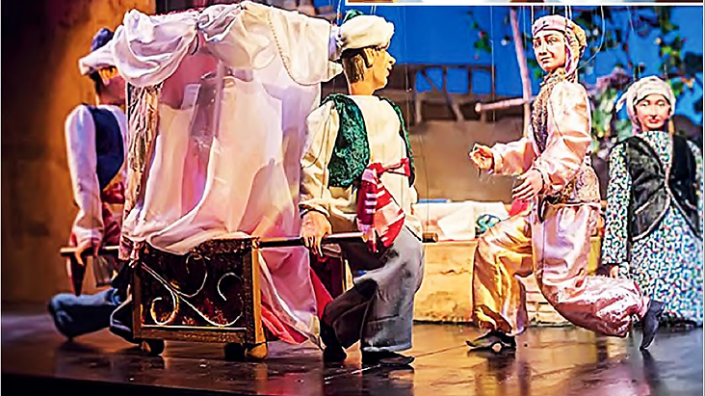
ENGLISH
Grade
8
THEME:
UNIT 10. All the World is a stage.
Lesson 2. He asked her to say.
(page 79)

Slide 2
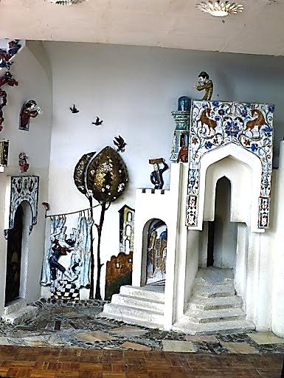
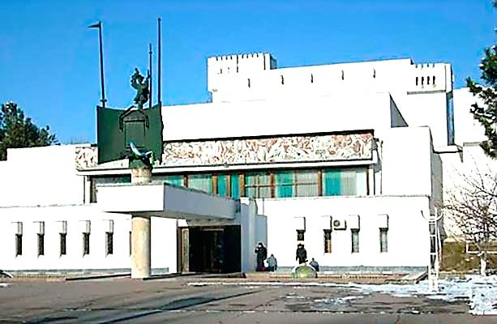
Checking the self-study work
Write about any puppet show you have
ever been to. Use the questions.
(U10, L1 p.118)
1) When did you go?
2) What dolls were there: glove puppets or marionettes?
3) What was the play about? Who were the characters?
4) Did you like the show? Why?/Why not?

Slide 3
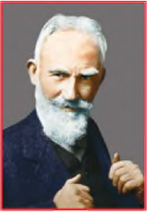
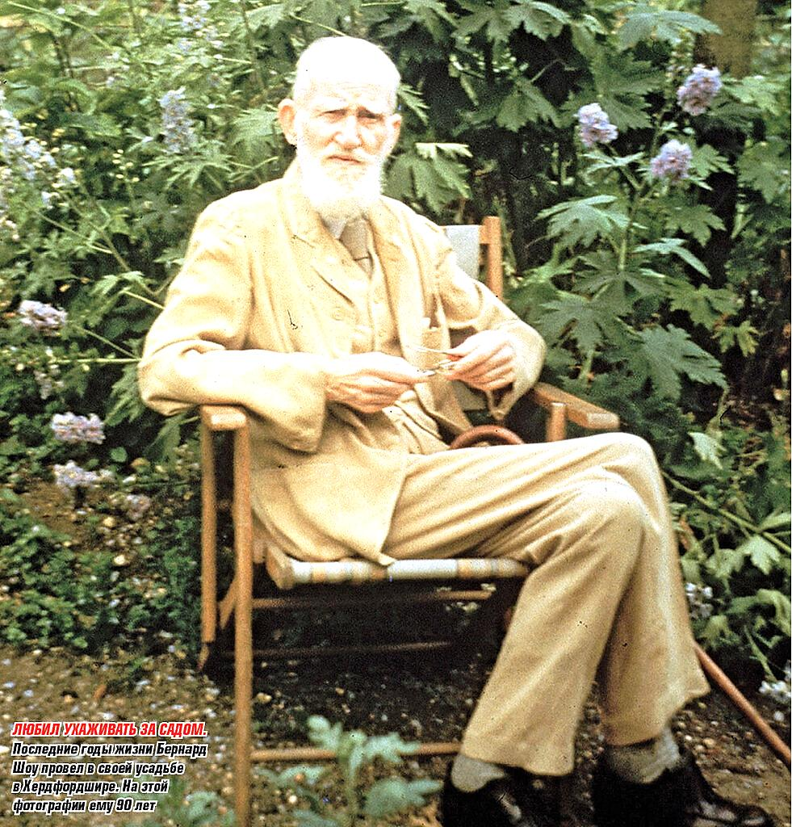
Activity 1a page 79
Say what you know about Bernard Shaw.

Slide 4
1b Ask and answer.
Teacher : look at this page.
Pupil: look at page 75.
e.g. Where was George Bernard Show born?
George Bernard Shaw was a famous Irish playwright and
writer. He was born in (1) ... (Where?) in 1856. At the age of
(2) ... (How old?) he moved to London. Bernard Show wanted
to become a (3) ... (What?). However, his novels were not
successful and he gave up writing them. Soon his attention
turned to the (4) ... (What?). Show wrote more than fifty plays.
His best-known play is (5) ... (What?). The main characters are Eliza Doolittle, Professor Higgins and Colonel Pickering.
Dublin
19
a novelist
drama
Pygmalion

Slide 5
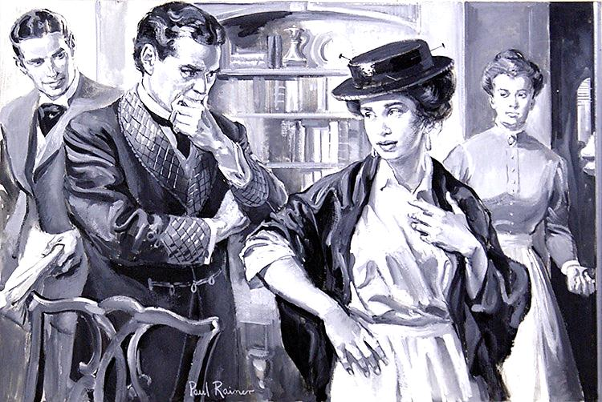
Activity 2 page 79
Answer the questions about the characters of the play Pygmalion.
1) Why did Eliza Doolittle come to Professor Higgins?
2) Why did Eliza want to talk and act like a lady?
3) Who gave money for her lessons?
4) What doesn’t she like about Professor Higgins?

Slide 6
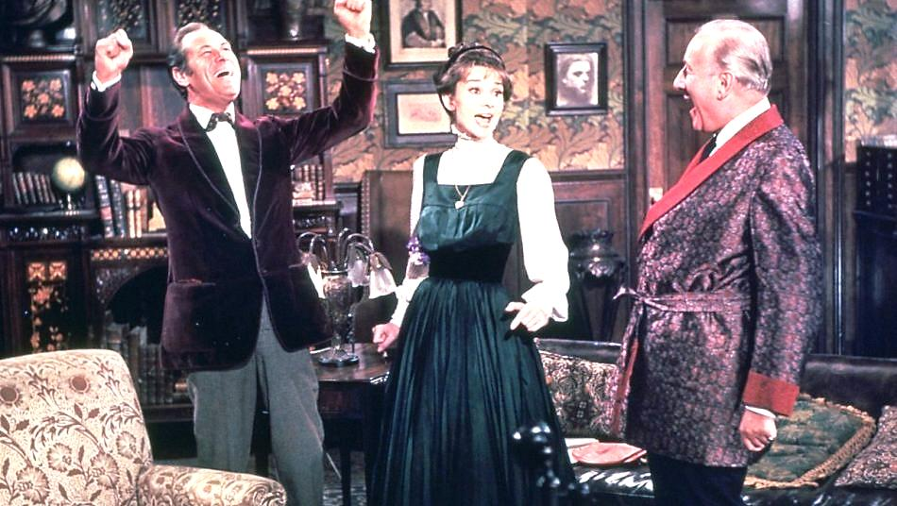
2b Read and check your ideas.
Professor Henry Higgins is good at the English language. He meets
a flower girl Eliza Doolittle. Eliza Doolittle was grown up in a poor part of London and spoke English badly. Nobody could really understand her when she spoke. She asks Higgins to teach her to talk and act like a lady so that she might work in a very good flower shop.
Higgins’s friend, Colonel Pickering, offers to give money for her lessons.
Eliza makes a success in her study but she does not like Higgins’s
bad manners because he does not treat her like a lady.

Slide 7
Pygmalion
Pygmalion is a play by George Bernard Shaw, named after a Greek mythological figure in which Pygmalion was a sculptor who fell in love with a statue he had carved. Shaw’s play has been adapted numerous
times, most notably as the musical My Fair Lady and its film version. It has a happy end. Higgins got married miss Doolittle.

Slide 8
3 a Watch the video and answer the questions.
1) What does Professor Higgins want Eliza to do?
2) Is it easy for Eliza to be a good learner?

Slide 9
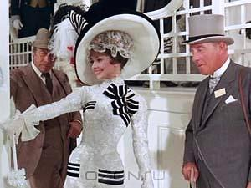
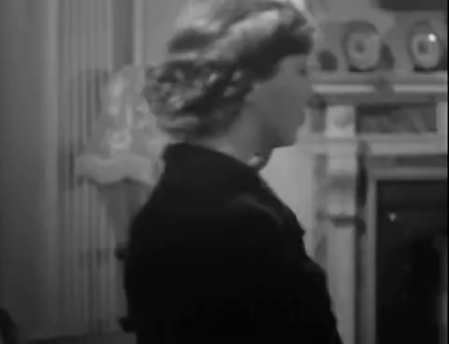
3b Explain the stage directions.
how the words are said
1) HIGGINS: [as a teacher] Say your alphabet.
2) HIGGINS: [thundering]. Say your alphabet!
3) PICKERING: [softly] Say it, Miss Doolittle.
4) HIGGINS: [to Eliza.] Say, “a cup of tea” .
who the speaker
addresses

Slide 10
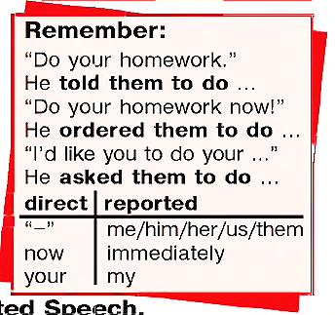
3c Look at the sentences in 3b
Say which verb in Reported Speech is the best. Why?
1) Higgins ordered / told / asked Eliza to say her alphabet.
2) Higgins ordered / told / asked Eliza to say her alphabet.
3) Pickering ordered / told / asked Eliza to say her alphabet.
4) Higgins ordered / told / asked Eliza to say “a cup of tea”.
Other verbs like advise, warn, suggest, and in commands the verb order can be used.

Slide 11
4 Write the sentences in the Reported Speech
Albina (to her friend): Please, visit me at hospital.
1) Albina asked her friend to visit her at hospital.
2) Teacher (to the pupils): Don’t eat in the classroom, please.
2) The teacher asked the pupils not to eat in the classroom.
3) Director (to the pupils): Don’t use your mobile phones at the lesson!!!
3) The director ordered/told the pupils not to use their mobile phones at the lesson.
4) Sasha (to his mother): I don’t understand this book. Mom, can you help me?
4) Sasha asked his mother to help him to understand the book.
5) Mother (to her child): Be careful and don’t run when you cross the street.
5) Mother told her child to be careful and not to run when s/he crosses the street.
6) Alisher (to his sister): Could you buy some bread?
6) Alisher asked his sister to buy some bread.

Slide 12
For self-study
1. Write the sentences in Reported Speech
e.g. She often asked me to stay for lunch.
1) She often said to me, “Could you stay for lunch?”
2) The doctor said to me, “Stop smoking!”
3) I said politely, “Please, make less noise.”
4) She will certainly say to her sister, “Please help
me with my homework.”
5) “Get out of the car!” said the policeman.
2. Answer the questions.
1) Do you think Pygmalion is
a comedy or a tragedy? Why
do you think so?
2) Would you like to see this
play? Why? /Why not?
(U10, L2 p.118)

