Slide 1
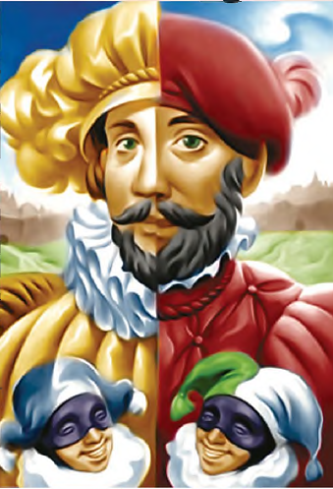
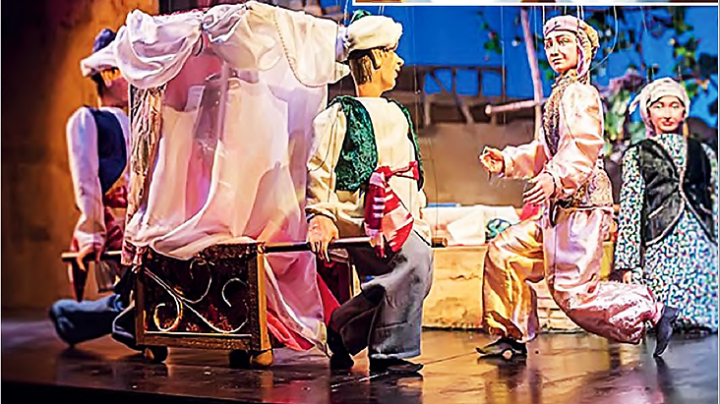
ENGLISH
Grade
8
THEME:
UNIT 10. All the World is a stage.
Lesson 1. Ancient theatres. Part I.
(page 78)

Slide 2
Checking the self-study work
p.104 Unit 6 L1

Slide 4
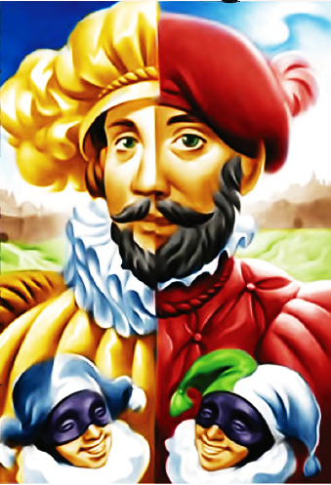
Activity 1a Learn new words
audience - аудитория
gesture - жест
tragedy - трагедия
stage set - декорации

Slide 5
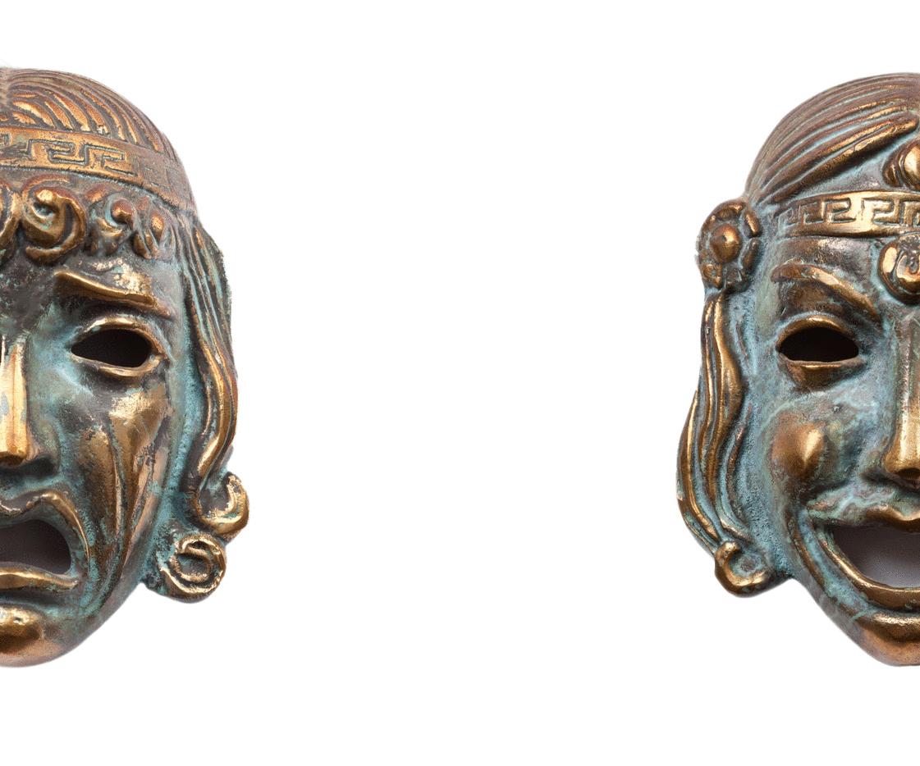
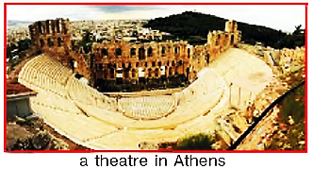
Activity 1b Answer the questions
1) What is theatre?
2) When and where did the first theatres appear?
3) What types of plays were performed?
4) Who were the actors?

Slide 6
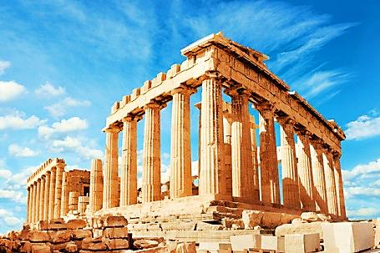
1c Read and check your ideas.
The first people who created plays were the ancient Greeks in
700 BC. The ancient Greeks invented two types of plays. Tragedies always had a sad ending, while comedies always had a happy ending.

Slide 7
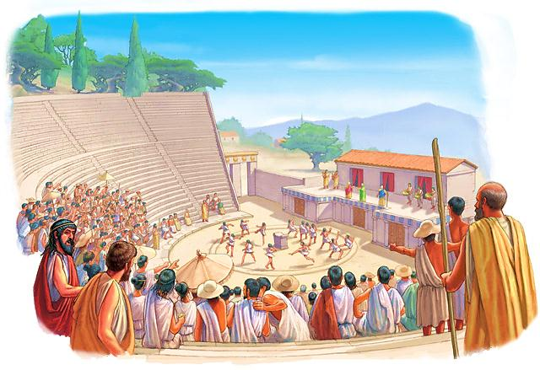
1c Read and check your ideas.
Both kinds of plays are still used today. The chorus sang and danced as part of a play. Only men played in the theatre. They wore masks.

Slide 8
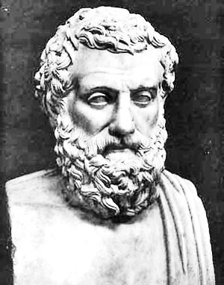
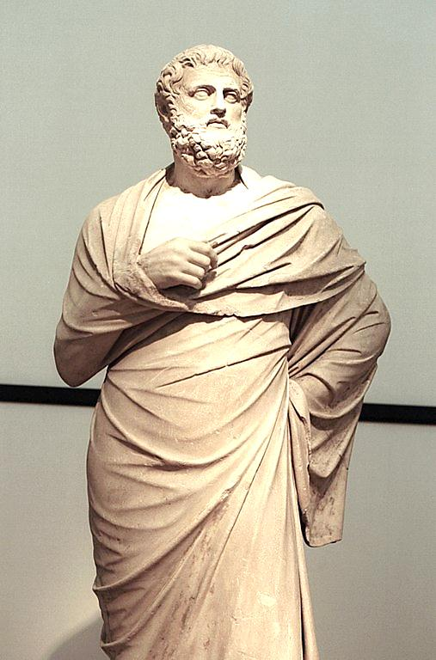
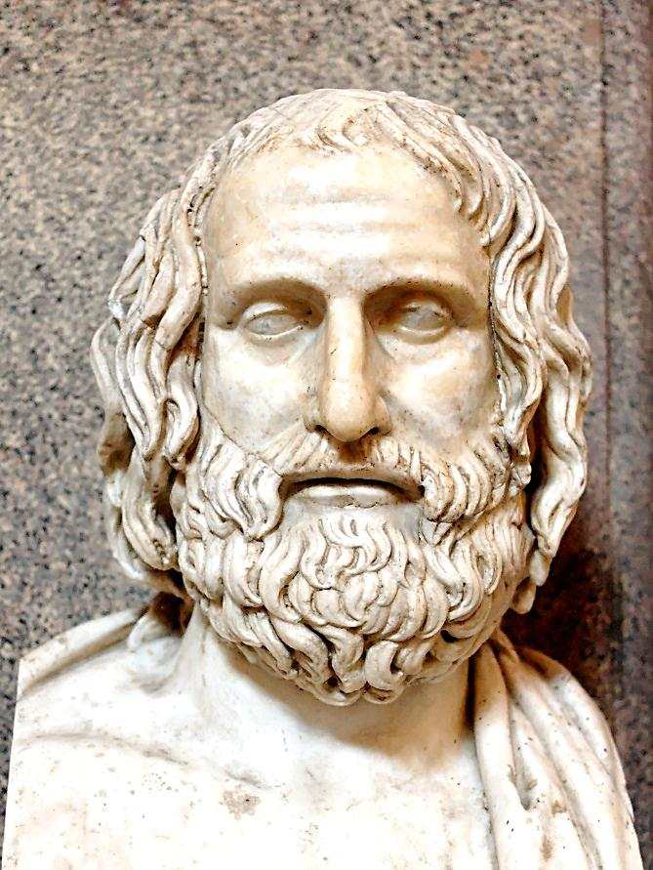
1c Read and check your ideas.
The masks were different for each type of play. The best known ancient Greek playwrights were Aeschylus, Sophocles and Euripides. Some of their plays are still performed today. Sophocles wrote 123 plays!

Slide 9
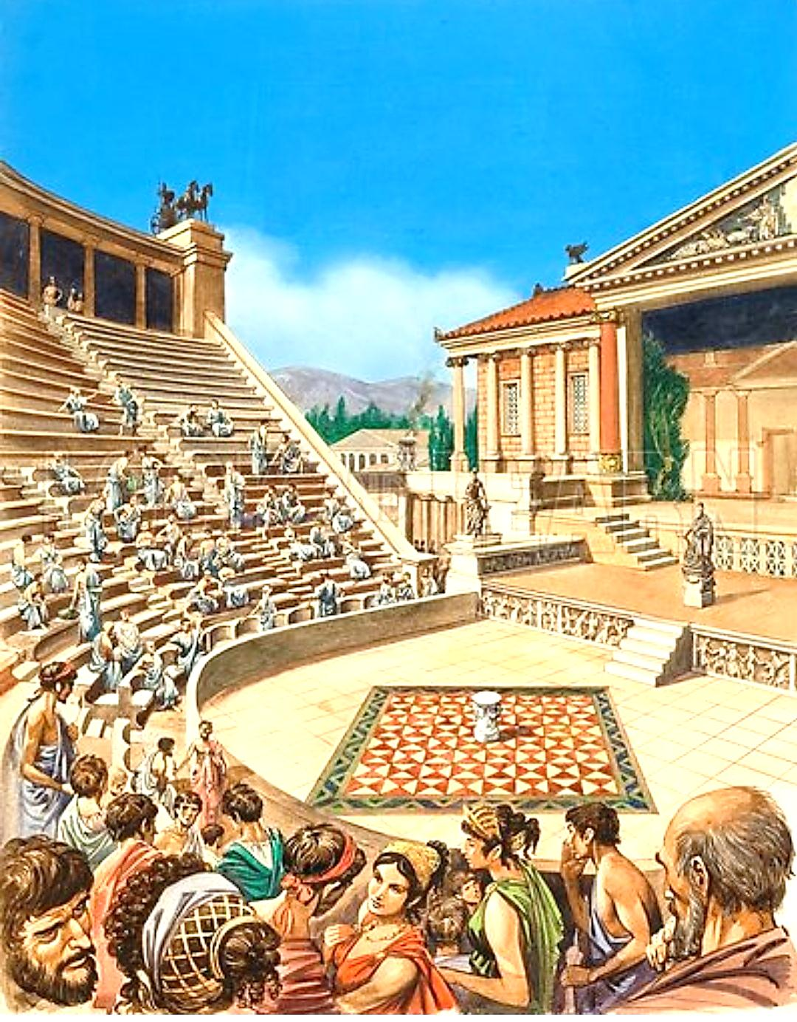
1c Read and check your ideas.
These plays were performed outdoors in large open air theatres, so that up to 15,000 people could see them. There were contests among the playwrights and the winner got a prize. The audience was men, women and children.

Slide 10
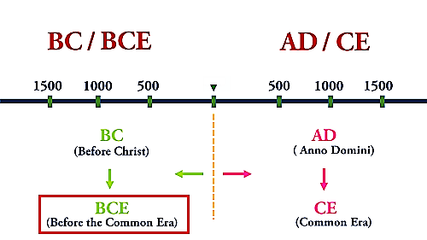
2. Read and say how old the ancient Greek theatre is.
Since we all live in AD or CE (Common Era) years now, there is no need to say “AD” , it is understood. So, it is 2021 AD, but all that you say is 2020. If you have a date in BC or BCE (Before Common Era) and you want to find out how long ago it was, you just add it to the current year. So, if we want to know how long ago 1000 BC was, it was 3021 years ago
(2021 + 1000 = 3021).
The first people who created plays were the ancient Greeks in 700 BC.
Possible answer key:
Ancient Greek theatre is 2721 years old.

Slide 11
For self-study
Complete the sentences with the words. Translate the sentences.
1) A play is divided into several ... .
2) Each act is divided into several ... .
3) What the actors say is the ... .
4) The ... is the furniture and decoration on the stage.
5) The ... tell the actors how to speak, where to move, etc.
stage directions, scenes, stage set, acts, dialogue
(U10, L1 p.118)

