Slide 1
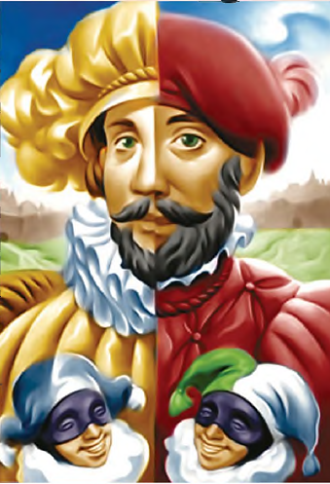
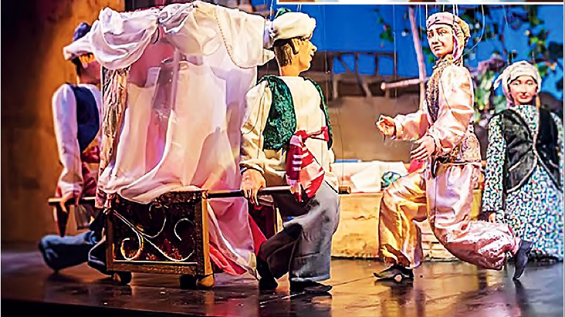
ENGLISH
Grade
8
THEME:
UNIT 10. All the World is a stage.
Lesson 1. Ancient theatres. Part II.
(page 78)

Slide 2
Checking the self-study work
Complete the sentences with the words. Translate the sentences.
acts
1) A play is divided into several ... .
2) Each act is divided into several ... .
3) What the actors say is the ... .
4) The ... is the furniture and decoration on the stage.
5) The ... tell the actors how to speak, where to move, etc.
scenes
dialogue
stage directions, scenes, stage set, acts, dialogue
stage set
stage directions
1) Спектакль делится на несколько действий .
2) Каждое действие разделено на несколько сцен .
3) То, что говорят актеры, - это диалог .
4) Сценический набор - это мебель и декорации на сцене.
5) Сценические постановки говорят актерам, как говорить, куда двигаться
и т. д.
(U10, L1 p.118)

Slide 3
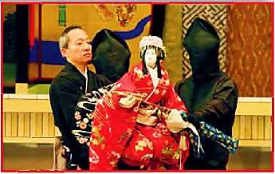
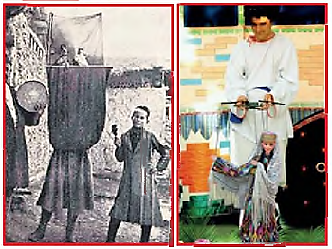
Activity 3a page 78
Listen and repeat the new words, and show them in the pictures.
puppeteer - кукловод
glove puppet - перчатка марионетка
marionette - марионетка
string - нить

Slide 4
3b Answer the questions.
1) What countries are these puppeteers from?
2) How many people operate one doll?
3) What clothes are the dolls wearing?
4) Are these puppet shows modern or old?

Slide 5
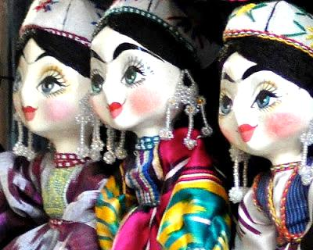
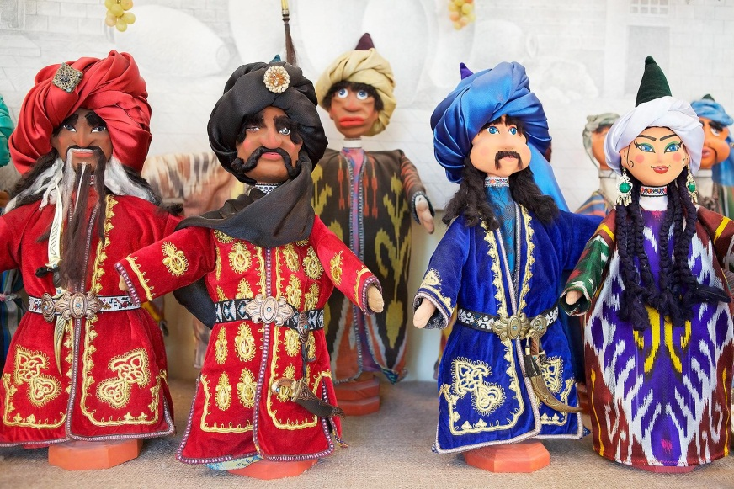
4a Listen and complete the table about Uzbekistan.

Slide 6
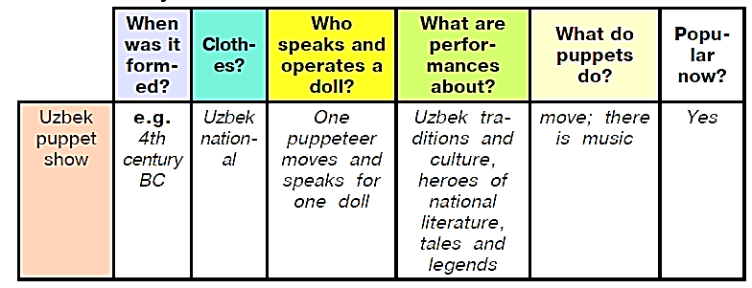
Answer key

Slide 7
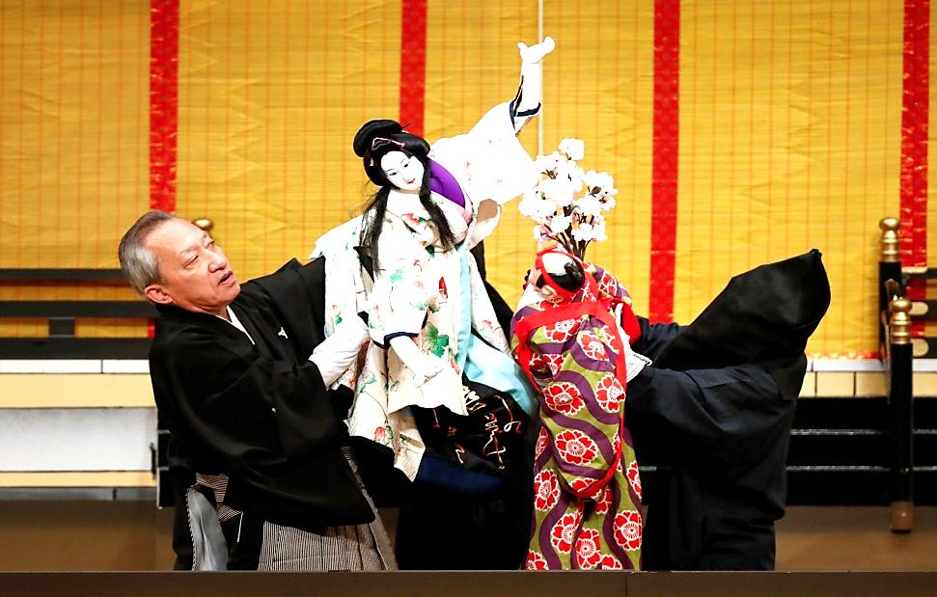
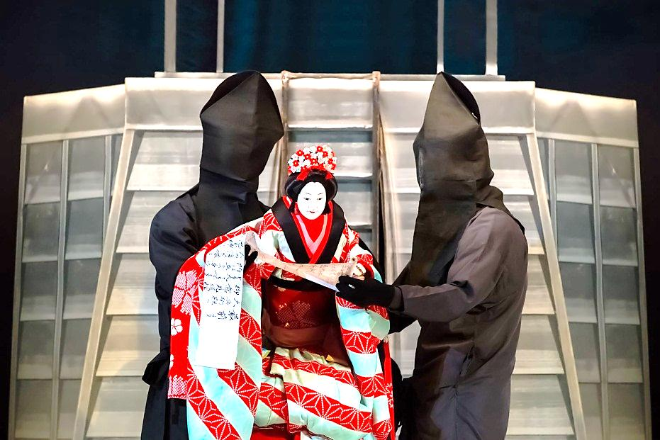
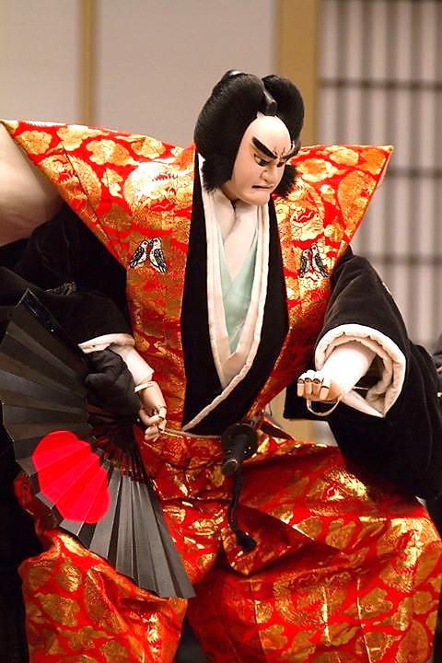
4b Listen one more time and complete the table about Japan.

Slide 8
Answer key

Slide 9
Activity 4c page 78
Say the differences between the Uzbek puppet show and Japanese Bunraku.
e.g. Uzbek puppet show is older than Japanese Bunraku. But
both Uzbek and Japanese dolls wear national costumes.
One puppeteer moves and speaks for one doll in Uzbek puppet show, but in Japanese Bunraku three puppeteers operate one doll, only one person speaks the voice of all the dolls.
The performances in the Uzbek puppet show are about Uzbek traditions and culture, heroes of national literature, tales and legends, but in the Japanese Bunraku they are about stories, legends, tales and stories based on historical events.

Slide 10
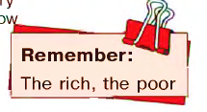
Remember
Adjectives are often used without nouns.
The structure the + adjective is used to talk about some well-known groups of people.
Examples are: the rich, the poor, the young, the old, the blind, the deaf, etc.

Slide 11
For self-study
Write about any puppet show you have
ever been to. Use the questions.
1) When did you go?
2) What dolls were there: glove puppets
or marionettes?
3) What was the play about? Who were
the characters?
4) Did you like the show? Why?/Why not?
(U10, L1 p.118)

