Slide 1
ENGLISH
Grade
8
THEME:
UNIT 9. THE ENVIRONMENT.
Lesson 6. Project.
(page 75)

Slide 2
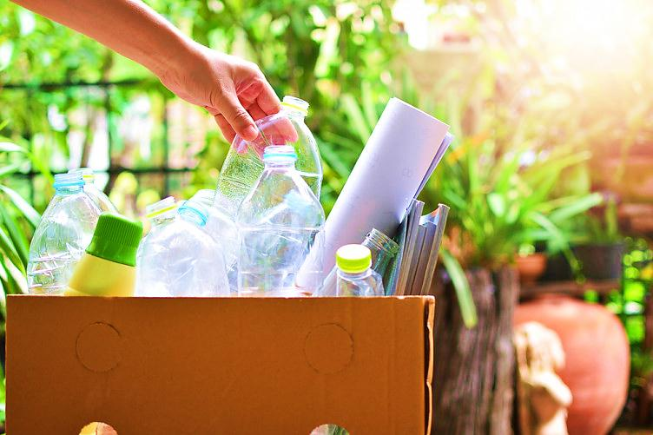
Checking the self-study work
(U9, L5 p.117)
Write five tips to use less plastic.
e.g. Buy cardboard boxes instead of plastic bottles.
Bring up your own shopping bag
Use a reusable water bottle
Use a reusable coffee cup
Say no to plastic cutlery and straws
Take a packed lunch in reusable containers

Slide 3
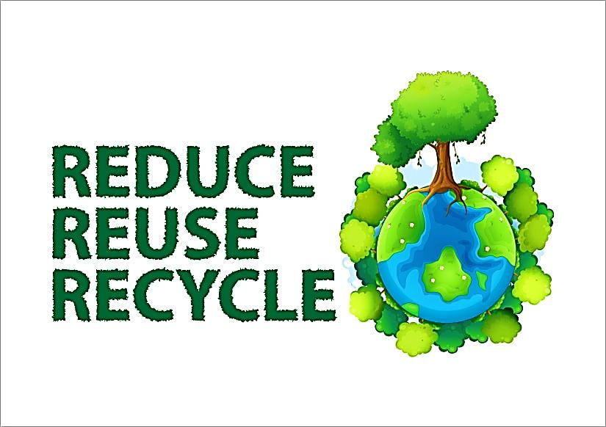
“ Reduce, Reuse, Recycle”
Reduce means to minimise the amount of waste we create.
Reuse refers to using items more than once.
Recycle means putting a product to a new use instead of throwing it away.
Three R’s prevent the emissions of many greenhouse gases and water pollutants, and saves energy.

Slide 4
Learn new words.
island
appear
disappear
to cause
bushfires
to be on fire
to reach
ruin their habitat
scientist
average
to include
to reduce problems
approximately
остров
появляться
пропадать
вызывать
лесные пожары
быть в огне
достигать
разрушить их среду обитания
ученый
средний
включать
уменьшить проблемы
примерно

Slide 5
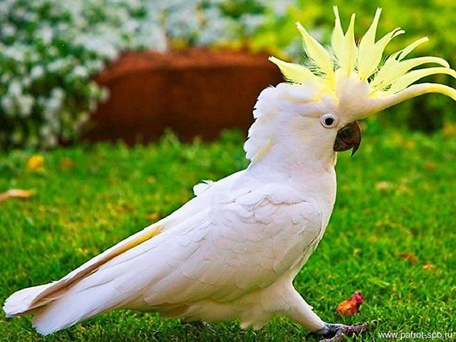
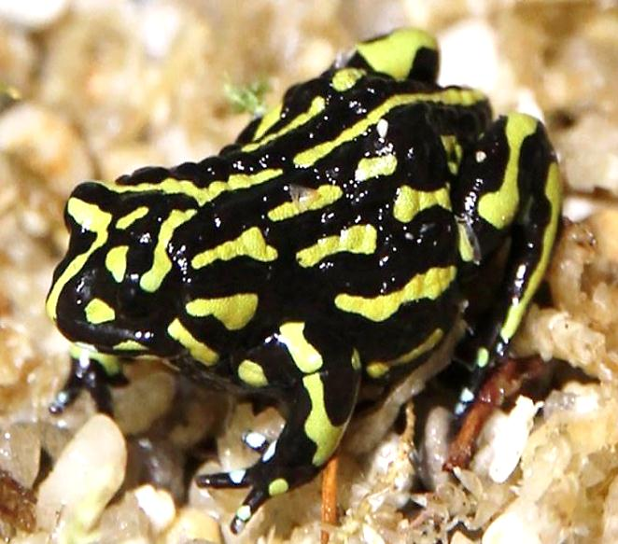
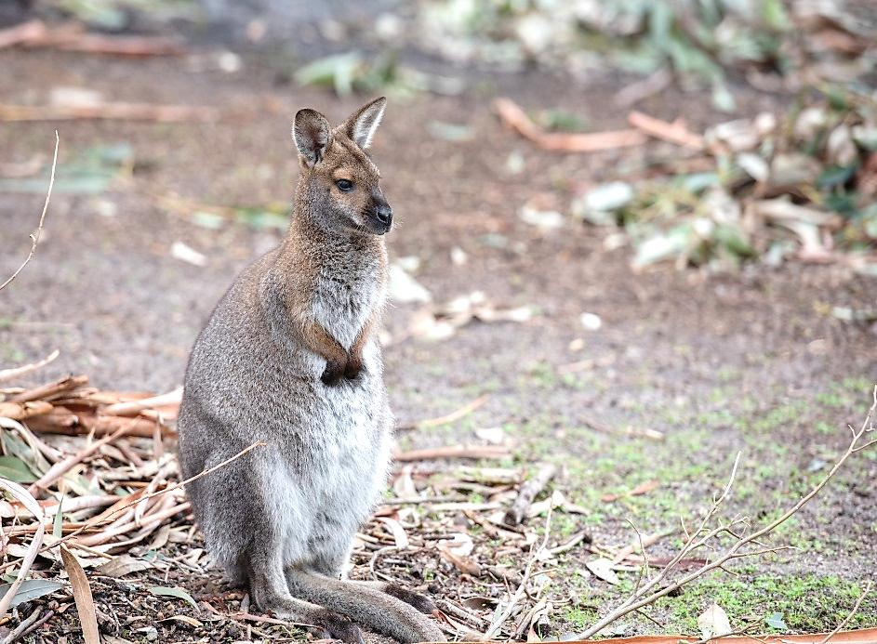
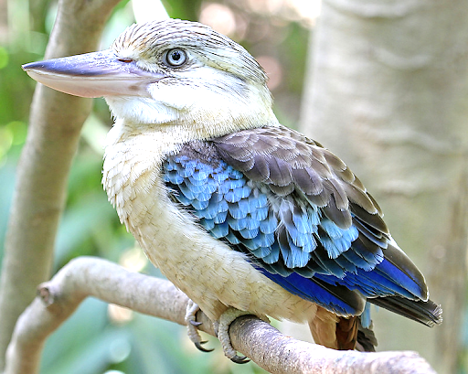
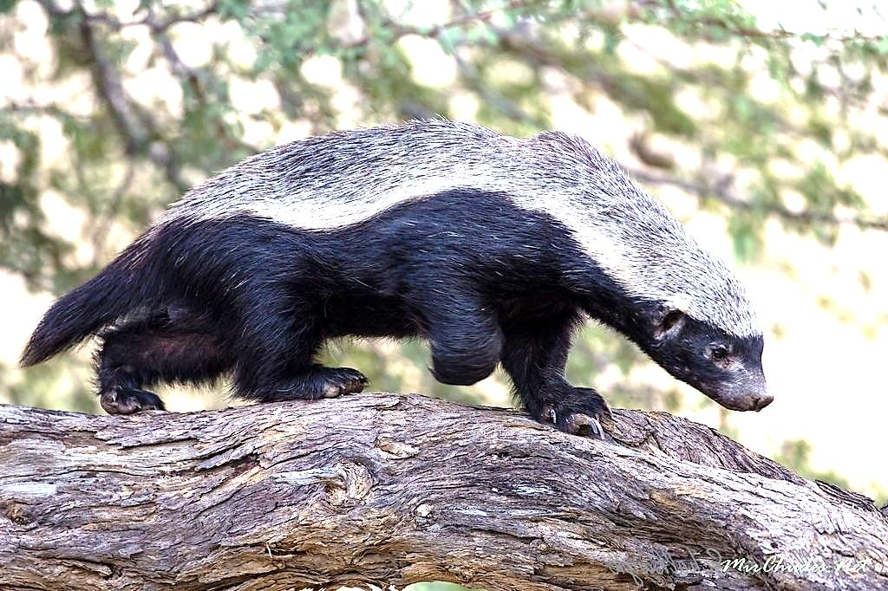
Learn new words.
wallaby
kookaburra
cockatoo
honeyeater
corroboree frog
валлаби
кукабарра
какаду
медоед
лягушка корробори

Slide 6
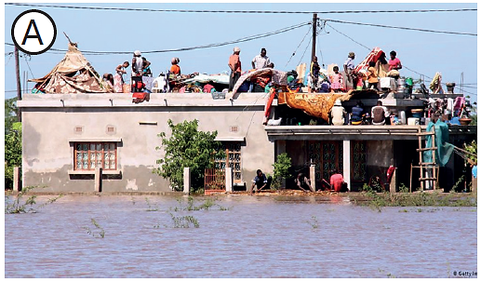
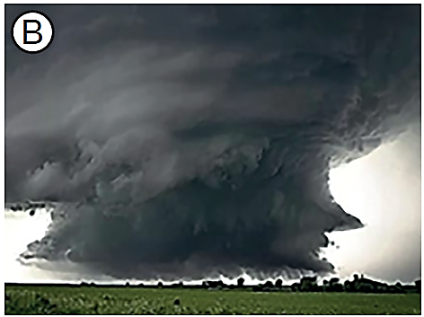
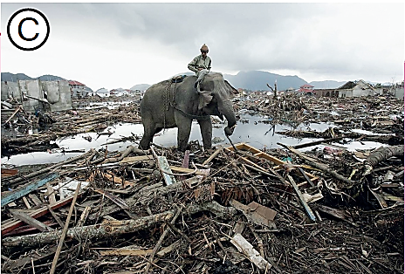
Listen and match the texts with pictures.
Flood in Mozambique
Hurricane in the USA
Tsunami in India

Slide 7
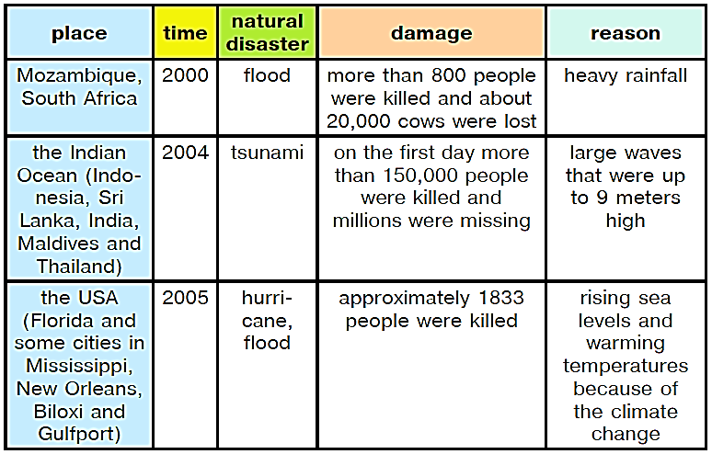
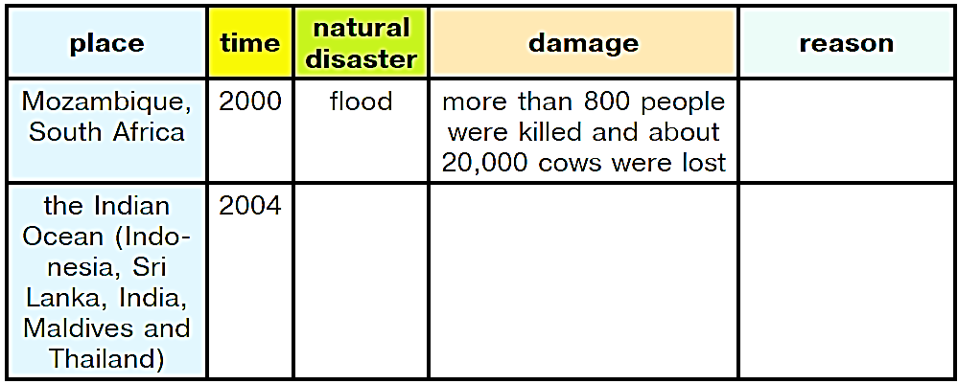
Listen one more time and complete the table.

Slide 8
Read and choose the correct words.
the Dodo, relative, did not fly, could eat them, because of humans
The Dodo was a bird that (1) … . Like many other island birds, dodos only lived on the island of Mauritius. There were no other animals which (2) … and they lost the power to fly. The Dodo was about 1 metre tall and could have weight of 10.6-17.5 kg. It was brownish-grey with yellow feet. The first people landed on Mauritius in 1598. Less than 65 years later, (3) … disappeared. Perhaps you’ve heard the popular saying “as dead as a Dodo”. The Dodo is one of the first birds which have died (4) … since the late 17th century. The nearest dodo’s (5) … is the Nicobar Pigeon.
Answer key:
1)did not fly
2) could eat them
3) the dodo
4) because of humans
5) relative

Slide 9
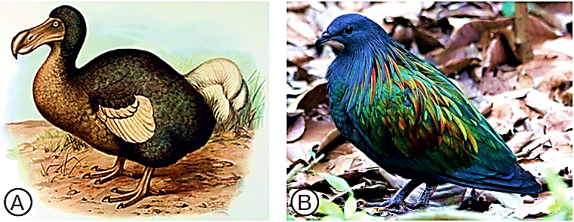
Choose the picture of the Dodo bird.

Slide 10
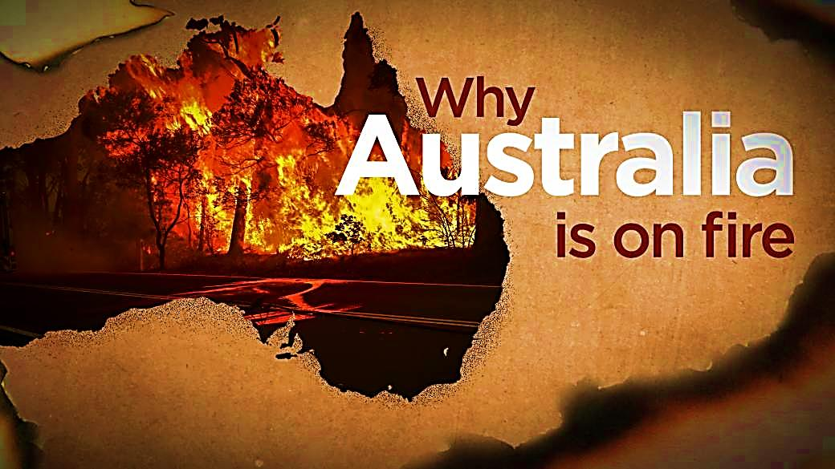
Read and match the texts with headings.
A Can’t animals just run away from a fire?
B Were the Australia fires caused by climate change?
C What about the future?
D How big were the Australia fires 2020?
E How do the Australia fires usually start?
F How many animals have died in the fires?
1) Bushfires have always been a part of Australia’s ecology and environment
for thousands of years. Fires are usually caused by a thunderstorm.
But some fires are started by people. The worst fires are caused
by a long period when there is no rain and there are heat waves. The
bushfires of 2019-2020 were a lot worse than normal. At least 26 people
died.

Slide 11
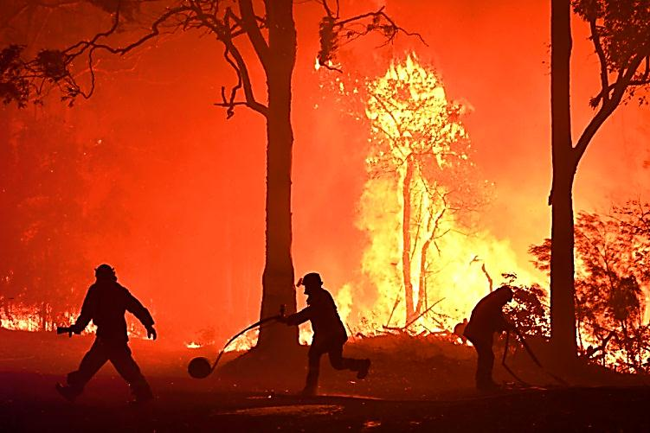
Read and match the texts with headings.
A Can’t animals just run away from a fire?
B Were the Australia fires caused by climate change?
C What about the future?
D How big were the Australia fires 2020?
E How do the Australia fires usually start?
F How many animals have died in the fires?
2) More than 63,000 sq km in Victoria state, the Blue Mountains, the
regions in Southern and Western Australia were on fire. This territory is
as big as 6.3 million sports fields. An environmental scientist of the WWW
Australia, Stuart Blanch, said that the fires had reached Victoria’s Alpine
National Park and New South Wales’s Kosciuszko National Park – home
to very rare animals.

Slide 12
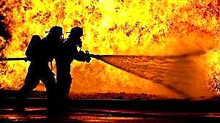
Read and match the texts with headings.
A Can’t animals just run away from a fire?
B Were the Australia fires caused by climate change?
C What about the future?
D How big were the Australia fires 2020?
E How do the Australia fires usually start?
F How many animals have died in the fires?
3) Scientists have long talked that the climate is changing. Hotter and
drier weather makes the risk of fires. In September 2019, the weather in
Australia was too hot and dry. In January, the Australia’s driest summer
month, rainfall was 40% lower than average. It was caused by rising
levels of CO2 on the planet. Australia had a new temperature record: an
average maximum of 41.9C was recorded on 18 December 2019.

Slide 13
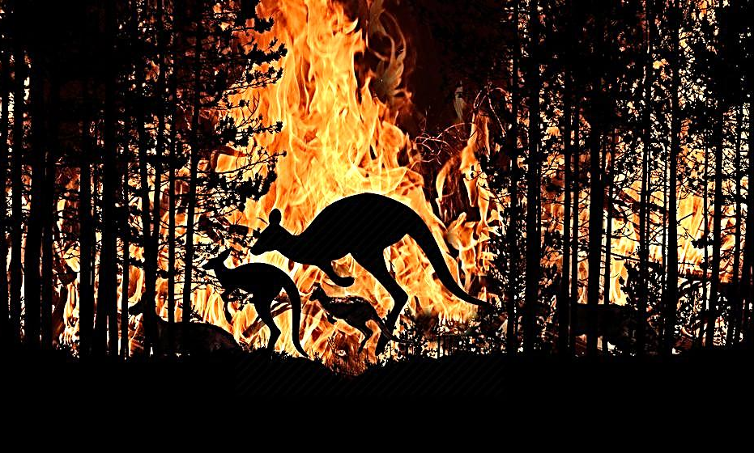
Read and match the texts with headings.
A Can’t animals just run away from a fire?
B Were the Australia fires caused by climate change?
C What about the future?
D How big were the Australia fires 2020?
E How do the Australia fires usually start?
F How many animals have died in the fires?
4) More than 1,250,000,000 animals have died in Australia’s wildfires.
This includes thousands of koalas, kangaroos, wallabies, kookaburras,
cockatoos and honeyeaters which were burnt alive. But the fires don’t
only kill animals; they also ruined their habitat, leaving the animals without
food and home. We can have no such rare animals as the corroboree
frog, the mountain pygmy-possum, the black cockatoo and koalas in the future. Experts say that more than 100,000 cows and sheep were lost
for farmers.

Slide 14
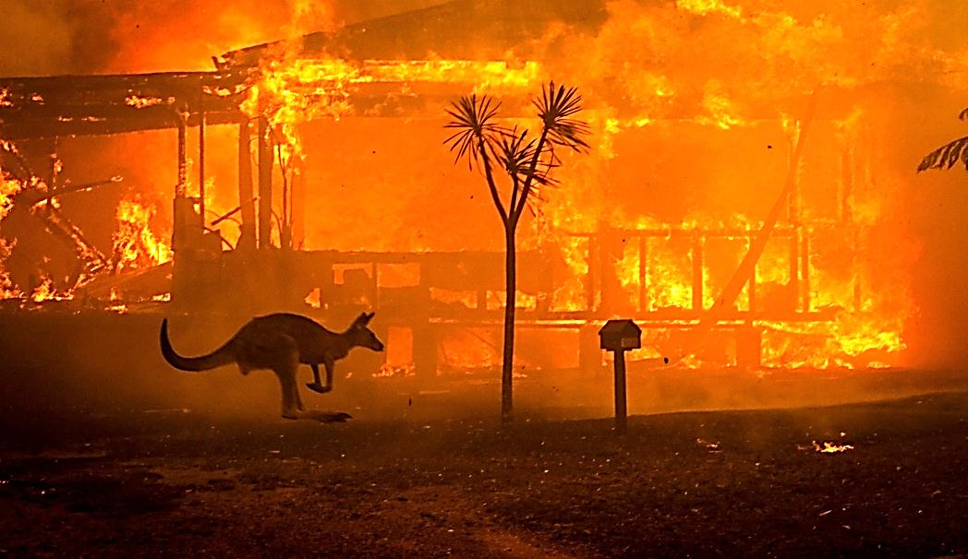
Read and match the texts with headings.
A Can’t animals just run away from a fire?
B Were the Australia fires caused by climate change?
C What about the future?
D How big were the Australia fires 2020?
E How do the Australia fires usually start?
F How many animals have died in the fires?
5) “Certainly, large animals, like kangaroos, emus, many birds, can
move away from the fire,” Prof. Chris Dickman, an expert on Australian
wildlife, said. But he added that “Sometimes the fire is coming from
different directions. In this case there is no way for any animals to leave
away.” “And there are the smaller animals that cannot run. Koalas are a
good example. Approximately 8,000 of them have died from the fires,”
ecologists say. “That’s almost one-third of all koalas in Australia, which
forms their main habitat.”

Slide 15
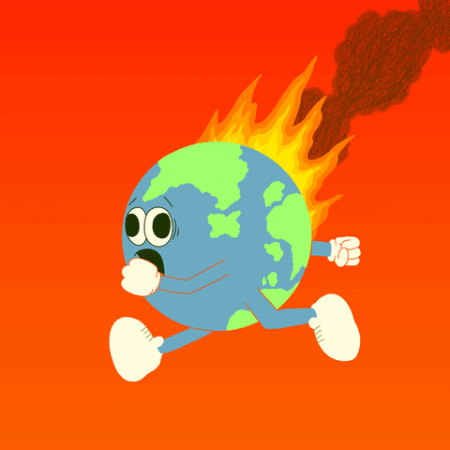
Read and match the texts with headings.
A Can’t animals just run away from a fire?
B Were the Australia fires caused by climate change?
C What about the future?
D How big were the Australia fires 2020?
E How do the Australia fires usually start?
F How many animals have died in the fires?
6) The president of the Australian Academy of Science, Prof. John Shine,
said, “Australia must take stronger action as part of the world community
to limit global warming to reduce the worst problems of climate change
in the future.”

Slide 16
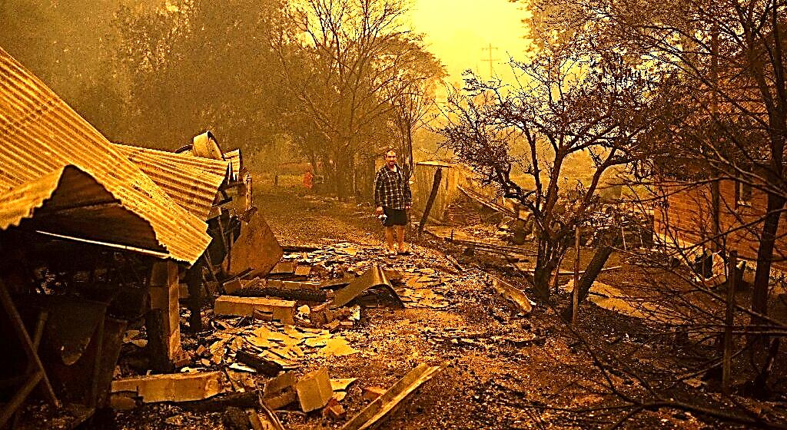
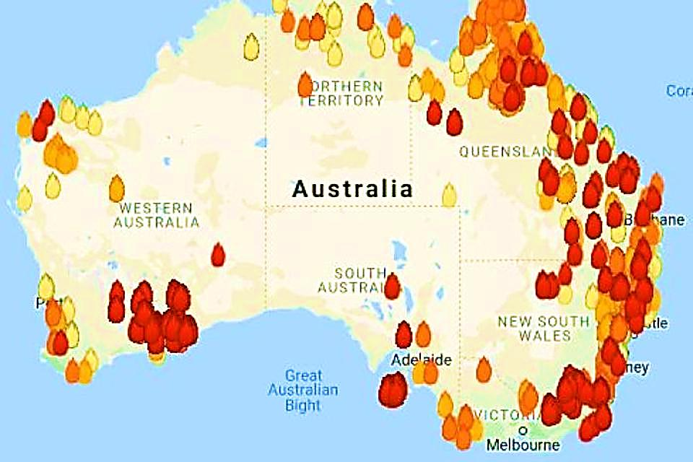
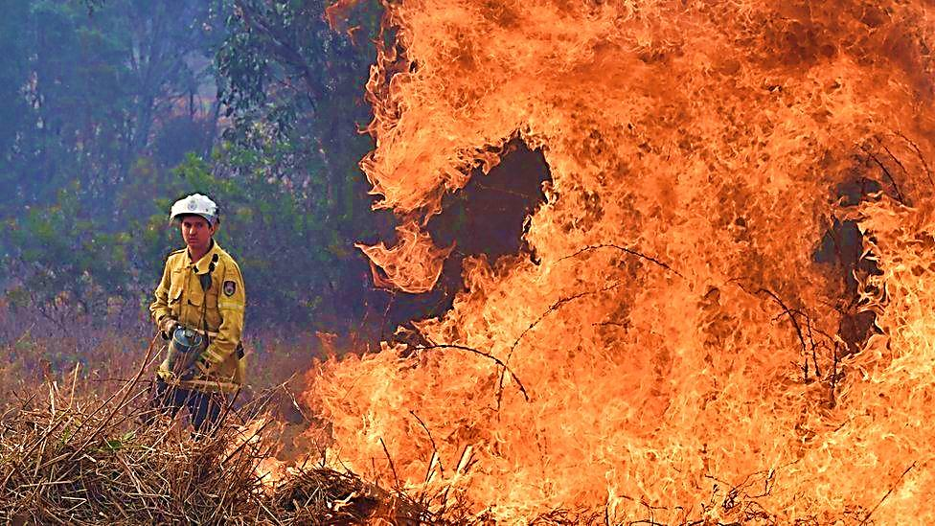
Read and say True or False.
T
1) There were bushfires in Australia before 2020.
2) In the National parks the rare animals were saved.
3) It is summer in Australia in January.
4) Many domestic animals died in Australia’s wildfires.
5) Many animals died after the fires.
6 The situation with bushfires may not happen in the future.
F
T
T
T
F

Slide 17
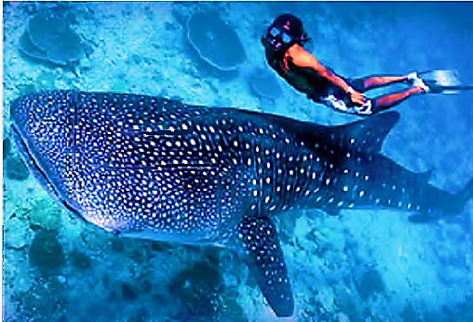
For self-study
1. Learn new words
2. Home Reading:
“Datiz and the Whale Shark”
(Home Reading p.76)

