Slide 1
ENGLISH
Grade
8
THEME:
UNIT 9. THE ENVIRONMENT.
Lesson 5. How can we help to improve the world?
(page 74)

Slide 2
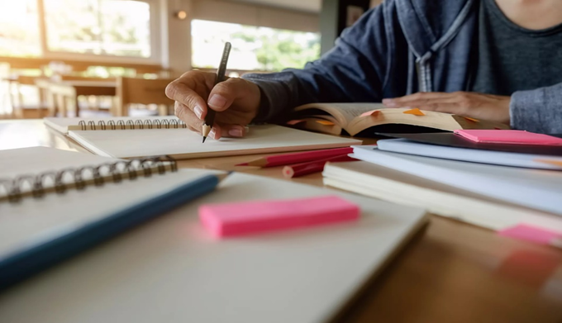
Checking the self-study work
1 Complete the sentences. Use very or really.
1) We had a ... fantastic time. 2) The food was ... delicious. 3) There was
a ... interesting article on climate change in the paper yesterday. 4) There
was a ... unpleasant smell coming from the kitchen. 5) Mr. Graham was
... surprised to find 46 ... ancient gold coins inside the pot. 6) They have
always been ... friendly to me.
Answer key:
1) really
2) really
3) very
4) very
5) very
6) very
2 Match the adjectives which have similar meaning.
1) freezing a) bad
2) delicious b) interesting
3) boiling c) hot
4) awful, terrible d) cold
5) ancient e) sad
6) great, fantastic,
amazing, wonderful f) good
7) exciting g) old
8) miserable h) tasty
3 Look at the table in activity 5. Write the sentences.
(U9, L4, p.117)

Slide 3
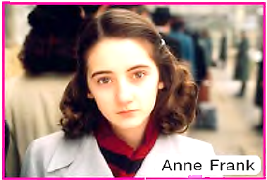
1 Think of what the quotation means.
“How wonderful it is that nobody needs to wait a single
moment before starting to improve the world. ”
Anne Frank
Как это прекрасно, что никому не нужно ждать ни одного
момента перед тем, как начать улучшать мир.
Анна Франк

Slide 4
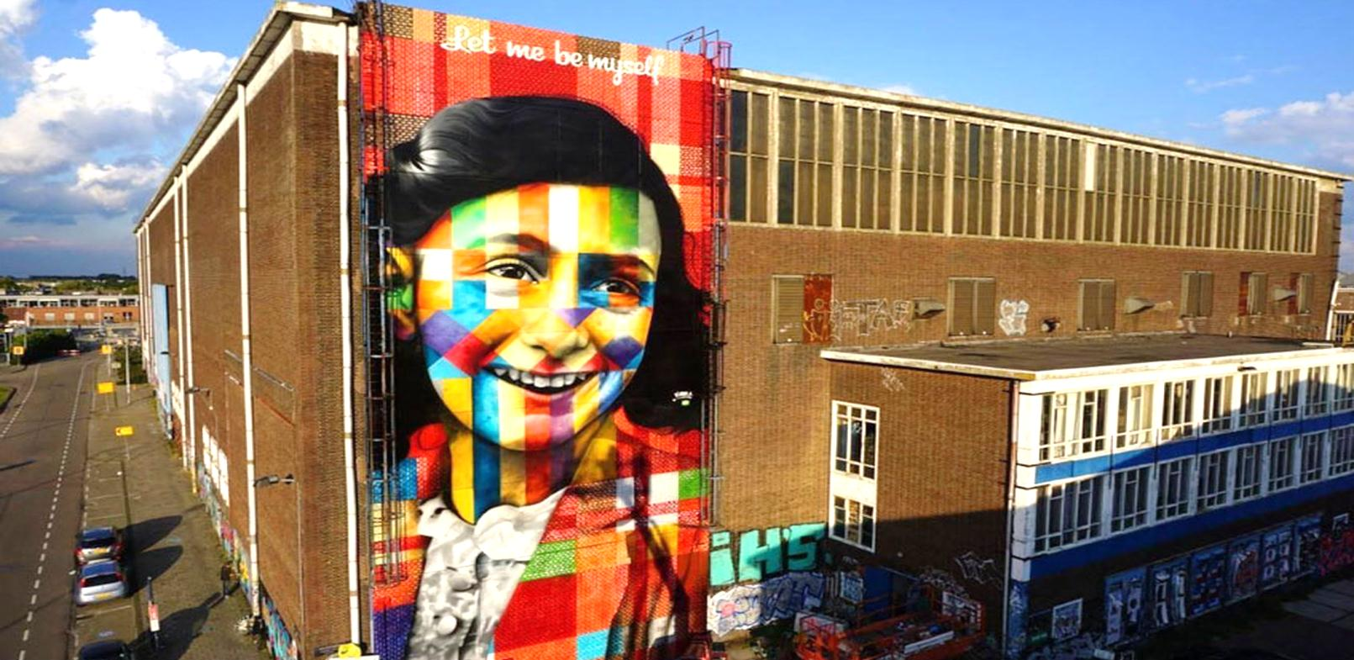
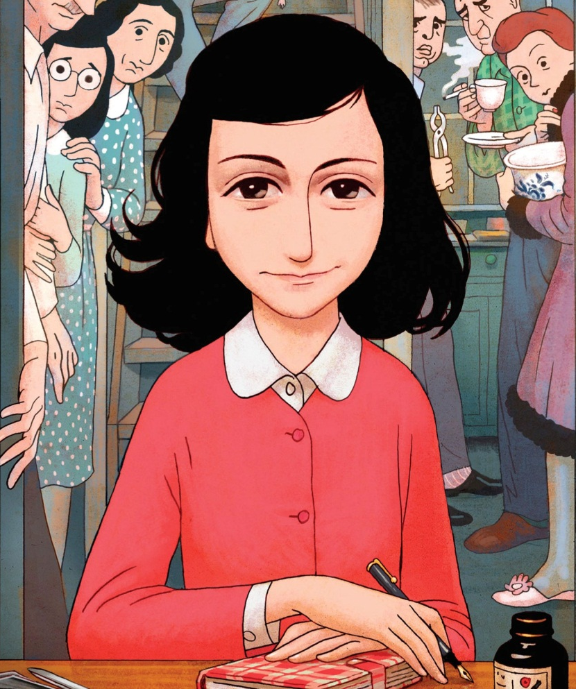
Who was Anne Frank?
Anne Frank was one of the thousands of Jewish children who were killed in the Holocaust. She became a well-known name and one of the most discussed victims of the holocaust after her diary ‘The Diary of a Young Girl’ which has been translated into over 70 languages.

Slide 5
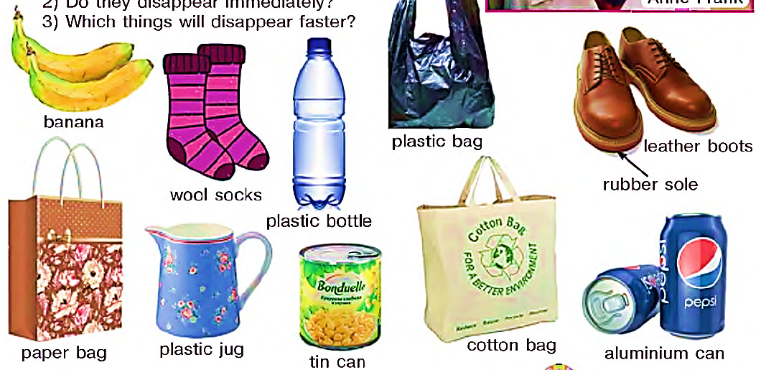
2a Answer the questions. Make a list.
1) What will happen when these things end up in the landfill?
2) Do they disappear immediately?
3) Which things will disappear faster?
banana
plastic bag
leather boots
wool socks
rubber sole
plastic bottle
paper bag
plastic jug
tin can
cotton bag
aluminium can

Slide 6
2b Answer the question.
How long will each item last?
(how many weeks, months or years)
banana - 3 to 4 weeks
paper bag
cotton bag
wool sock
leather boot
rubber sole of the boot
tin can
aluminium can
plastic bag
plastic jug
plastic bottle

Slide 7
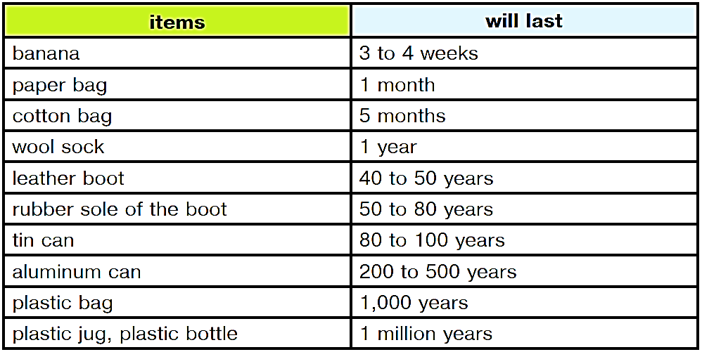
Answer key
The data above was gathered from sources such as the Oregon Department of Environmental Quality

Slide 8
3a Do the quiz.
1) How many scientists think that climate change, which was caused by humans, is happening right now?
50% b) 83% c) 97%
2) True or False: The terms “global warming” and “climate change” mean the same thing.
3) What’s the difference between climate and weather?
a) Weather is what’s happening today; climate is what’s happening long-term.
b) Climate is what’s happening today; weather is what’s happening long-term.
c) Weather changes all the time; climate does not change.

Slide 9
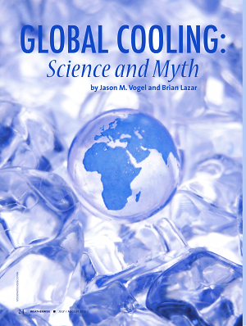
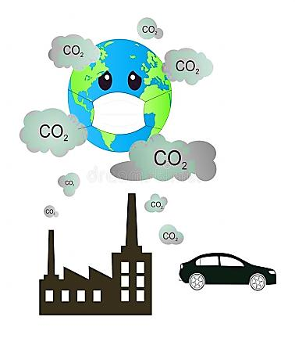
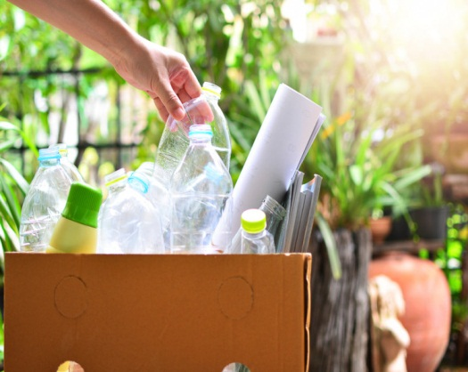
3a Do the quiz.
4) Back in the 1970s, did most scientists think the world was cooling?
Yes.
b) No.
c) Researchers could not make up their minds.
5) Which of these is the most effective thing an individual person can do?
a) recycling as much as possible
b) living without a car
c) taking one less flight across the Atlantic Ocean
6) How much plastic waste is recycled each year in the world?
a) 9% b) 19% c) 29%

Slide 10
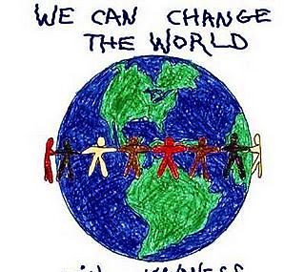
3a Do the quiz.
7) Of the 19 hottest recorded years, how many have taken place since 2000?
11
b) 14
c) 18
8) Is it too late to turn back the problems of climate change?
Yes.
b) No.
c) Not sure.
One of the best climate scientists Kate Marvel told The New York Times, “It’s too late to avoid climate change, but it’s not too late to prevent the worst outcomes. Even if the planet is already warming, we still should do what we can limit the damage”.

Slide 11
3b Answer the question.
What can we do to improve the world?
Volunteer your time at local schools. Children are the future of this world.
Recognize the humanity of the other people, and respect their dignity.
Use less paper.
Conserve water.
Donate to clean water charities.
Be generous.
Проводите время в местных школах добровольно. Дети - будущее этого мира.
Признавайте гуманность других людей и уважайте их достоинство.
Используйте меньше бумаги.
Экономьте воду.
Делайте пожертвования благотворительным организациям, занимающимся чистой водой.
Будьте щедрыми.

Slide 12
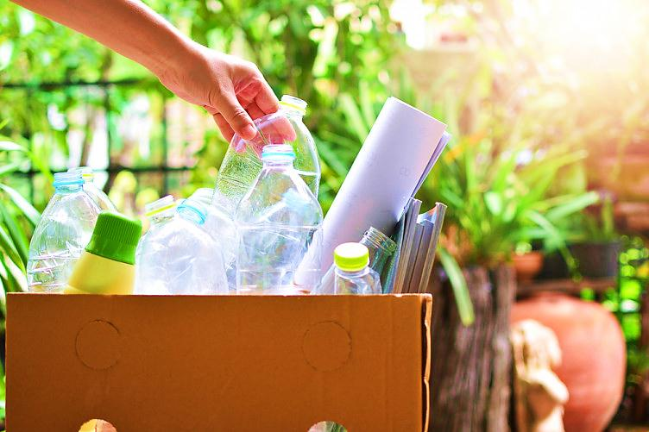
For self-study
Write five tips to use less plastic.
e.g. Buy cardboard boxes instead of plastic bottles.
(U9, L5 p.117)

