Slide 1


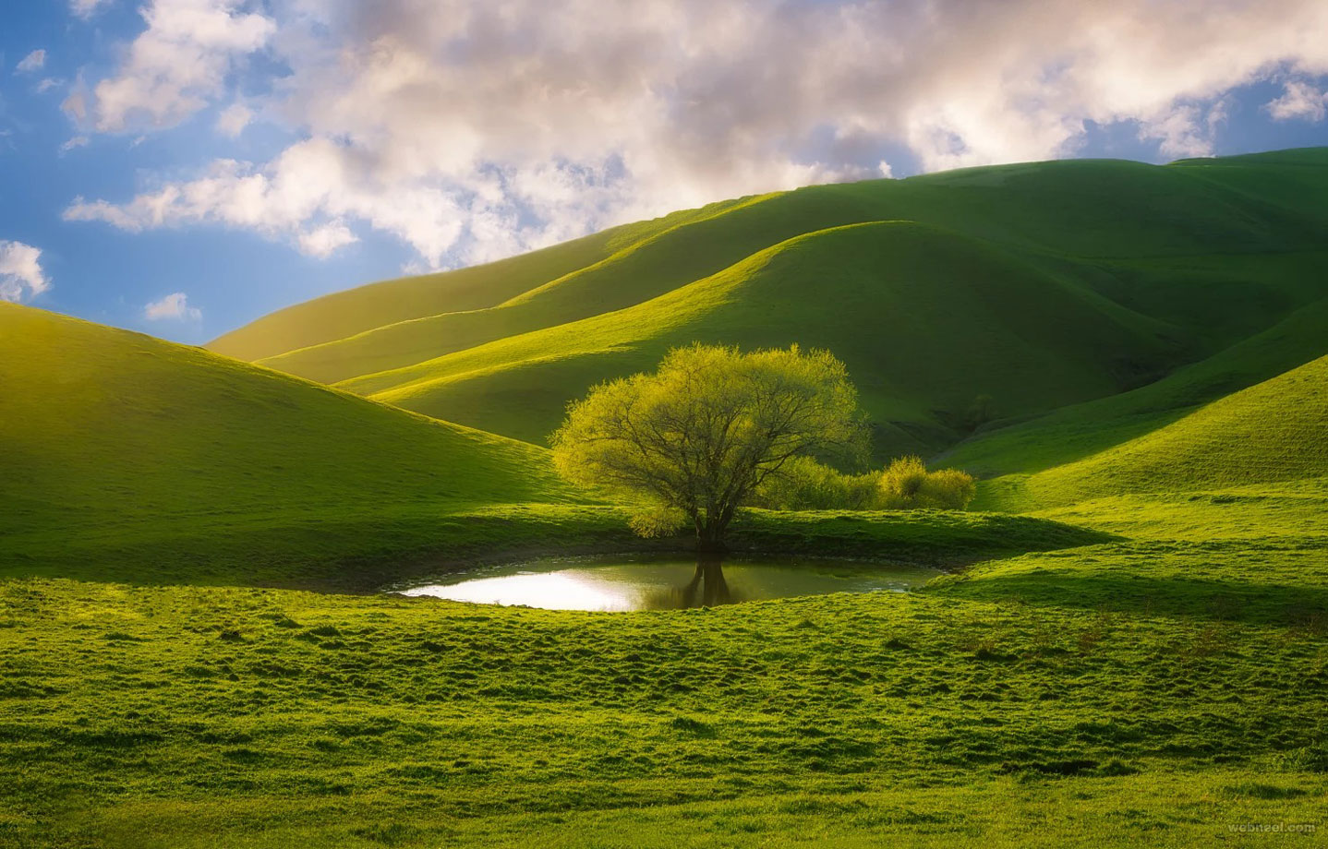
ENGLISH
Grade
8
THEME:
UNIT 9. THE ENVIRONMENT.
Lesson 4. Global climate change
(page 73)

Slide 2
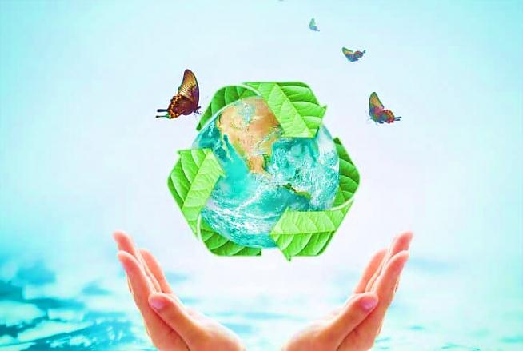
Checking the self-study work
1. Read activity 4 and add three more examples.
e.g. Turn off lights in any room if there is nobody there.
Reduce, Reuse, Recycle.
Use less heat and air conditioning.
Drive less.
Plant a tree.
p.117 Unit 9 L3
2. Write about what your family does to save energy.
e.g. When I open the refrigerator door, I try quickly shut it to keep the cold air in and save energy.
When my siblings switch the light on, I try to turn off the unnecessary lights.
We always try to use natural light.
We always turn the water off when brushing teeth.
Unplug unused electronics.
We try to keep all electronic issues repaired.

Slide 3
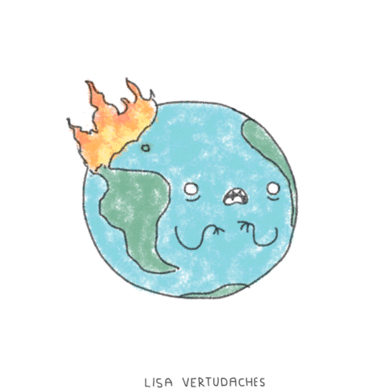
1 Listen and repeat the new words.
flood - наводнение
tsunami - цунами
heat wave - жара
hurricane - ураган
oxygen - кислород
CO2 (gas) - углекислый газ
hunger - голод
spray - спрей

Slide 4
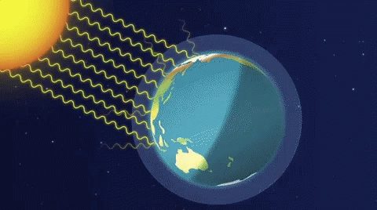
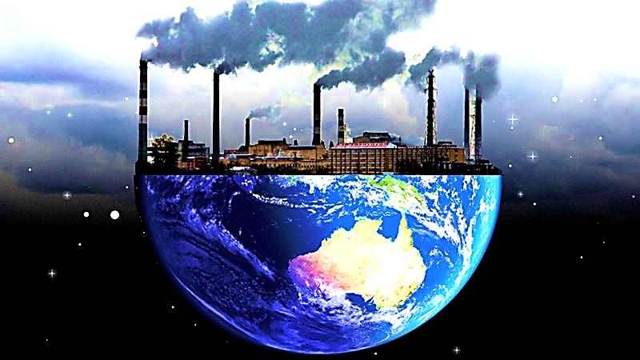
2a Answer the questions.
1) What do you know about ‘climate change’?
2) Where does the ‘greenhouse gas’ come from? Is it good or bad?

Slide 5
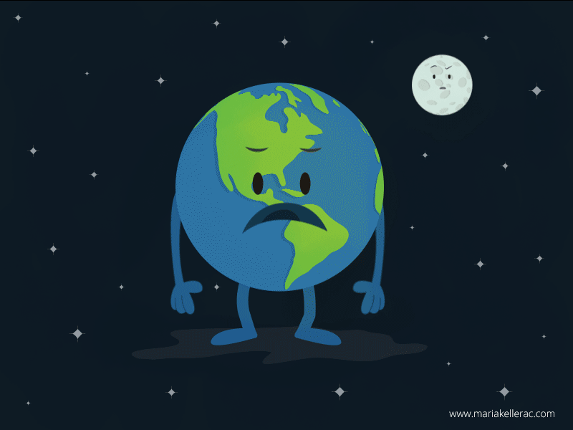
2b Read and check your ideas.
Climate plays a very important role in the life
of plants, animals and humans, and is different
in different parts of the world. Some
scientists think that the world is becoming
hotter. Winters have become warmer because
of the greenhouse gas. During the
last 100 years people have produced a lot
of CO2 gas. This gas in the air works like
glass in a greenhouse. It lets heat get in, but
it does not let much heat get out. So the air
becomes warmer. Where does the CO2 gas
come from? CO2 gas is mostly produced by human activities.

Slide 6
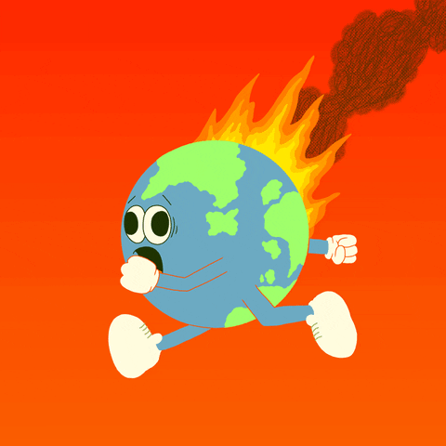
2b Read and check your ideas.
We produce CO2 when we burn fossil fuels, use electricity, transport or other activities, for example, when we use spray for body or hair. Trees take this gas from the air and give oxygen. But in the last few years, people have cut down and burnt
big areas of rainforest. This means there
are fewer trees and, of course, more CO2
gas! These changes are dangerous for our
planet because every year we have more
floods, tsunami, hurricanes and fires.

Slide 7

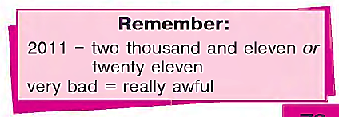
3 Complete the sentences
Use very or really.
The floods are e.g. really awful events on the earth.
2) After walking through the snow, my feet were ... freezing.
3) We’ve just had some ... bad news.
4) The weather was ... terrible.
5) When it is ... hot, we drink a lot of water.
6) In Europe we don’t usually have ... boiling weather.
7) They had ... miserable conditions of life.
8) The natural disaster was ... awful when it first appeared in the
news program.
Answer key:
1) really
2) really
3) very
4) really
5) very
6) really
7) really
8) really

Slide 8
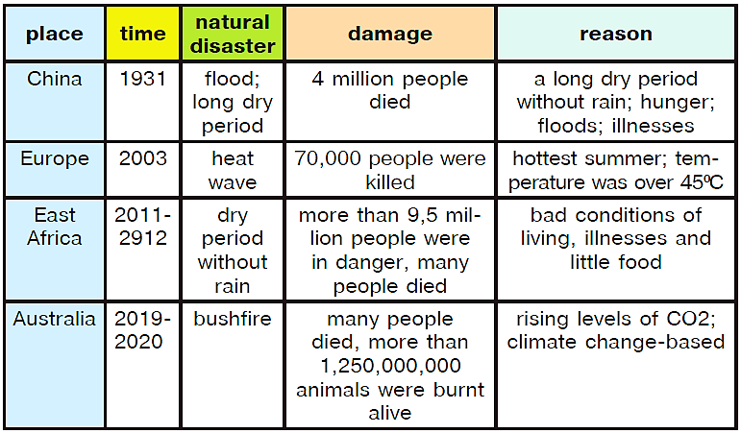
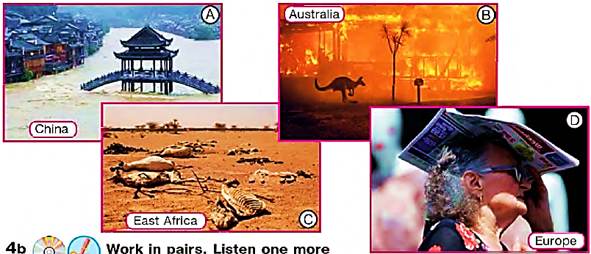
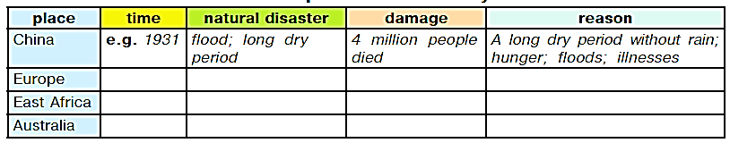
4 Listening Comprehension
Look at the pictures. Listen and complete the table with years and natural disasters.

Slide 9
5 Complete the table.
Think of what people can do to reduce climate change.
Use mustn't, could, may, should, shouldn’t.
Problems | Actions we can take
1) People burn old leaves. It (1) ... give CO2 gas to the air. 2) People burn hay in the fields. It (3) ... start fires. 3) Birds and homeless animals in winter do not have food. They (5) ... die. 4) We use a lot of spray for body and hair. It creates greenhouse gas | 1) We (2) ... burn old leaves. 2) We (4) ... burn hay. 3) We (6) ... feed the birds in winter. 4) We (7) ... use it much. We (8) ... use other hygiene things.

Slide 10
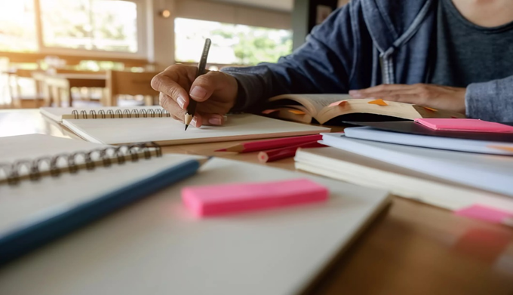
For self-study
1 Complete the sentences. Use very or really.
1) We had a ... fantastic time. 2) The food was ... delicious. 3) There was
a ... interesting article on climate change in the paper yesterday. 4) There
was a ... unpleasant smell coming from the kitchen. 5) Mr. Graham was
... surprised to find 46 ... ancient gold coins inside the pot. 6) They have
always been ... friendly to me.
2 Match the adjectives which have similar meaning.
1) freezing a) bad
2) delicious b) interesting
3) boiling c) hot
4) awful, terrible d) cold
5) ancient e) sad
6) great, fantastic,
amazing, wonderful f) good
7) exciting g) old
8) miserable h) tasty
3 Look at the table in activity 5. Write the sentences.
(U9, L4, p.117)

