Slide 1
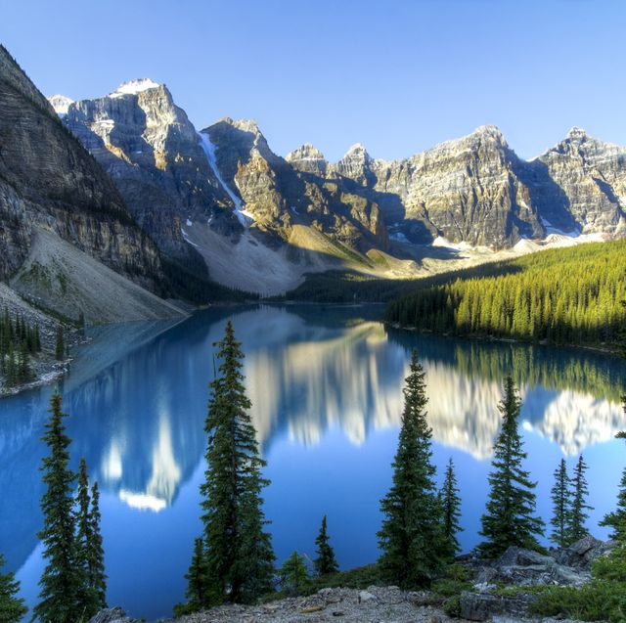
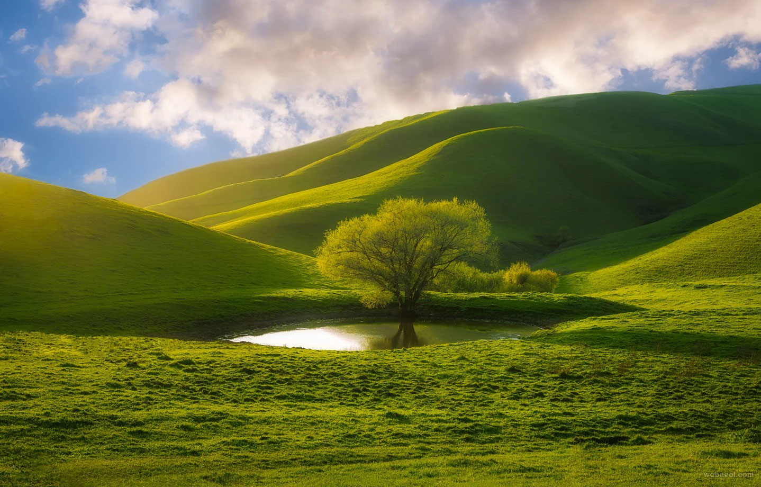
ENGLISH
Grade
8
THEME:
UNIT 9. THE ENVIRONMENT.
Lesson 3. OUR GREEN PLANET
Part I
(page 72)

Slide 2
Checking the self-study work
p.116 Unit 9 L2
Read and match the titles and the texts “Disadvantages of Biofuels”.
a) Chemicals cause water and soil pollution
b) Future rise in prices
c) Less food
d) Bad for farming
e) High cost of production

Slide 3
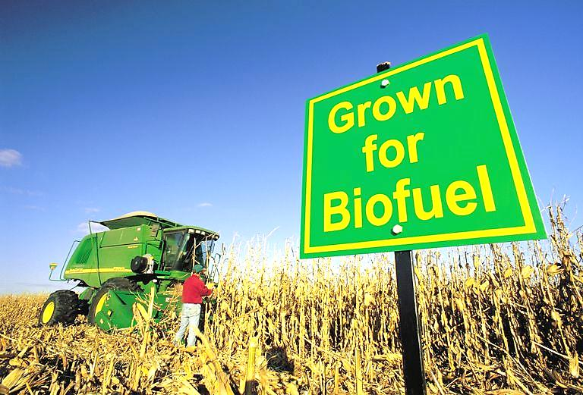
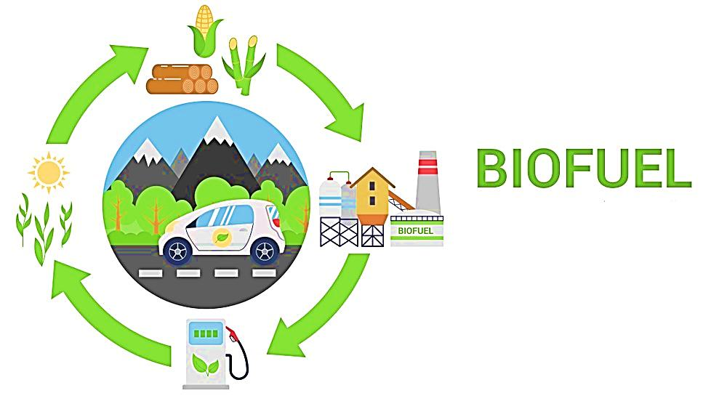
Disadvantages of Biofuels
e) High cost of production
1) Even though there are lots of advantages
in biofuels, they are expensive to produce.
Such a disadvantage is a reason why biofuels
are not becoming more popular.
d) Bad for farming
2) The crops and plants which are grown
year after year on the same fields make the
soil poor.

Slide 4
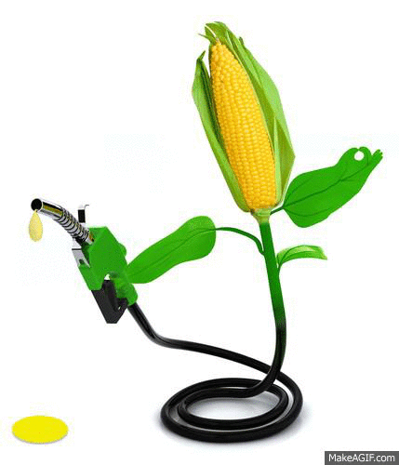
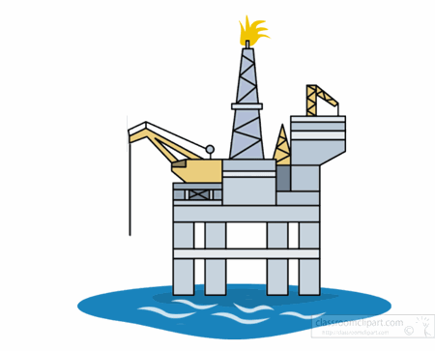
Disadvantages of Biofuels
a) Chemicals cause water and soil pollution
3) Crops for biofuels need chemicals to
grow better. But use of chemicals is bad
for the environment and may cause water
pollution. Chemicals can be washed away
from fields to lakes or rivers. Production of
biofuels also uses a lot of water which is not
good for local water resources.
c) Less food
4) Biofuels are taken from plants and crops
that have high levels of sugar. That is why
these crops are also used as food by people
and animals.

Slide 5
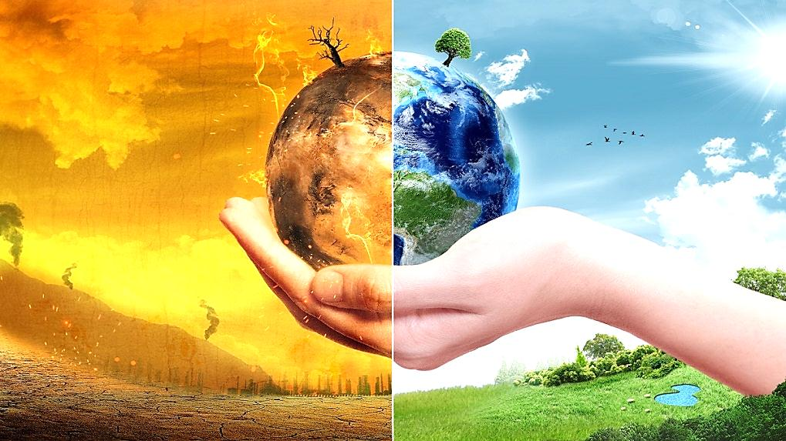
Disadvantages of Biofuels
b) Future rise in prices
5) Now, the prices of biofuels is higher than
fossil fuels. Biofuels take some agricultural
space from other crops, which can cause a
global rise in food prices. Constantly rising
prices may make the use of biofuels difficult
for the economy.

Slide 6
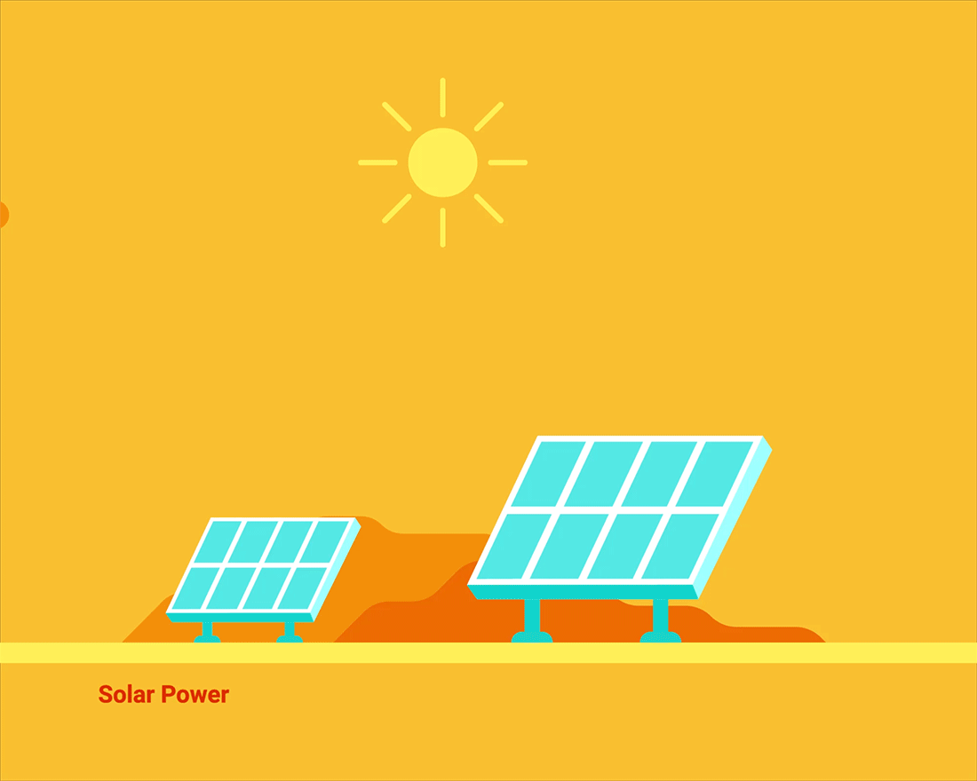
Guess the words
биотопливо
преимущество
недостаток
причина
зерновые культуры
растение
почва
химикаты
среда
загрязнение
ископаемое топливо
сельскохозяйственный
мельница
источник энергии
парниковые газы
biofuel
advantage
disadvantage
reason
crops
plant
soil
chemicals
environment
pollution
fossil fuels
agricultural
windmill
source of energy
greenhouse gasses

Slide 7
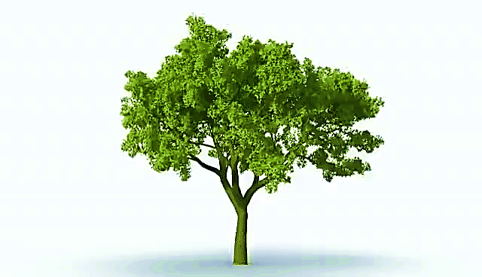
Activity 1 a. Read and Answer the questions
How long does it take to grow a tree?
That depends on the kind of tree, the growing conditions, and the climate.
Some trees, in good growing conditions and a favorable climate, might grow to two metres in only a year or two, or even less.
Other trees as slow growing, taking many years to reach that height even under good conditions.

Slide 8
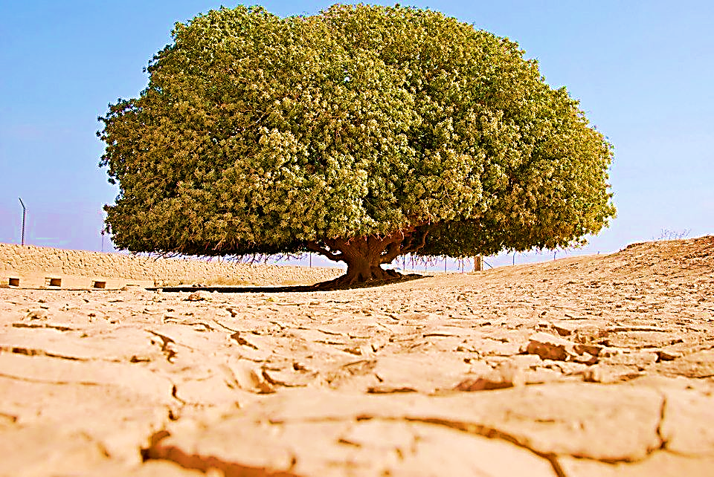
Activity 1 a. Read and Answer the questions
Where is the oldest tree in the world? How old is it?
This tree is located in the inhospitable desert in northern Jordan. Our prophet (peace be upon him) used to rest in the shadow of this tree. Today, 1400 years later, the blessed tree is still alone, without any other tree around.

Slide 9
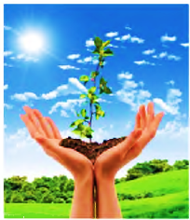
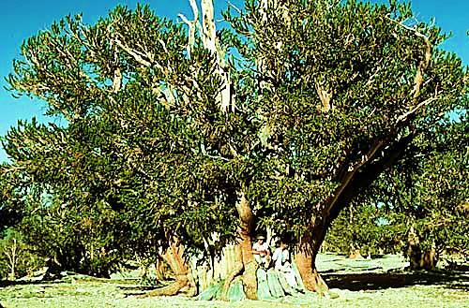
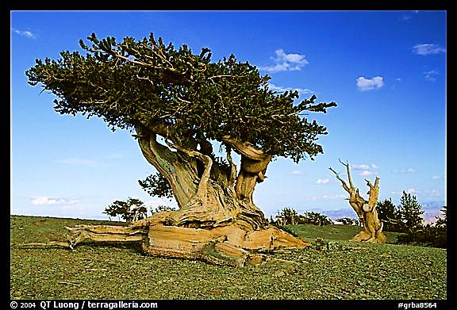
1b Read and check your answer.
For a tree to reach full growth, it needs good climate and
enough water. In tropical climates with warm weather and a
lot of water, a tree can become fully grown in 30 years. A tree
in cooler regions may take several hundred years to reach full
growth. The oldest tree in the world is a Great Basin pine in
California, which is approximately 5,064 years old.

Slide 10
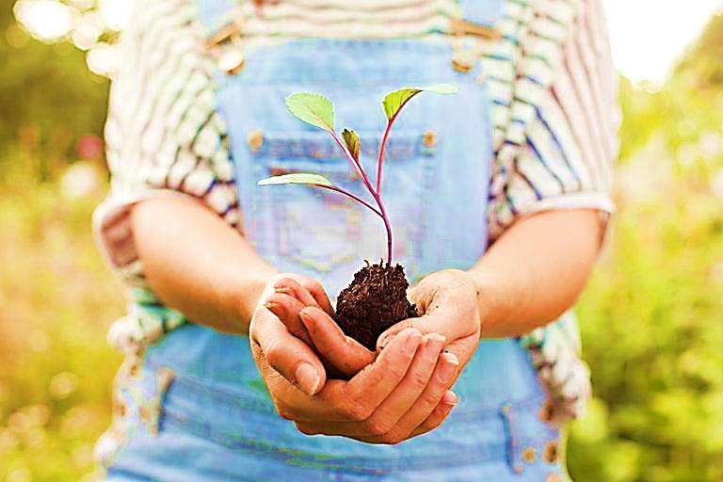
Activity 2. Read and answer the questions. Put the verbs in the correct form
1.What is used to make paper? 2.Is this process environmentally friendly?
used
chopped
are
needs
plant
are
is
transport
thrown
1.Trees, much water, chemicals & energy are needed.
2.No,it produces a lot of poisonous wastes.
is
takes

Slide 11
For self-study
Learn new words.
Make up not less than 6 sentences on the Simple Passive with Modal verbs (can, could, must).
e.g. Chemicals can be washed away from fields to lakes or rivers.
Модальный глагол
подлежащее
V3
BE
(U9, L3)

