Slide 1
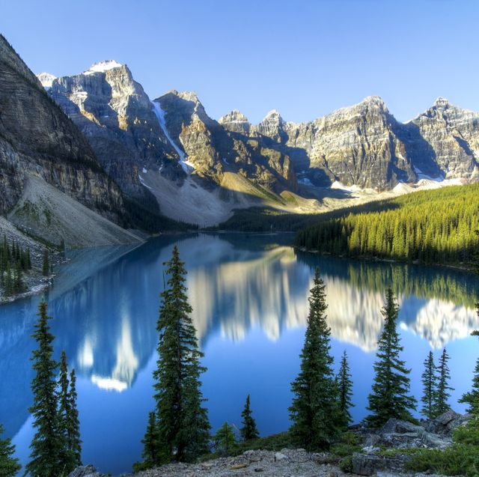
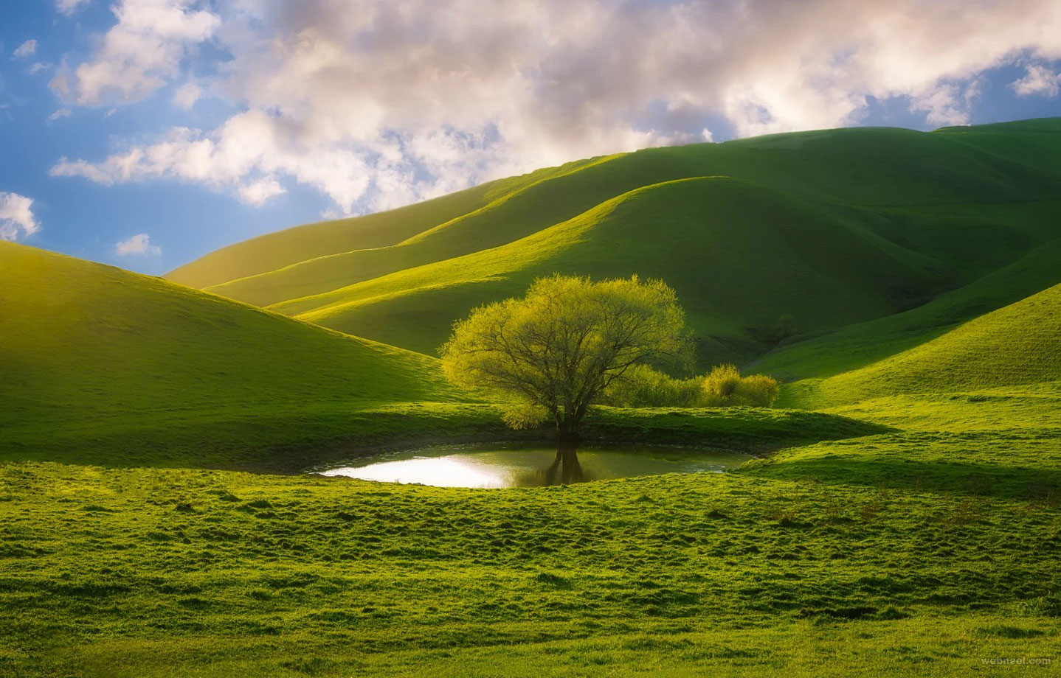
ENGLISH
Grade
8
THEME:
UNIT 9. THE ENVIRONMENT.
Lesson 1. MOTHER NATURE
(page 70)

Slide 2
Checking the self-study work
1. Which sculpture is the most interesting?
In my opinion, the most interesting sculpture is “The Swedish Language”. The message of the sculpture is that people in the modern world have a lot of problems, but they should stay strong.
2.Which sculptures best tell about how to take care of nature?
I think the sculpture called “Caring Hand” is the best one. It was created as a message to show how important nature is. People must think of how to take care of the beauty all around.

Slide 3
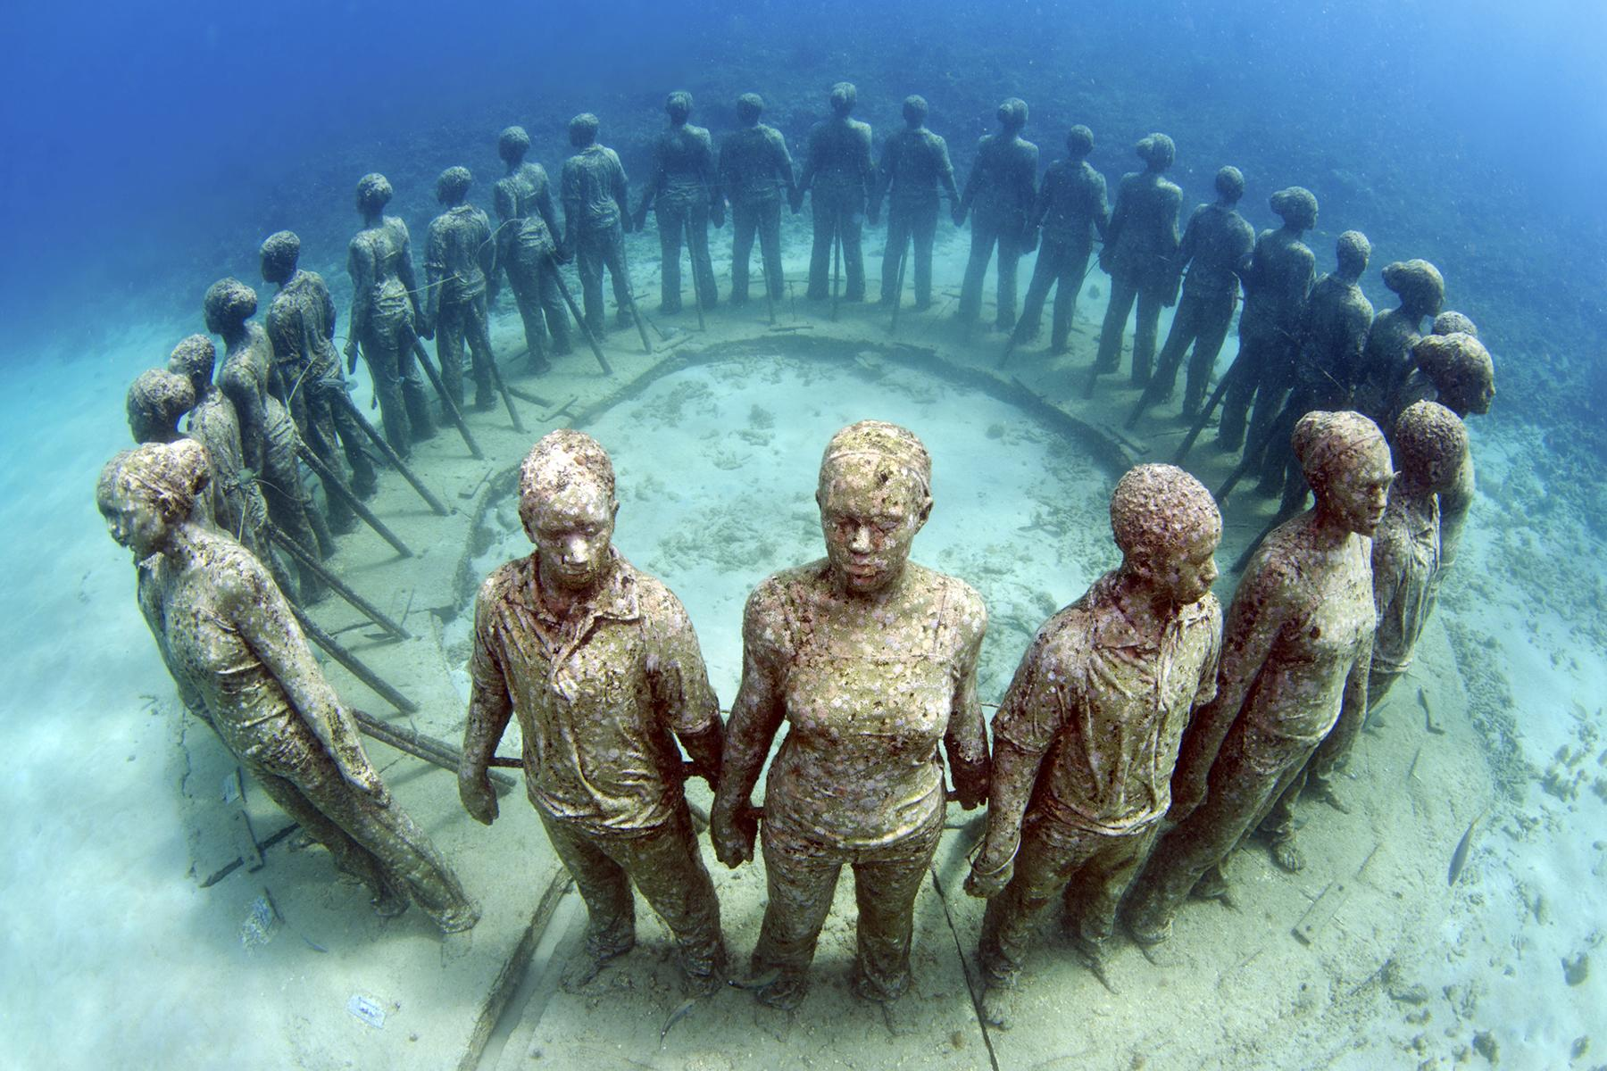
Checking the self-study work
2. Which sculptures best tell about how to take care of nature?
I’d like to add the monument of 26 figures of children Underwater Sculpture Park in Grenada, Spain. The statues have become
a man-made home for sea animals and plants. The circle of children
shows the life cycle and that humans must take care of the nature for the best future of children.

Slide 4
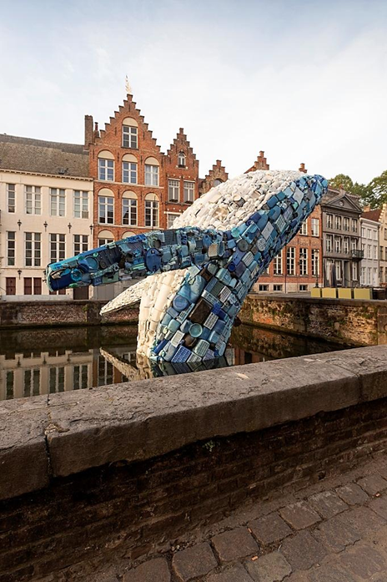
Checking the self-study work
3. Which sculptures tell why we should be kind to animals on the land and in water?
I am sure that the monument which is in Belgium called “The Skyscraper” tells us to be kind to animals. This is a very tall whale which consists of 5 tons of sea plastic that was collected in just 4 months. What is more, it has plastic packets, bottles, toys and even chairs and other things. It shows a problem of the dirty ocean to people and the fact that plastic may kill a lot of sea animals.

Slide 5
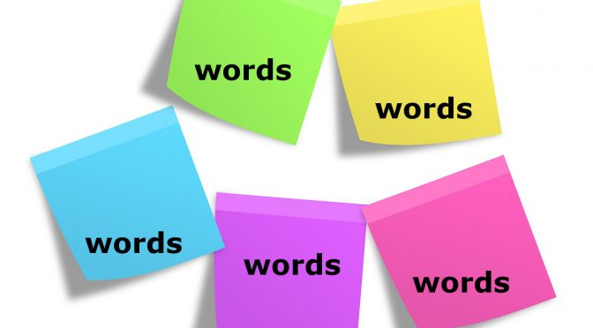
Learn new word expressions
environment - окружающая среда
to depend (on) - зависеть от чего-л.
a process - процесс
ecosystem - экосистема
a balance - баланс

Slide 6
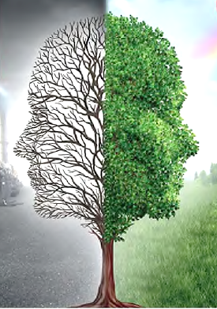
Learn new word expressions
fossil fuel - ископаемое топливо
nuclear power - атомная энергия
renewable - возобновляемый
run out - закончиться
biofuel - биотопливо
waste to-energy (WtE) - отходы в энергию
pollution (n) – загрязнение
to pollute (v) - загрязнять

Slide 7
Activity 2. Match the words and explanations. .
a) nature b) environment c) ecosystem
It includes all living and non-living things that are around us: air, water, land, people, animals and plants.
2) All plants, animals and people depend on each other. It shows how living things act with each other and how they feel in their environment.
3) It is the physical or material world or universe. It includes all the animals, plants, humans, seas, mountains in the world and all the processes that happen without people, such as the weather, the birth of young animals and plants.
b) environment
c) ecosystem
a) nature

Slide 8
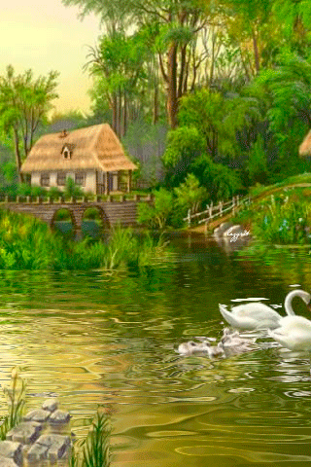
3.Read and choose the best answer to the question. Give your own answer.
Why do we say “Mother Nature”?
It is nature that has created all of us and is the source of our life.
2) We say “Mother Nature” because nature is life-giving like a mother who feeds and protect us.
3) People must think of how they treat animals, plants and resources as it is our Mother Nature. So respect your Mother Nature because those who kill their mother kill themselves.

Slide 9
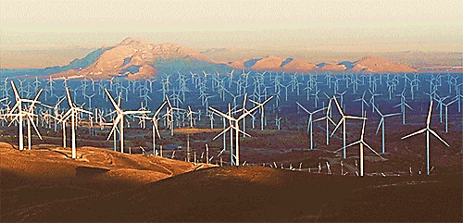
4b.Complete the table about the sources of energy. Page 70
wood, coal, water power, wind power,
natural gas, nuclear power, oil, wave power, solar power, waste-to-energy (WtE)
fossil fuel or not renewable | renewable
e.g. coal | e.g. wood
gas
waste to energy
water/wind power
oil
nuclear power
wave/ solar power

Slide 10
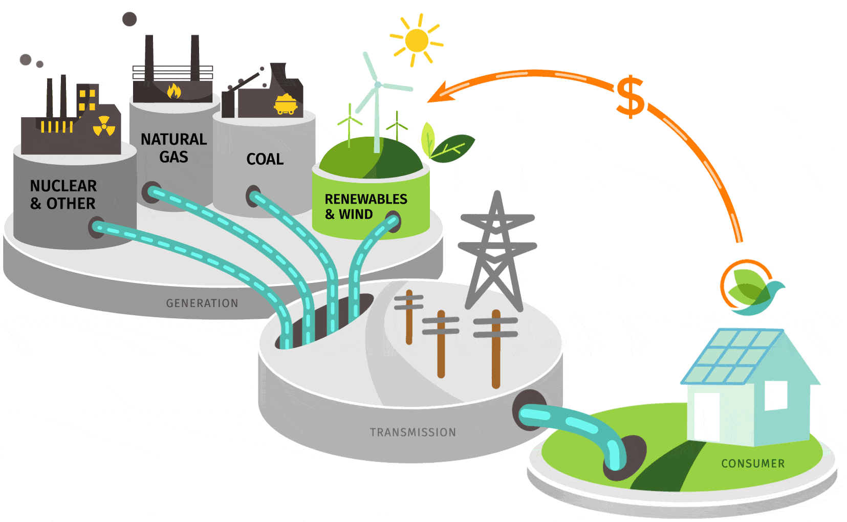
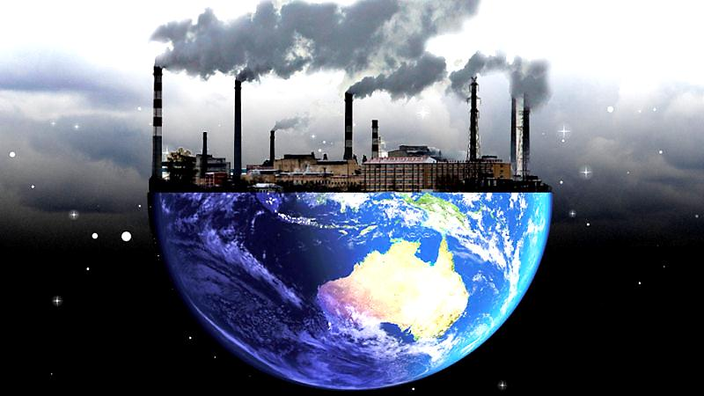
Advantages and disadvantages of fossil fuels.
Advantage
1) Fossil fuels are one of the most important
sources of energy in today’s world.
Scientists believe that they come from dead
plants and animals. The formation of most
fossil fuels started 370 million years ago.
Disadvantage
2) Fossil fuels pollute water in the process
of coal mining or drilling of oil or natural
gas. These actions seriously pollute the
Underground water, lakes and seas. Polluted
water is poisonous for water plants and fish
and also for people who eat the fish.

Slide 11
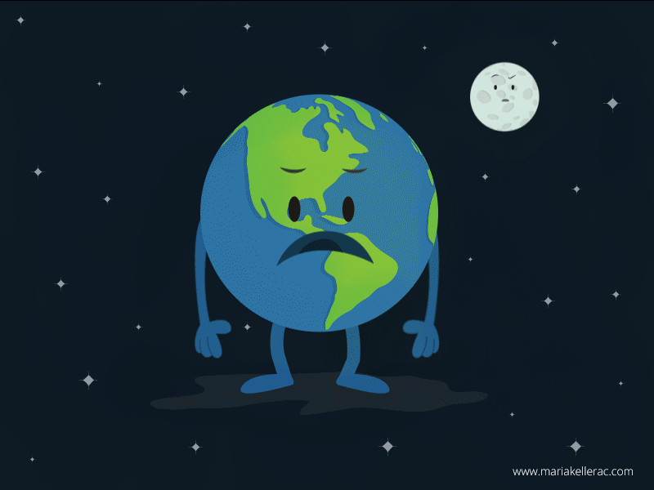
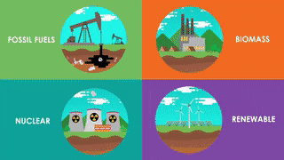
Advantages and disadvantages of fossil fuels.
Advantage
3) Fossil fuels are used in the production
of some medicines and other things we
generally use in our daily lives like plastic,
shoes, clothes, dishwashers and electronic
things, such as computers and refrigerators.
Advantage
4) Fossil fuels give almost 80% of the
world’s energy needs. Coal is mainly used
for getting electricity. From small cars to
ships and airplanes, fossil fuels are used
to give power to the engine in all the major
means of transportation.

Slide 12
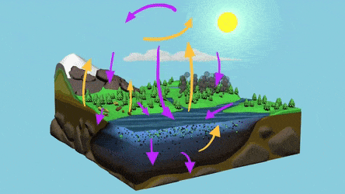
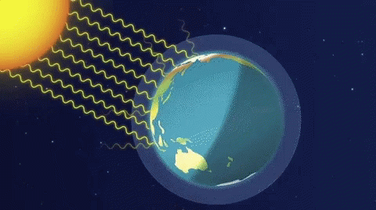
Advantages and disadvantages of fossil fuels.
5) Fossil fuel burning brings the most dangerous
effect to the environment. It is global
warming. The burning produces greenhouse
gases, which keep heat and do not allow it to
go back into space at night. Because of global
warming, the sea level is rising because
ice melts at the poles. This changes the
balance of the natural processes.
Disadvantage
6) Fossil fuels are easy to get and their cost is lower as compared to other sources.
7) Fossil fuels produce air pollution when they are burnt. Burning causes smog, which is harmful for the environment and public health.
8) Fossil fuels are not-renewable. It means that one day they will run out.
Advantage
Disadvantage
Disadvantage

Slide 13
FOR SELF-STUDY.
1 Read and complete the table.
2 Read and complete the sentences with the words.
Human environment is a man-made environment. It was (1) ... by humans for their needs. Before (2) ... appeared, humans lived in the natural environment. They had an environment-friendly life. With time, their (3) ... grew and grew. Humans learnt new ways to change their environment for their needs. They learnt to grow crops and animals, and build houses. They (4) ... the wheel, money, trade and business. Transportation became faster. It became possible after they had invented new technologies. Communication became easier and fast across the world. They formed a man-made (5) ... . We need a balance between the natural and man-made environment. If we use the natural (6) ... wisely, we can have a healthy balance. We should use our resources wisely and learn to save them. Natural resources like wood, minerals, water and air are important for (7) ... . If we do not use them wisely, we may run out of them one day. We should think about our (8) ...
life, needs, ecosystem, changed, future, invented, technology, sources
(U9, L1 p.116)

