Slide 1
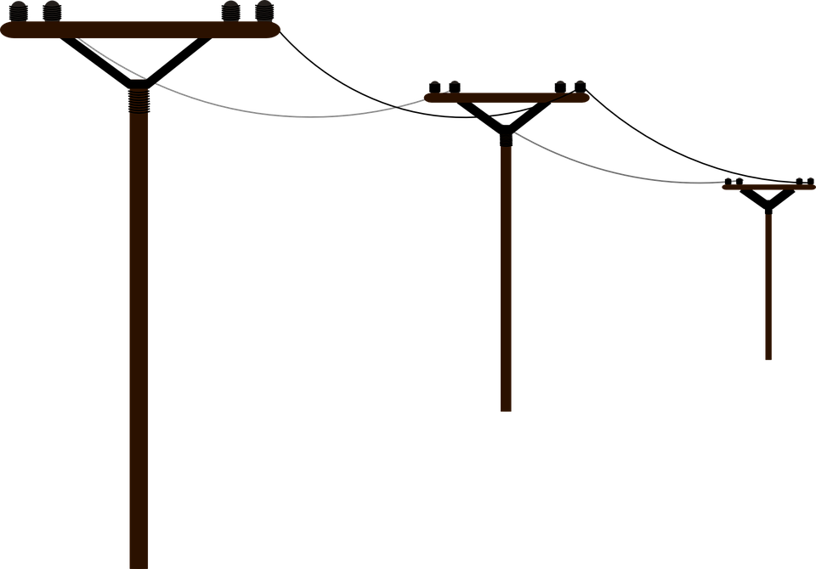
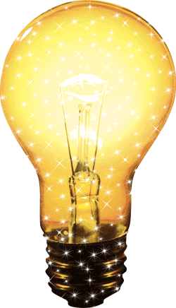
FIZIKA
8- sinf

Slide 2
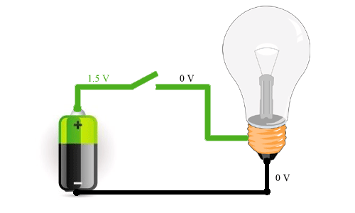
MUSTAHKAMLASH
Necha V dan yuqori kuchlanishdan inson hayoti uchun xavfli hisoblanadi?
A) $25$
B) $30$
C) $42$
D) 120

Slide 3
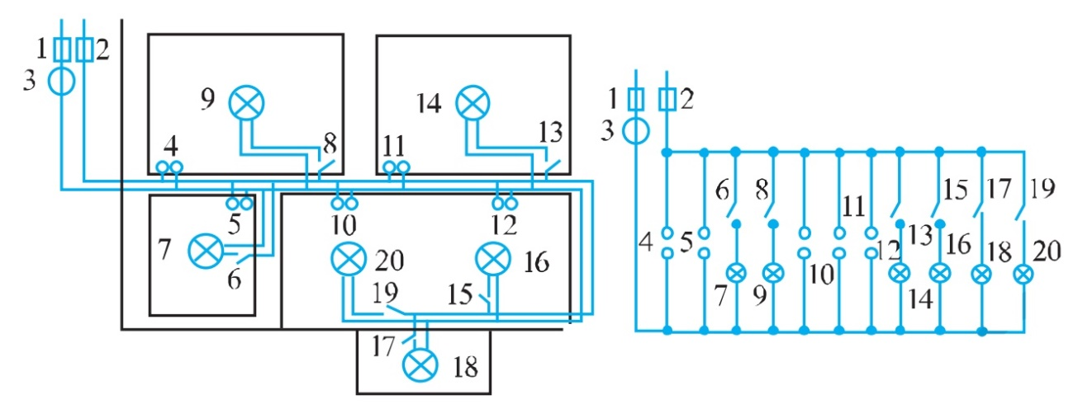
MUSTAHKAMLASH
Savol: Xonadonlar elektr tarmoqlaridagi kuchlanish necha voltga teng?
Javob: $220 volt$.

Slide 4
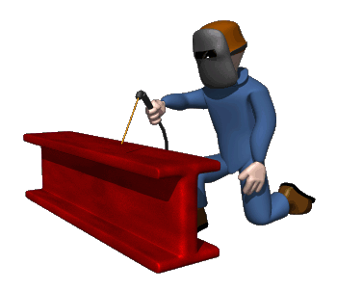
FIZIKA
MAVZU: MASALALAR YECHISH

Slide 5
Masala yechish (1)
Ko‘ndalang kesimining yuzi ${150 mm}^{2}$ bo‘lgan aluminiy simdan tortilgan elektr toki uzatish liniyasining uzunligi 120 km. Agar uzatayotgan tokning kuchi 160 A bo‘lsa, liniyadagi kuchlanish tushuvi nimaga teng? Sim materialining solishtirma elektr qarshiligi $ρ={2,8•10}^{−8} Ω•m$ ga teng.

Slide 6
Yechish (1)
Berilgan:
$$S={150 mm}^{2}=$$
$$={1,5•10}^{−4}m^{2}$$
$$l=120 km=$$
$$=12•{10}^{4} m$$
$ρ=2,8•{10}^{−8}$ $•$ $• Ω•m$
$$I=160 A$$
Formulasi:
Yechilishi:
$$R=ρ\frac{l}{S}$$
$$U=160•2,8•{10}^{−8}•$$
$$U=IR$$
$$•\frac{12•{10}^{4}}{{1,5•10}^{−4}}V=$$
$$U=I•ρ\frac{l}{S}$$
$3584 V$
$$\left[U\right]=\frac{A•Ω•m•m}{m^{2}}=$$
Javob: $U=3584 V$
Topish kerak:
$$U=?$$
$$=A•Ω=$$
$$V$$

Slide 7
Masala yechish (2)
Xonadon elektr zanjiri ko‘ndalang kesimining yuzasi ${1,5 mm}^{2}$ bo‘lgan aluminiy sim orqali 220 V kuchlanishli tarmoqqa ulangan. Agar xonadonda 3 ta 100 W li lampochka, 100 W li muzlatgich, 300 W li televizor va 1 kW quvvatli dazmol bir vaqtda elektr zanjiriga ulangan bo‘lsa, bunday ko‘ndalang kesimli aluminiy sim bardosh bera oladimi?

Slide 8
Yechish (2)
Berilgan:
$$S={1,5 mm}^{2}=$$
$$={1,5•10}^{−6}m^{2}$$
$$P_{1}=P_{2}=P_{3}=100 W$$
$P_{4}=100 W$
$P_{5}=300 W$
$P_{6}=1 kW=1000 W$
$$I_{(1,5 max)}=7 A$$
Topish kerak:
$$I= ?$$
Formulasi:
Yechilishi:
$P=P_{1}{+P}_{2}$+
+$P_{3}$+$P_{4}$+$P_{5}$+$P_{6}$
$$P=3•100 W+100 W+$$
$$+300 W+1000 W=$$
$$1700 W$$
$$I=\frac{P}{U}$$
$$I=\frac{1700 W}{220 V}=$$
$$7,73 A$$
Javob:
$$7,73>7A bunday tok$$
$$kuchiga bardosh bera$$
$$olmaydi.$$

Slide 9
Masala yechish
21-mashq, 2-masala.
Odam tanasining o‘rtacha qarshiligi taxminan 10 kΩ. Agar odam nam yerda turib 42 V kuchlanishli ochiq simni bexosdan ushlab olsa, undan qancha tok o‘tadi?

Slide 10
Yechimi
Berilgan:
$$R=10 kΩ=10000 Ω$$
$$U=42 V$$
Topish kerak:
$$I= ?$$
Formulasi:
Yechilishi:
$$I=\frac{42 V}{10000 Ω}=$$
$${4,2•10}^{−3} A=$$
$$I=\frac{U}{R}$$
$$=4,2 mA$$
Javob:
$$I=4,2 mA$$

Slide 11
Masala yechish
21-mashq, 3-masala.
220 V kuchlanishga mo‘ljallangan 400 W quvvatli televizorga qo‘yilgan eruvchan saqlagichda 2 A deb yozilgan. Ba’zida tarmoqdagi kuchlanish 220 V dan ortib ketadi. Tarmoqdagi kuchlanish qanchaga yetganda eruvchan saqlagich erib ketadi?

Slide 12
Yechimi
Berilgan:
$$U_{1}=220 V$$
$$P=400 W$$
$$I_{2}=2 A$$
Topish kerak:
$$U_{2}=?$$
Formulasi:
Yechilishi:
$$I_{1}=\frac{P}{U_{1}}$$
$$P=I_{1}U_{1}$$
$$U_{2}=\frac{{220}^{2}•2}{400}V=$$
$$R=\frac{U}{I}$$
$$\frac{U_{1}}{I_{1}}=\frac{U_{2}}{I_{2}}$$
$$=\frac{48400 }{200 }V=$$
$$242 V$$
$$U_{2}=\frac{U_{1}•I_{2}}{I_{1}}$$
$$U_{2}=\frac{{U_{1}}_{}^{2}•I_{2}}{P}$$
Javob: $U_{2}=242 V$

Slide 13
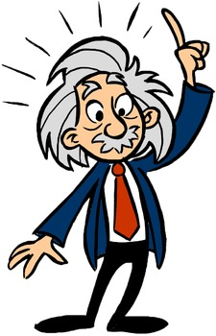
MUSTAQIL BAJARISH UCHUN TOPSHIRIQLAR:
Darslikdaning 21-mashqning 1-4-5-masalalarini mustaqil bajarish. (111-bet)
II. III bobni takrorlash uchun test topshiriqlarni bajarish. (112-bet)

