Slide 1
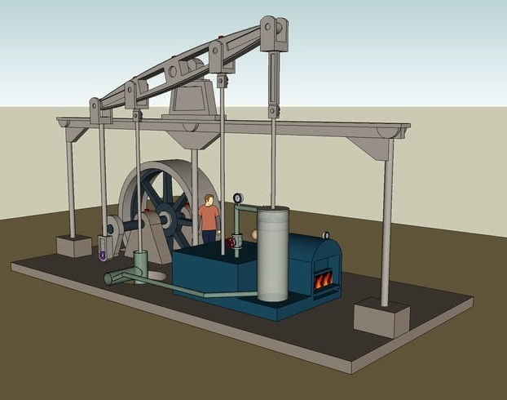
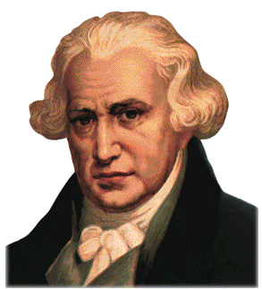
FIZIKA
8-sinf

Slide 2
MUSTAHKAMLASH
Vaqt birligi ichida bajarilgan ishga aytiladi. $P=\frac{A}{t}$
Quvvat deb nimaga aytiladi?
Elektr iste’molchining quvvati nimaga teng?
$$P=IU$$
Sarflangan energiya miqdor jihatdan nimaga teng?
Bajarilgan ishga teng. $W=A$
Zanjirning kuchlanishi bir volt bo‘lgan qismida tok kuchi bir amper bo‘lgan tokning quvvatiga nima deyiladi?
Bir $vatt$ deb aytiladi.

Slide 3
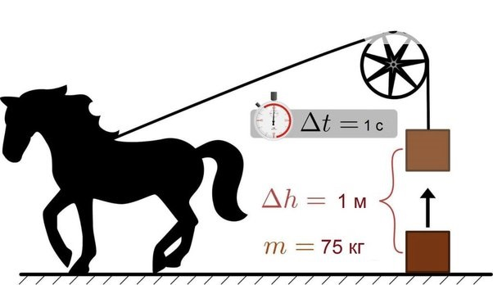
FIZIKA
MAVZU: MASALALAR YECHISH

Slide 4
Masala yechish (1)
Quvvati 100 W va 200 W li ikkita lampa parallel ravishda 220 V kuchlanishli tarmoqqa ulangan. Har bir lampadagi tok kuchini, ikkala lampadan o‘tadigan to‘liq tok kuchini, har bir lampa qarshiligini va lampalarning to‘liq qarshiligini aniqlang.

Slide 5
Yechish (1)
Berilgan:
$$P_{1}=100 W$$
$$P_{2}=200 W$$
$$U=220 V$$
Formulasi:
$$I_{1}=\frac{P_{1}}{U}; I_{2}=\frac{P_{2}}{U};$$
$$I=I_{1}+I_{2};$$
Topish kerak:
$I_{1}=?; I_{2}=?;$ $I=?;$ $R_{1}=?;$ $R_{2}=?;$ $R=\text{?}$
$$R_{1}=\frac{U}{I_{1}}; R_{2}=\frac{U}{I_{2}};$$
$$R=\frac{U}{I};$$

Slide 6
Yechish (1)
Yechilishi:
$$I_{1}=\frac{100 W}{220 V}$$
$$I_{2}=\frac{200 W}{220 V}$$
$$≈0,45 A$$
$$≈0,91 A$$
$$R_{1}=\frac{220 V}{0,45 A }$$
$$I=0,45 A+0,91 A$$
$$=1,36 A;$$
$≈489 Ω;$
$$R_{2}=\frac{220 V}{0,91 A }$$
$$R=\frac{220 V}{1,36 A }$$
$$≈242 Ω;$$
$≈162 Ω$
Javob: $I_{1}≈0,45 A; I_{2}≈0,91 A;$ $I=1,36 A;$
$R_{1}≈489 Ω;$ $R_{2}≈242 Ω;$ $R≈162 Ω$

Slide 7
Masala yechish (2)
Qarshiligi 80 Ω va 60 Ω bo‘lgan iste’molchilar zanjirga parallel ulangan. Birinchi iste’molchi 12 W quvvat bilan ishlayotgan bo‘lsa, ikkinchi iste’molchi qanday quvvat bilan ishlaydi?

Slide 8
Yechish (2)
Berilgan:
$R_{1}=80 Ω,$
$R_{2}=60 Ω,$
$P_{1}=12 W,$
Topish kerak:
$$P_{2}= ?$$
Formulasi:
Yechilishi:
$$P_{2}=\frac{12•80}{60}W=$$
$$U_{1}=U_{2}=U$$
$$P_{1}=\frac{U^{2}}{R_{1}}; P_{2}=\frac{U^{2}}{R_{2}};$$
$$16 W$$
$$P_{1}•R_{1}\text{=} P_{2}•R_{2};$$
$$P_{2}=\frac{P_{1}•R_{1}}{R_{2}}$$
$$\left[P_{2}\right]=\frac{W•Ω}{Ω}$$
Javob: $P_{2}=16 W$
$$=W$$

Slide 9
Masala yechish (3)
Qarshiligi 75 Ω va 50 Ω bo‘lgan iste’molchilar zanjirga ketma-ket ulangan. Birinchi iste’molchi 120 W quvvat bilan ishlayotgan bo‘lsa ikkinchi iste’molchi qanday quvvat bilan ishlaydi?

Slide 10
Yechish (3)
Berilgan:
$R_{1}=75 Ω,$
$R_{2}=50 Ω,$
$P_{1}=120 W,$
Topish kerak:
$$P_{2}=?$$
Formulasi:
Yechilishi:
$$P_{2}=\frac{120•50}{75}W=$$
$$I_{1}=I_{2}=I$$
$$P_{1}=I^{2}•R_{1}$$
$$80 W$$
$$P_{2}=I^{2}•R_{2}$$
$$P_{2}=\frac{P_{1}•R_{2}}{R_{1}}$$
$$\left[P_{2}\right]=\frac{W•Ω}{Ω}$$
$$=W$$
Javob: $P_{2}=80 W$

Slide 11
Masala yechish
18-mashq (3)
Zanjirdan 5 A tok o‘tganda elektr plitasi 30 minut davomida 1800 kJ energiya sarflaydi. Plitaning qarshiligi qanday?

Slide 12
Yechish
18-mashq (3)
Berilgan:
$$I=5 A$$
$$t=30 min=$$
$$=1800 s$$
$$W=1800 kJ=$$
$$=1800•{10}^{3}J$$
Topish kerak:
$$R=?$$
Formulasi:
Yechilishi:
$$W=I^{2}Rt$$
$$R=\frac{1800•{10}^{3}}{5^{2}•1800}Ω=$$
$$R=\frac{W}{I^{2}t}$$
$$=\frac{1000}{25}Ω$$
$$=40 Ω$$
Javob: $R=40 Ω$

Slide 13
Masala yechish
18-mashq (5)
220 V kuchlanishga ulangan lampochkadan 0,4 A tok o‘tmoqda. Tok 10 minut davomida qancha ish bajaradi?

Slide 14
Yechish
18-mashq (5)
Berilgan:
$$U=220 V$$
$$I=0,4 A$$
$$t=10 min=$$
$$=600 s$$
Topish kerak:
$$A=?$$
Formulasi:
Yechilishi:
$$A=IUt$$
$$A=0,4•220•600 J=$$
$$=52800 J$$
$=52,8 kJ$
Javob: $A=52,8 kJ$

Slide 15
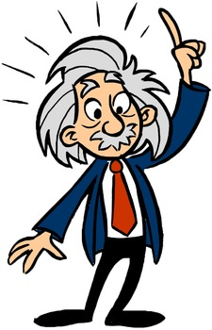
MUSTAQIL BAJARISH UCHUN TOPSHIRIQ:
I. Darslikdagi 95-betidagi 18-mashqning 1-2-4-6-7-masalalarini mustaqil bajarish.
II.O‘tilgan mavzularni takrorlash.

