Slide 1
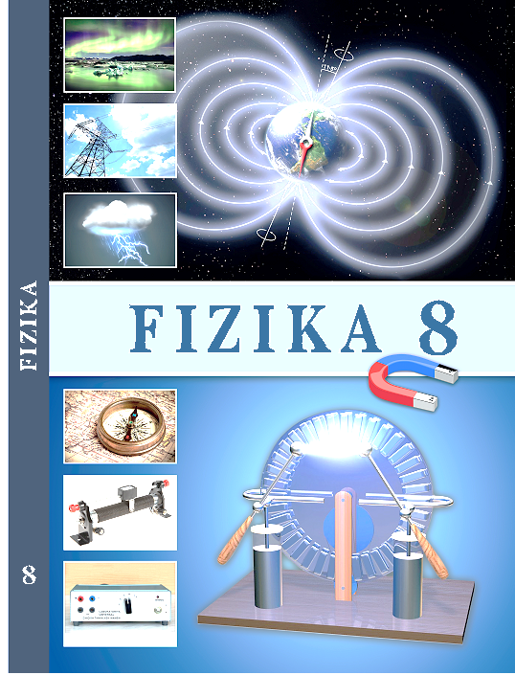
F I Z I K A
8-sinf
7
MAVZU: MASALALAR YECHISH
O‘qituvchi: Hamidova Zaynura Ramazanovna

Slide 2
TOPSHIRIQ NATIJALARI
1)
Berilgan:
Formulasi:
r = 5 cm
F$=k \frac{\left|q_{1}\right|{∙\left|q_{2}\right|}_{ }}{r^{2}}$
$$q_{1}=− \text{8} ∙{10}^{−8} C$$
$$q_{2}=4∙{10}^{−8} C$$
Topish kerak:
F = ?
Javob: F = 11,52 mN

Slide 3
TOPSHIRIQ NATIJALARI
3)
Berilgan:
Formulasi:
$q_{1}=$0,36 $μ$C
F$=k \frac{\left|q_{1}\right|{∙\left|q_{2}\right|}_{ }}{r^{2}}$
$$q_{2}=10 n C$$
F = 9 mN
Javob: r = 6 cm
Topish kerak:
r = ?
4)
Javob: $\frac{F_{i}}{F_{t}} ≈$ 4,2 $∙{10}^{42}$ marta

Slide 4
1- MASALA
1. Bir xil manfiy zaryadga ega bo‘lgan ikki metall sharcha 8 cm masofada 14,4 $μ$N kuch bilan o‘zaro ta’sirlashmoqda. Har bir sharchada qancha ortiqcha elektronlar bo‘lgan?

Slide 5
1- MASALA
Berilgan:
Formulasi:
$q_{1}=q_{2}$ $=$q
q = N $∙$ e
r = 8 cm = 0,08 m = 8 $∙{10}^{−2}$m
(1)
N = $\frac{q}{e}$
F = 14,4 $μ$N = 14,4 $∙{10}^{−6}$N
F$=k \frac{\left|q_{1}\right|{∙\left|q_{2}\right|}_{ }}{r^{2}}$= $k \frac{q^{2}}{r^{2}}$
e = 1,6$∙{10}^{−19}$C
q =$\sqrt{\frac{F∙r^{2}}{k}}$ = r $\sqrt{\frac{F}{k}}$
k = 9 $∙{10}^{9}\frac{N∙m^{2}}{C^{2}}$
(2)
Topish kerak:
N = ?
$\left[q\right]=\text{m}\sqrt{\frac{N}{\frac{N∙m^{2}}{C^{2}}}}$ = $\sqrt{C^{2} }$= C

Slide 6
1- MASALA
Formulasi:
Hisoblash:
q = N $∙$ e
q = $8$ $∙{10}^{−2}$ $\sqrt{\frac{\text{14,4} ∙{10}^{−6}}{\text{9 }∙{10}^{9}}}$ C =
= 3,2 $∙{10}^{−9}$ C
(1)
N = $\frac{q}{e}$
F$=k \frac{\left|q_{1}\right|{∙\left|q_{2}\right|}_{ }}{r^{2}}$= $k \frac{q^{2}}{r^{2}}$
q =$\sqrt{\frac{F∙r^{2}}{k}}$ = r $\sqrt{\frac{F}{k}}$
N = $\frac{\text{3,2 }∙{10}^{−9} \text{C}}{\text{1,6}∙{10}^{−19}\text{C}}$ = 2 $∙{10}^{10}$ ta
(2)
Javob: N = 2 $∙{10}^{10}$ ta elektron bor ekan.

Slide 7
2- MASALA
1. Bir xil zaryadga ega bo‘lgan ($q_{1}=q_{2}$ $=$8 nC) ikki nuqtaviy zaryad 4 cm masofada o‘zaro ta’sirlashib turibdi. Agar ulardan birining yarim zaryadi ikkinchisiga o‘tkazilsa, o‘zaro ta’sir kuchi qanday o‘zgaradi?

Slide 8
2- MASALA
Berilgan:
Formulasi:
$q_{1}=q_{2}$ $=8 nC$
$∆F=F_{2}$- $F_{1}$
(1)
r = 4 cm = 0,04 m = 4 $∙{10}^{−2}$m
$$F_{1} =k \frac{\left|q_{1}\right|{∙\left|q_{2}\right|}_{ }}{r^{2}}$$
(2)
$q_{1}^{I}=q_{1}$ - $\frac{q_{1}}{2}=\text{4} ∙{10}^{−9}$ C
$$F_{2} =k \frac{\left|q_{1}^{I}\right|{∙\left|q_{2}^{I}\right|}_{ }}{r^{2}}$$
$q_{2}^{I}=q_{2}$ + $\frac{q_{1}}{2}=\text{12} ∙{10}^{−9}$ C
(3)
k = 9 $∙{10}^{9}\frac{N∙m^{2}}{C^{2}}$
(3) Va (2) $→$(1)
Topish kerak:
$∆F$ = ?
$∆F=$ $k \frac{\left|q_{1}^{I}\right|{∙\left|q_{2}^{I}\right|}_{ }}{r^{2}}$- $k \frac{\left|q_{1}\right|{∙\left|q_{2}\right|}_{ }}{r^{2}}$
(4)

Slide 9
2- MASALA
Hisoblash:
$F_{1} =\text{9 }∙{10}^{9}\frac{\left|\text{8} ∙{10}^{−9}\right|{∙\left|\text{8} ∙{10}^{−9}\right|}_{ }}{{(\text{4} ∙{10}^{−2})}^{2}}$ = $\text{3}\text{,6} ∙{10}^{−4}$N
$F_{2} =\text{9 }∙{10}^{9}\frac{\left|\text{4} ∙{10}^{−9}\right|{∙\left|\text{12} ∙{10}^{−9}\right|}_{ }}{{(\text{4} ∙{10}^{−2})}^{2}}$ = $\text{2}\text{,7} ∙{10}^{−4}$N
$∆F=F_{2}$- $F_{1}$= $\text{2,7} ∙{10}^{−4}$N - $\text{3,6} ∙{10}^{−4}$N = - 0,9 $∙{10}^{−4}$ N
Javob: $∆F=$- 90 $μ$N

Slide 10
3- MASHQ
4. Bir xil ishorali 2q va 10q zaryadlar bilan zaryadlangan ikkita bir xil sharcha bir-biridan r masofada o‘zaro ta’sirlashib turibdi. Sharchalar bir-biriga tekkizilib, avvalgi vaziyatiga qaytarildi. Bunda ularning o‘zaro ta’sir kuchi qanday o‘zgaradi?

Slide 11
3- mashqning 4- masalasi
Berilgan:
$$q_{1}=2q$$
+
+
+
+
$$q_{1}$$
$$q_{2}$$
$$q_{2}=10q$$
$$q_{1}$$
$$q_{2}$$
r
a)
b)
$r_{1}=r_{2}$= r
+
+
Topish kerak:
$\frac{F_{2}}{F_{1}}$ = ?
$$q_{2}^{I}$$
$$q_{1}^{I}$$
r
d)
$q_{1}^{I}=$ $q_{2}^{I}=\frac{q_{1}+q_{2}}{2}$ = $\frac{2q+10q}{2}$ = 6q

Slide 12
3-mashqning 4-masalasi
Berilgan:
Formulasi:
$$q_{1}=2q$$
$$F_{1} =k \frac{\left|q_{1}\right|{∙\left|q_{2}\right|}_{ }}{r^{2}}$$
$$F_{2} =k \frac{\left|q_{1}^{I}\right|{∙\left|q_{2}^{I}\right|}_{ }}{r^{2}}$$
$$q_{2}=10q$$
$\frac{F_{2}}{F_{1}}$ = $\frac{k \frac{\left|q_{1}^{I}\right|{∙\left|q_{2}^{I}\right|}_{ }}{r^{2}}}{k \frac{\left|q_{1}\right|{∙\left|q_{2}\right|}_{ }}{r^{2}}}$ = $\frac{\left|q_{1}^{I}\right|{∙\left|q_{2}^{I}\right|}_{ }}{\left|q_{1}\right|{∙\left|q_{2}\right|}_{ }}$
$r_{1}=r_{2}$= r
Topish kerak:
$\frac{F_{2}}{F_{1}}$ = ?
Hisoblash:
$\frac{F_{2}}{F_{1}}$ = $\frac{6q∙6q}{2q∙10q}$ = 1,8
$F_{2}$= 1,8 $F_{1}$
Javob: 1,8 marta ortadi.

Slide 13
3 - MASHQ
5. Ikki nuqtaviy zaryad bir-biridan r masofada turibdi. Zaryadlar orasidagi masofa 20 cm ga orttirilganda ular orasidagi o‘zaro ta’sir kuchi 9 marta kamaygan. Zaryadlar orasidagi dastlabki masofa qanday bo‘lgan?

Slide 14
3- mashqning 5-masalasi
Berilgan:
Formulasi:
$$q_{1}=q_{2}=q$$
$F_{1} =k \frac{\left|q_{1}\right|{∙\left|q_{2}\right|}_{ }}{{{ r}_{1}}^{2}}$ = $k \frac{q^{2}}{{{ r}_{1}}^{2}}$
$$r_{2}=r_{1}+20 cm$$
$$F_{2} =k \frac{q^{2}}{{{ r}_{2}}^{2}}=k \frac{q^{2}}{{(r_{1}+0,2)}^{2}}$$
$\frac{F_{2}}{F_{1}}$ = $\frac{1}{9}$
$\frac{F_{2}}{F_{1}}$ = $\frac{k \frac{q^{2}}{{(r_{1}+0,2)}^{2}}}{k \frac{q^{2}}{{{ r}_{1}}^{2}}}$ = $\frac{{{ r}_{1}}^{2}}{{(r_{1}+0,2)}^{2}}$
$F_{1}$= 9 $F_{2}$
Topish kerak:
${ r}_{1}$= ?
$F_{2}{∙(r_{1}+0,2)}^{2}$ = ${{F_{1}∙r}_{1}}^{2}$
$F_{2}{∙(r_{1}+0,2)}^{2}$ = 9 $F_{2} {{∙r}_{1}}^{2}$

Slide 15
3-mashqning 5-masalasi
Hisoblash:
${(r_{1}+0,2)}^{2}$ = 9 ${r_{1}}^{2}$
${(r_{1}+0,2)}^{2}$ = ${{(3∙r}_{1})}^{2}$
${(r_{1}+0,2)}^{2}$ = ${{(3∙r}_{1})}^{2}$
$r_{1}+0,2$= ${3r}_{1}$
$0,2$= ${3r}_{1}$- $r_{1}$
$0,2$= ${2 r}_{1}$
$r_{1}$ = $\frac{0,2}{2}$ = 0,1 m
Javob: $r_{1}$= 10 cm

Slide 16
Mustaqil bajarish uchun topshiriqlar:
3-mashqning 1- 3- masalalarini yeching.
Jadvalni to‘ldiring.
O‘tkazgichlar | Dielektriklar
Alyuminiy
Rezina

Slide 17
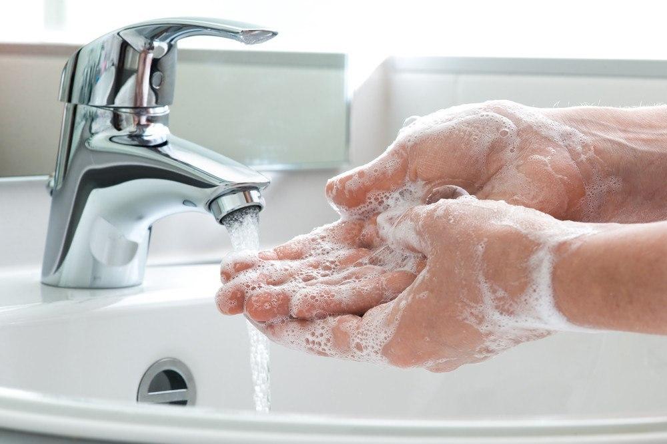
Aziz o‘quvchilar,
Shaxsiy gigiyena qoidalariga amal qiling
va qo‘lingizni tez-tez sovunlab yuvishni unutmang!

